Slide 1
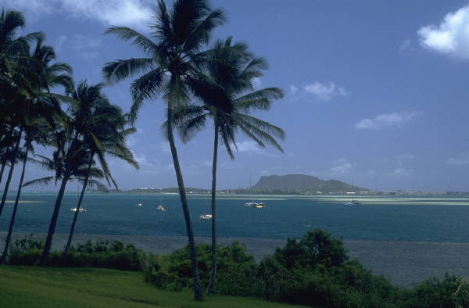
Lesson 20 Acts 28:1-31 The End is the Beginning

Slide 2
The Truth God establishes His church through faithful believers!

Slide 3
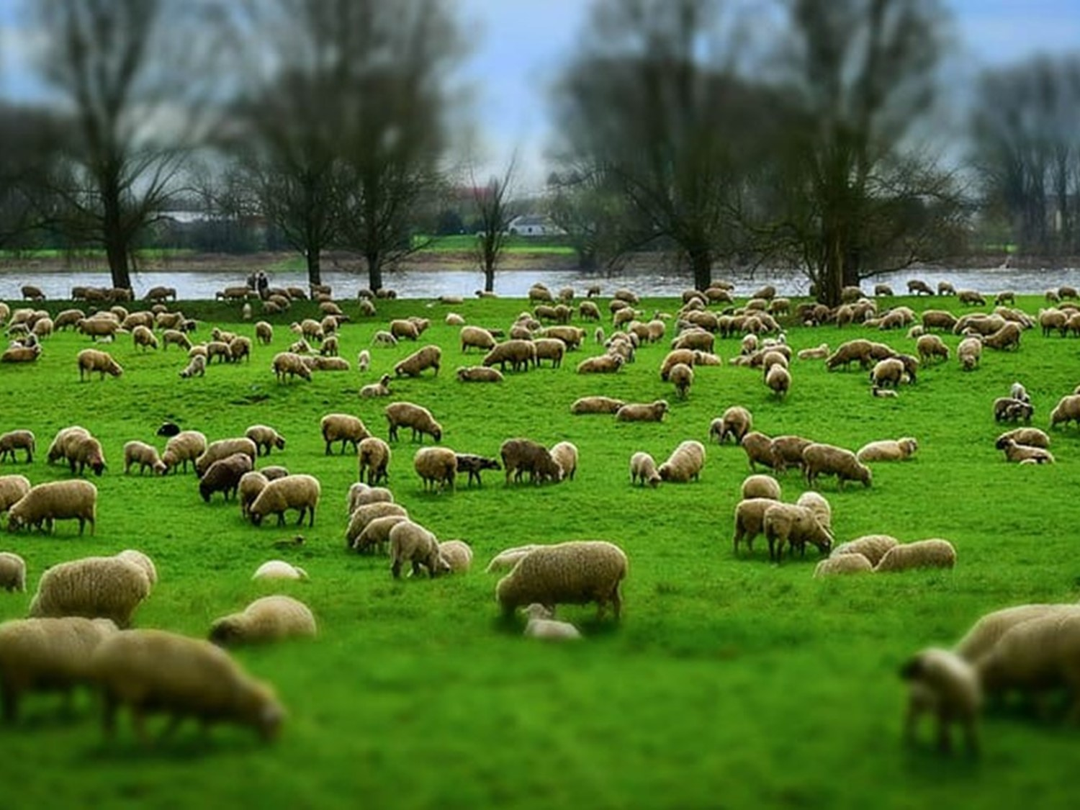
"'Keep watch over yourselves and all the flock of which the Holy Spirit has made you overseers. Be shepherds of the church of God, which he bought with his own blood.'" Acts 20:28

Slide 4
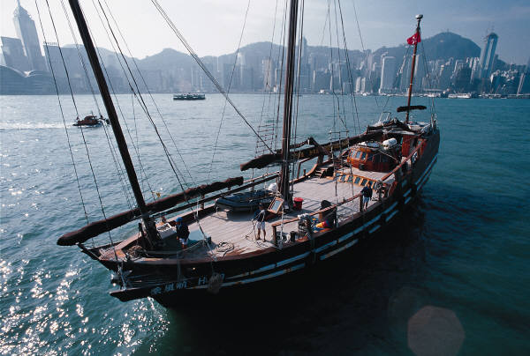
Once safely on shore, we found out that the island was called Malta.

Slide 5

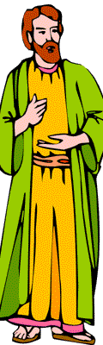
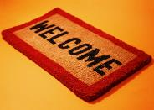
The islanders showed us unusual kindness. They built a fire and welcomed us all because it was raining and cold.

Slide 6
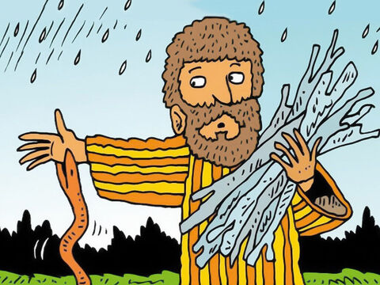
Paul gathered a pile of brushwood and, as he put it on the fire, a viper, driven out by the heat, fastened itself on his hand.

Slide 7
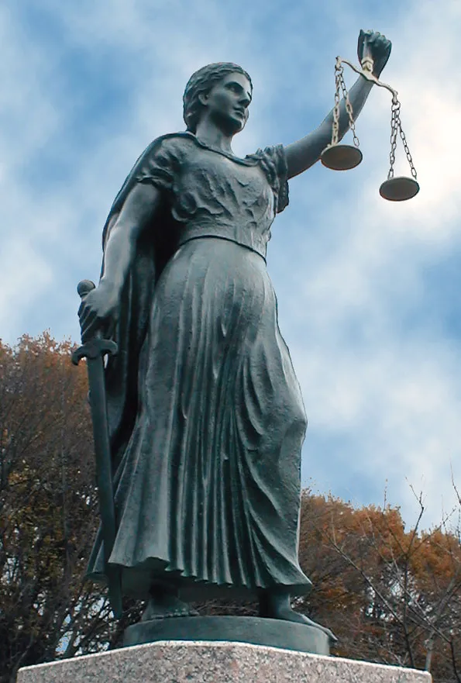
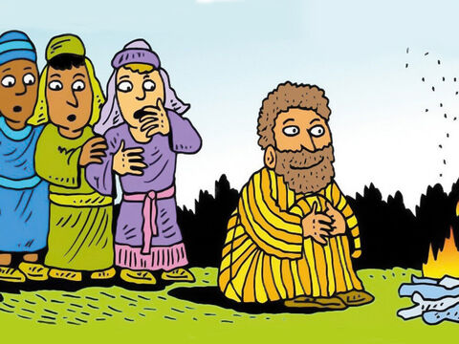
When the islanders saw the snake hanging from his hand, they said to each other,
This man must be a murderer; for though he escaped from the sea, the goddess Justice has not allowed him to live.

Slide 8

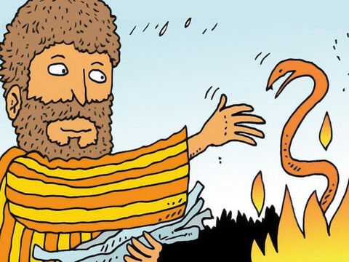
But Paul shook the snake off into the fire and suffered no ill effects.
NOT
ILL

Slide 9
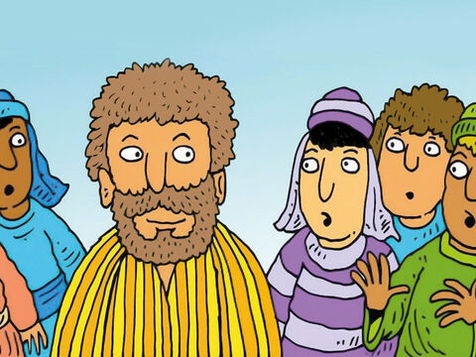

The people expected him to swell up or suddenly fall dead, but after waiting a long time and seeing nothing unusual happen to him, they changed their minds and said
…he was a god.

Slide 10
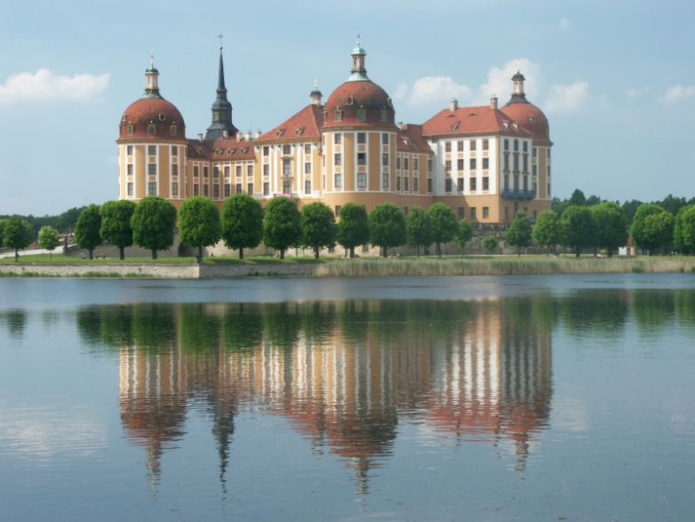
There was an estate nearby that belonged to Publius, the chief official of the island. He welcomed us to his home and showed us generous hospitality for 3 days.

Slide 11
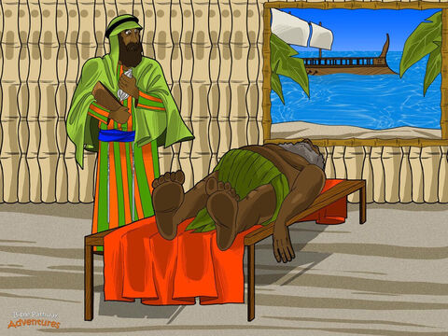
His father was sick in bed, suffering from fever and dysentery. Paul went in to see him and, after prayer, placed his hands on him and healed him.

Slide 12
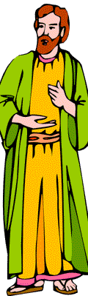
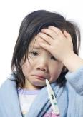
When this had happened, the rest of the sick on the island came and were cured.

Slide 13

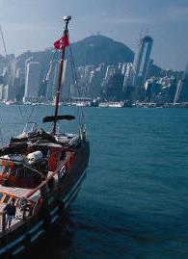

They honored us in many ways and when we were ready to sail, they furnished us with the supplies we needed.

Slide 14
Arrival at Rome

Slide 15
After 3 months we put out to sea in a ship that had wintered in the island.

Slide 16
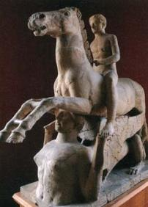
It was an Alexandrian ship with the figurehead of the twin gods Castor and Pollux.

Slide 17
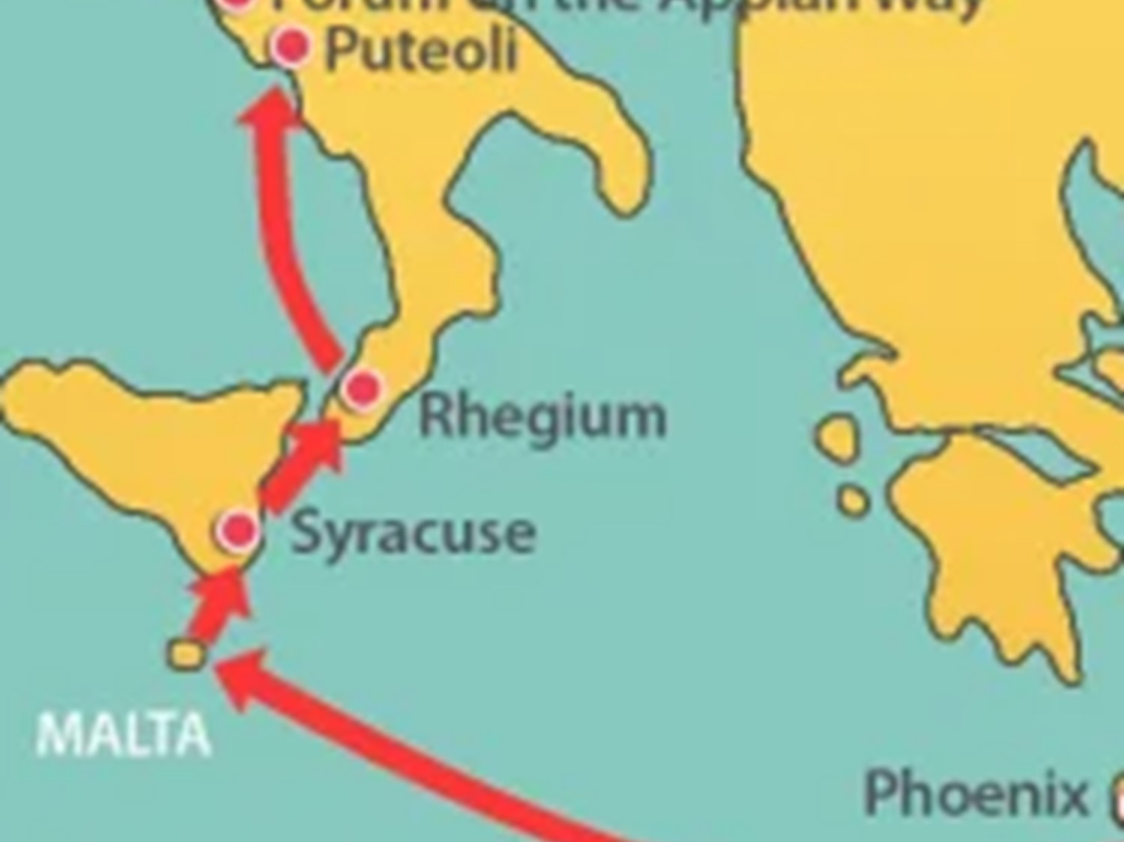
We put in at Syracuse and stayed there 3 days. From there we set sail and arrived at Rhegium.
The next day the south wind came up, and on the following day we reached Puteoli.

Slide 18
There we found some brothers and sisters who invited us to spend a week with them. And so we came to Rome.

Slide 19
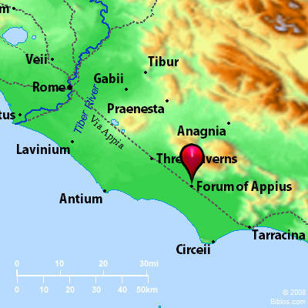
The brothers and sisters there had heard that we were coming, and they traveled as far as the Forum of Appius and the Three Taverns to meet us.

Slide 20
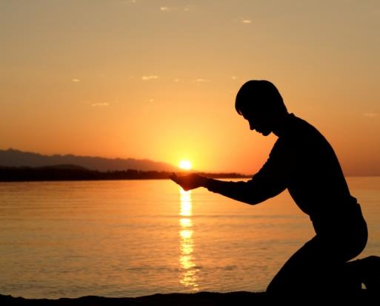
At the sight of these people Paul thanked God and was encouraged.

Slide 21
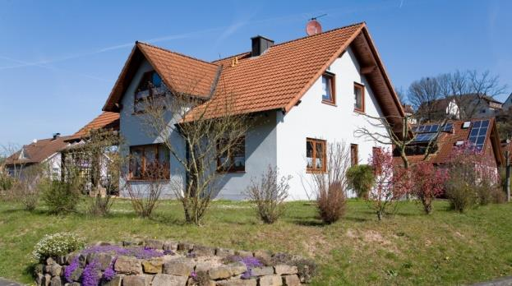
When we got to Rome, Paul was allowed to live by himself, with a soldier to guard him.

Slide 22
Paul Preaches at Rome Under Guard

Slide 23
Three days later he called together the local Jewish leaders.

Slide 24
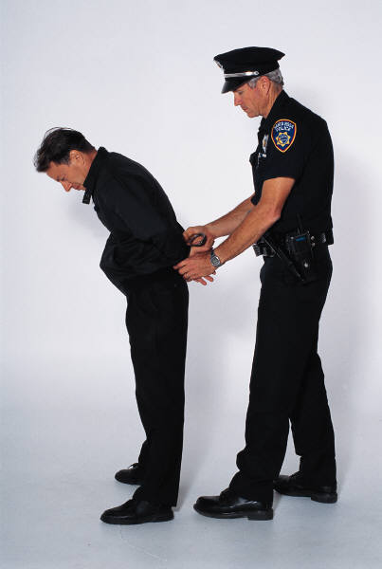
When they had assembled, Paul said to them:
My brothers, although I have done nothing against our people or against the customs of our ancestors, I was arrested in Jerusalem and handed over to the Romans…

Slide 25

They examined me and wanted to release me, because I was not guilty of any crime deserving death.

Slide 26

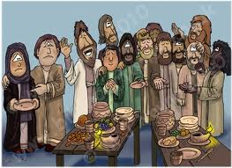
The Jews objected, so I was compelled to appeal to Caesar. I certainly did not intend to bring any charge against my own people.

Slide 27
For this reason I have asked to see you and talk with you. It is because of the hope of Israel that I am bound with this chain.

Slide 28

They replied,
We have not received any letters from Judea concerning you, and none of our people who have come from there has reported or said anything bad about you.

Slide 29

But we want to hear what your views are, for we know that people everywhere are talking against this sect.

Slide 30

They arranged to meet Paul on a certain day, and came in even larger numbers to the place where he was staying.

Slide 31
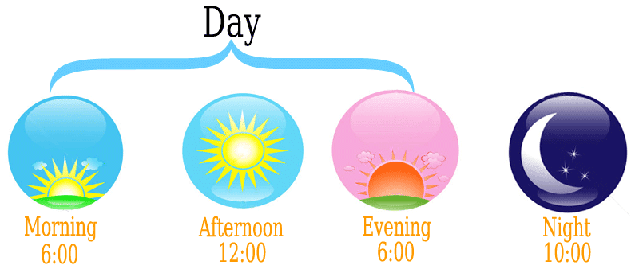
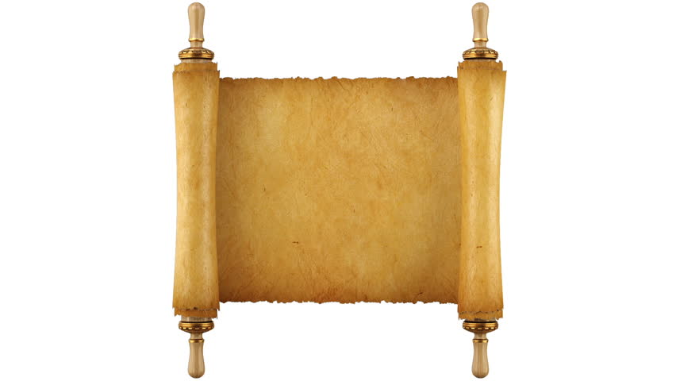
He witnessed to them from morning till evening, explaining about the kingdom of God, and from the Law of Moses and from the Prophets he tried to persuade them about Jesus.
This Photo by Unknown Author is licensed under CC BY-SA-NC

Slide 32
Some were convinced by what he said, but others would not believe.

Slide 33

They disagreed among themselves and began to leave after Paul had made this final statement:
The Holy Spirit spoke the truth to your ancestors when he said through Isaiah the prophet:

Slide 34
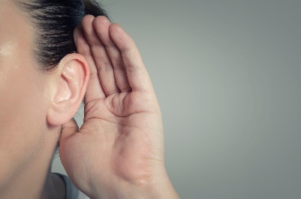
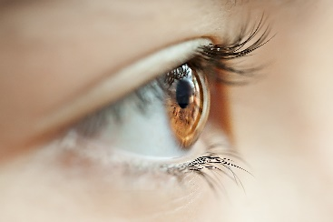
Go to this people and say,
You will be ever hearing but never understanding; you will be ever seeing but never perceiving.

Slide 35



For this people’s heart has become calloused; they hardly hear with their ears, and they have closed their eyes. Otherwise they might see with their eyes, hear with their ears, understand with their hearts and turn, and I would heal them.

Slide 36

Therefore I want you to know that God’s salvation has been sent to the Gentiles, and they will listen!

Slide 37
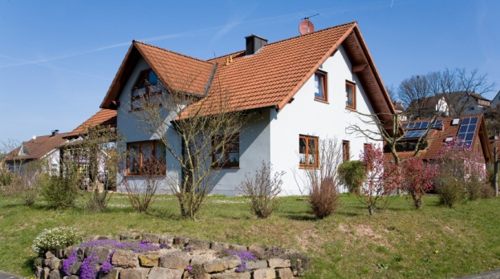
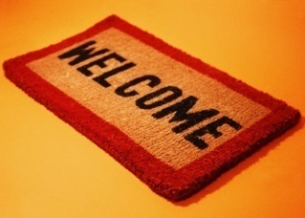
For 2 whole years Paul stayed there in his own rented house and welcomed all who came to see him

Slide 38
He proclaimed the kingdom of God and taught about the Lord Jesus Christ – with all boldness and without hindrance!

