Slide 1
Dig Site 19
Faith in the Storm!
Acts 27:1-2, 9-26, 33-44

Slide 2
The truth
God wants us to put our hope in Him!

Slide 3
Hebrews 10:23
"Let us hold unswervingly to the hope we profess, for he who promised is faithful."

Slide 4
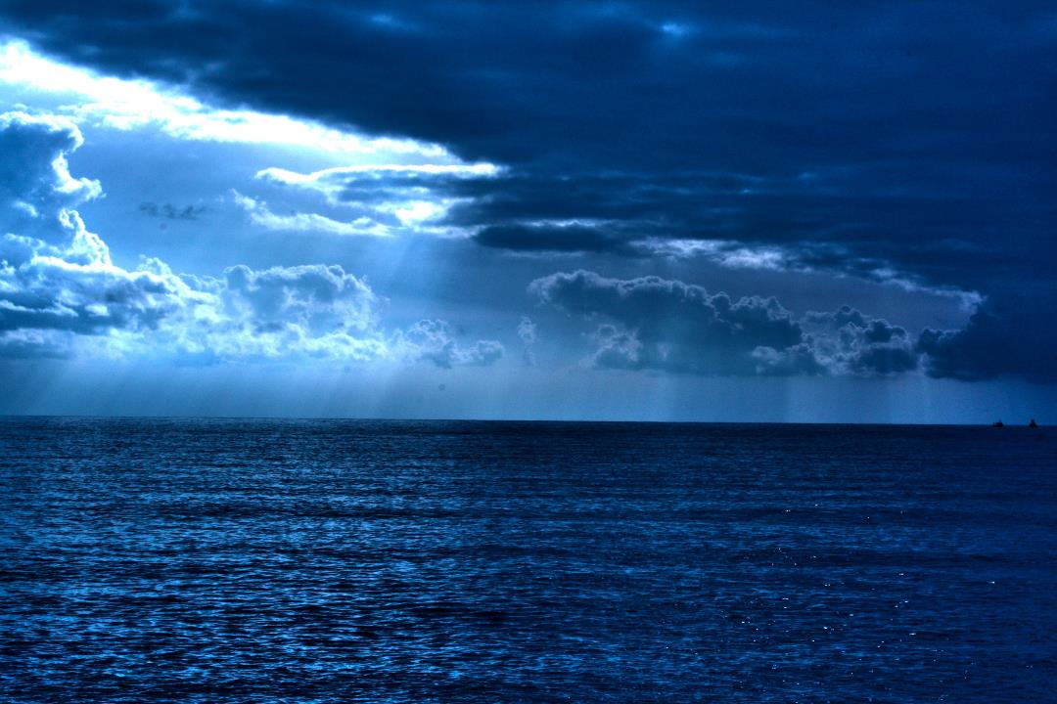
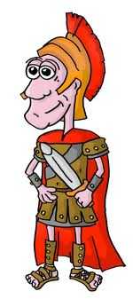
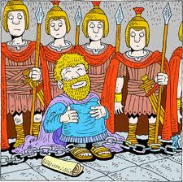
When it was decided that we would sail for Italy, Paul and some other prisoners were handed over to a centurion named Julius, who belonged to the Imperial Regiment.

Slide 5
We boarded a ship from Adramyttium about to sail for ports along the coast of the province of Asia, and we put out to sea. Aristarchus, a Macedonian from Thessalonica, was with us.

Slide 6
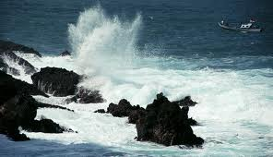
Much time had been lost, and sailing had already become dangerous because by now it was after the Day of Atonement.
*The Day of Atonement (Yom Kippur), usually in late September; Few sailed the Mediterranean Sea after Sept. 15 because the water was very rough and dangerous.

Slide 7
So Paul warned them,
Men, I can see that our voyage is going to be disastrous and bring great loss to ship and cargo, and to our own lives also.

Slide 8
But the centurion, instead of listening to what Paul said, followed the advice of the pilot and of the owner of the ship.
Let’s keep going!
X

Slide 9
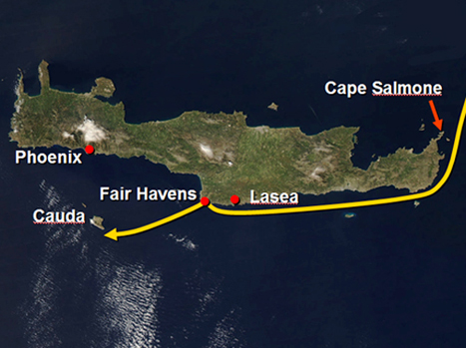
Since the harbor was unsuitable to winter in, the majority decided that we should sail on, hoping to reach Phoenix and winter there. This was a harbor in Crete, facing both southwest and northwest.

Slide 10
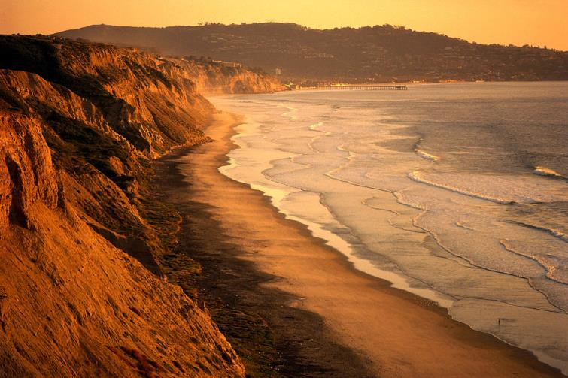
When a gentle south wind began to blow, they saw their opportunity; so they weighed anchor and sailed along the shore of Crete.

Slide 11
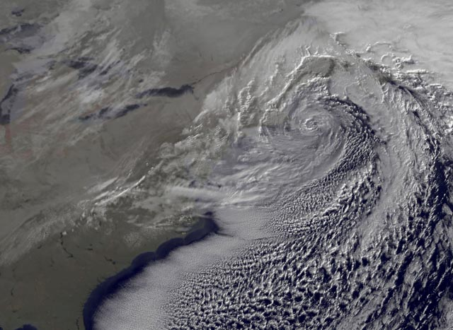
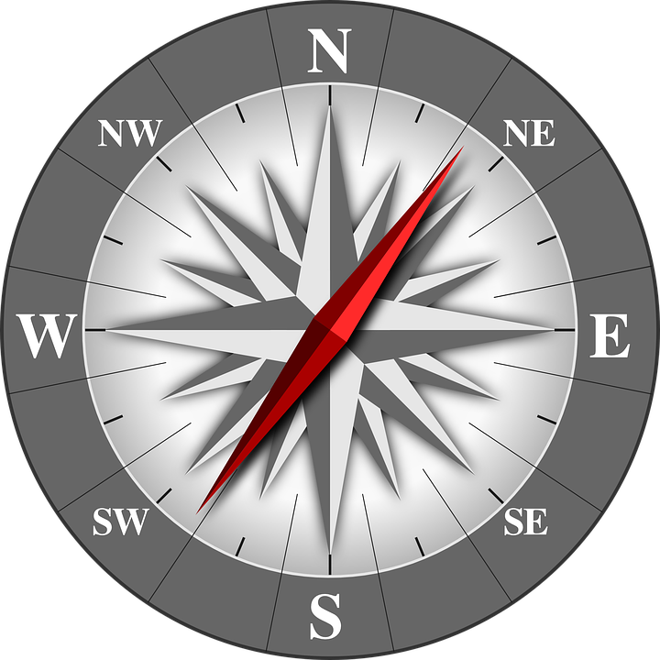
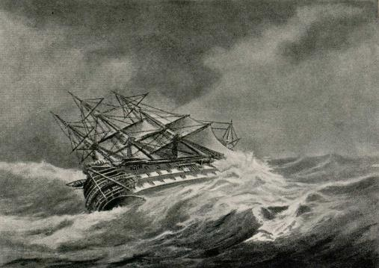
Before very long, a wind of hurricane force, called the Northeaster, swept down from the island. The ship was caught by the storm and could not head into the wind; so we gave way to it and were driven along.

Slide 12
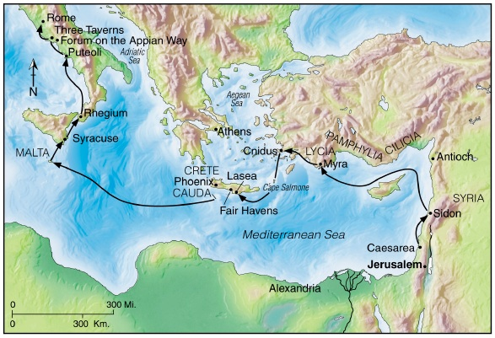
As we passed to the lee of a small island called Cauda, we were hardly able to make the lifeboat secure,

Slide 13
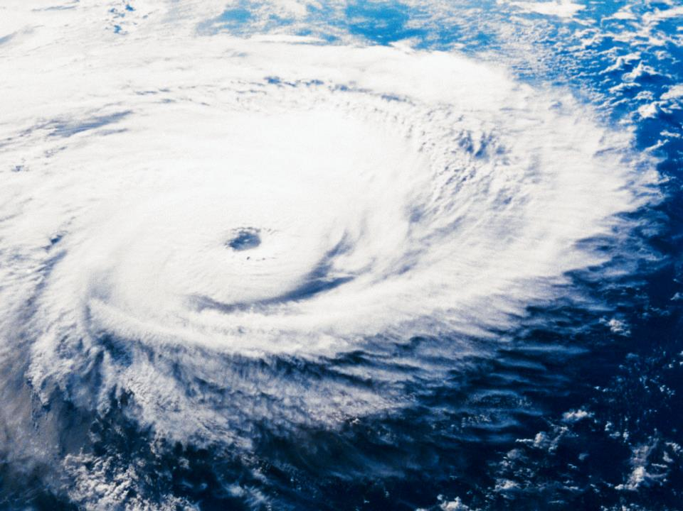
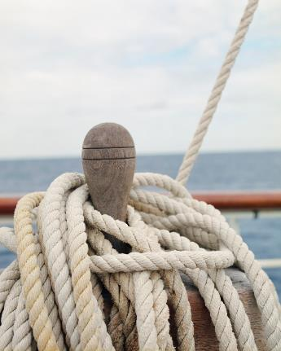
so the men hoisted it aboard. Then they passed ropes under the ship itself to hold it together.

Slide 14
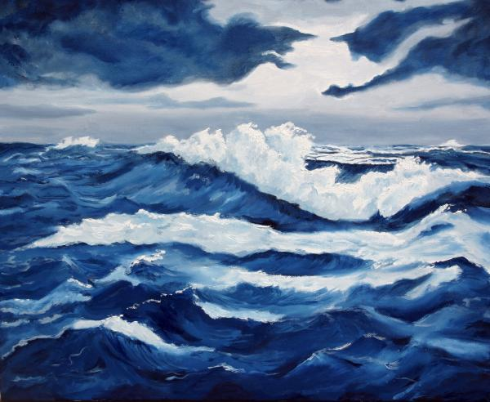
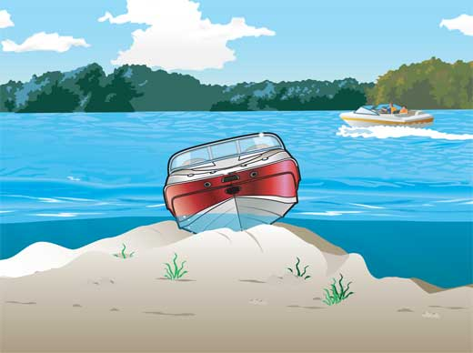
Because they were afraid they would run aground on the sandbars of Syrtis, they lowered the sea anchor and let the ship be driven along.

Slide 15
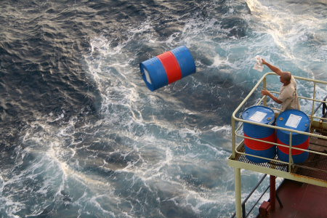
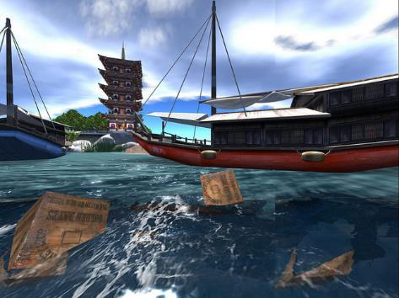
We took such a violent battering from the storm that the next day they began to throw the cargo overboard.

Slide 16
On the third day, they threw the ship’s tackle overboard with their own hands.

Slide 17


When neither sun nor stars appeared for many days and the storm continued raging, we finally gave up all hope of being saved.
X
X

Slide 18
After the men had gone a long time without food, Paul stood up before them and said:
Men, you should have taken my advice not to sail from Crete; then you would have spared yourselves this damage and loss.

Slide 19
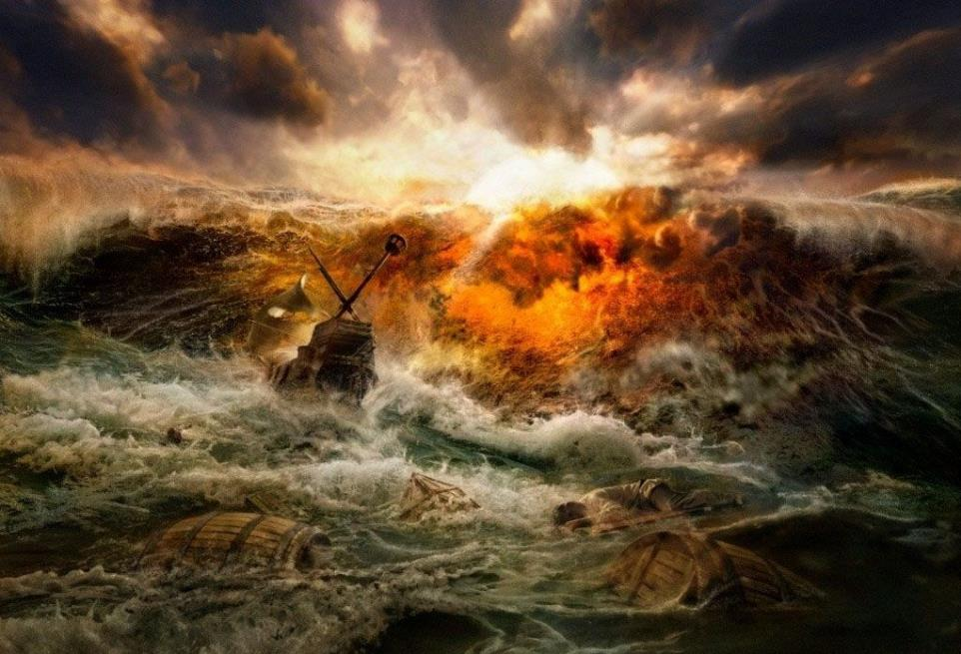
But now I urge you to keep up your courage, because not one of you will be lost; only the ship will be destroyed.

Slide 20
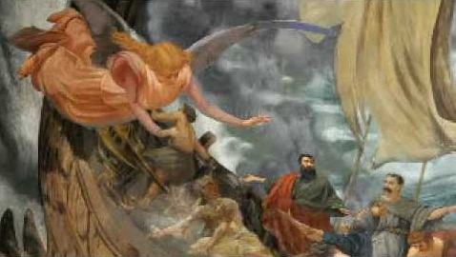
Last night an angel of the God to whom I belong and whom I serve stood beside me and said,
Do not be afraid, Paul. You must stand trial before Caesar; and God has graciously given you the lives of all who sail with you.

Slide 21
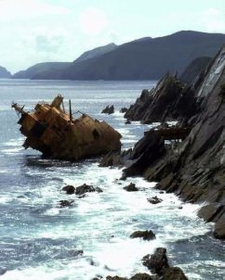
So keep up your courage, men, for I have faith in God that it will happen just as he told me. Nevertheless, we must run aground on some island.

Slide 22
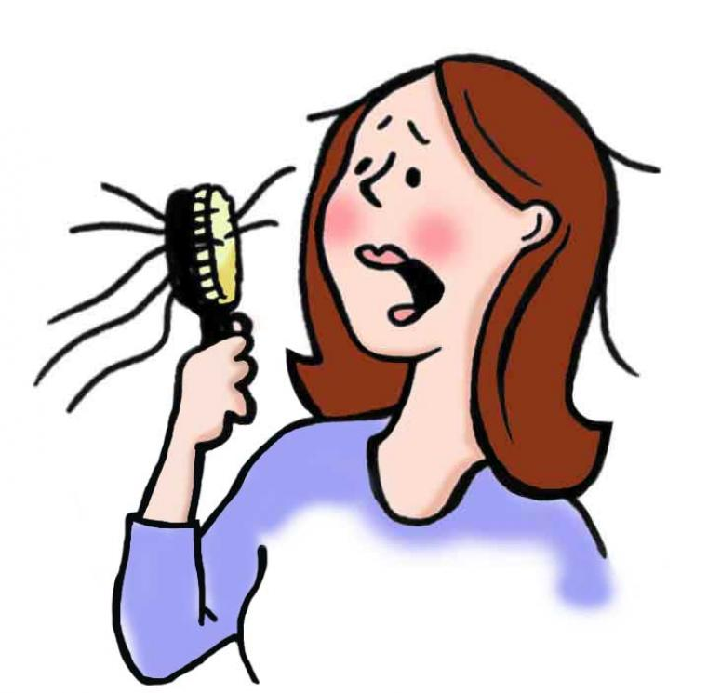
Just before dawn Paul urged them all to eat.
"For the last fourteen days", he said, "you have been in constant suspense and have gone without food—you haven’t eaten anything. Now I urge you to take some food. You need it to survive. Not one of you will lose a single hair from his head."

Slide 23


After he said this, he took some bread and gave thanks to God in front of them all. Then he broke it and began to eat. They were all encouraged and ate some food themselves.
YUM!
YUM!
YUM!
YUM!

Slide 24
Altogether there were 276 of us on board.

Slide 25
When they had eaten as much as they wanted, they lightened the ship by throwing the grain into the sea.

Slide 26
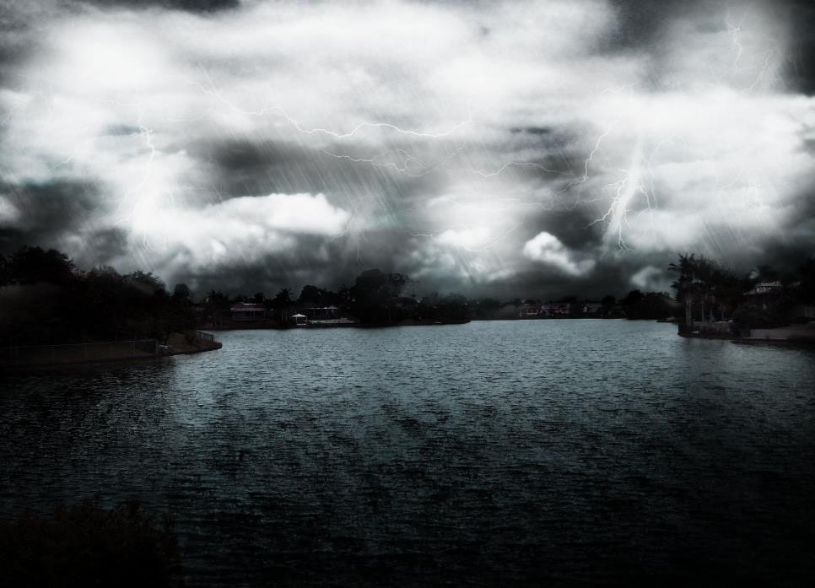
When daylight came, they did not recognize the land, but they saw a bay with a sandy beach, where they decided to run the ship aground if they could.

Slide 27
Cutting loose the anchors, they left them in the sea and at the same time untied the ropes that held the rudders. Then they hoisted the foresail to the wind and made for the beach.

Slide 28
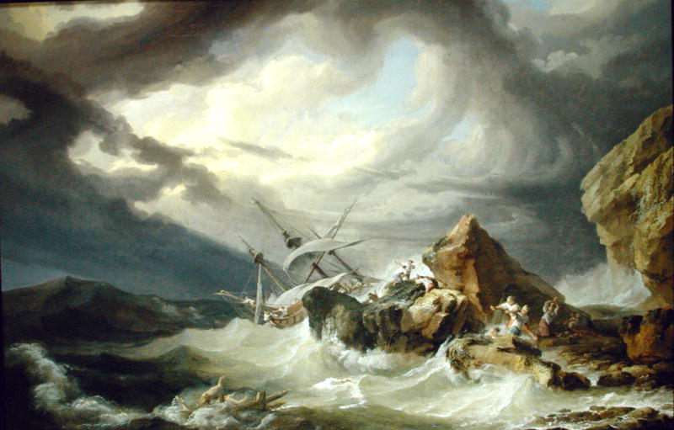
But the ship struck a sandbar and ran aground. The bow stuck fast and would not move, and the stern was broken to pieces by the pounding of the surf.

Slide 29
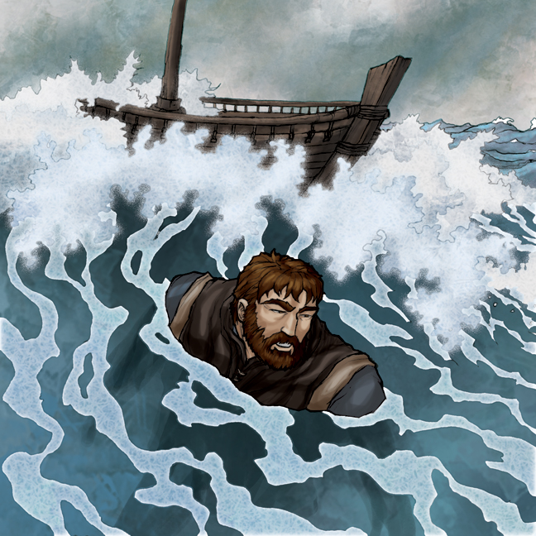
The soldiers planned to kill the prisoners to prevent any of them from swimming away and escaping.

Slide 30
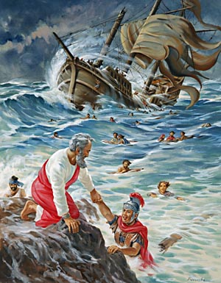
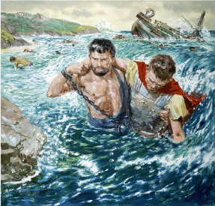
But the centurion wanted to spare Paul’s life and kept them from carrying out their plan. He ordered those who could swim to jump overboard first and get to land.

Slide 31
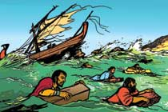
The rest were to get there on planks or on other pieces of the ship. In this way everyone reached land safely.

