Slide 1
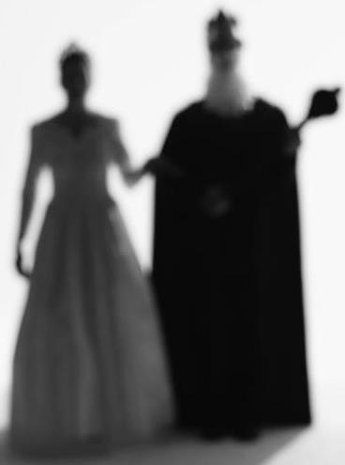
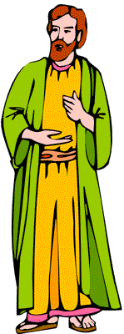
Paul's Living Testimony
Lesson #18
Acts 25:23-26:32

Slide 2
The Truth
God wants us to testify to His work in our lives!

Slide 3
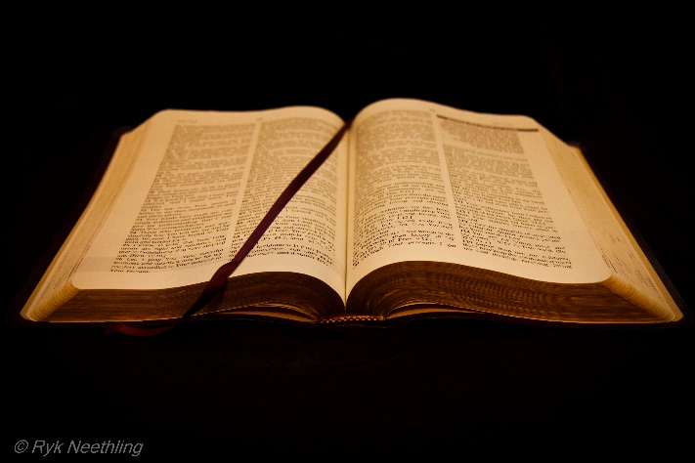
Acts 4:20
"'As for us, we cannot help speaking about what we have seen and heard.'"
This Photo by Unknown Author is licensed under CC BY

Slide 4
The next day Agrippa and Bernice came with great pomp and entered the audience room with the high-ranking military officers and the prominent men of the city.
At the command of Festus, Paul was brought in.

Slide 5
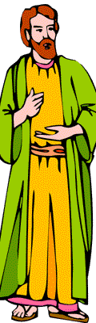
Festus said:
King Agrippa, and all who are present with us, you see this man!
The whole Jewish community has petitioned me about him in Jerusalem and here in Caesarea, shouting that he ought not to live any longer.

Slide 6
I found he had done nothing deserving of death, but because he made his appeal to the Emperor I decided to send him to Rome.

Slide 7
But I have nothing definite to write to His Majesty about him.
Therefore I have brought him before all of you, and especially before you, King Agrippa, so that as a result of this investigation I may have something to write.

Slide 8
For I think it is unreasonable to send a prisoner on to Rome without specifying the charges against him.

Slide 9
Then Agrippa said to Paul,
You have permission to speak for yourself.

Slide 10
So Paul motioned with his hand and began his defense:

Slide 11
King Agrippa, I consider myself fortunate to stand before you today as I make my defense against all the accusations of the Jews,

Slide 12
and especially so because you are well acquainted with all the Jewish customs and controversies. Therefore, I beg you to listen to me patiently.

Slide 13
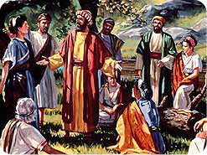
The Jewish people all know the way I have lived ever since I was a child, from the beginning of my life in my own country, and also in Jerusalem.

Slide 14
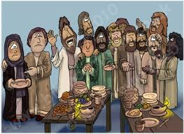
They have known me for a long time and can testify, if they are willing, that I conformed to the strictest sect of our religion, living as a Pharisee.

Slide 15
And now it is because of my hope in what God has promised our ancestors that I am on trial today.

Slide 16


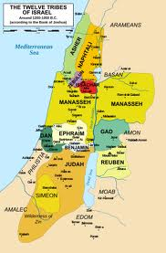

This is the promise our twelve tribes are hoping to see fulfilled as they earnestly serve God day and night.
King Agrippa, it is because of this hope that these Jews are accusing me.

Slide 17
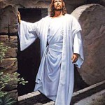

Why should any of you consider it incredible that God raises the dead?

Slide 18
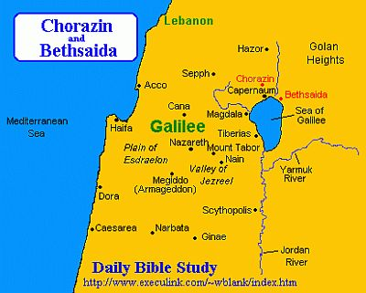
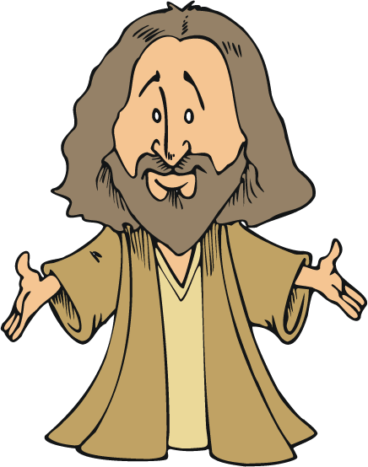
I too was convinced that I ought to do all that was possible to oppose the name of Jesus of Nazareth.
JESUS
Of
Nazareth

Slide 19


And that is just what I did in Jerusalem.
On the authority of the chief priests I put many of the Lord’s people in prison, and when they were put to death, I cast my vote against them.

Slide 20

Many a time I went from one synagogue to another to have them punished, and I tried to force them to blaspheme.

Slide 21
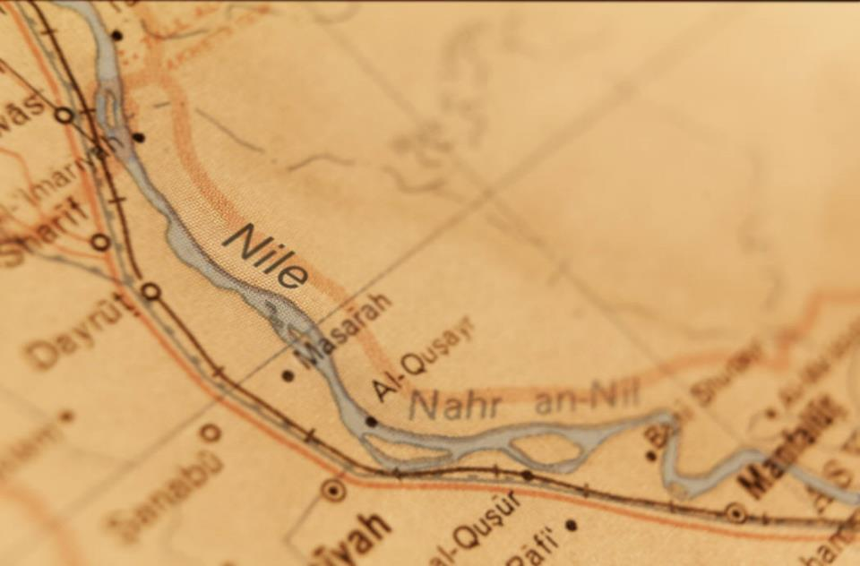
I was so obsessed with persecuting them that I even hunted them down in foreign cities.

Slide 22

On one of these journeys I was going to Damascus with the authority and commission of the chief priests.

Slide 23
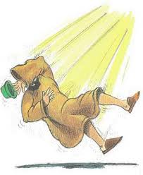

About noon, King Agrippa, as I was on the road, I saw a light from heaven, brighter than the sun, blazing around me and my companions.

Slide 24

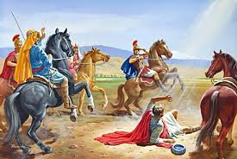
We all fell to the ground, and I heard a voice saying to me in Aramaic, ‘Saul, Saul, why do you persecute me? It is hard for you to kick against the goads.’

Slide 25
Then I asked,
I am Jesus, whom you are persecuting,
the Lord replied.
Who are you, Lord?

Slide 26
Now get up and stand on your feet. I have appeared to you to appoint you as a servant and as a witness of what you have seen and will see of me.

Slide 27
I will rescue you from your own people and from the Gentiles. I am sending you to them

Slide 28


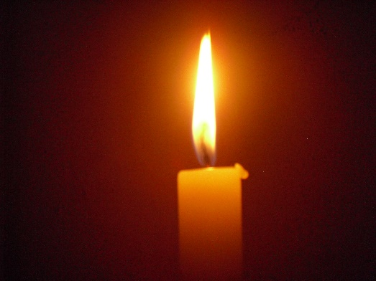
to open their eyes and turn them from darkness to light,
and from the power of Satan to God, so that they may receive forgiveness of sins and a place among those who are sanctified by faith in me.
This Photo by Unknown Author is licensed under CC BY-SA

Slide 29
So then, King Agrippa, I was not disobedient to the vision from heaven.

Slide 30
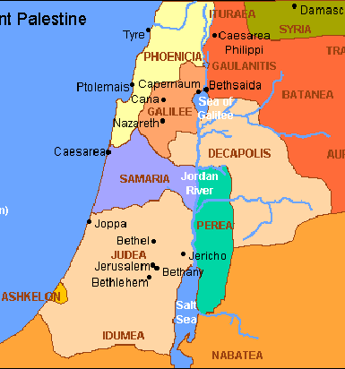
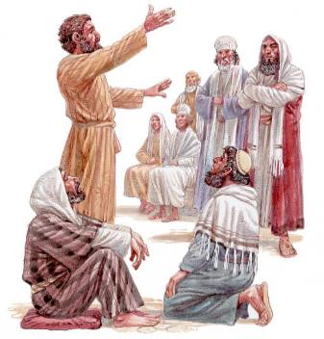
First to those in Damascus, then to those in Jerusalem and in all Judea, and then to the Gentiles,
I preached that they should repent and turn to God and demonstrate their repentance by their deeds.

Slide 31
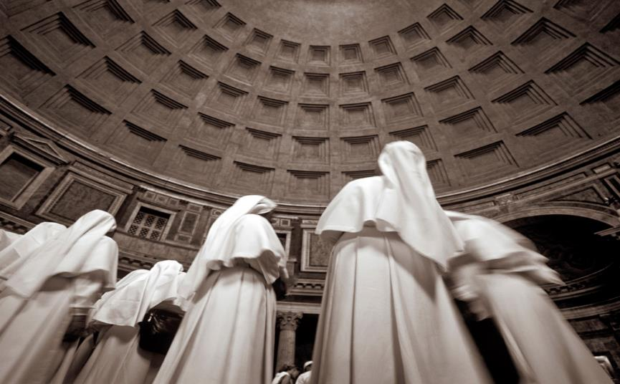
That is why some Jews seized me in the temple courts and tried to kill me.

Slide 32
But God has helped me to this very day; so I stand here and testify to small and great alike. I am saying nothing beyond what the prophets and Moses said would happen—

Slide 33


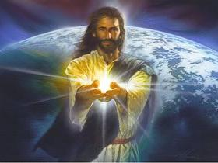
…that the Messiah would suffer and, as the first to rise from the dead, would bring the message of light to his own people and to the Gentiles.

Slide 34
At this point Festus interrupted Paul’s defense.
You are out of your mind, Paul!
he
shouted.
Your great learning is driving you insane.

Slide 35
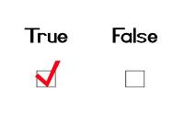
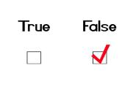
I am not insane, most excellent Festus,
Paul
replied.
What I am saying is true
and reasonable.

Slide 36
The king is familiar with these things, and I can speak freely to him. I am convinced that none of this has escaped his notice, because it was not done in a corner.

Slide 37
King Agrippa, do you believe the prophets?
I know you do.

Slide 38
Then Agrippa said to Paul,
Do you think that in such a short time you can persuade me to be a Christian?

Slide 39
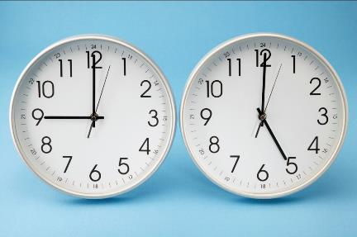
Paul replied,
Short time or long—I pray to God that not only you but all who are listening to me today may become what I am, except for these chains.

Slide 40
The king rose, and with him the governor and Bernice and those sitting with them.

Slide 41



After they left the room, they began saying to one another,
This man is not doing anything that deserves death or imprisonment.

Slide 42
Agrippa said to Festus,
This man could have been set free if he had not appealed to Caesar.

