Slide 1
ACTS DIG SITE 17
ACTS 22:30 – 23:24, 31-35
"A Murderous Oath"

Slide 2
Memory Verse
"On him we have set our hope that he will continue to deliver us."
2 Corinthians 1:10b

Slide 3
The Truth
God cares for us and delivers us!

Slide 4
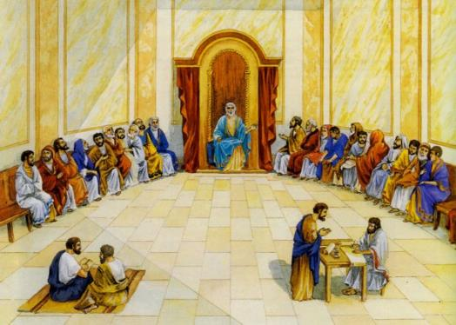
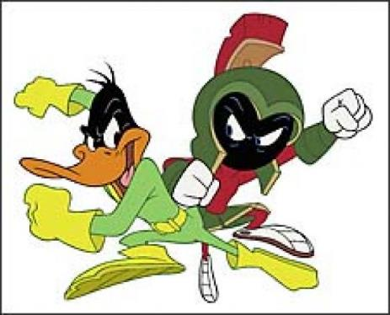
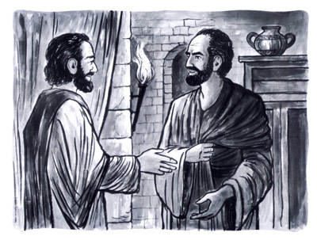
The commander wanted to find out exactly why Paul was being accused by the Jews. So the next day he released him and ordered the chief priests and all the members of the Sanhedrin to assemble. Then he brought Paul and had him stand before them.

Slide 5
Paul looked straight at the Sanhedrin and said,
My brothers, I have fulfilled my duty to God in all good conscience to this day.

Slide 6
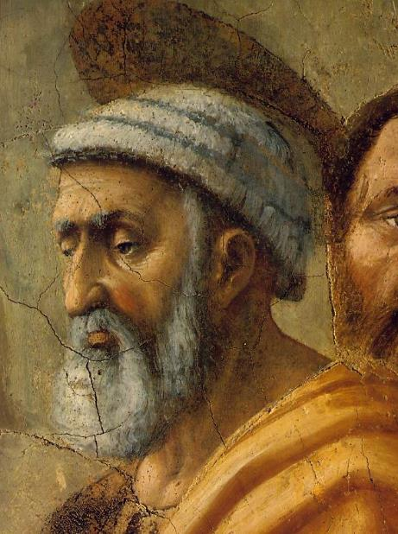
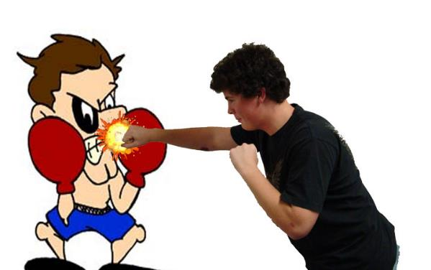
At this the high priest Ananias ordered those standing near Paul to strike him on the mouth.

Slide 7

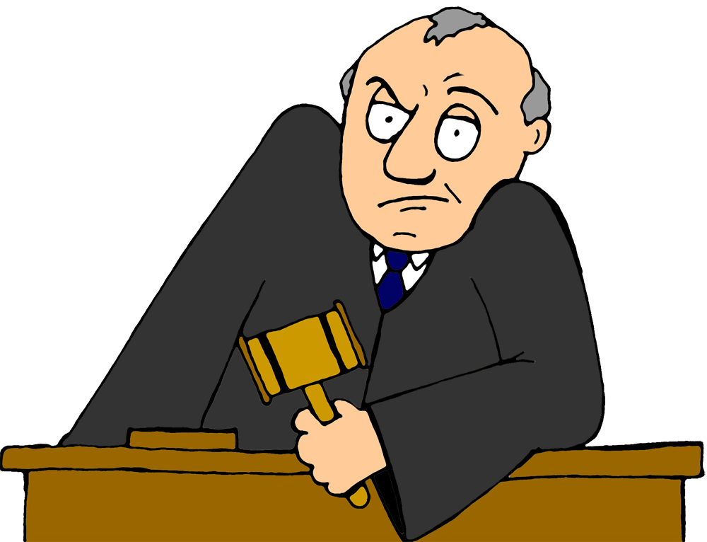
Then Paul said to him,
God will strike you, you whitewashed wall! You sit there to judge me according to the law, yet you yourself violate the law by commanding that I be struck!

Slide 8
Those who were standing near Paul said,
How dare you insult God’s high priest!
Paul replied,
Brothers, I did not realize that he was the high priest; for it is written:
'Do not speak evil about the ruler of your people.'

Slide 9
Then Paul, knowing that some of them were Sadducees and the others Pharisees, called out in the Sanhedrin,
My brothers, I am a Pharisee, descended from Pharisees. I stand on trial because of the hope of the resurrection of the dead.

Slide 10
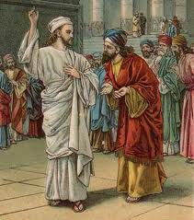
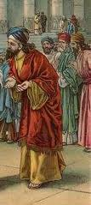
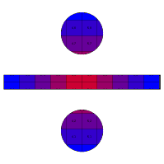
When he said this, a dispute broke out between the Pharisees and the Sadducees, and the assembly was divided.
(The Sadducees say that there is no resurrection, and that there are neither angels nor spirits, but the Pharisees believe all these things.)

Slide 11

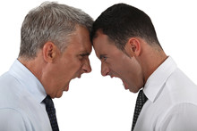
There was a great uproar, and some of the teachers of the law who were Pharisees stood up and argued vigorously.*
The dispute became so violent that the commander was afraid Paul would be torn to pieces by them. He ordered the troops to go down and take him away from them by force and bring him into the barracks.
* "We find nothing wrong with this man," they said. "What if a spirit or an angel has spoken to him?"

Slide 12
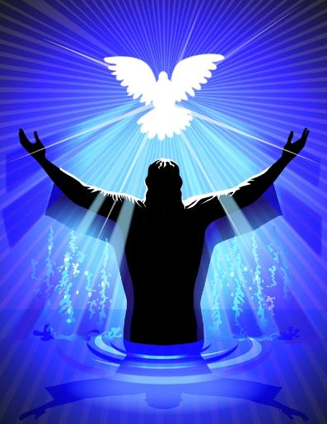
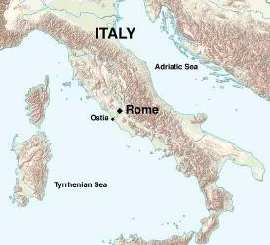
The following night the Lord stood near Paul and said,
Take courage! As you have testified about me in Jerusalem, so you must also testify in Rome.

Slide 13

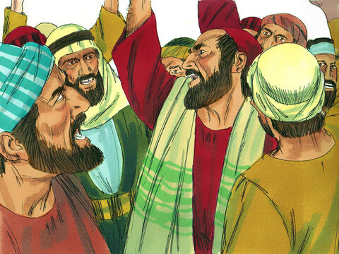

The next morning some Jews formed a conspiracy and bound themselves with an oath not to eat or drink until they had killed Paul. More than forty men were involved in this plot.

Slide 14
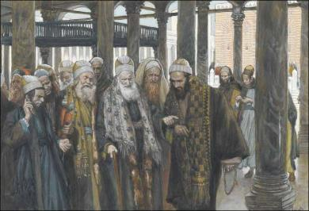

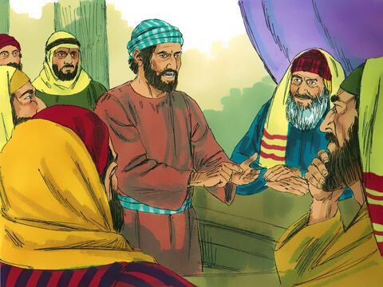
They went to the chief priests and the elders and said,
"We have taken a solemn oath not to eat anything until we have killed Paul. Now then, you and the Sanhedrin petition the commander to bring him before you on the pretext of wanting more accurate information about his case. We are ready to kill him before he gets here."

Slide 15
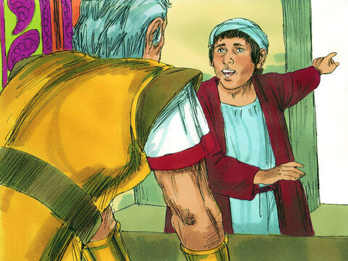
But when the son of Paul’s sister heard of this plot, he went into the barracks and told Paul. Then Paul called one of the centurions and said,*
So he took him to the commander.
*Take this young man to the commander; he has something to tell him.

Slide 16
The centurion said,
“Paul, the prisoner, sent for me and asked me to bring this young man to you because he has something to tell you.”
"What is it you want to tell me?"
The commander took the young man by the hand, drew him aside and asked,

Slide 17


He said:
Some Jews have agreed to ask you to bring Paul before the Sanhedrin tomorrow on the pretext of wanting more accurate information about him. Don’t give in to them, because more than forty of them are waiting in ambush for him. They have taken an oath not to eat or drink until they have killed him. They are ready now, waiting for your consent to their request.

Slide 18
The commander dismissed the young man with this warning:
"Don’t tell anyone that you have reported this to me."

Slide 19
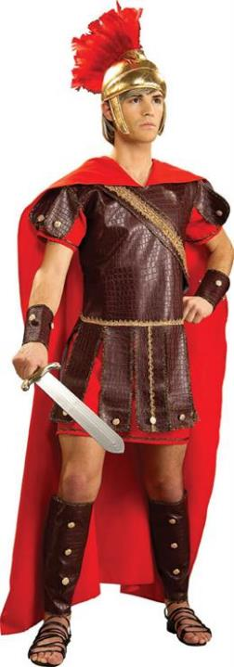

Then he called two of his centurions and ordered them,
"Get ready a detachment of two hundred soldiers, seventy horsemen and two hundred spearmen to go to Caesarea at nine tonight. Provide horses for Paul so that he may be taken safely to Governor Felix."

Slide 20
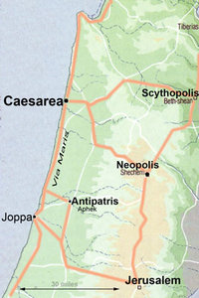
So the soldiers, carrying out their orders, took Paul with them during the night and brought him as far as Antipatris.*

Slide 21
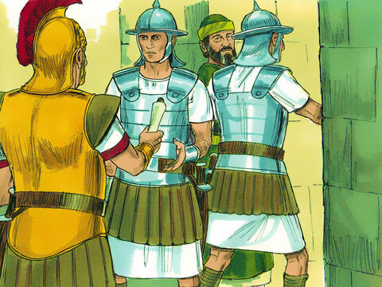
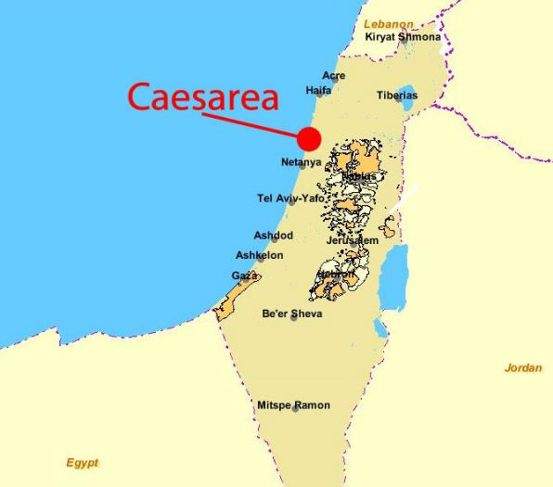
The next day they let the cavalry go on with him, while they returned to the barracks. When the cavalry arrived in Caesarea, they delivered the letter to the governor and handed Paul over to him.

Slide 22
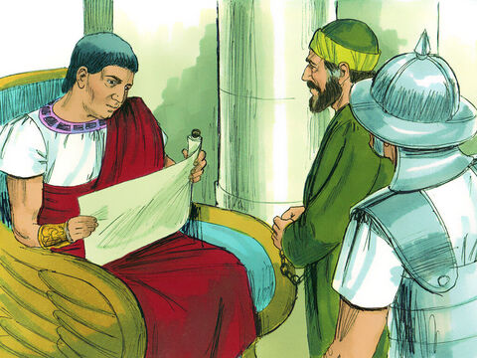
The governor read the letter and asked what province he was from. Learning that he was from Cilicia, he said,
"I will hear your case when your accusers get here."
Then he ordered that Paul be kept under guard in Herod’s palace.

