Slide 1
Paul's Amazing Race
Dig Site 15
Acts 20:17-24, 32-38; 21:17-19

Slide 2
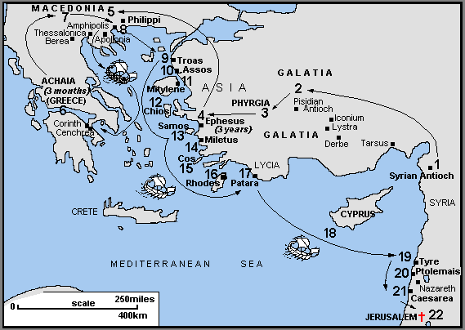
ACTS
Dig Site 15
Acts 20:17-24 & 32-38; 21:17-19

Slide 3
"However, I consider my life worth nothing to me; my only aim is to finish the race and complete the task the Lord Jesus has given me – the task of testifying to the good news of God's grace."
Acts 20:24

Slide 4
God entrusts us with the task of sharing the gospel!
The Truth

Slide 5
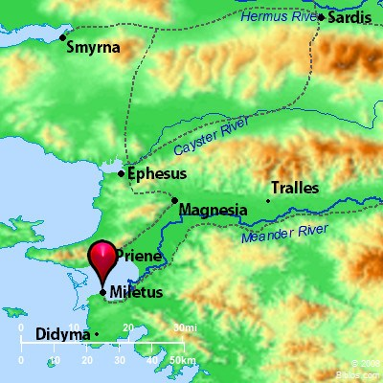
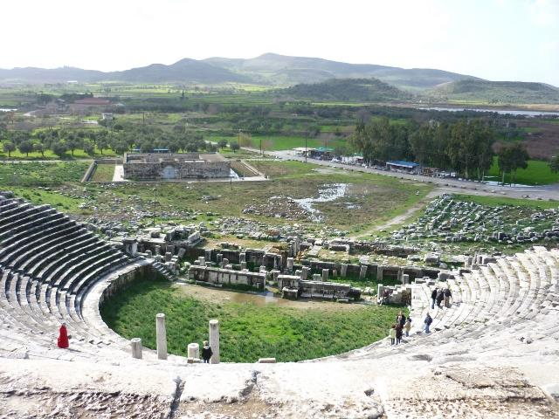
From *Miletus, Paul sent to *Ephesus for the elders of the church.

Slide 6
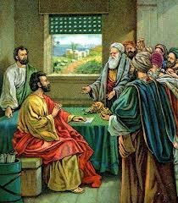
When they arrived, he said to them:
You know how I lived the whole time I was with you, from the first day I came into the province of Asia.

Slide 7
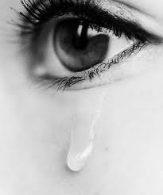
I served the Lord with great humility and with tears and in the midst of severe testing by the plots of my Jewish opponents.

Slide 8


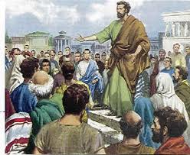



You know that I have not hesitated to preach anything that would be helpful to you but have taught you publicly and from house to house.

Slide 9


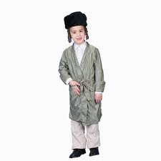
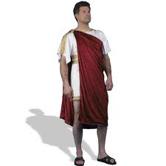
I have declared to both Jews and Greeks that they must turn to God in repentance and have faith in our Lord Jesus.

Slide 10
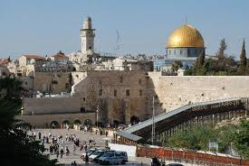
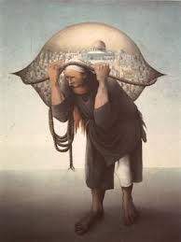
And now, compelled by the Spirit, I am going to Jerusalem, not knowing what will happen to me there. I only know that in every city the Holy Spirit warns me that prison and hardships are facing me.

Slide 11

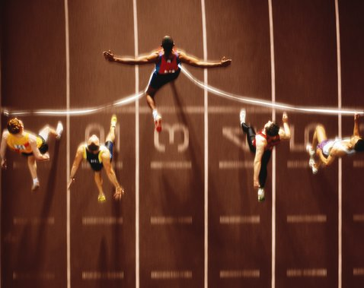

However, I consider my life worth nothing to me; my only aim is to finish the race and complete the task the Lord Jesus has given me —the task of testifying to the good news of God’s grace.

Slide 12
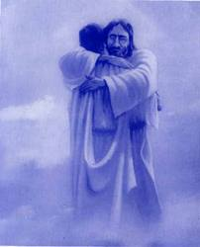
Now I commit you to God and to the word of his grace, which can build you up and give you an inheritance among all those who are sanctified.

Slide 13
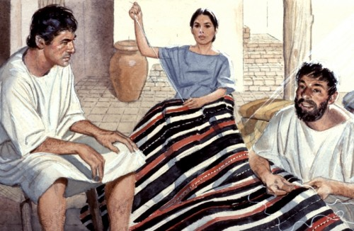
I have not coveted anyone’s silver or gold or clothing. You yourselves know that these hands of mine have supplied my own needs and the needs of my companions.

Slide 14
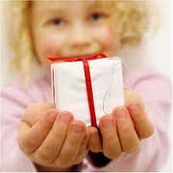
In everything I did, I showed you that by this kind of hard work we must help the weak, remembering the words the Lord Jesus himself said: ‘It is more blessed to give than to receive.’

Slide 15
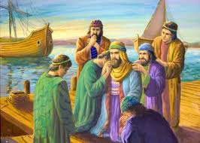
When Paul had finished speaking, he knelt down with all of them and prayed.

Slide 16
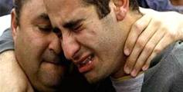
They all wept as they embraced him and kissed him. What grieved them most was his statement that they would never see his face again.

Slide 17
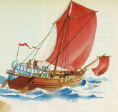

Then they accompanied him to the ship.

Slide 18
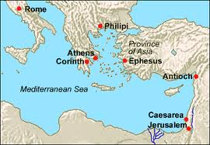


When we arrived at Jerusalem, the brothers received us warmly.

Slide 19
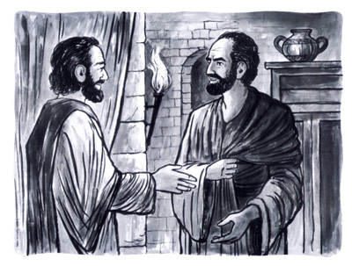
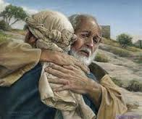
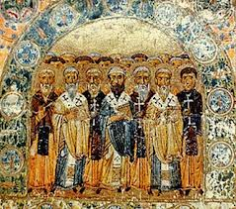
The next day Paul and the rest of us went to see James, and all the elders were present.

Slide 20
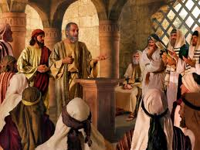
Paul greeted them and reported in detail what God had done among the Gentiles through his ministry.

