Slide 1
Dig Site 14
Acts 19:1-12, 23-41
& Acts 20:7-12
Riots and Miracles

Slide 2
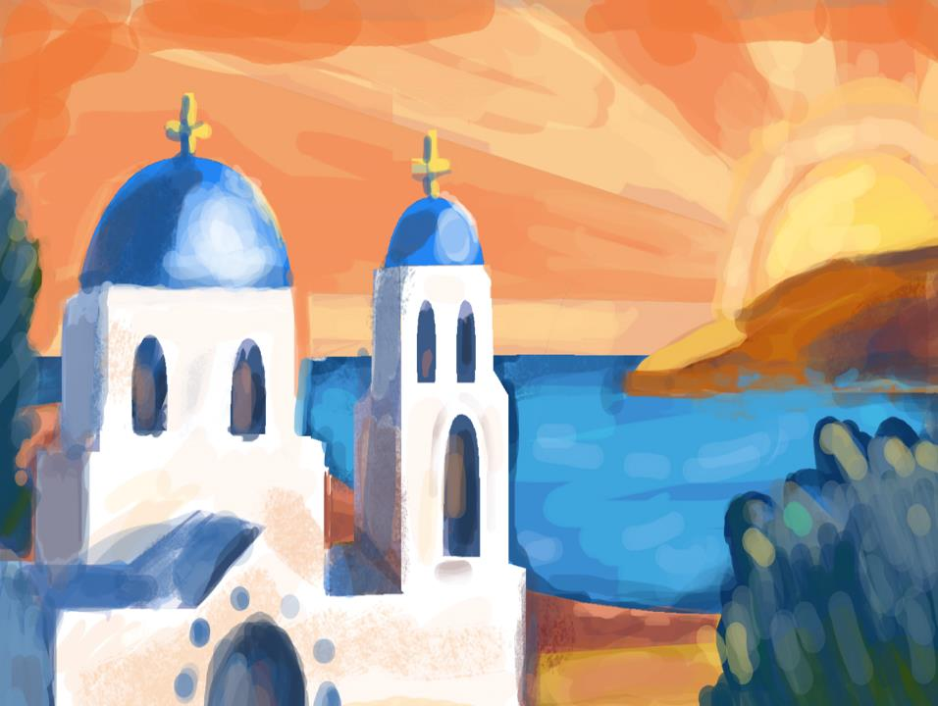
While Apollos was at Corinth…

Slide 3
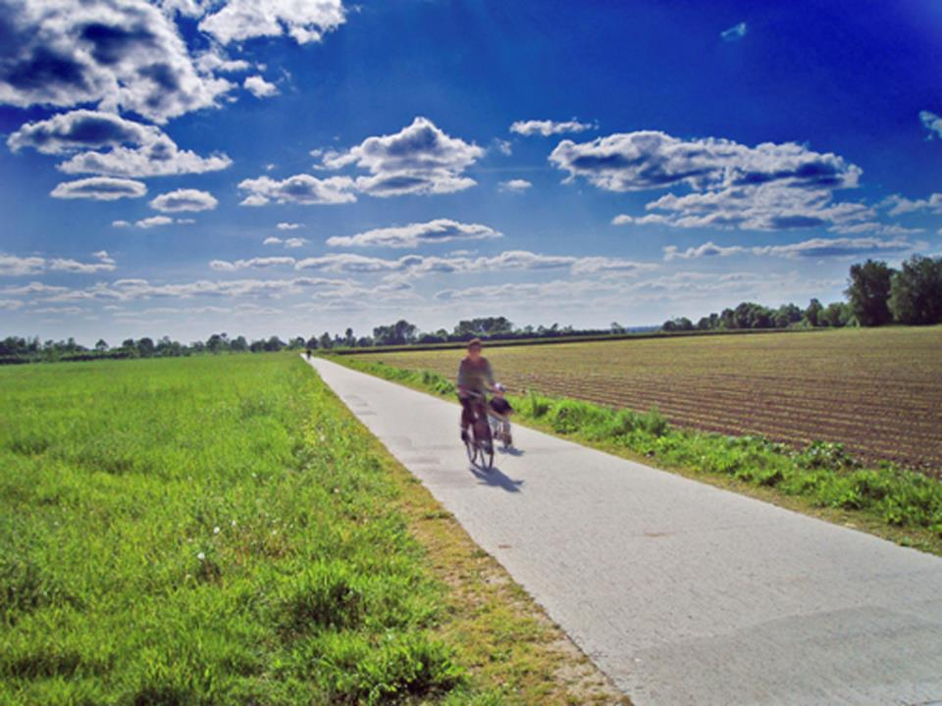
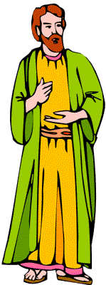
Paul took the road through the interior and arrived at Ephesus.
There he found some disciples and asked them…

Slide 4
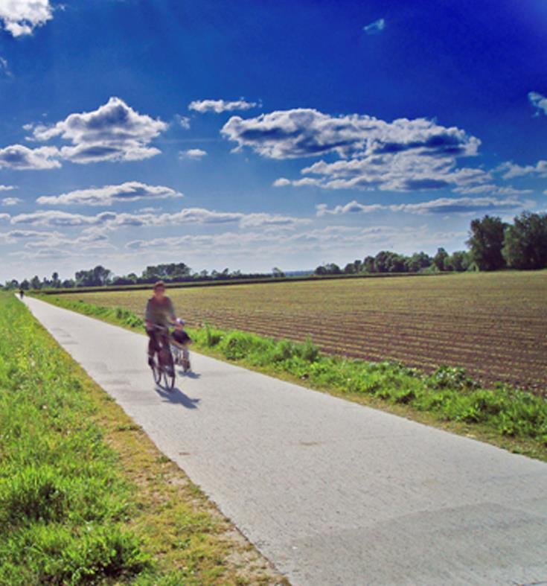
Did you receive the Holy Spirit when you believed?
They answered,
No, we have not even heard that there is a Holy Spirit.

Slide 5
So Paul asked,
John’s baptism,
Then what baptism did you receive?
they replied.

Slide 6
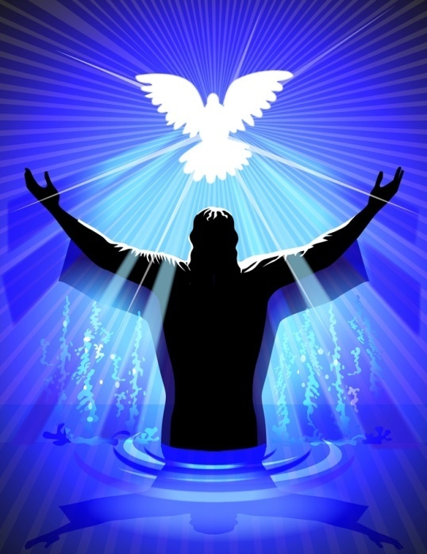
Paul said,
John’s baptism was a baptism of repentance. He told the people to believe in the one coming after him, that is, in Jesus.

Slide 7
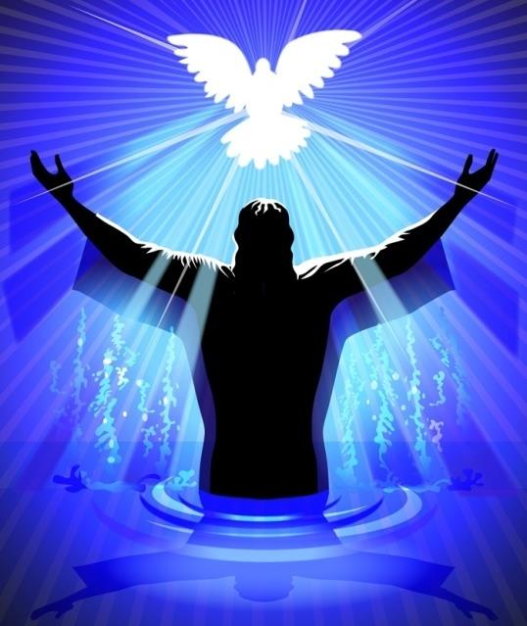
On hearing this, they were baptized
into the name
of the Lord Jesus.

Slide 8
When Paul placed his hands on them,
the Holy Spirit came on them,
and they spoke in tongues and prophesied.

Slide 9
There were about twelve men in all.
5
9
11
12
3
6
7
8
2
4
1
10

Slide 10
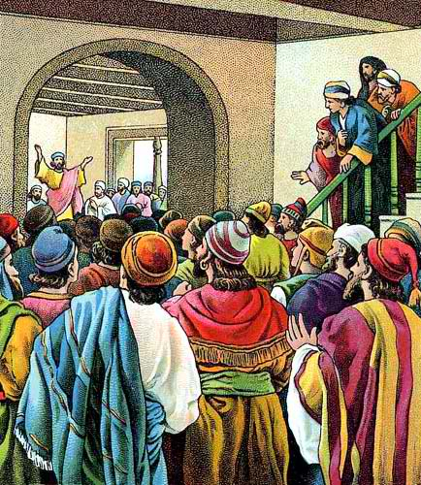
Paul entered the synagogue and spoke boldly there for three months,
arguing persuasively about the kingdom of God.

Slide 11
But some of them became obstinate; they refused to believe and publicly maligned the Way.
So Paul left them.

Slide 12
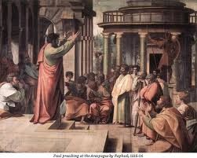
He took the disciples with him
and had discussions daily in the lecture hall of Tyrannus.

Slide 13
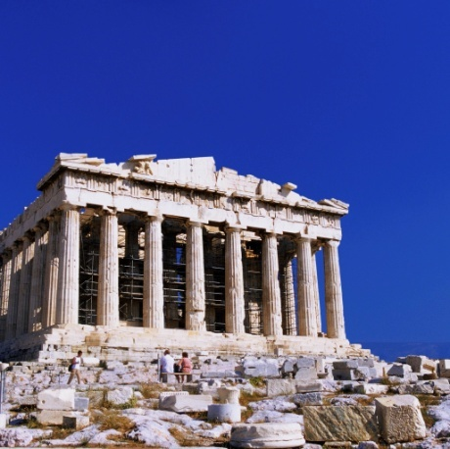




This went on for 2 years, so that all the Jews and Greeks who lived in the province of Asia heard the word of the Lord.

Slide 14
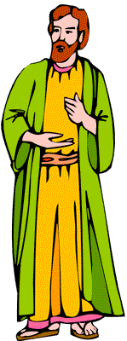
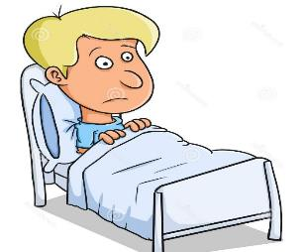
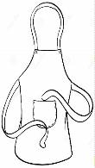



God did extraordinary miracles through Paul, so that even handkerchiefs and aprons that had touched him were taken to the sick
and their illnesses were cured and
the evil spirits left them.
This Photo by Unknown Author is licensed under CC BY-NC

Slide 15
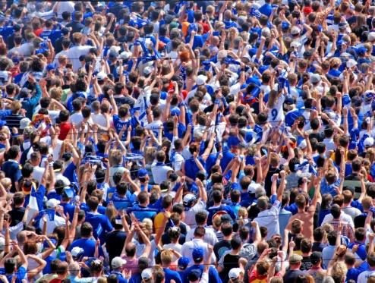
About that time there arose a great disturbance about the Way

Slide 16
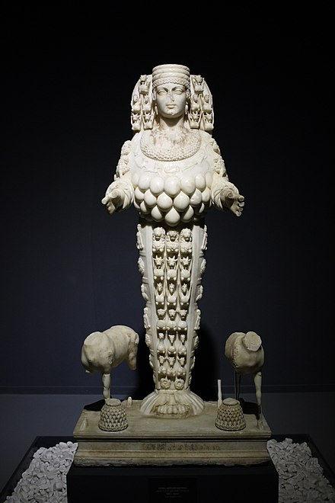
A silversmith named Demetrius, who made silver shrines of Artemis, brought in a lot of business for the craftsmen.
This Photo by Unknown Author is licensed under CC BY-SA

Slide 17
He called them together, along with the workmen in related trades, and said:
You know, my friends, that we receive a good income from this business.

Slide 18
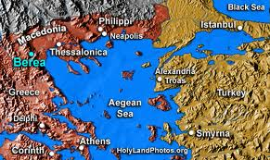
And you see and hear how this fellow Paul has convinced and led astray large numbers of people here in Ephesus and in practically the whole province of Asia.*

Slide 19

He says that gods made by human hands are no gods at all.
There is danger not only that our trade will lose its good name,…

Slide 20
…but also that the temple of the great goddess Artemis will be discredited, and the goddess herself,
who is worshiped throughout the province of Asia and the world, will be robbed of her divine majesty.
This Photo by Unknown Author is licensed under CC BY-SA

Slide 21
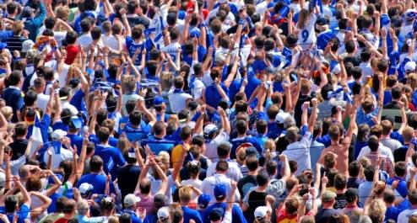
Soon the whole city was in an uproar.
When they heard this, they were furious and began shouting:
Great is Artemis
of the Ephesians!

Slide 22
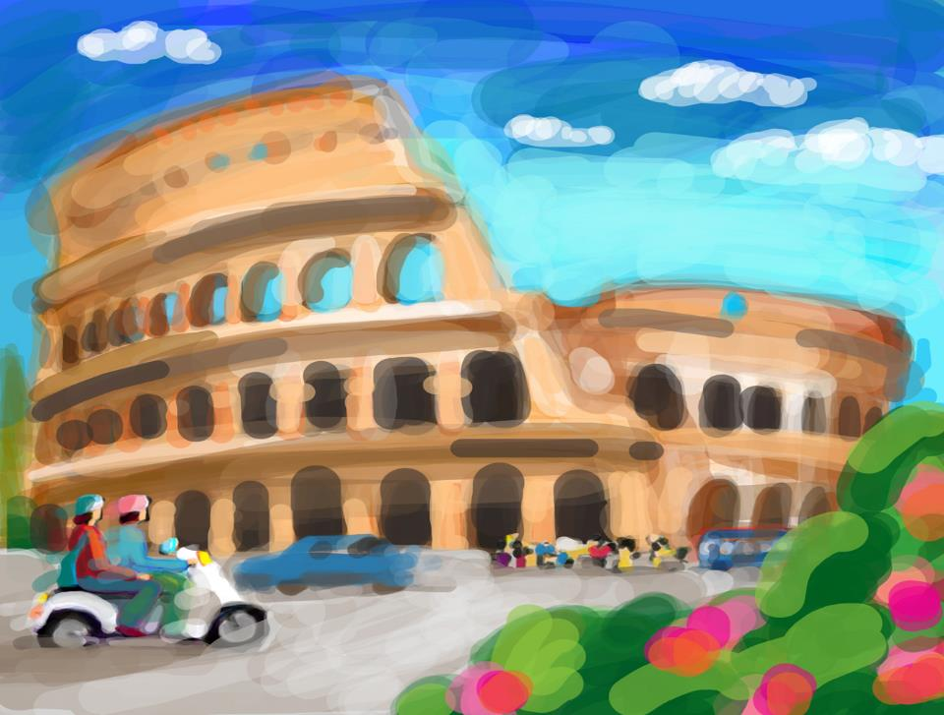

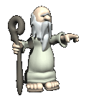
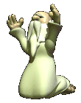
The people seized Gaius and Aristarchus, Paul’s traveling companions from Macedonia, and all of them rushed into the theater together.

Slide 23

Even some of the officials of the province, friends of Paul, sent him a message begging him not to venture into the theater.
Paul wanted to appear before the crowd, but the disciples would not let him

Slide 24
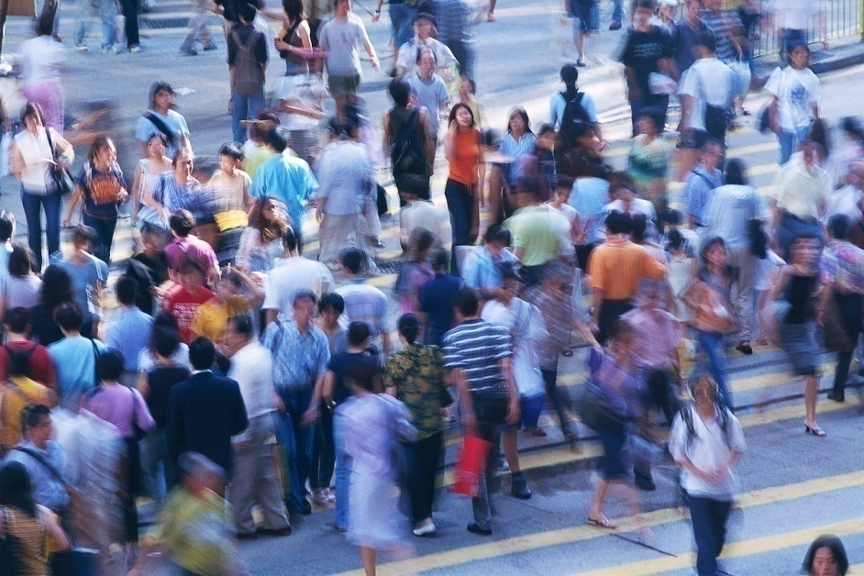
The assembly was in confusion: Some were shouting one thing, some another.
Most of the people did not even know why they were there.

Slide 25

The Jews in the crowd pushed Alexander to the front, and they shouted instructions to him. He motioned for silence in order to make a defense before the people.

Slide 26
But when they realized he was a Jew, they all shouted in unison for about 2 hours:
Great is Artemis
of the Ephesians!

Slide 27
The city clerk quieted the crowd and said:
Fellow Ephesians, doesn’t all the world know that the city of Ephesus is the guardian of the temple of the great Artemis and of her image, which fell from heaven?

Slide 28
Therefore, since these facts are undeniable, you ought to calm down and not do anything rash.

Slide 29
You have brought these men here, though they have neither robbed temples nor blasphemed our goddess.
This Photo by Unknown Author is licensed under CC BY-SA

Slide 30
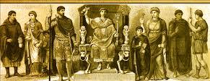
If, then, Demetrius and his fellow craftsmen have a grievance against anybody, the courts are open and there are proconsuls. They can press charges.

Slide 31
If there is anything further you want to bring up, it must be settled in a legal assembly

Slide 32
As it is, we are in danger of being charged with rioting because of what happened today.
In that case we would not be able to account for this commotion, since there is no reason for it.

Slide 33
After he had said this,
he dismissed the assembly.

Slide 34
Eutychus
Raised From the Dead at Troas

Slide 35
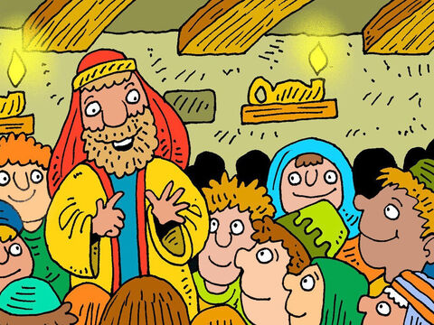


On the first day of the week we came together to break bread. Paul spoke to the people and, because he intended to leave the next day, kept on talking until midnight.
There were many lamps in the upstairs room where we were meeting.

Slide 36
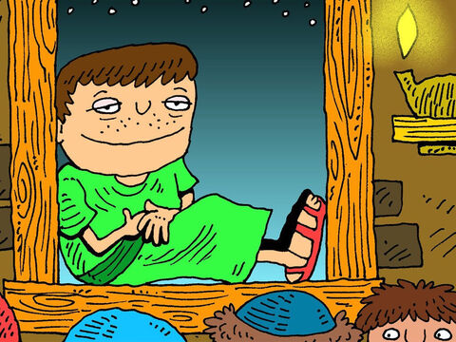

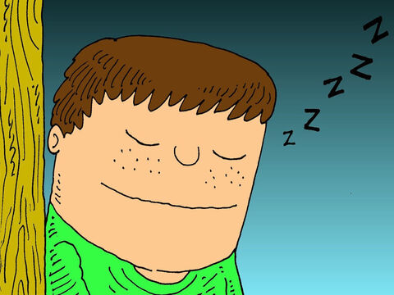
Seated in a window was a young man named Eutychus, who was sinking into a deep sleep as Paul talked on and on.

Slide 37
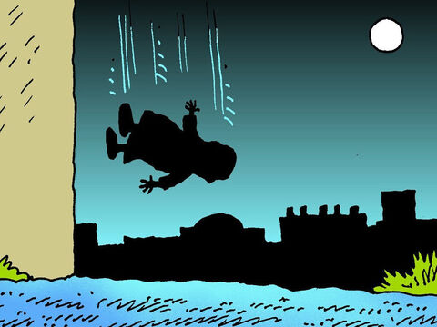
When he was sound asleep, he fell to the ground from the third story and was picked up dead.

Slide 38
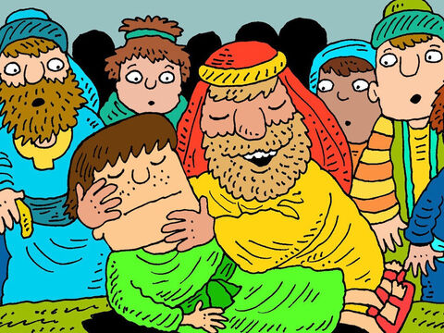
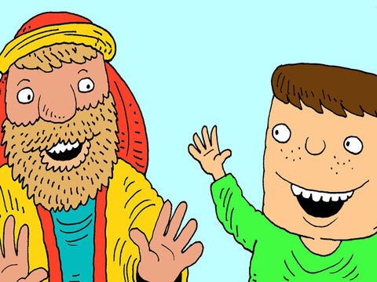
Paul went down, threw himself on the young man and put his arms around him.
Don’t be alarmed,
he said.
he said.
He’s alive!

Slide 39

Then he went upstairs again and broke bread and ate.
After talking until daylight, he left.
The people took the young man home alive and were greatly comforted.

