Slide 1

Lesson 13 Acts 18:1-11, 18-28 Teaching and Preaching

Slide 2
Memory Verse Romans 8:31 "What then shall we say in response to these things? If God is for us, who can be against us?"

Slide 3
The Truth God encourages us to share His Word even if others reject us!

Slide 4
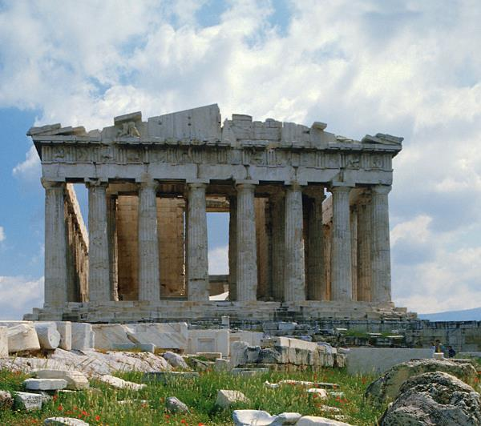
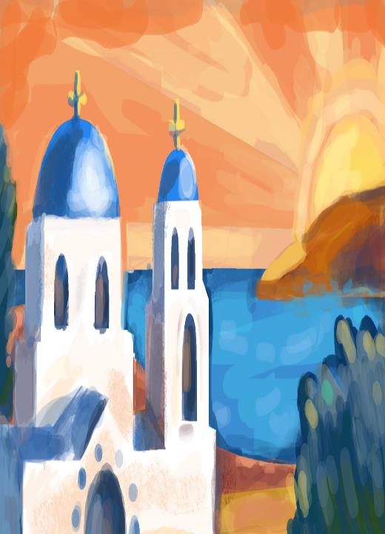
After this, Paul left Athens
and went to Corinth.

Slide 5
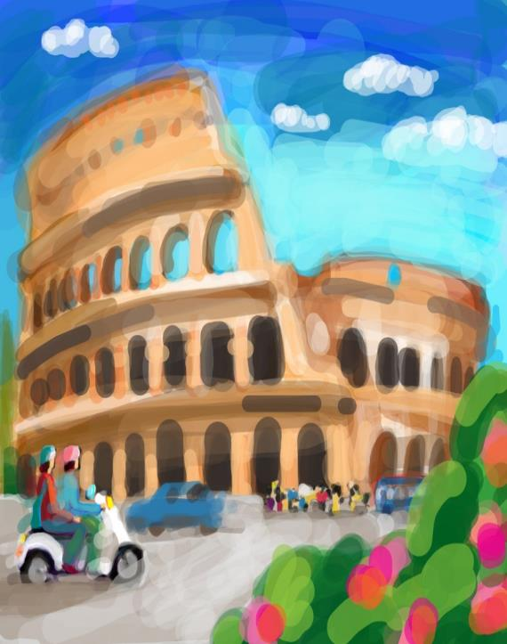
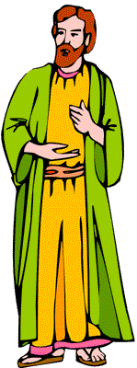
There he met a Jew named Aquila, a native of Pontus, who had recently come from Italy with his wife Priscilla, because Claudius had ordered all Jews to
LEAVE ROME

Slide 6
Paul went to see them,
and because he was a tentmaker as they were,
he stayed and worked with them.

Slide 7
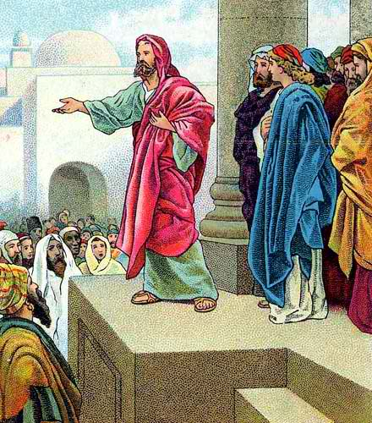
Every Sabbath he reasoned in the synagogue, trying to persuade Jews and Greeks.

Slide 8
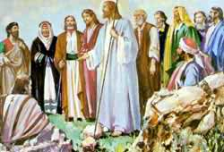
When Silas and Timothy came from Macedonia, Paul devoted himself exclusively to preaching, testifying to the Jews that Jesus was the Messiah.

Slide 9
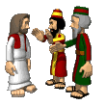
But when they opposed Paul and became abusive
he shook out his clothes in protest and said to them,
Your blood be on your own heads!
I am innocent of it.
From now on I will go to the Gentiles.

Slide 10
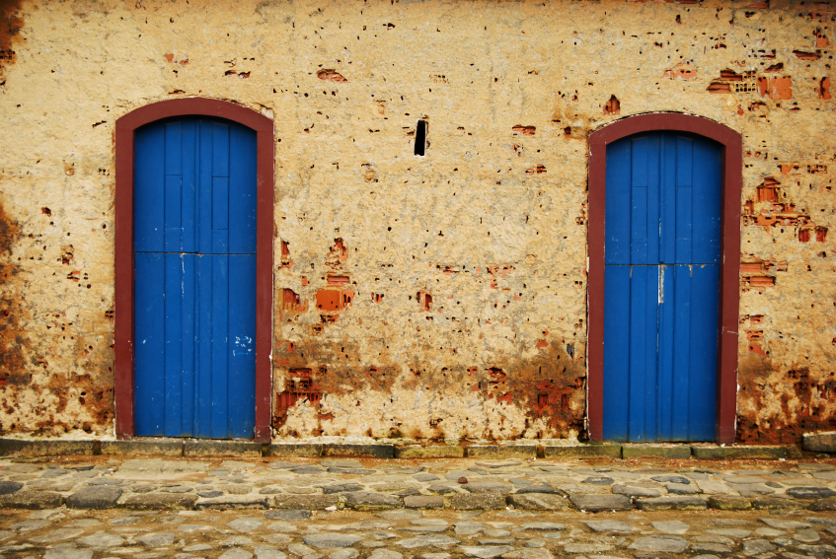
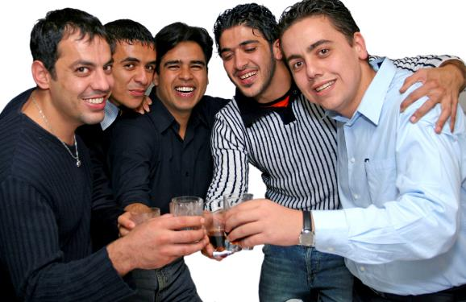
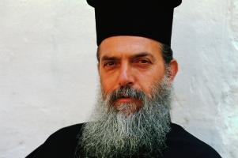

Then Paul left the synagogue and went next door to the house of Titius Justus, a worshiper of God.
Crispus, the synagogue ruler, and his entire household believed in the Lord;

Slide 11

and many of the Corinthians who heard Paul believed and were baptized.

Slide 12

One night the Lord spoke to Paul in a vision:
Do not be afraid;
keep on speaking,
do not be silent.
For I am with you,
and no one is going to attack and harm you, because I have many people in this city.

Slide 13

So Paul stayed in Corinth for a year and a half, teaching them the word of God.

Slide 14
Paul stayed on in Corinth for some time. Then he left the brothers and sisters and sailed for Syria, accompanied by Priscilla and Aquila.

Slide 15
Before he sailed, he had his hair cut off at Cenchrea because of a vow he had taken.

Slide 16
They arrived at Ephesus, where Paul left Priscilla and Aquila.

Slide 17
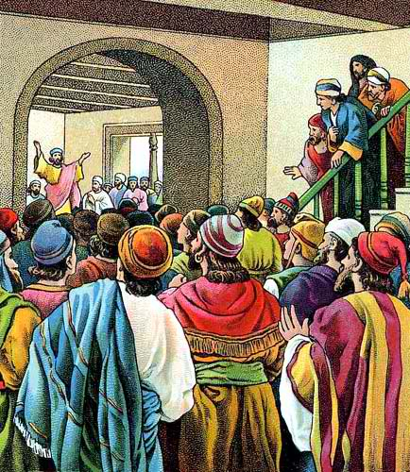
He himself went into the synagogue and reasoned with the Jews. When they asked him to spend more time with them, he declined.
But as he left, he promised,
“I will come back if it is God’s will.”
Then he set sail from Ephesus.

Slide 18
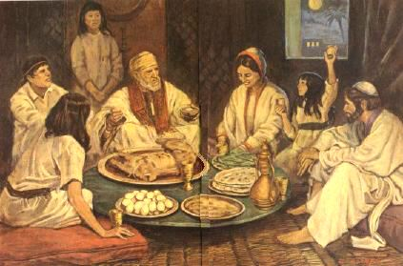
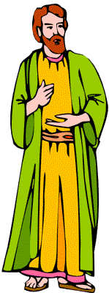
When he landed at Caesarea, he went up to Jerusalem and greeted the church
and then went down to Antioch.

Slide 19
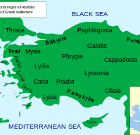

After spending some time in Antioch, Paul set out from there and traveled from place to place throughout the region of Galatia and Phrygia, strengthening all the disciples.

Slide 20
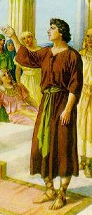
Meanwhile a Jew named Apollos, a native of Alexandria, came to Ephesus. He was a learned man, with a thorough knowledge of the Scriptures.

Slide 21

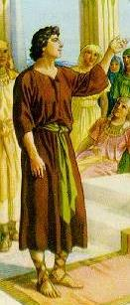
He had been instructed in the way of the Lord, and he spoke with great fervor and taught about Jesus accurately, though he knew only the baptism of John.

Slide 22
He began to speak boldly in the synagogue.
When Priscilla and Aquila heard him, they invited him to their home and explained to him the way of God more adequately.

Slide 23
When Apollos wanted to go to Achaia, the brothers and sisters encouraged him and wrote to the disciples there to welcome him.
ACHAIA

Slide 24
When he arrived, he was a great help to those who by grace had believed.

Slide 25
For he vigorously refuted the Jewish opponents in public debate, proving from the Scriptures that Jesus was the Messiah.

