Slide 1
ACTS Dig Site 10
Acts 14:26-28; 15:1-12, 22-41

Slide 2
The Jerusalem Council

Slide 3
Memory
Verse
Ephesians 4:2-3
Be completely humble and gentle;
be patient,
bearing with one another in love.
Make every effort to keep the unity of the spirit
through the bond of peace.
DS #10

Slide 4
The Truth
God wants His people to respect each other even when they disagree!
DS #10

Slide 5
Return to Antioch
Acts 14:26-28

Slide 6
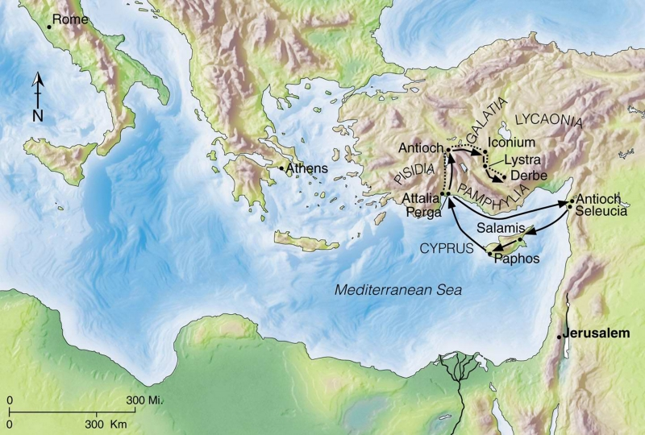
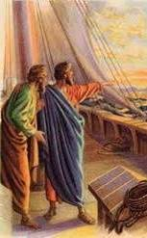
From Attalia* they (Paul & Barnabas) sailed back to Antioch*, where they had been committed to the grace of God for the work they had now completed.

Slide 7
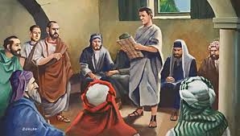
On arriving there, they gathered the church together and reported all that God had done through them and how he had opened a door of faith to the Gentiles. And they stayed there a long time with the disciples.

Slide 8
The Council at Jerusalem
Acts 15:1-12

Slide 9
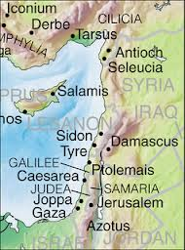
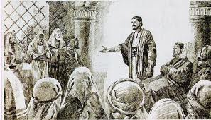
Some men came down from Judea* to Antioch* and were teaching the believers: "Unless you are circumcised, according to the custom taught by Moses, you cannot be saved."

Slide 10
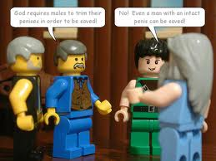
We are required to follow the law of Moses.
God looks at your heart, not what’s on the outside.
This brought Paul and Barnabas into sharp dispute and debate with them.

Slide 11
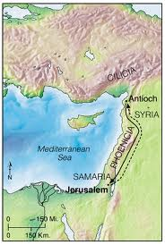
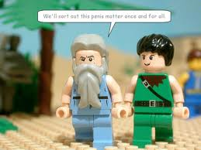
So Paul and Barnabas were appointed, along with some other believers, to go up to Jerusalem* to see the apostles and elders about this question.
We'll get this settled once and for all!

Slide 12
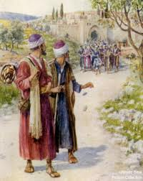
The church sent them on their way, and as they traveled through Phoenicia* and Samaria, they told how the Gentiles had been converted. This news made all the believers very glad.

Slide 13
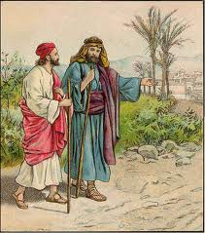

When they came to Jerusalem, they were welcomed by the church and the apostles and elders, to whom they reported everything God had done through them.
Welcome back!

Slide 14
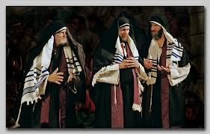
Then some of the believers who belonged to the party of the Pharisees stood up and said,
The Gentiles must be circumcised and required to obey the law of Moses.

Slide 15
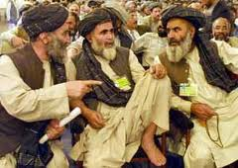
The apostles and elders met to consider this question.

Slide 16
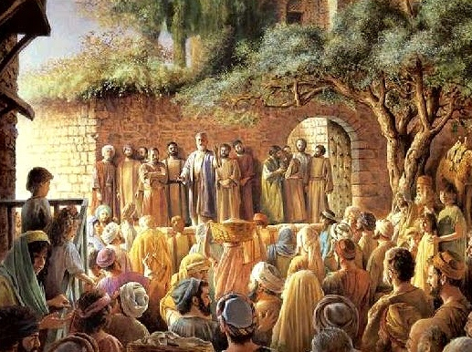
After much discussion, Peter got up and addressed them:
Brothers, you know that some time ago God made a choice among you that the Gentiles might hear from my lips the message of the gospel and believe.

Slide 17

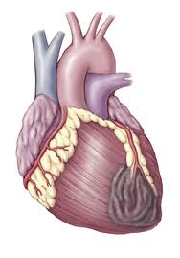
God, who knows the heart, showed that he accepted them by giving the Holy Spirit to them, just as he did to us. He did not discriminate between us and them, for he purified their hearts by faith.

Slide 18
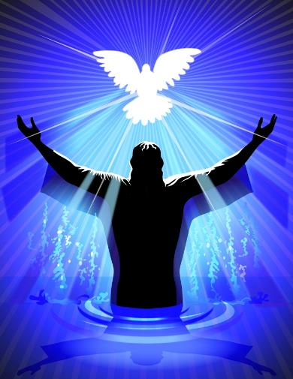
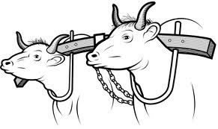
Now then, why do you try to test God by putting on the necks of Gentiles a yoke that neither we nor our ancestors have been able to bear? No! We believe it is through the grace of our Lord Jesus that we are saved, just as they are.

Slide 19
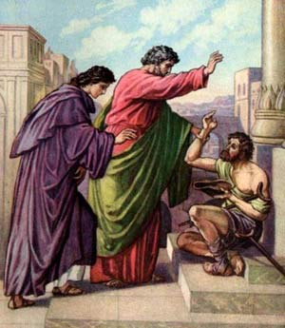
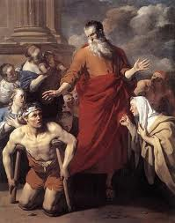
The whole assembly became silent* as they listened to Barnabas and Paul telling about the miraculous signs and wonders God had done among the Gentiles through them.

Slide 20
The Council’s Letter to the Gentile Believers
Acts 15:22-35

Slide 21
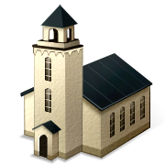
Then the apostles and elders, with the whole church, decided to choose some of their own men and send them to Antioch* with Paul and Barnabas.

Slide 22
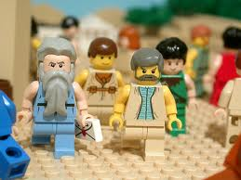
They chose Judas (called Barsabbas) and Silas, men who were leaders among the believers.

Slide 23
With them they sent the following letter:
The apostles and elders, your brothers,
To the Gentile believers in Antioch, Syria and Cilicia:
Greetings.

Slide 24
We have heard that some went out from us without our authorization and disturbed you, troubling your minds by what they said.

Slide 25
So we all agreed to choose some men and send them to you with our dear friends Barnabas and Paul — men who have risked their lives for the name of our Lord Jesus Christ.

Slide 26
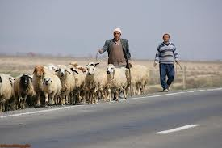
Therefore we are sending Judas and Silas to confirm by word of mouth what we are writing.
The letter is true!

Slide 27
It seemed good to the Holy Spirit and to us not to burden you with anything beyond the following requirements:*
You are to abstain from
1. food sacrificed to idols,
2. from blood,
3. from the meat of strangled animals
4. and from sexual immorality.
You will do well to avoid these things.

Slide 28
So the men were sent off and went down to Antioch, where they gathered the church together and delivered the letter.

Slide 29
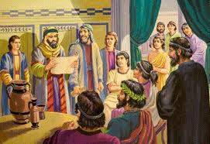
The people read it and were glad for its encouraging message.

Slide 30
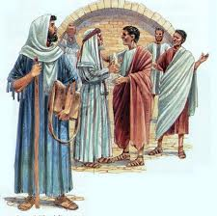
Judas and Silas, who themselves were prophets, said much to encourage and strengthen the believers.

Slide 31
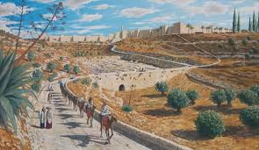
Jerusalem, here we come!
After spending some time there, they were sent off by the believers with the blessing of peace to return to those who had sent them.

Slide 32
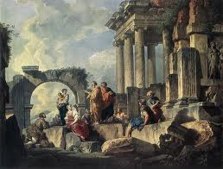
But Paul and Barnabas remained in Antioch, where they and many others taught and preached the word of the Lord.

Slide 33
Disagreement between Paul and Barnabas
Acts 15:36-41

Slide 34
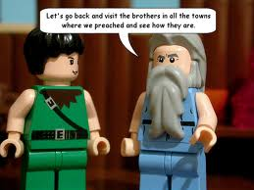
Some time later Paul said to Barnabas,
Let us go back and visit the believers in all the towns where we preached the word of the Lord and see how they are doing.

Slide 35
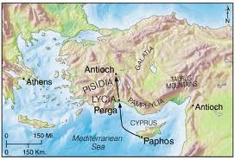

Barnabas wanted to take John, also called Mark, with them, but Paul did not think it wise to take him, because he had deserted them in Pamphylia and had not continued with them in the work.

Slide 36
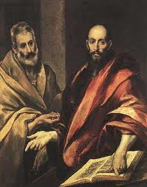

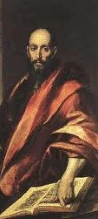
They had such a sharp disagreement that they parted company.

Slide 37
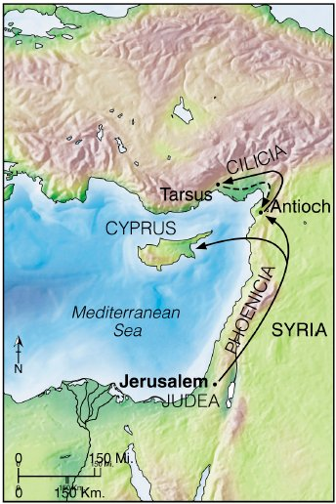
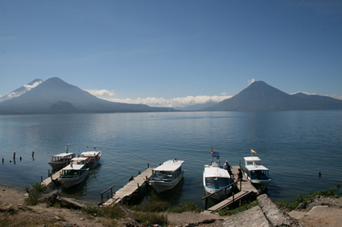
Barnabas took Mark and sailed for Cyprus,*

Slide 38
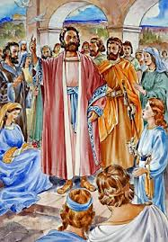
but Paul chose Silas and left, commended by the brothers to the grace of the Lord. He went through Syria* and Cilicia,* strengthening the churches.

