Slide 1
ACTS
Dig Site 9
Peter's Prison Break
Acts 12:1-19, 13:1-12

Slide 2
Peter’s Prison Break

Slide 3
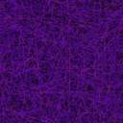
James 5:16b
The prayer of a righteous person is powerful and effective.
Memory
Verse
DS #9

Slide 4
God answers prayer,
sometimes in miraculous ways!
The Truth
DS #9

Slide 5
The Escape from Prison
Acts 12:1-19

Slide 6
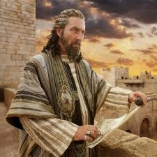
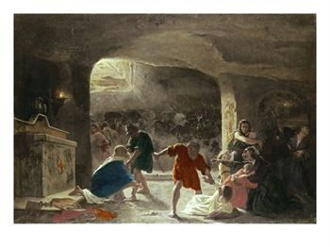
It was about this time that King Herod arrested some who belonged to the church, intending to persecute them.

Slide 7
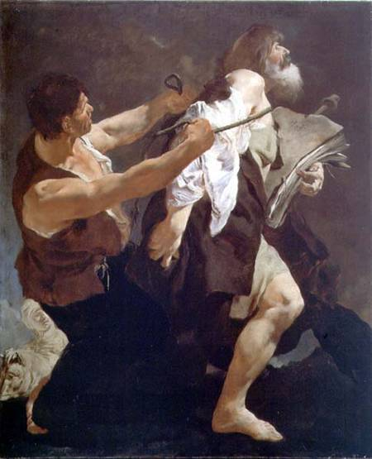
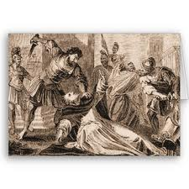
He had James, the brother of John, put to death with the sword. When he saw that this met with approval among the Jews, he proceeded to seize Peter also. This happened during the Festival of Unleavened Bread.

Slide 8
The Feast of Unleavened Bread reminds us of the unleavened bread the Israelites ate when they left Egypt. Jews get rid of "chametz“--any food or drink that contains even a trace of wheat, barley, rye, or oats and wasn't guarded from leavening or fermentation. This includes bread, cake, cookies, cereal, pasta, and most alcoholic beverages.

Slide 9
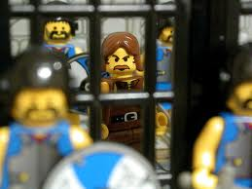
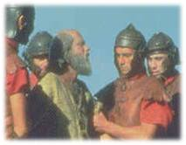
After arresting him, he put him in prison, handing him over to be guarded by four squads of four soldiers each. Herod intended to bring him out for public trial after the Passover.

Slide 10
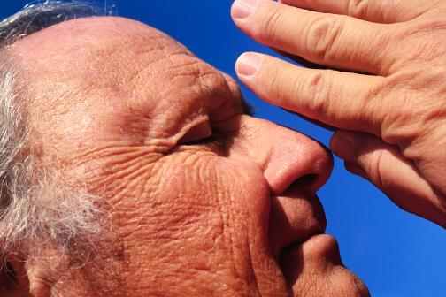
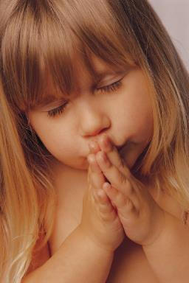
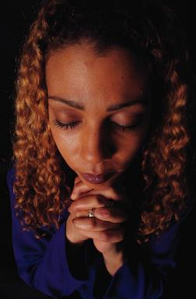
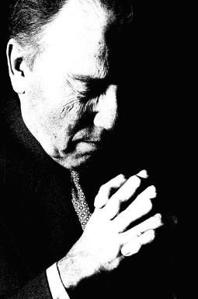
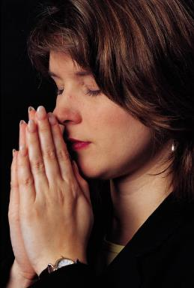
So Peter was kept in prison, but the church was earnestly praying to God for him.

Slide 11
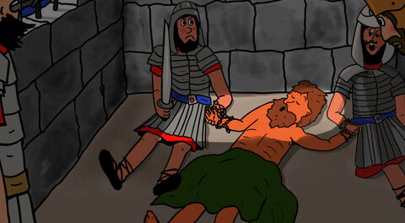
The night before Herod was to bring him to trial, Peter was sleeping between two soldiers, bound with two chains, and sentries stood guard at the entrance.

Slide 12
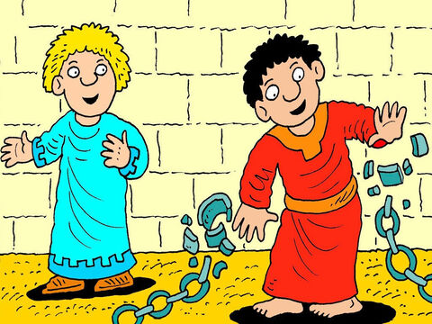
""Quick, get up!"
Suddenly an angel of the Lord appeared and a light shone in the cell. He struck Peter on the side and woke him up. "Quick, get up!" he said, and the chains fell off Peter’s wrists.

Slide 13
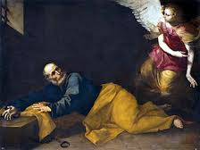
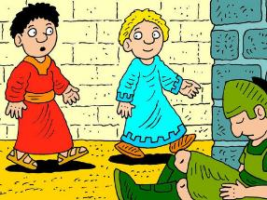
Then the angel said to him,
"Put on your clothes and sandals."
And Peter did so.
"Wrap your cloak around you and follow me."
The angel told him

Slide 14
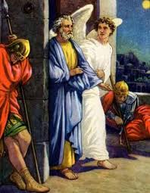
Peter followed him out of the prison, but he had no idea that what the angel was doing was really happening; he thought he was seeing a vision.

Slide 15
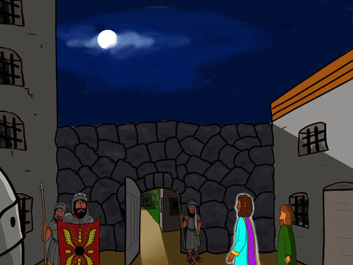
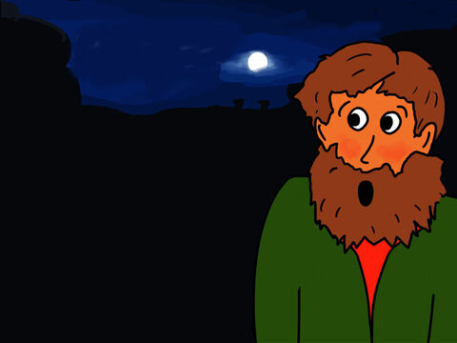
They passed the first and second guards and came to the iron gate leading to the city. It opened for them by itself, and they went through it. When they had walked the length of one street, suddenly the angel left him.

Slide 16
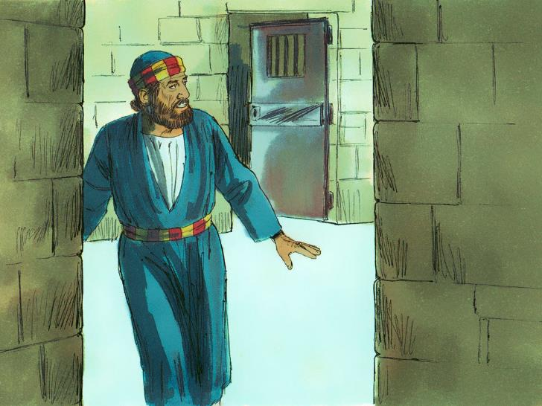
Then Peter came to himself and said,
"Now I know without a doubt that the Lord sent his angel and rescued me from Herod’s clutches and from everything the Jewish people were anticipating."

Slide 17
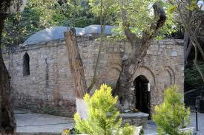
When this had dawned on him, he went to the house of Mary the mother of John, also called Mark, where many people had gathered and were praying.

Slide 18
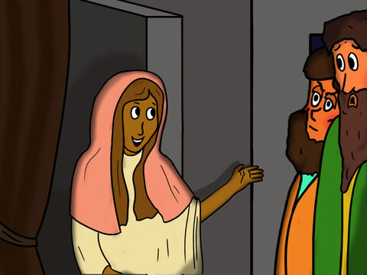
Peter knocked at the outer entrance, and a servant girl named Rhoda came to answer the door. When she recognized Peter’s voice, she was so overjoyed she ran back without opening it and exclaimed,
Peter is at the door!

Slide 19
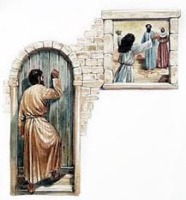
"You're our of your mind," they told her. When she kept insisting that it was so, they said,
"It must be his angel."

Slide 20
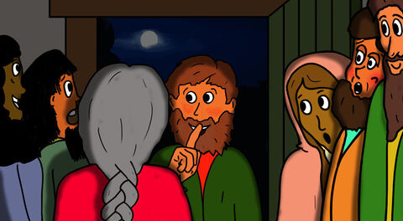
But Peter kept on knocking, and when they opened the door and saw him, they were astonished.

Slide 21
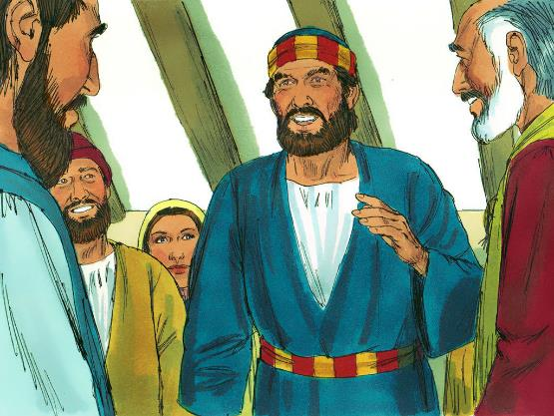
Peter motioned with his hand for them to be quiet and described how the Lord had brought him out of prison.
"Tell James and the other brothers and sisters about this,"
he said, and then he left for another place.

Slide 22
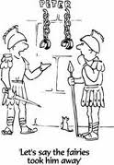

In the morning, there was no small commotion among the soldiers as to what had become of Peter.

Slide 23
After Herod had a thorough search made for him and did not find him, he cross-examined the guards and ordered that they be executed.

Slide 24
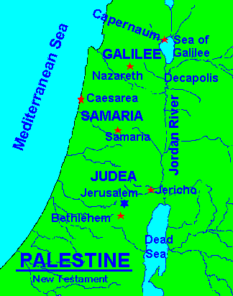
Then Herod went from Judea to Caesarea and stayed there.

Slide 25
Barnabas and Saul Sent Off
Acts 13:1-3

Slide 26
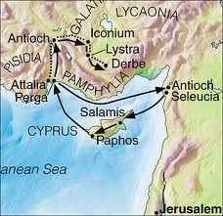
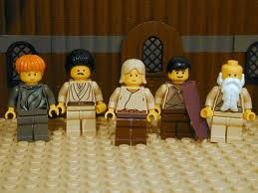
Now in the church at Antioch there were prophets and teachers: Barnabas, Simeon called Niger, Lucius of Cyrene, Manaen (who had been brought up with Herod the tetrarch) and Saul.

Slide 27
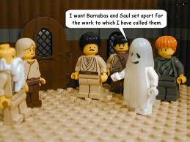
While they were worshiping the Lord and fasting, the Holy Spirit said,
"Set apart for me Barnabas and Saul for the work to which I have called them."
So after they had fasted and prayed, they placed their hands on them and sent them off.

Slide 28
On Cyprus
Acts 13:4-12

Slide 29
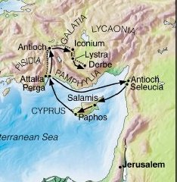
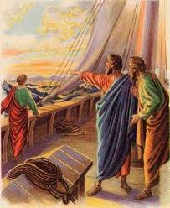
The two of them, sent on their way by the Holy Spirit, went down to Seleucia* and sailed from there to Cyprus.* When they arrived at Salamis,* they proclaimed the word of God in the Jewish synagogues. John was with them as their helper.

Slide 30
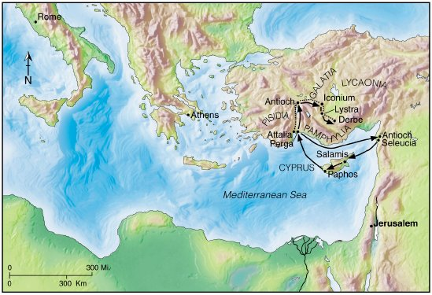
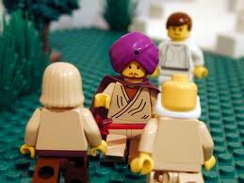
They traveled through the whole island until they came to Paphos.* There they met a Jewish sorcerer and false prophet named Bar-Jesus,* who was an attendant of the proconsul, Sergius Paulus.

Slide 31
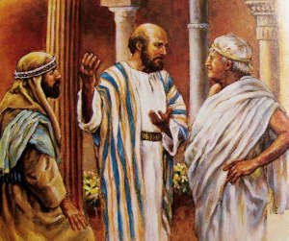
The proconsul, an intelligent man, sent for Barnabas and Saul because he wanted to hear the word of God.

Slide 32
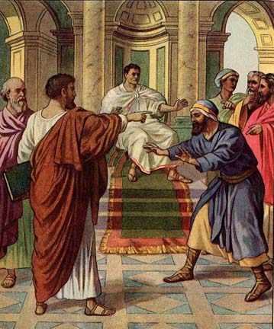
But Elymas the sorcerer (for that is what his name means) opposed them and tried to turn the proconsul from the faith.

Slide 33
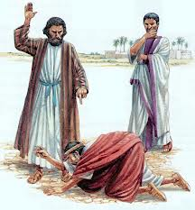
You are a child of the devil and an enemy of everything that is right! You are full of all kinds of deceit and trickery.
Will you never stop perverting the right ways of the Lord?
Then Saul, who was also called Paul, filled with the Holy Spirit, looked straight at Elymas and said,

Slide 34


Now the hand of the Lord is against you. You are going to be blind for a time, not even able to see the light of the sun.

Slide 35
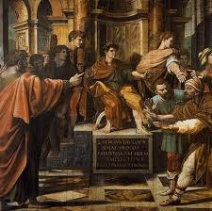
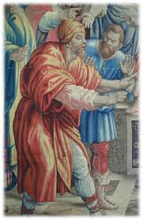
Immediately mist and darkness came over him, and he groped about, seeking someone to lead him by the hand.

Slide 36
I believe!
When the proconsul saw what had happened, he believed, for he was amazed at the teaching about the Lord.

