Slide 1
Dig Site 8 "God Doesn't Play Favorites" Acts 10:24-28, 34-48; 11:19-26

Slide 2
The Truth God's Salvation is available to everyone!

Slide 3
Acts 10:34-35 "Then Peter began to speak: 'I now realize how true it is that God does not show favoritism but accepts from every nation the one who fears him and does what is right.'"

Slide 4

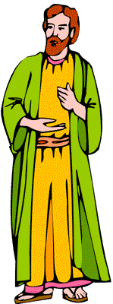
The following day he arrived in Caesarea.
Peter

Slide 5
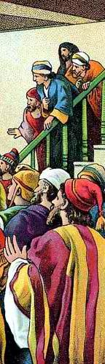

Cornelius was expecting them
and had called together
his relatives and close friends.

Slide 6
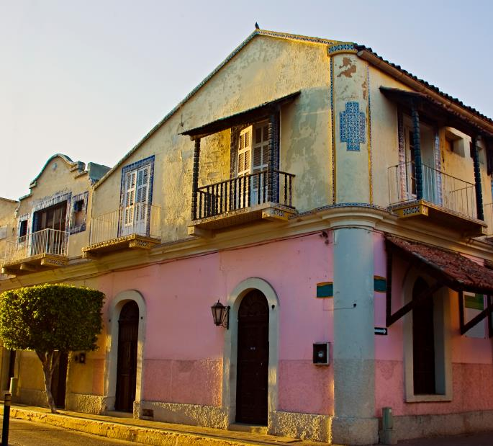
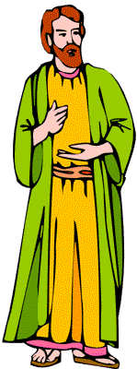
As Peter entered the house, Cornelius met him and fell at his feet in reverence.

Slide 7
But Peter made him get up.
Stand up, [he said] I am only a man myself.

Slide 8

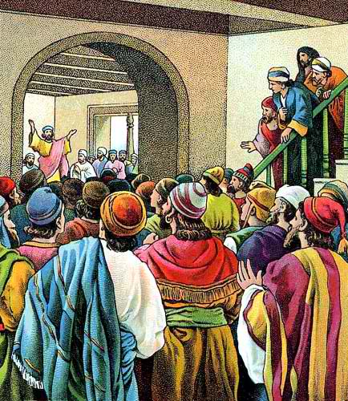
While talking with him, Peter went inside and found a large gathering of people.

Slide 9

Then Peter began to speak:
"I now realize how true it is that God does not show favoritism but accepts from every nation the one who fears him and does what is right."

Slide 10
You know the message God sent to the people of Israel, telling the good news of peace through Jesus Christ, who is Lord of all.

Slide 11
You know what has happened throughout Judea, beginning in Galilee after the baptism that John preached—

Slide 12
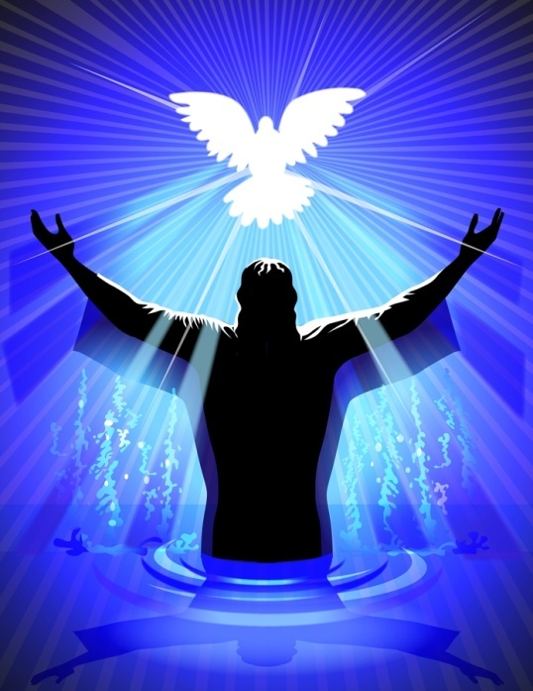
…how God anointed Jesus of Nazareth with the Holy Spirit and power, …

Slide 13

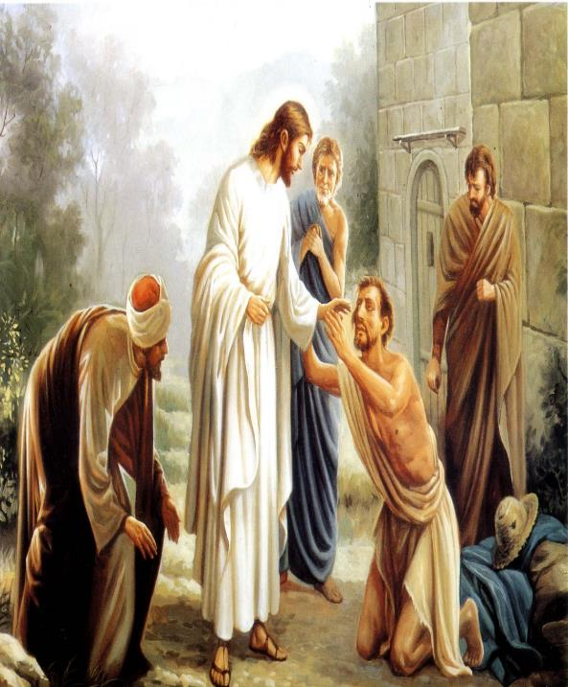
…and how he went around doing good and healing all who were under the power of the devil, because God was with him.

Slide 14
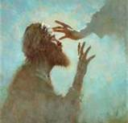
We are witnesses of everything he did in the country of the Jews and in Jerusalem.

Slide 15
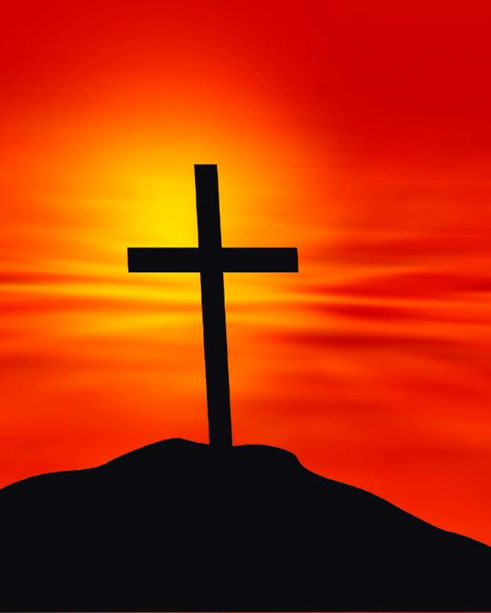
They killed him by hanging him on a tree,

Slide 16
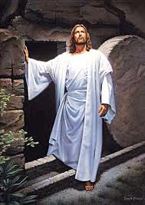
but God raised him from the dead on the third day and caused him to be seen.

Slide 17
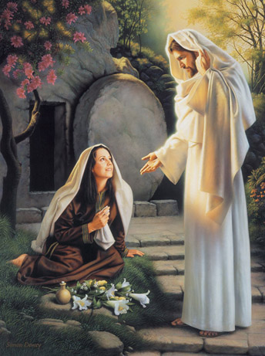
He was not seen by all the people, but by witnesses whom God had already chosen-

Slide 18
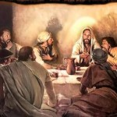
…by us who ate and drank with him after he rose from the dead.

Slide 19
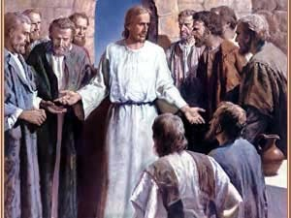

He commanded us to preach to the people and to testify that he is the one whom God appointed as judge of the living and the dead.

Slide 20
All the prophets testify about him that
everyone who believes in him receives forgiveness of sins through his name.

Slide 21
While Peter was still speaking these words, the Holy Spirit came on all who heard the message.

Slide 22
The circumcised believers who had come with Peter were astonished that the gift of the Holy Spirit had been poured out even on the Gentiles.

Slide 23


For they heard them speaking in tongues and praising God.

Slide 24

Then Peter said,
"Surely no one can stand in the way of their being baptized with water."

Slide 25
"They have received the
Holy Spirit just as we have."

Slide 26
So he ordered that they be baptized in the name of Jesus Christ.
Be
Baptized
Be Baptized
Be
Baptized
Be Baptized

Slide 27
Then they asked Peter to stay with them for a few days.

Slide 28
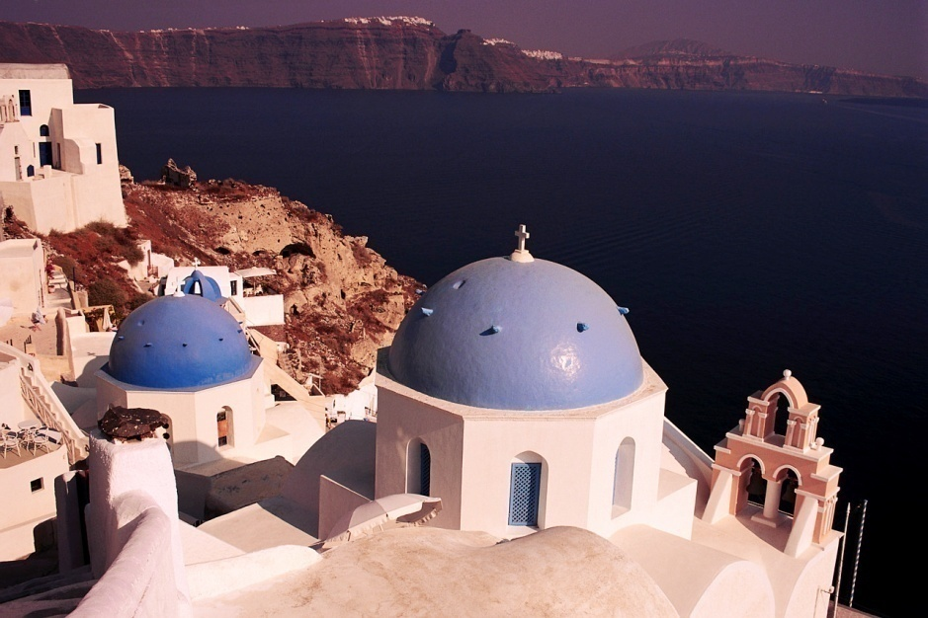
Acts 11:19-26 The Church in Antioch

Slide 29
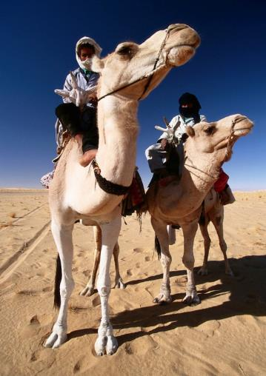
Now those who had been scattered by the persecution that broke out when Stephen was killed traveled as far as Phoenicia, Cyprus and Antioch, spreading the word only among Jews.

Slide 30
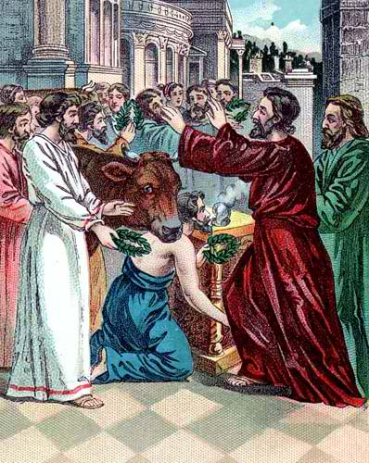
Some of them, however, men from Cyprus and Cyrene, went to Antioch and began to speak to Greeks also, telling them the good news about the Lord Jesus.

Slide 31
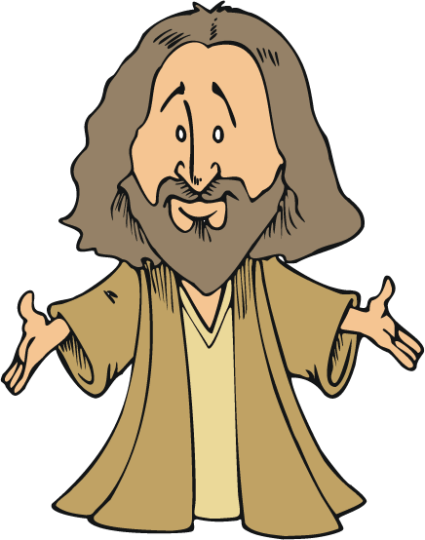
The Lord’s hand was with them, and a great number of people believed and turned to the Lord.

Slide 32
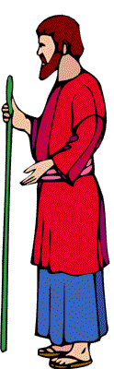

News of this reached the ears of the church at Jerusalem, and they sent Barnabas to Antioch.

Slide 33

When he arrived and saw the evidence of the grace of God, he was glad
and encouraged them all to remain true to the Lord with all their hearts.

Slide 34
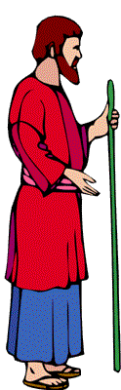
He was a good man, full of the Holy Spirit and faith,
and a great number of people were brought to the Lord.

Slide 35

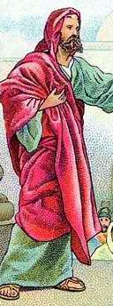
Then Barnabas went to Tarsus to look for Saul, and when he found him, he brought him to Antioch.
SAUL
BARNABAS

Slide 36
So for a whole year Barnabas and Saul met with the church and taught great numbers of people.
SAUL
BARNABAS

Slide 37

The disciples were called Christians first at Antioch.

Slide 38
Acts 10:34-35 Then Peter began to speak: “I now realize how true it is that God does not show favoritism but accepts from every nation the one who fears him and does what is right.” Acts 10:34-35

