Slide 1
Dig Site 6
Saul Transformed
Acts 9:1-31

Slide 2
2 Corinthians 5:17
"Therefore, if anyone is in Christ, the new creation has come: The old is gone, the new is here!"

Slide 3
The Truth
God transforms who we are and how we live!

Slide 4
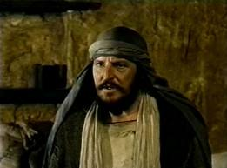
Meanwhile, Saul was still breathing out murderous threats against
the Lord’s disciples.

Slide 5
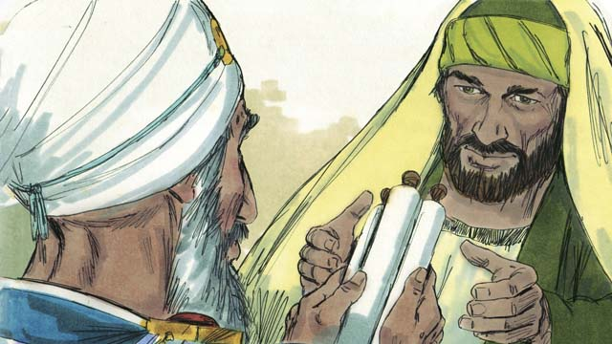
He went to the high priest and asked him for letters to the synagogues in Damascus, so that if he found any there who belonged to the Way, whether men or women, he might take them as prisoners to Jerusalem.

Slide 6
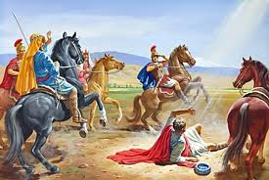
As he neared Damascus on his journey, suddenly a light from heaven flashed around him.

Slide 7
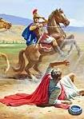
He fell to the ground and heard a voice say to him,
"Saul, Saul, why do you persecute me?"
"Who are you, Lord?" Saul asked.
"I am Jesus, whom you are persecuting," he replied. "Now get up and go into the city, and you will be told what you must do."

Slide 8
The men traveling with Saul stood there speechless; they heard the sound but did not see anyone.

Slide 9
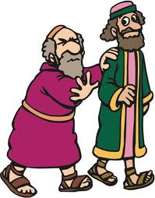
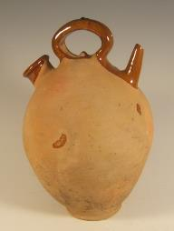
Saul got up from the ground, but when he opened his eyes he could see nothing.
So they led him by the hand into Damascus. For 3 days he was blind, and did not eat or drink anything.

Slide 10

In Damascus there was a disciple named Ananias. The Lord called to him in a vision,
Ananias!
Yes, Lord,
he answered.

Slide 11
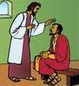
The Lord told him,
“Go to the house of Judas on Straight Street and ask for a man from Tarsus named Saul, for he is praying.
In a vision he has seen a man named Ananias come and place his hands on him to restore his sight.”

Slide 12
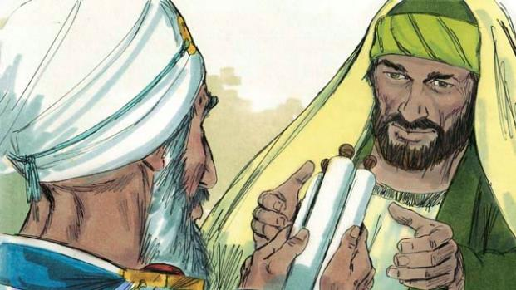
“Lord,” Ananias answered, “I have heard many reports about this man and all the harm he has done to your people in Jerusalem.
And he has come here with authority from the chief priests to arrest all who call on your name.”

Slide 13
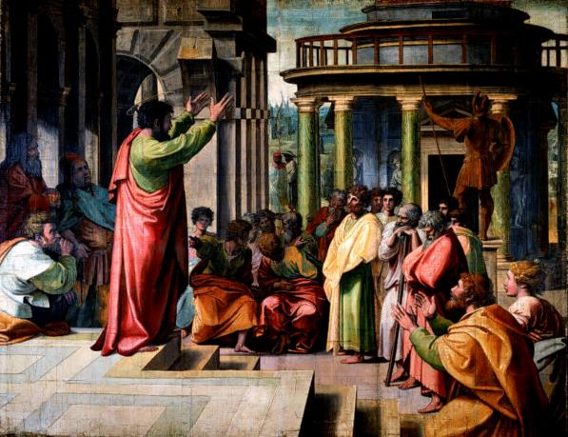
But the Lord said to Ananias,
“Go! This man is my chosen instrument to proclaim my name to the Gentiles and their kings and to the people of Israel.
I will show him how much he must suffer for my name.”

Slide 14
Then Ananias went to the house entered it. Placing his hands on Saul, he said,
"Brother Saul,
the Lord—Jesus,
who appeared to you
on the road as you
were coming here—
has sent me so that
you may see again
and be filled
with the Holy Spirit."

Slide 15
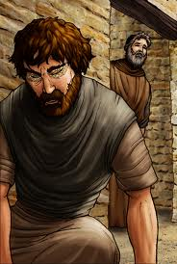
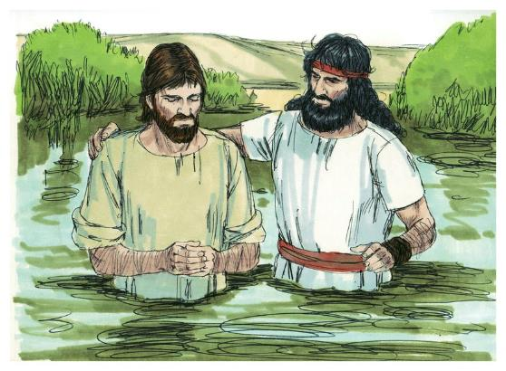
Immediately, something like scales fell from Saul’s eyes, and he could see again.
He got up and was baptized, and after taking some food, he regained his strength.

Slide 16
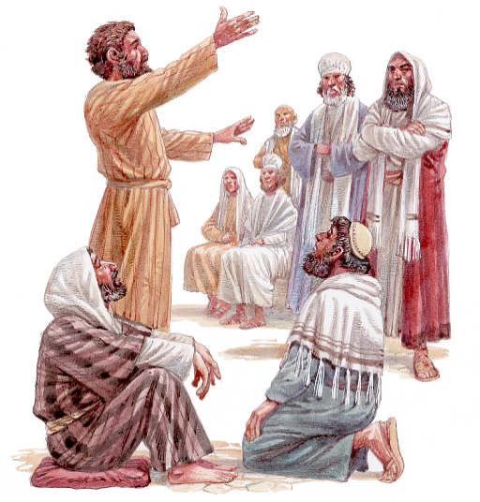
Saul spent several days with the disciples in Damascus.
At once he began to preach in the synagogues that Jesus is the Son of God.

Slide 17
All those who heard him were astonished and asked,
"Isn’t he the man who raised havoc in Jerusalem among those who call on this name?
And hasn’t he come here to take them as prisoners to the chief priests?"

Slide 18
Yet Saul grew more and more powerful and baffled the Jews living in Damascus by proving that Jesus is the Messiah.
?

Slide 19
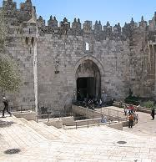
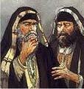

After many days had gone by, there was a conspiracy among the Jews to kill him, but Saul learned of their plan. Day and night they kept close watch on the city gates in order to kill him.

Slide 20
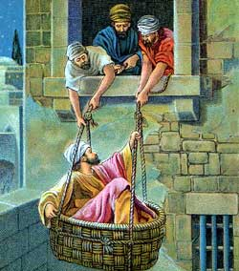
But his followers
took him by night and lowered him
in a basket through an opening
in the wall.

Slide 21
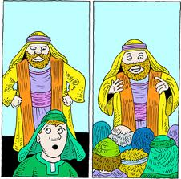
When he came to Jerusalem,
he tried to join the disciples,
but they were all afraid of him,
not believing that he really was a disciple.

Slide 22
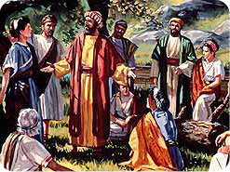
But Barnabas took him and brought him to the apostles.
He told them how Saul on his journey had seen the Lord and that the Lord had spoken to him, and how in Damascus he had preached fearlessly in the name of Jesus.

Slide 23
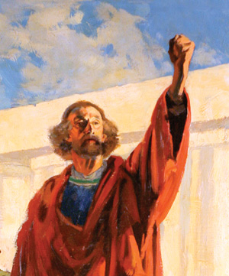
So Saul stayed with them and moved about freely in Jerusalem, speaking boldly in the name of the Lord.
He talked and debated with the Hellenistic Jews,
but they tried
to kill him.

Slide 24
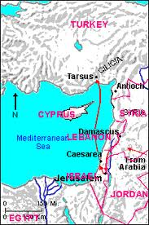
When the believers learned
of this,
they took him down to Caesarea and sent him off
to Tarsus.

Slide 25
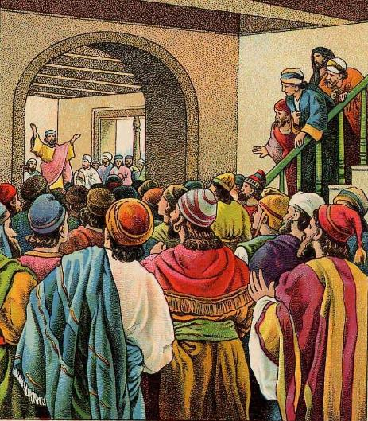
Then the church throughout Judea, Galilee and Samaria enjoyed a time of peace and was strengthened.
Living in the fear
of the Lord and encouraged by
the Holy Spirit,
it increased
in numbers.

