Slide 1
Dig Site 5 Time to Win the World for Jesus
Acts 8:4-40

Slide 2
The Truth
God helps us know Him and understand His Word!

Slide 3

Psalm 119:130
"The unfolding of your words gives light; it gives understanding to the simple."

Slide 4
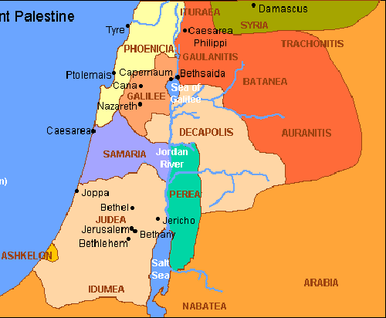



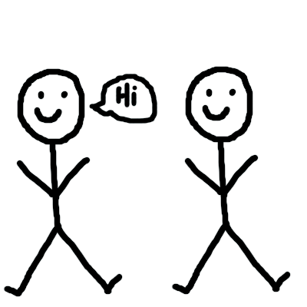

Those who had been scattered preached the word wherever they went.
Philip went down to a city in Samaria
and proclaimed the Messiah there.

Slide 5
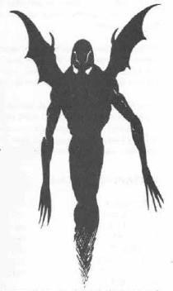

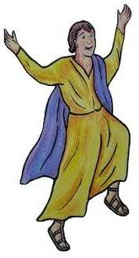
When the crowds heard Philip and saw the signs he performed, they all paid close attention to what he said.
For with shrieks, impure spirits came out of many, and many who were paralyzed or lame were healed.
So there was great joy in that city.

Slide 6
Now for some time a man named Simon had practiced sorcery in the city and amazed all the people of Samaria.
He boasted that he was someone great.

Slide 7

And all the people, both high and low,
gave him their attention and exclaimed.
This man is rightly called the Great Power of God.
They followed him because he had amazed them for a long time with his sorcery.

Slide 8
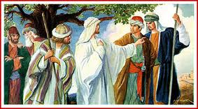
But when they believed Philip
as he proclaimed the good news of the kingdom of God and the name of Jesus Christ,
they were baptized, both men and women.

Slide 9
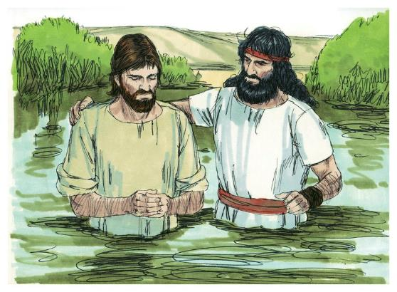
Simon himself believed and was baptized.
And he followed Philip everywhere,
astonished by the great signs and miracles he saw.

Slide 10
When the apostles in Jerusalem heard that Samaria had accepted the word of God,
they sent Peter and John to Samaria.

Slide 11
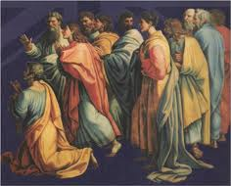
When they arrived, they prayed for them
that they might receive the Holy Spirit,
because the Holy Spirit
had not yet come on any of them;
they had simply been baptized in the name of the Lord Jesus.

Slide 12
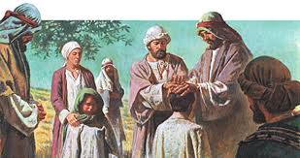
Then Peter and John placed
their hands on them,
and they received the Holy Spirit.

Slide 13
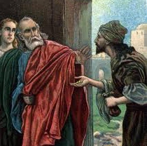
When Simon saw that the Spirit was given at the laying on of the apostles’ hands,
he offered them money and said,
"Give me also this ability so that everyone on whom I lay my hands may receive the Holy Spirit."

Slide 14
Peter answered:
"May your money perish with you, because you thought you could buy the gift of God with money!
You have no part or share in this ministry, because your heart is not right before God.
Repent of this wickedness and pray to the Lord in the hope that he may forgive you for having such a thought in your heart. For I see that you are full of bitterness and captive to sin."

Slide 15
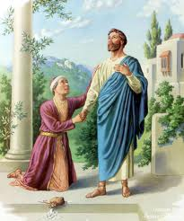
Then Simon answered,
"Pray to the Lord for me so that nothing you have said may happen to me."

Slide 16
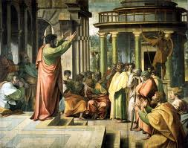
After they had further proclaimed the word of the Lord and testified about Jesus,
Peter and John returned to Jerusalem,
preaching the gospel in many Samaritan villages.

Slide 17
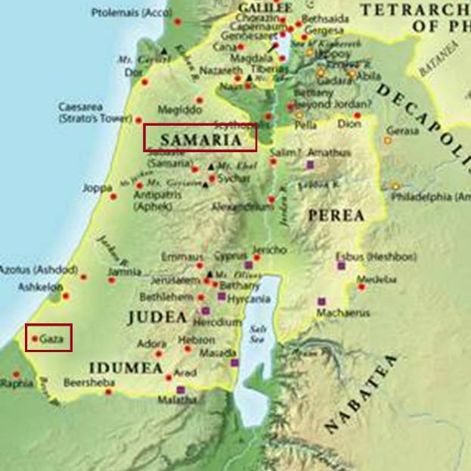
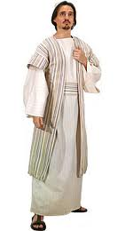
Now an angel of the Lord said to Philip,
"Go south to the road—the desert road—that goes down from Jerusalem to Gaza."

Slide 18
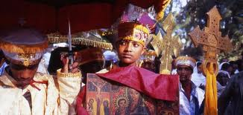
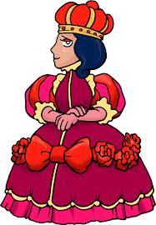
So he started out, and on his way he met an Ethiopian, an important official in charge of all the treasury of Kandake
(which means “queen of the Ethiopians”).

Slide 19
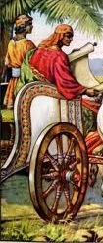
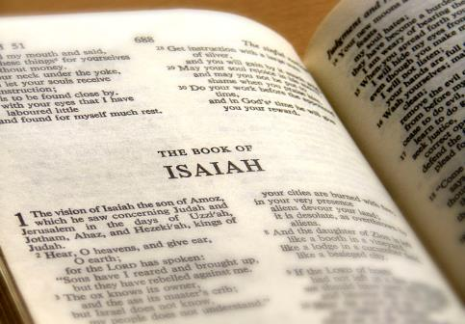
This man had gone to Jerusalem to worship, and on his way home was sitting in his chariot reading the book of Isaiah the prophet.

Slide 20
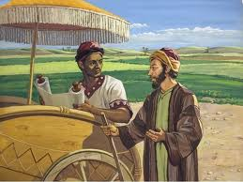
The Spirit told Philip,
“Go to that chariot and stay near it.”
Then Philip ran up to the chariot and heard the man reading Isaiah the prophet.

Slide 21
"Do you understand what you are reading?"
Philip asked.
"How can I," he said, "unless someone explains it to me?"
So he invited Philip to come up and sit with him.

Slide 22
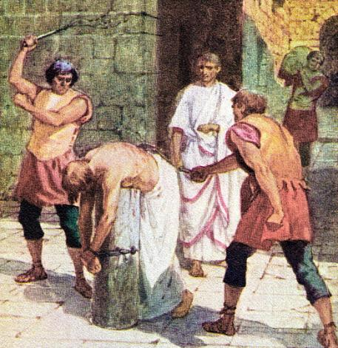
This is the passage of Scripture the eunuch was reading:
‘He was led like a sheep to the slaughter, and as a lamb before its shearer is silent, so he did not open his mouth.
In his humiliation he was deprived of justice.
Who can speak of his descendants?
For his life was taken from the earth.”

Slide 23
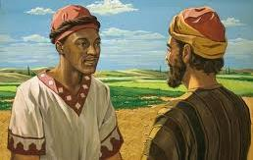
The eunuch asked Philip,
"Tell me, please, who is the prophet talking about, himself or someone else?"
Then Philip began with that very passage of Scripture and told him the good news about Jesus.

Slide 24
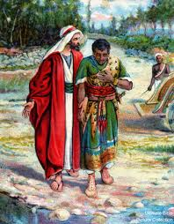
As they traveled along the road, they came to some water and the eunuch said,
"Look, here is water. What can stand in the way of my being baptized?"
And he gave orders to stop the chariot.

Slide 25
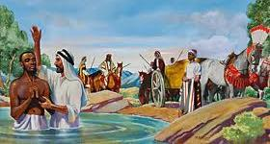
Then both Philip and the eunuch went down into the water and Philip baptized him.

Slide 26
When they came up out of the water, the Spirit of the Lord suddenly took Philip away, and the eunuch did not see him again,
but went on his way rejoicing.

Slide 27
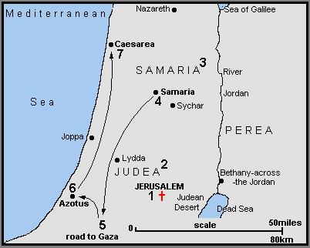
Philip, however, appeared at Azotus* and traveled about, preaching the gospel in all the towns until he reached Caesarea.*

