Slide 1
ACTS
Dig Site 3
Acts 4:23-37 & 5:1-11

Slide 2
One in Heart and Mind

Slide 3
Memory
Verse
Hebrews 13:16
And do not forget to do good and to
share with others, for with such
sacrifices God is pleased.
DS #3

Slide 4
The Truth
God uses His people to meet the needs of others.
DS #3

Slide 5
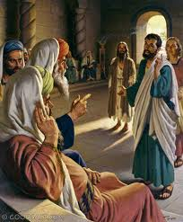
The chief priests and elders told us not to teach or speak at all in the name of Jesus.
Chief priests & elders
On their release, Peter and John went back to their own people and reported all that the chief priests and elders had said to them.

Slide 6
When they heard this, they raised their voices together in prayer to God.

Slide 7
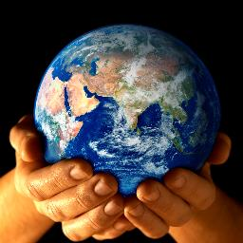


“Sovereign Lord, they said, you made the heavens and the earth and the sea, and everything in them.

Slide 8
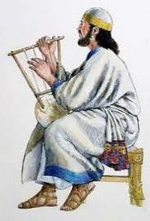
You spoke by the Holy Spirit through the mouth of your servant, our father David:

Slide 9
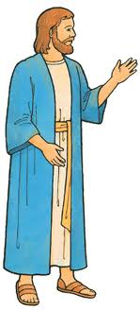
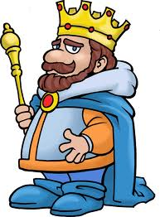
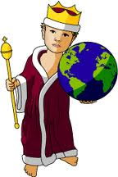
Why do the nations rage and the peoples plot in vain? The kings of the earth rise up and the rulers band together against the Lord and against his anointed one.
We’ve teamed up against you.

Slide 10
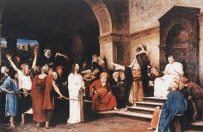
Indeed Herod and Pontius Pilate met together with the Gentiles and the people of Israel in this city to conspire against your holy servant Jesus, whom you anointed. They did what your power and will had decided beforehand should happen.

Slide 11
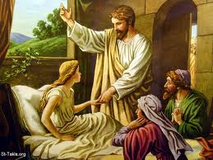
Now, Lord, consider their threats and enable your servants to speak your word with great boldness. Stretch out your hand to heal and perform signs and wonders through the name of your holy servant Jesus.

Slide 12
After they prayed, the place where they were meeting was shaken. And they were all filled with the Holy Spirit and spoke the word of God boldly.

Slide 13

All the believers were one in heart and mind.
We totally agree!

Slide 14
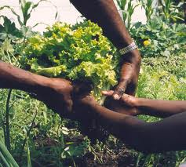
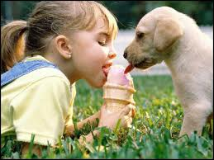
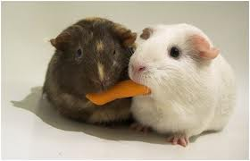
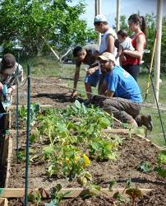
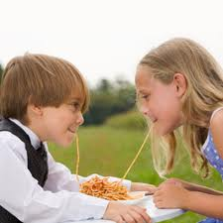
No one claimed that any of his possessions was their own, but they shared everything they had.

Slide 15
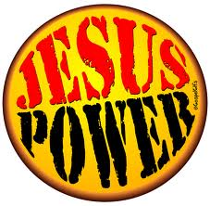
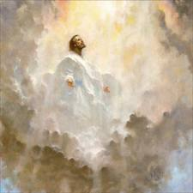
With great power the apostles continued to testify to the resurrection of the Lord Jesus, and God’s grace was so powerfully at work in them all.

Slide 16
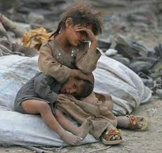
that there were no needy persons among them.
Stewardship – wisely using what God has given us

Slide 17
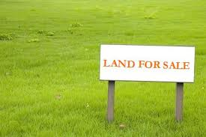
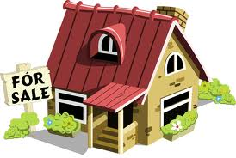
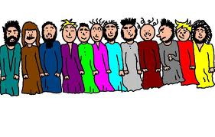
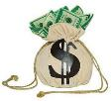
For from time to time those who owned lands or houses sold them, brought the money from the sales and put it at the apostles’ feet, and it was distributed to anyone who
had need.

Slide 18
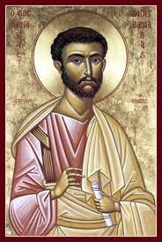
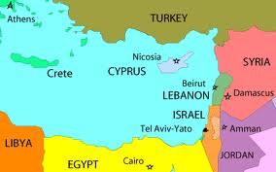
whom the apostles called Barnabas (which means Son of encouragement),
This is where I'm from.
Joseph, a Levite from Cyprus

Slide 19
sold a field he owned and brought the money and put it at the apostles’ feet.

Slide 20
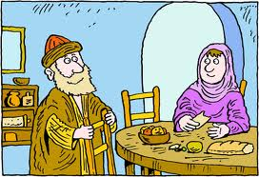
Sold!
Now a man named Ananias, together with his wife Sapphira, also sold a piece of property.

Slide 21

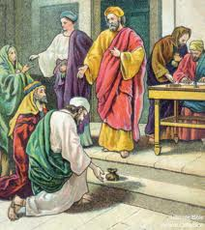
With his wife’s full knowledge he kept back part of the money for himself,
but brought the rest and put it at the apostles’ feet.

Slide 22
Then Peter said, “Ananias, how is it that Satan has so filled your heart that you have lied to the Holy Spirit and have kept for yourself some of the money you received for the land?

Slide 23
Didn’t it belong to you before it was sold?
And after it was sold, wasn’t the money at your disposal?
What made you think of doing such a thing?
You have not lied to human beings but to God.”

Slide 24
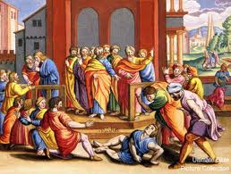
When Ananias heard this, he fell down and died.
And great fear seized all who heard what had happened.

Slide 25
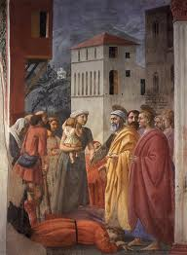
Then some young men came forward, wrapped up his body, and carried him out and buried him.

Slide 26

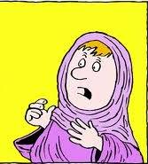
About three hours later his wife came in, not knowing what had happened.

Slide 27
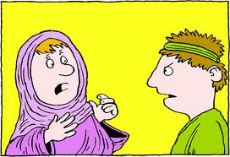
Peter asked her, Tell me, is this the price you and Ananias got for the land?
Yes, she said,
that is the price.
Sapphira
Peter

Slide 28
Peter said to her, How could you agree to test the Spirit of the Lord? Listen! The feet of the men who buried your husband are at the door, and they will carry you out also.
Peter

Slide 29
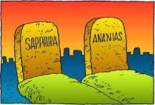
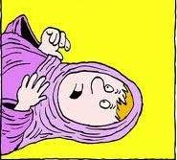
At that moment she fell down at his feet and died. Then the young men came in and, finding her dead, carried her out and buried her beside her husband.

Slide 30
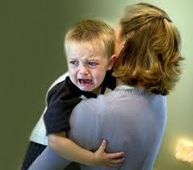
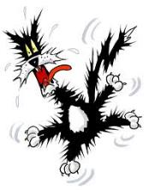

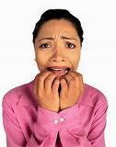
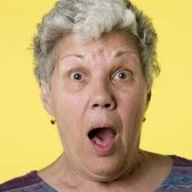
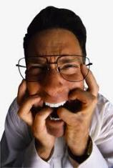
Great fear seized the whole church and all who heard about these events.

