Slide 1
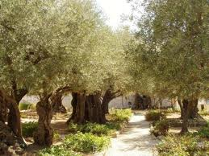
A Night of Struggles
Lesson #16
Matthew 26:31-56

Slide 2
Memory Verse
Going a little farther, he fell with his face to the ground and prayed,
“My Father, if it is possible, may this cup be taken from me.
Yet not as I will, but as you will.”
Matthew 26:39

Slide 3
The Truth
Jesus struggled, but once again chose to follow God’s plan for our salvation!

Slide 4

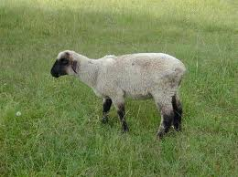
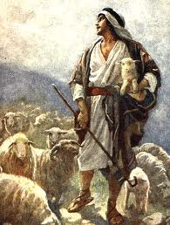
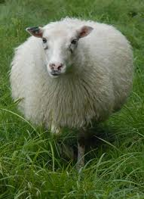
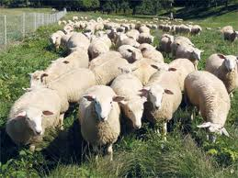
Then Jesus told them, “This very night you will all fall away on account of me, for it is written*: “‘I will strike the shepherd, and the sheep of the flock will be scattered.’

Slide 5
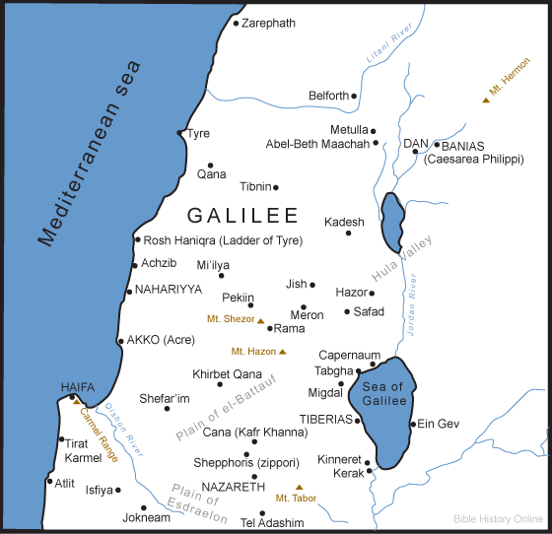
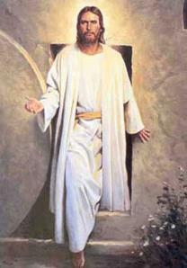
But after I have risen, I will go ahead of you into Galilee.

Slide 6
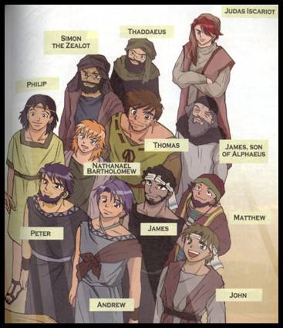

Peter replied, “Even if all fall away on account of you, I never will.”
Notes:
6

Slide 7
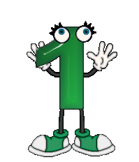

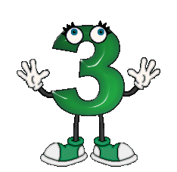
“Truly I tell you,” Jesus answered, “this very night, before the rooster crows, you will disown me three times.”
Cock-a-doodle-doo!
Notes:
7

Slide 8
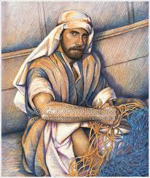
But Peter declared, “Even if I have to die with you, I will never disown you.” And all the other disciples said the same.
Notes:
8

Slide 9
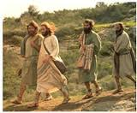
Then Jesus went with his disciples to a place called Gethsemane, and he said to them, “Sit here while I go over there and pray.”

Slide 10
He took Peter and the 2 sons of Zebedee along with him, and he began to be sorrowful and troubled.

Slide 11

Then he said to them, “My soul is overwhelmed with sorrow to the point of death. Stay here and keep watch with me.”

Slide 12

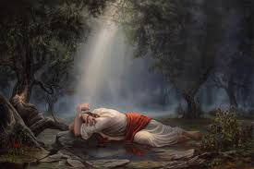
Going a little farther, he fell with his face to the ground and prayed, “My Father, if it is possible, may this cup be taken from me.
Yet not as I will,
but as you will.”

Slide 13
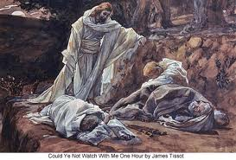
Then he returned to his disciples and found them sleeping.
Couldn’t you men keep watch with me for one hour?
he asked
Peter.

Slide 14

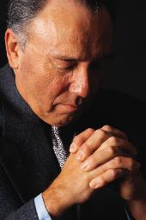
“Watch and pray so that you will not fall into temptation. The spirit is willing, but the flesh is weak.”
weak
and
willing

Slide 15


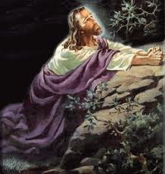
He went away a 2nd time and prayed,
My Father, if it is not possible for this cup to be taken away
unless I drink it, may your will be done.
This Photo by Unknown Author is licensed under CC BY-NC

Slide 16

When he came back, he again found them sleeping, because their eyes were heavy.
Notes:
16

Slide 17

So he left them and went away once more and prayed the 3rd time, saying the same thing.
This Photo by Unknown Author is licensed under CC BY-NC

Slide 18

Then he returned to the disciples and said to them,
Are you still
sleeping and resting?
Notes:
18

Slide 19
Look, the hour has come, and the Son of Man is delivered into the hands of sinners. Rise, let us go! Here comes my betrayer.
Notes:
19

Slide 20
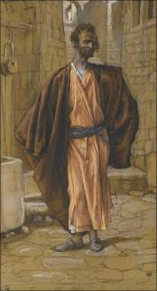
While he was still speaking, Judas, one of the Twelve, arrived.

Slide 21


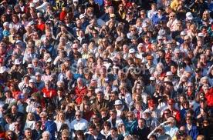

With him was a large crowd armed with swords and clubs, sent from the chief priests and the elders of the people.

Slide 22
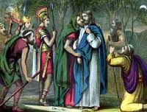
Now the betrayer had arranged a signal with them: “The one I kiss is the man; arrest him.” Going at once to Jesus, Judas said, “Greetings, Rabbi!” and kissed him.
Notes:
22

Slide 23
Jesus replied, “Do what you came for, friend.”
Notes:
23

Slide 24
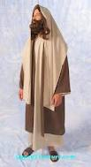
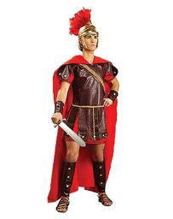
Then the men stepped forward, seized Jesus and arrested him.
Notes:
24

Slide 25
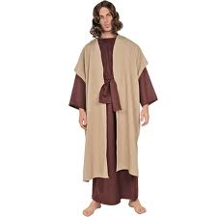
With that, one of Jesus’ companions reached for his sword, drew it out and struck the servant of the high priest, cutting off his ear.

Slide 26
“Put your sword back in its place,” Jesus said to him, “for all who draw the sword will die by the sword.

Slide 27
Do you think I cannot call on my Father, and he will at once put at my disposal more than twelve legions of angels?

Slide 28
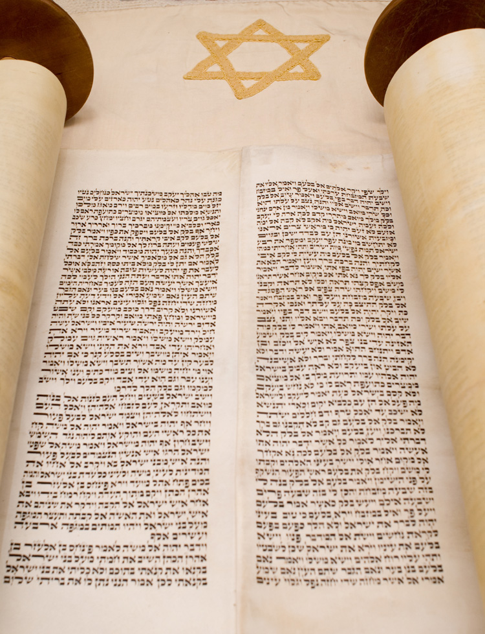
But how then would the Scriptures be fulfilled that say it must happen in this way?”

Slide 29

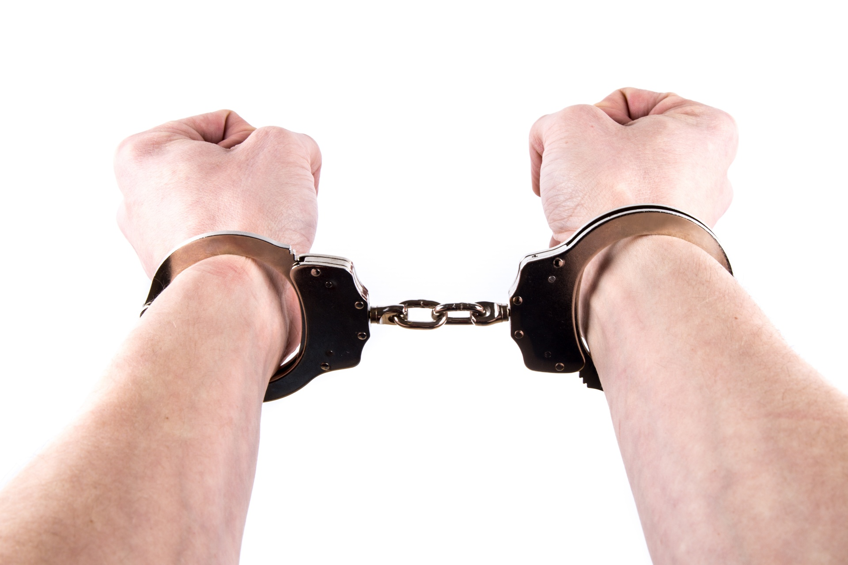
In that hour Jesus said to the crowd, “Am I leading a rebellion, that you have come out with swords and clubs to capture me?.

Slide 30
Every day I sat in the temple courts teaching, and you did not arrest me.

Slide 31

“But this has all taken place that the writings of the prophets might be fulfilled.” Then all the disciples deserted him and fled.
Notes:
31

