Slide 1
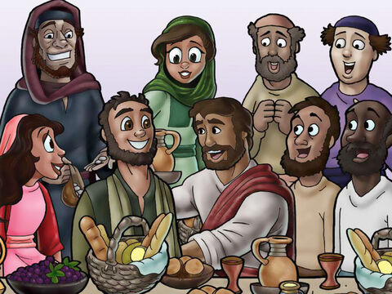
Plots, Preparation, and Passover
Matthew 26:1-30
Dig Site15

Slide 2

The Truth
Jesus knowingly prepared to give His life for all people.

Slide 3
Memory Verse
In him we have redemption through his blood, the forgiveness of sins, in accordance with the riches of God’s grace.
-Ephesians 1:7

Slide 4
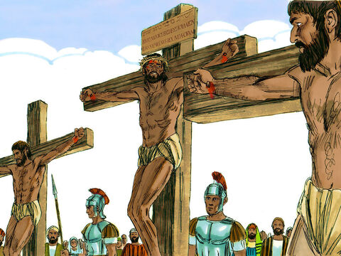
When Jesus had finished saying all these things, he said to his disciples,
Mat 26:1
As you know, the Passover is two days away--and the Son of Man will be handed over to be crucified.
Mat 26:2

Slide 5
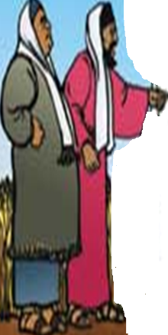
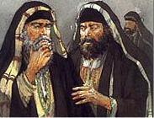
Then the chief priests and the elders of the people assembled in the palace of the high priest, whose name was Caiaphas, and they schemed to arrest Jesus secretly and kill him.
Mat 26:3-4

Slide 6


But not during the festival, they said, or there may be a riot among the people.– Mat 26:5

Slide 7
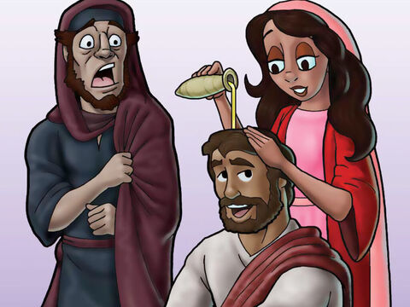
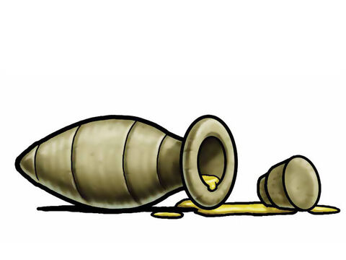
While Jesus was in Bethany in the home of Simon the Leper, a woman came to him with an alabaster jar of very expensive perfume, which she poured on his head as he was reclining at the table.
- Mat 26:6-7

Slide 8
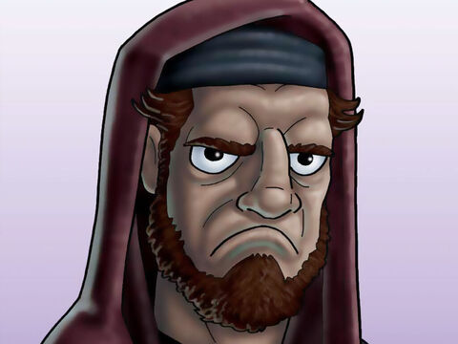
When the disciples saw this, they were indignant.
Why this waste?
they
asked.
-Mat 26:8

Slide 9
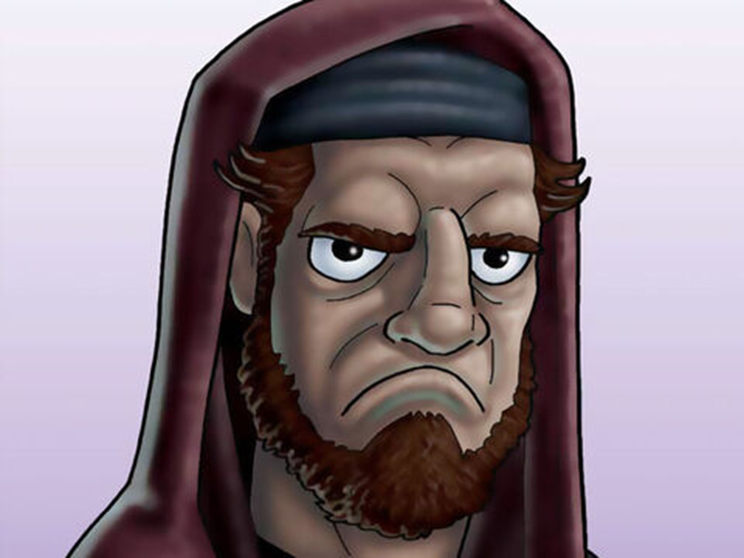

This perfume could have been sold at a high price and the money given to the poor. - Mat 26:9

Slide 10
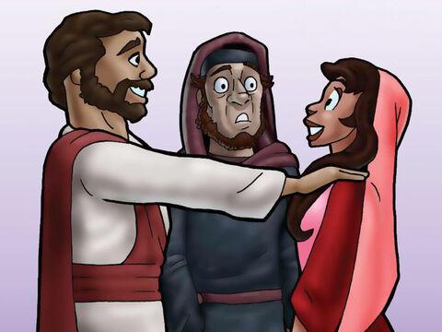
Aware of this,
Jesus said to them,
Why are
bothering this woman?
She has done a beautiful
thing to me.
Mat 26:10you

Slide 11
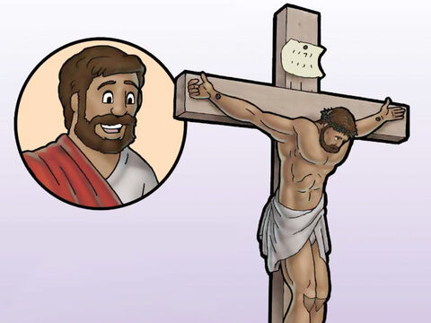
The poor
you will always
have with you,
but you will
not always
have me*.
Mat 26:11

Slide 12
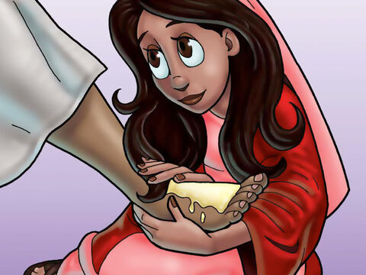
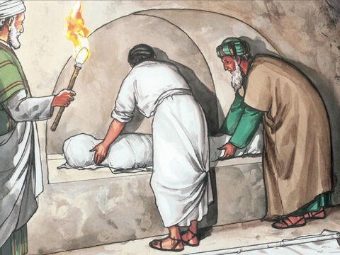
"When she poured this perfume on my body, she did it to prepare me for burial." - Mat 26:12

Slide 13
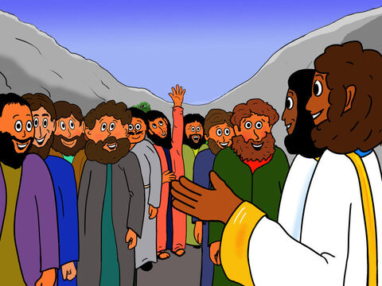
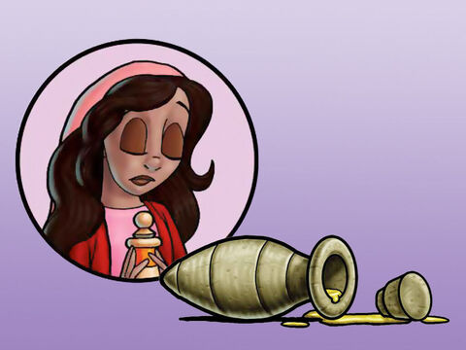
“Truly I tell you, wherever this gospel is preached throughout the world, what she has done will also be told, in memory of her." - Mat 26:13

Slide 14
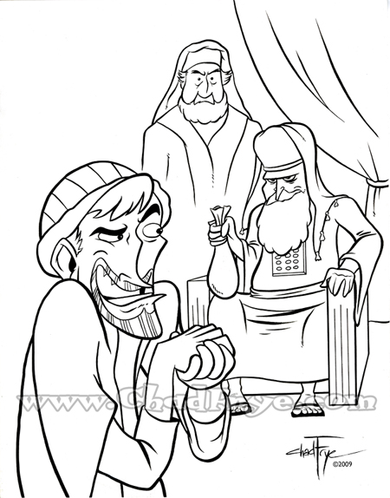
Then one of theTwelve—
the one called Judas Iscariot—
went to the chief priests
Mat 26:14

Slide 15
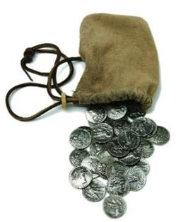
and asked,
"What are you willing to give me if I deliver him over to you?"
So they counted out for him thirty pieces of silver.
Mat 26:15

Slide 16
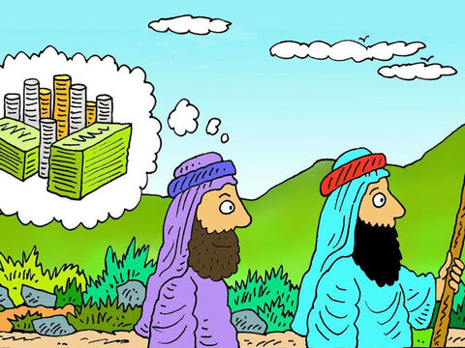
From then on Judas watched for an opportunity to hand him over. - Mat 26:16

Slide 17
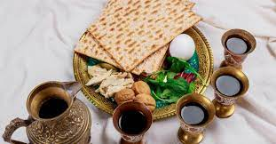
On the first day of the Festival of Unleavened Bread, the disciples came to Jesus and asked,
“Where do you want us to make preparations for you to eat the Passover?”- Mat 26:17

Slide 18
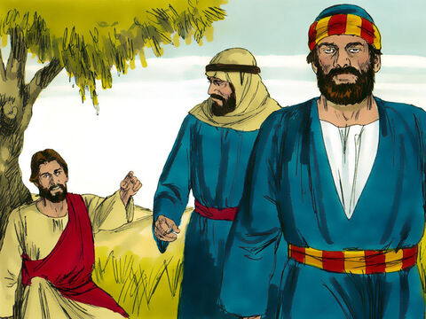
He replied,
"Go into the city to a certain man and tell him, 'The Teacher says: My appointed time is near.
I am going to celebrate the Passover with my disciples at your house.'"- Mat 26:18

Slide 19
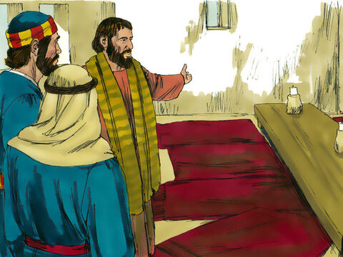
So the disciples did as Jesus had directed them and prepared the Passover. - Mat 26:19

Slide 20
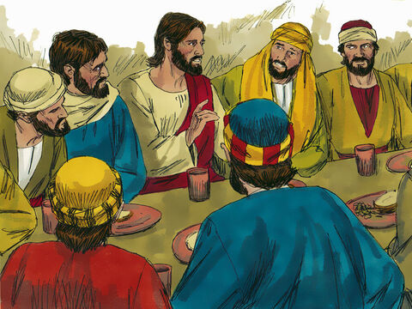
When evening came, Jesus was reclining at the table with the Twelve. - Mat 26:20
And while they were eating, he said,
“Truly I tell you, one of you will betray me.“
Mat 26:21

Slide 21
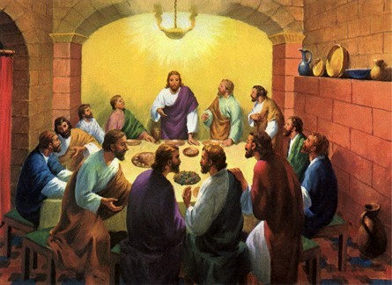
They were very sad and
began to say to him
one after the other,
"Surely you don’t mean me, Lord?" - Mat 26:22

Slide 22
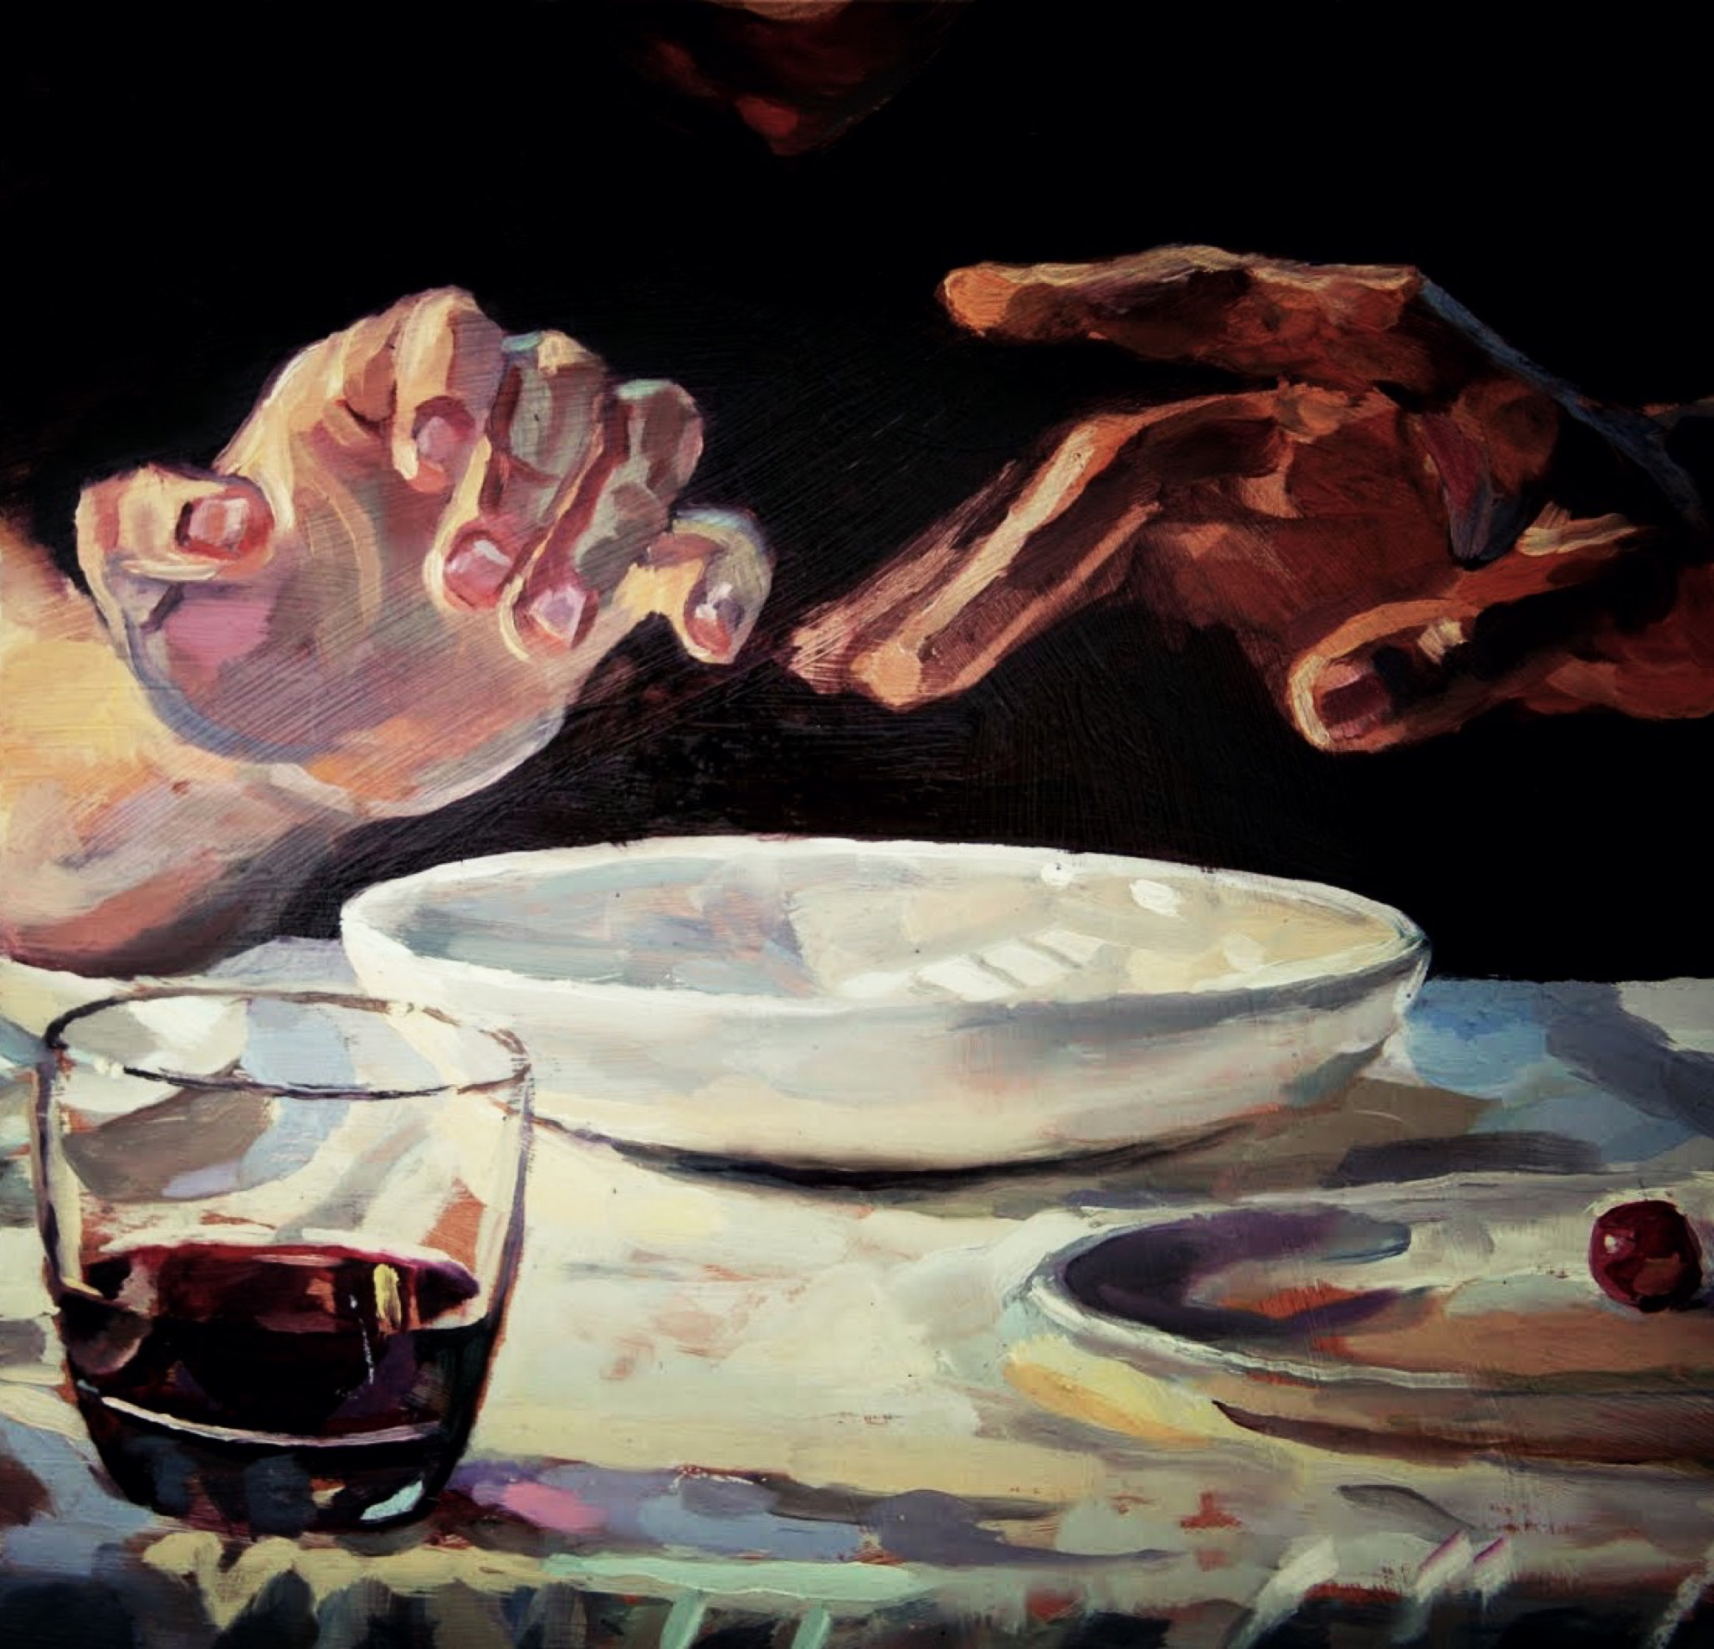
Jesus replied, "The one who has dipped his hand into the bowl with me
will betray
me.” - Mat 26:23

Slide 23
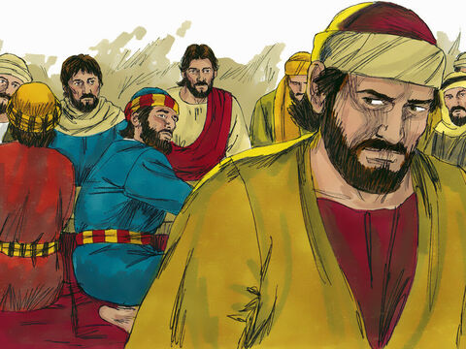
"The Son of Man will go just as it is written about him. But woe to that man who betrays the Son of Man! It would be better for him if he had not been born." - Mat 26:24
Then Judas, the one
who would betray him, said - Mat 26:25
"Surely you don’t mean me, Rabbi?“
Jesus answered, “You have said so."

Slide 24
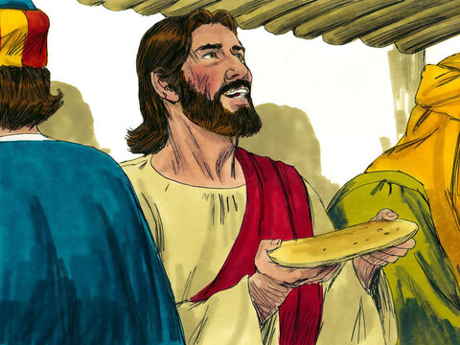
Take and eat;
this is my body.
"While they
were eating,
Jesus took
bread,
and when he had
given thanks, he
broke it,
and gave it
to his disciples, saying,
– Mat 26:26

Slide 25
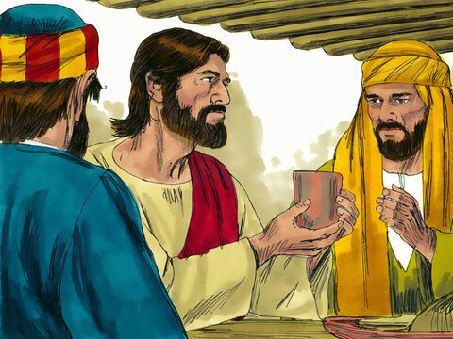
"Then he took a cup, and when he had given thanks, he gave it to them, saying,- Mat 26:27
Drink from it,
all of you.

Slide 26

"This is my blood of the covenant, which is poured out for many for the forgiveness of sins." - Mat 26:28

Slide 27
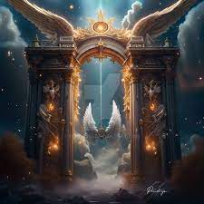
"I tell you, I will not drink from this fruit of the vine from now on until that day when I drink it new with you in my Father's kingdom." - Mat 26:29

Slide 28
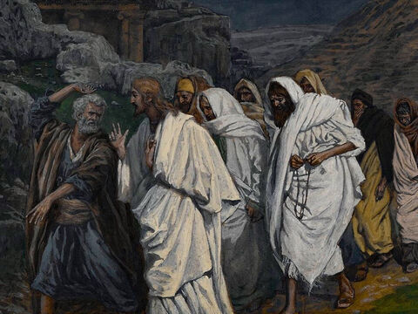
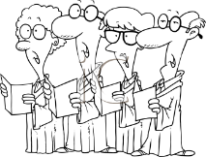
When they had sung a hymn, they went out to the Mount of Olives. - Mat 26:30

