Slide 1
Matthew
Dig Site 14
Matthew 24:36-42;
25:1-30

Slide 2
Memory Verse
“Because of the increase of wickedness,
the love of most will grow cold,
but he who stands firm to the end
will be saved.
Matthew 24:12-13
14

Slide 3
The Truth
Matthew
Jesus is coming again!
We need to be ready!

Slide 4
Ready for the Return
Matthew 24:36-42; 25:1-30

Slide 5
The Day and Hour Unknown

Slide 6
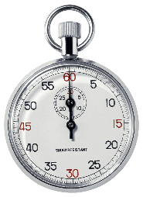
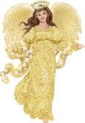
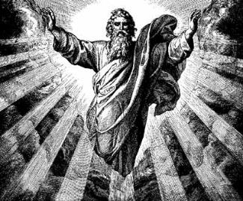
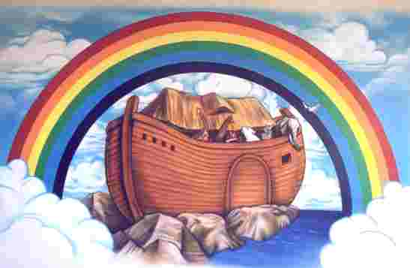
But about that day or hour no one knows, not even the angels in heaven, nor the Son, but only the Father.
As it was in the days of Noah, so it will be at the coming of the
Son of Man.

Slide 7
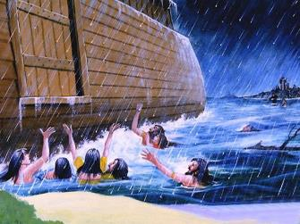

For in the days before the flood, people were eating and drinking, marrying and giving in marriage, up to the day Noah entered the ark;
and they knew nothing about what would happen until the flood came and took them all away. That is how it will be at the coming of the Son of Man.

Slide 8
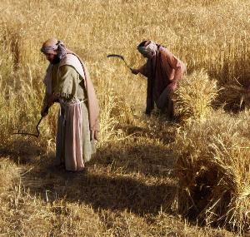
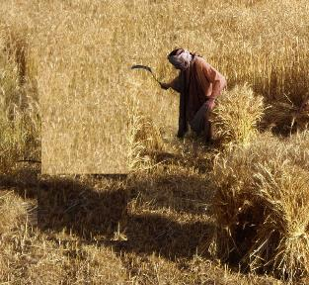
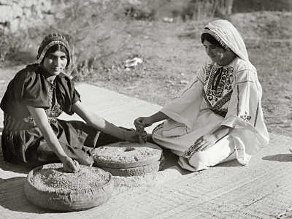
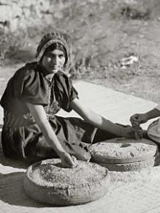
Two men will be in the field;
one will be taken and the other left.
Two women will be grinding with a hand mill; one will be taken and the other left.

Slide 9
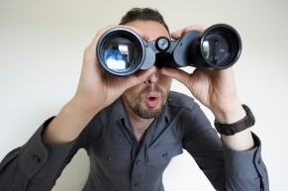
Therefore keep watch, because you do not know on what day your Lord will come.

Slide 10
The Parable of the Ten Virgins

Slide 11

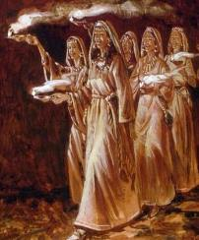
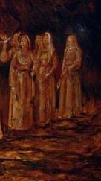
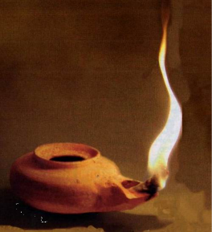
At that time the kingdom of heaven will be like ten virgins who took their lamps and went out to meet the bridegroom.
Five of them were foolish
and five were wise.

Slide 12

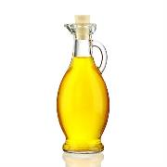


The foolish ones took their lamps but did not take any oil with them.
The wise, however, took oil in jars along with their lamps.

Slide 13
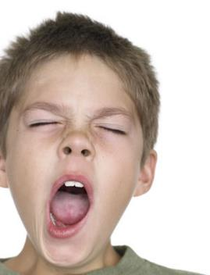
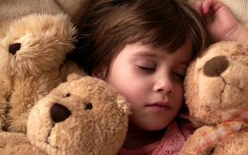

The bridegroom was a long time in coming, and they all became drowsy and fell asleep.
At midnight the cry rang out:
Here’s the bridegroom! Come out to meet him!

Slide 14

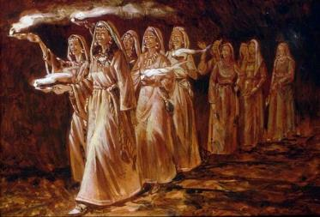
Then all the virgins woke up and trimmed their lamps. The foolish ones said to the wise,
Give us some of your oil; our lamps are going out.

Slide 15
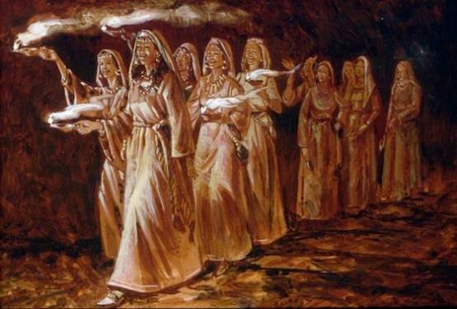
they replied,
"there may not be enough for both us and you. Instead, go to those who sell oil and buy some for yourselves."
"NO",

Slide 16

But while they were on their way to buy oil, the bridegroom arrived. The virgins who were ready went in with him to the wedding banquet. And the door was shut.

Slide 17
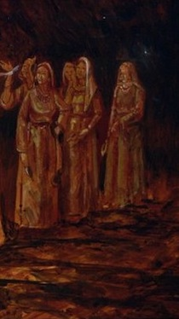
"Lord! Lord!"
Later the others also came.
they said.
"Open the door for us!"

Slide 18

But he replied,
Truly I tell you.
I don’t know you.
Therefore keep watch, because you do not know the day or the hour.

Slide 19
The Parable of the
Bags of Gold

Slide 20

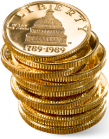

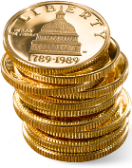

Again, it will be like a man going on a journey, who called his servants and entrusted his wealth to them.
To one he gave five bags of gold, to another two bags, and to another one bag, each according to his ability. Then he went on his journey.

Slide 21


The man who had received the five bags of gold went at once and put his money to work and gained five bags more.
So also, the one with the two bags of gold gained two more.

Slide 22
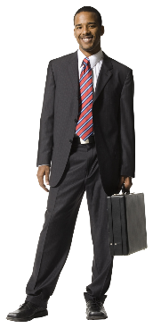
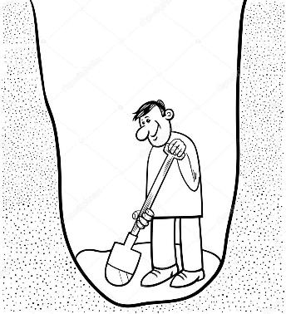

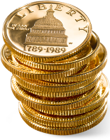
But the man who had received the one bag went off, dug a hole in the ground and hid his master’s money.
After a long time the master of those servants returned and settled accounts with them.

Slide 23
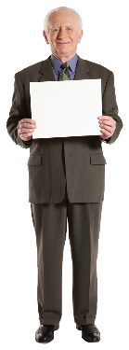
The man who had received the five bags brought the other five.
"Master,"
he said,
"you entrusted me with five bags of gold. See, I have gained five more."

Slide 24

His master replied,
"Well done, good and faithful servant! You have been faithful with a few things; I will put you in charge of many things. Come and share your master’s happiness!"

Slide 25


The man with the two bags also came.
"Master,"
he said,
"you entrusted me with two bags; see I have gained two more."

Slide 26
His master replied,
"Well done, good and faithful servant! You have been faithful with a few things; I will put you in charge of many things. Come and share your master’s happiness!"

Slide 27
Then the man who had received the one bag came.
"Master,"
he said,
"I knew that you are a hard man, harvesting where you have not sown and gathering where you have not scattered seed.
So I was afraid and went out and hid your gold in the ground. See, here is what belongs to you."

Slide 28
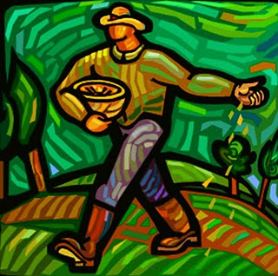

His master replied,
"You wicked, lazy servant! So you knew that I harvest where I have not sown and gather where I have not scattered seed?"

Slide 29
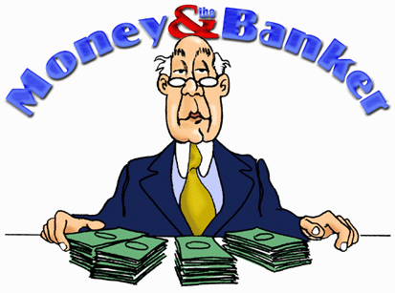

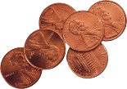
"Well then, you should have put my money on deposit with the bankers, so that when I returned I would have received it back with interest."

Slide 30


"So take the bag of gold from him and give it to the one who has ten bags.
For whoever who has will be given more, and they will have an abundance. Whoever does not have, even what they have will be taken from them."

Slide 31
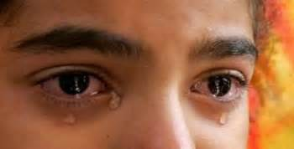

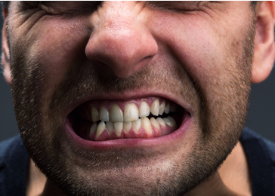
And throw that worthless servant outside, into the darkness, where there will be weeping and gnashing of teeth.

