Slide 1
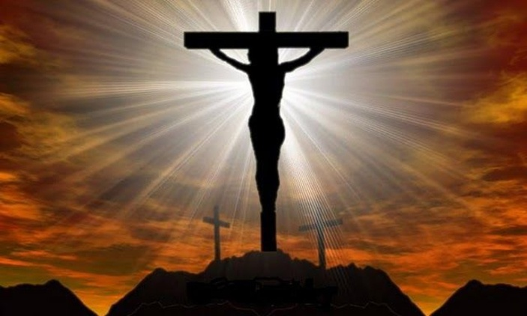
Dig Site 19
The Crucifixion & Death of Jesus
Matthew 27:32-56

Slide 2

Hide it in your
John 3:16
DS#19

Slide 3
For God so loved the world
that he gave his one and only Son,
that whoever believes in him
shall not perish but have eternal life.
John 3:16
DS#19

Slide 4

The Truth
Jesus willingly suffered and died so that everyone, even his enemies, could be saved from sin.

Slide 5

The
Crucifixion

Slide 6
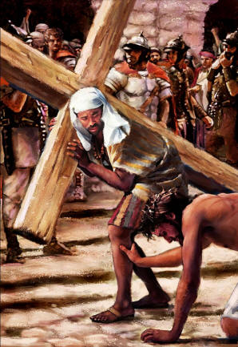
As they were going out, they met a man from Cyrene, named Simon, and they forced him to carry the cross.

Slide 7
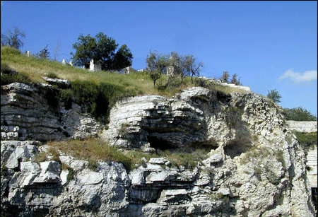
They came to a place called Golgotha (which means “the place of the skull”).

Slide 8
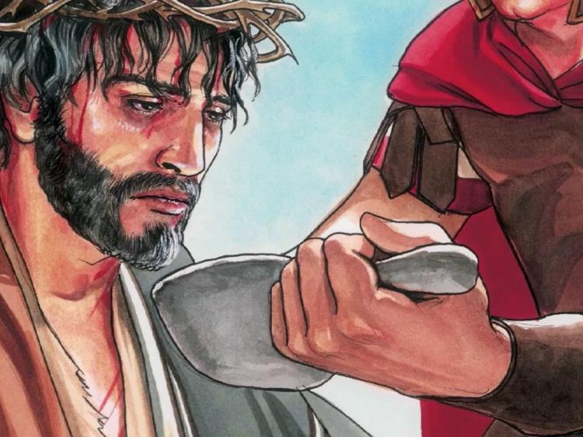
There they offered Jesus wine to drink, mixed with gall; but after tasting it, he refused to drink it.

Slide 9
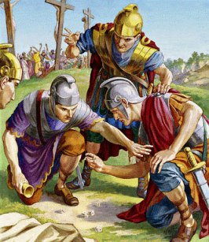
When they had crucified him, they divided up his clothes by casting lots.
And sitting down, they kept watch over him there.

Slide 10
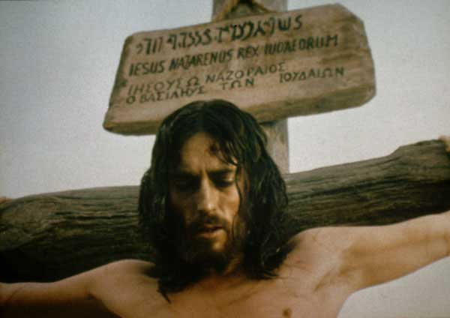
Above his head they placed the written charge against him: this is jesus, the king of the jews.

Slide 11
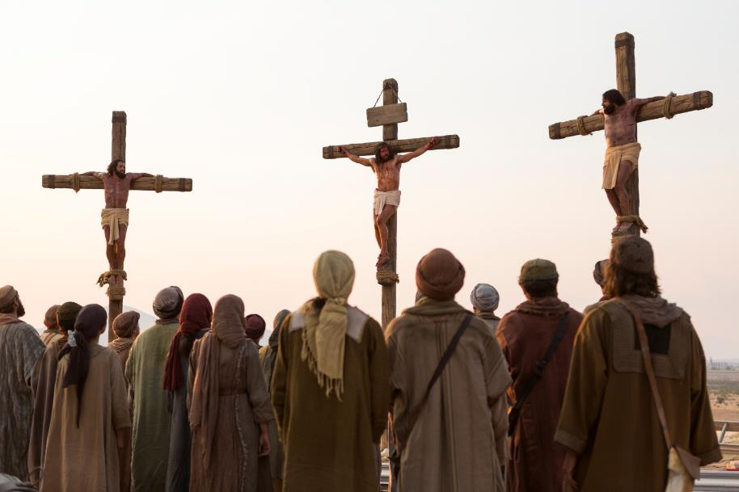
Two rebels were crucified with him, one on his right and one on his left.

Slide 12
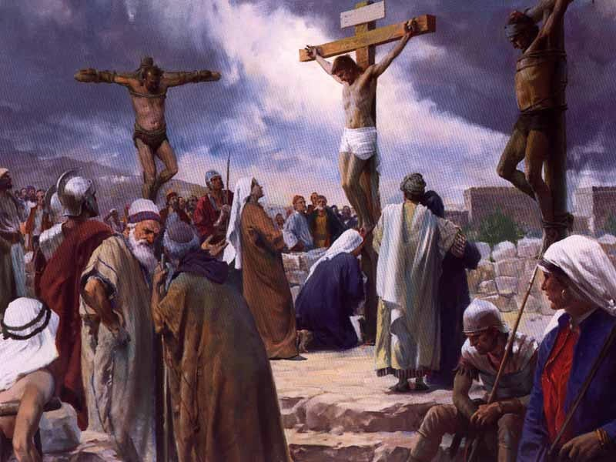
Those who passed by hurled insults at him, shaking their heads and saying,

Slide 13
“You who are going to destroy the temple and build it in three days, save yourself!

Slide 14
Come down from the cross,
if you are the Son of God!”

Slide 15
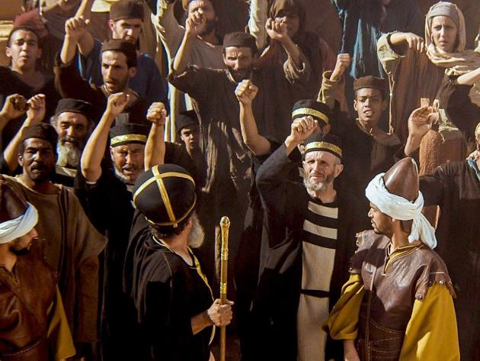
In the same way the chief priests, the teachers of the law and the elders mocked him. “He saved others,” they said,
“but he can’t save himself!

Slide 16
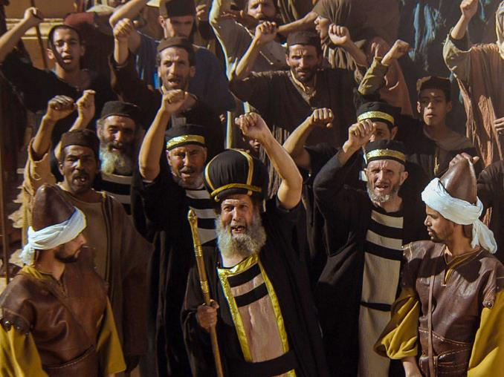
He’s the king of Israel!
Let him come down now from the cross, and we will believe in him.

Slide 17
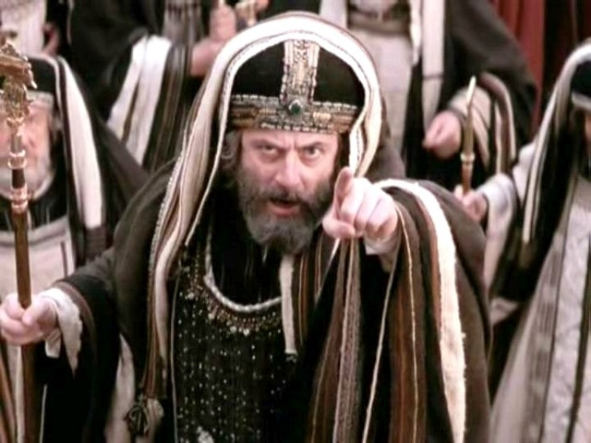
He trusts in God.
Let God rescue him now if he wants him, for he said,
‘I am the Son of God.’”

Slide 18
In the same way the rebels who were crucified with him also heaped insults on him.

Slide 19
The Death of
Jesus

Slide 20
From noon until three in the afternoon darkness came over all the land.

Slide 21
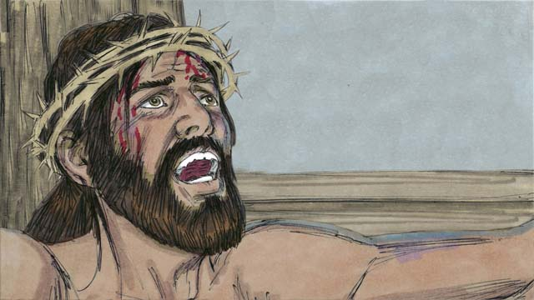
About three in the afternoon Jesus cried out in a loud voice,
“Eli, Eli, lema sabachthani?”
(which means “My God, my God, why have you forsaken me?”).

Slide 22
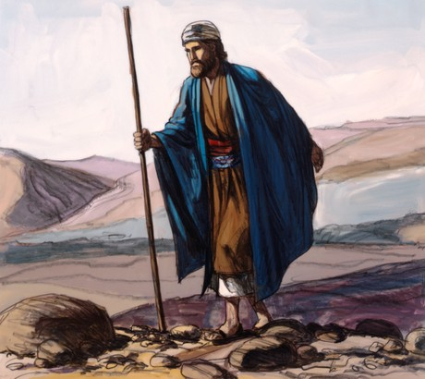
When some of those standing there heard this, they said, “He’s calling Elijah.”

Slide 23
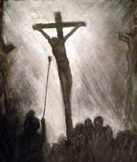
Immediately one of them ran and got a sponge.
He filled it with wine vinegar, put it on a staff, and offered it to Jesus to drink.

Slide 24
The rest said, “Now leave him alone.
Let’s see if Elijah comes to save him.”

Slide 25
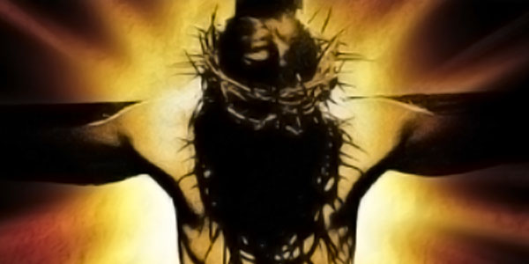
And when Jesus had cried out again in a loud voice, he gave up his spirit.

Slide 26
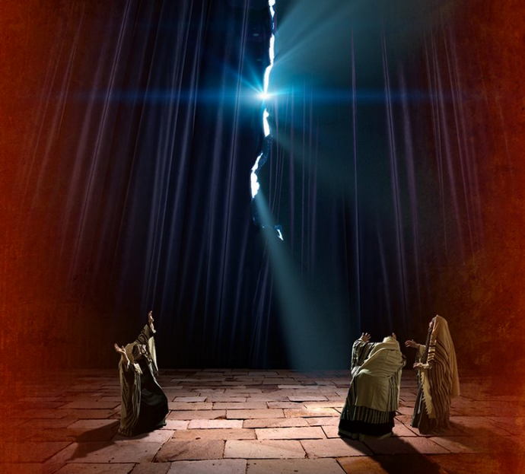
At that moment the curtain of the temple was torn in two from top to bottom.

Slide 27
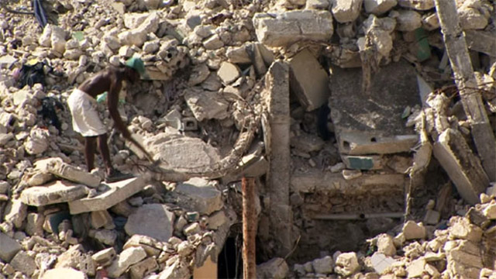
The earth shook

Slide 28
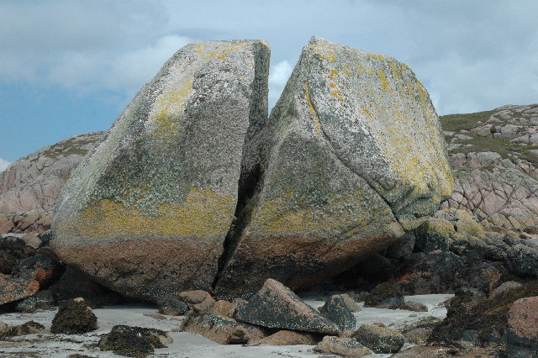
the rocks split

Slide 29
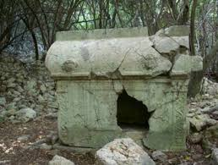
and the tombs broke open.

Slide 30
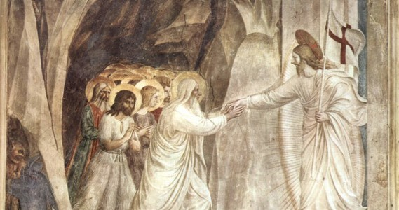
The bodies of many holy people who had died were raised to life. They came out of the tombs after Jesus’ resurrection and went into the holy city and appeared to many people.

Slide 31
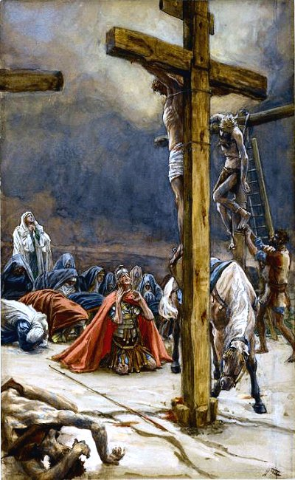
When the centurion and those with him who were guarding Jesus saw the earthquake and all that had happened, they were terrified, and exclaimed,
“Surely he was the Son of God!”

Slide 32
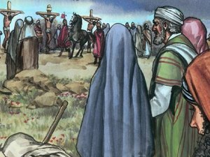
Many women were there, watching from a distance. They had followed Jesus from Galilee to care for his needs.

Slide 33
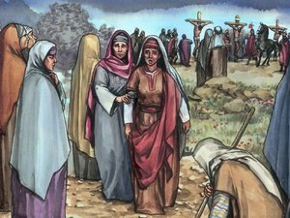
Among them were Mary Magdalene,
Mary the mother of James and Joseph, and the mother of Zebedee’s sons.

