Slide 1
Jesus on Trial
Dig Site 17
Matthew 26:57-27:5

Slide 2

Hide it in your
Matthew 16:24
DS#17

Slide 3
“Then Jesus said to his disciples,
“Whoever wants to be my disciple
Must deny themselves
And take up their cross
and follow me.”
Matthew 16:24
DS #17

Slide 4

The Truth
Jesus gives people a choice about how they will respond to Him.

Slide 5
Jesus before the Sanhedrin

Slide 6
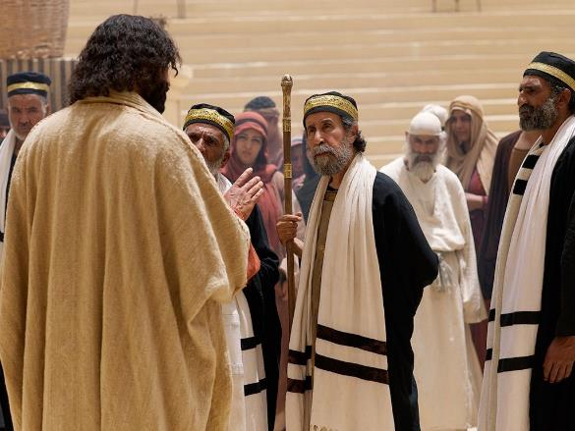
Those who had arrested Jesus took him to Caiaphas the high priest, where the teachers of the law and the elders had assembled.

Slide 7
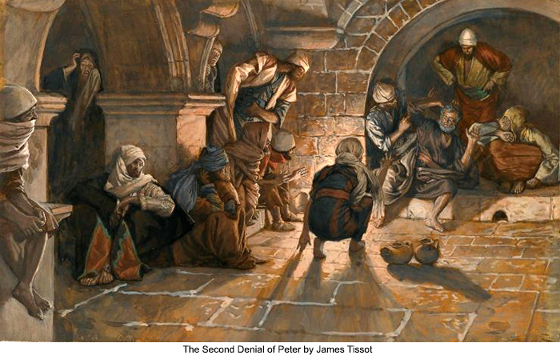
But Peter followed him at a distance, right up to the courtyard of the high priest.
He entered and sat down with the guards
to see the outcome.

Slide 8
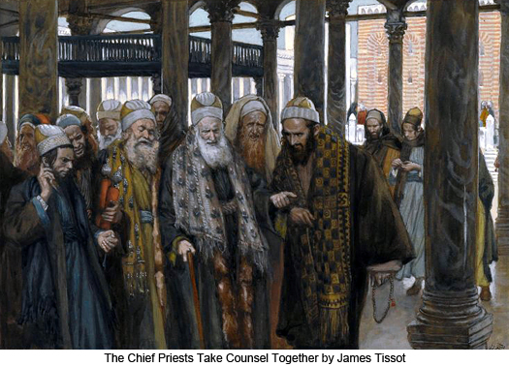
The chief priests and the whole Sanhedrin were looking for false evidence against Jesus so that they could
put him to death.

Slide 9
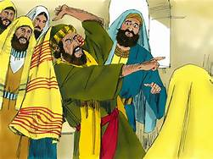
But they did not find any, though many false witnesses came forward.
Finally two came forward and declared,
“This fellow said, ‘I am able to destroy the temple of God and rebuild it in three days.’”

Slide 10
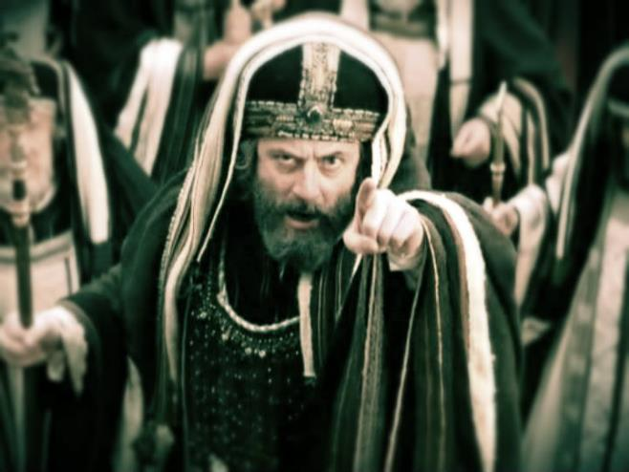
Then the high priest stood up and said to Jesus, “Are you not going to answer?
What is this testimony that these men
are bringing against you?”

Slide 11
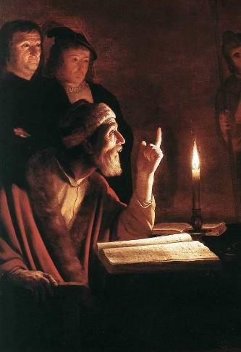
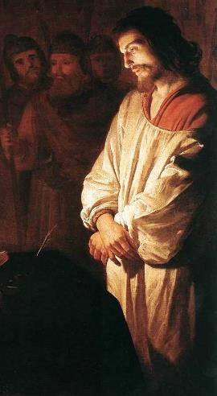
But Jesus remained silent. The high priest said to him, “I charge you under oath by the living God: Tell us if you are the Messiah, the Son of God.”

Slide 12
“You have said so,” Jesus replied.
“But I say to all of you:

Slide 13
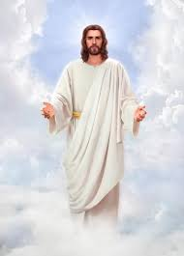
From now on you will see the Son of Man sitting at the right hand of the Mighty One and coming on the clouds of heaven.”

Slide 14
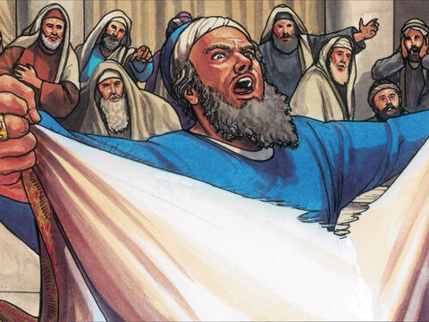
Then the high priest tore his clothes and said, “He has spoken blasphemy!
Why do we need any more witnesses?

Slide 15
Look, now you have heard the blasphemy.
What do you think?”
“He is worthy of death,” they answered.

Slide 16
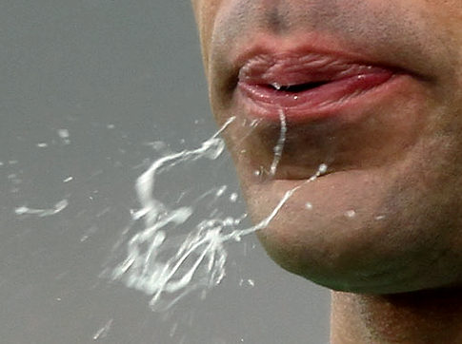
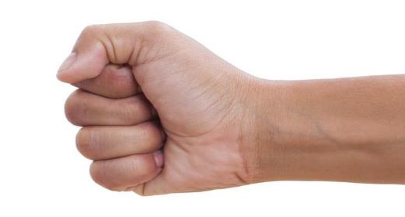
Then they spit in his face and struck him with their fists.

Slide 17

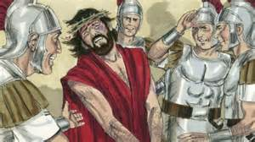
Others slapped him and said,
“Prophesy to us, Messiah.
Who hit you?”

Slide 18
Peter disowns
Jesus

Slide 19
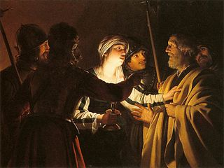
Now Peter was sitting out in the courtyard, and a servant girl came to him. “You also were with Jesus of Galilee,” she said.

Slide 20
But he denied it before them all.
“I don’t know what you’re talking about,”
he said.

Slide 21
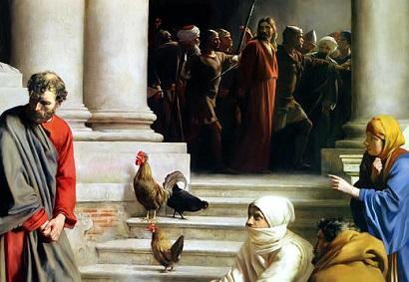
Then he went out to the gateway,
where another servant girl saw him
and said to the people there,
“This fellow was with Jesus of Nazareth.”

Slide 22
He denied it again, with an oath:
“I don’t know the man!”

Slide 23
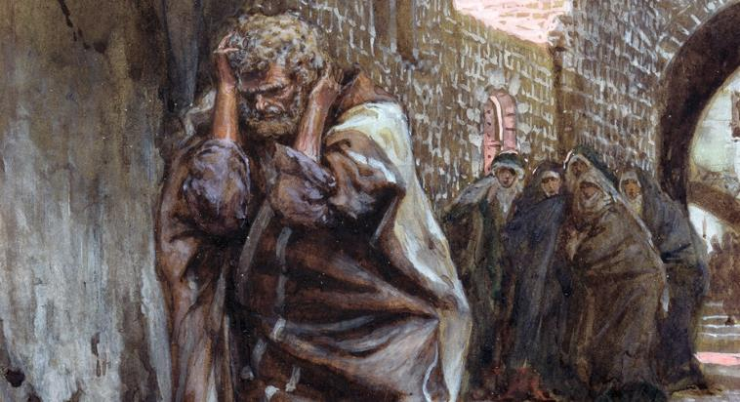
After a little while, those standing there went up to Peter and said,
“Surely you are one of them;
your accent gives you away.”

Slide 24
Then he began to call down curses,
and he swore to them,
“I don’t know the man!”

Slide 25
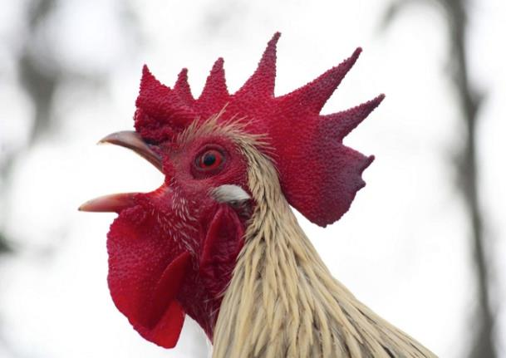
Immediately a rooster crowed.

Slide 26
Then Peter remembered the word Jesus had spoken: “Before the rooster crows,
you will disown me three times.”
Immediately a rooster crowed.

Slide 27
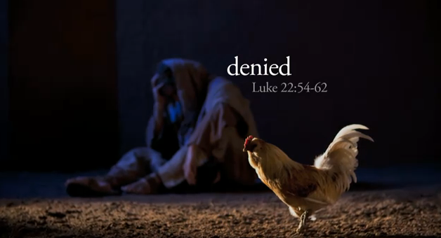

And he went outside
and wept
bitterly.

Slide 28
Judas
Hangs
Himself

Slide 29
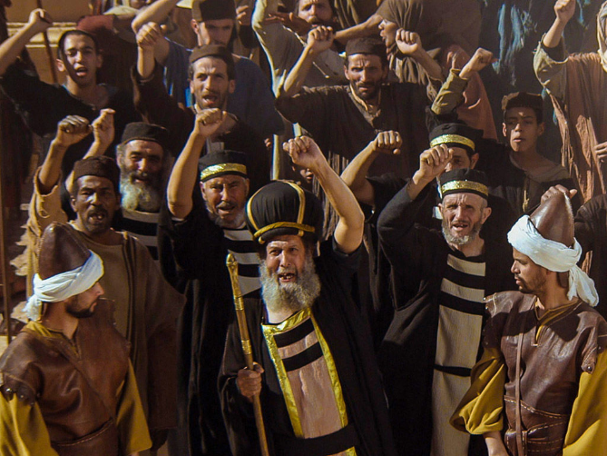
Early in the morning, all the chief priests and the elders of the people made their plans how to have Jesus executed.

Slide 30
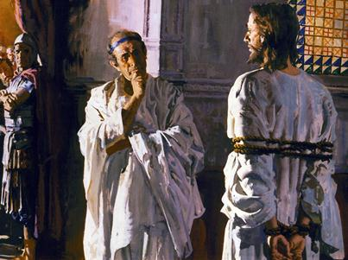
So they bound him, led him away and handed him over to Pilate the governor.

Slide 31
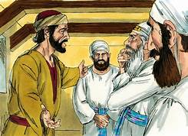
When Judas, who had betrayed him, saw that Jesus was condemned, he was seized with remorse and returned the 30 pieces of silver to the chief priests and the elders.

Slide 32
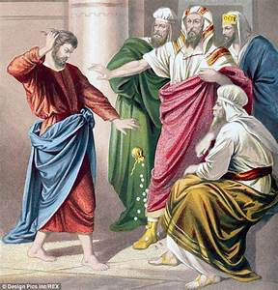
“I have sinned,” he said,
“for I have betrayed innocent blood.”
“What is that to us?” they replied.
“That’s your responsibility.”

Slide 33
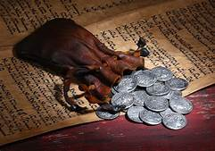
So Judas threw the money into the temple and left.
Then he went away and hanged himself.

