Slide 1

Hide it in your
Matthew 22:37-39
DS#13

Slide 2
Jesus replied:
“‘Love the Lord your God
with all your heart
and with all your soul
and with all your mind.’
This is the first and greatest commandment.
And the second is like it:
‘Love your neighbor as yourself.’”
Matthew 22:37-39
DS#13

Slide 3

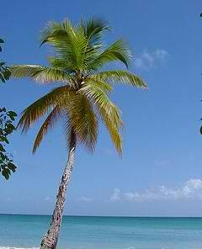
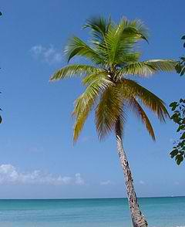
Dig Site 13
Palms of Praise
Matthew 21:1-17 & 22:34-40

Slide 4

The Truth
Jesus, our Savior and King, is worthy of our praise, obedience, and love.

Slide 5
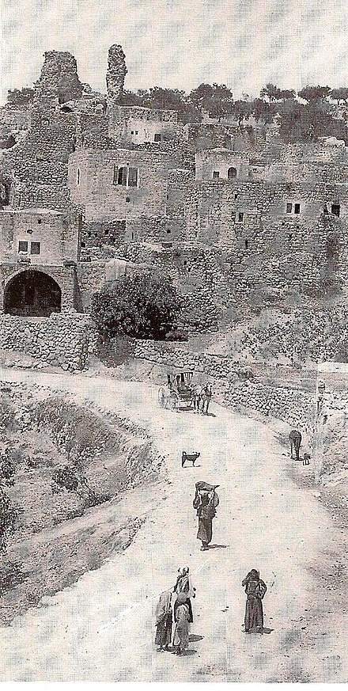
The
Triumphal Entry

Slide 6
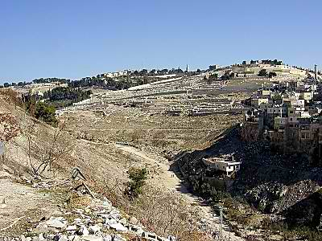
As they approached Jerusalem and came to
Bethphage
on the Mount of Olives,

Slide 7
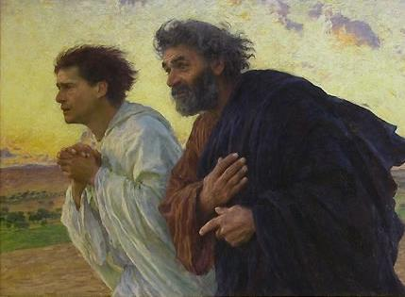
Jesus sent two disciples, saying to them, “Go to the village ahead of you,

Slide 8
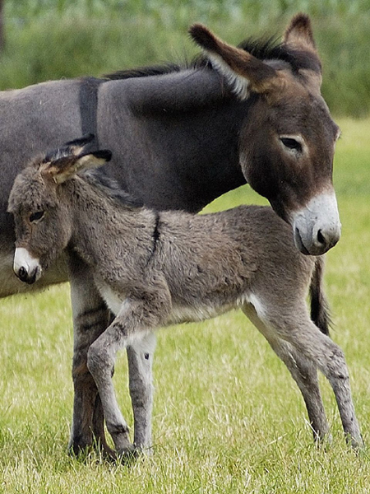
… and at once you will find a donkey tied there, with her colt by her.

Slide 9
Untie them
and bring them to me.

Slide 10

Don’t need
this rope.

Slide 11
If anyone says anything to you,
say that the Lord needs them,
and he will send them right away.”

Slide 12
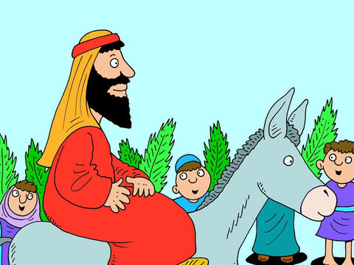
This took place to fulfill what was spoken through the prophet:
“Say to Daughter Zion,
‘See, your king comes to you,
gentle and riding on a donkey,
and on a colt,
the foal of a donkey.’”

Slide 13
The disciples went and did as Jesus had instructed them.

Slide 14
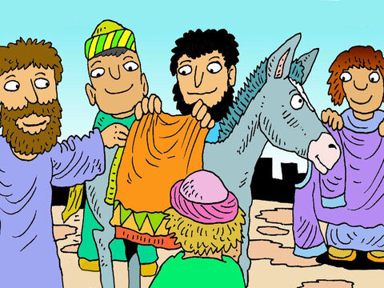
They brought the donkey and the colt and placed their cloaks on them for Jesus sit on.

Slide 15
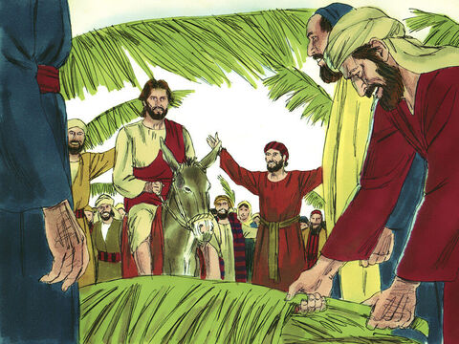
A very large crowd spread their cloaks on the road, while others cut branches from the trees and spread them on the road.

Slide 16
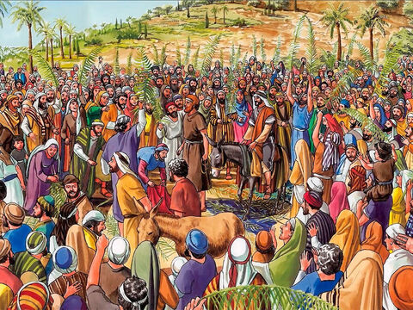
The crowds that went ahead of him and those that followed shouted,

Slide 17
Hosanna to the Son of David!”

Slide 18
“Blessed is He who comes
in the name of the Lord!”

Slide 19
“Hosanna in the highest heaven!”

Slide 20
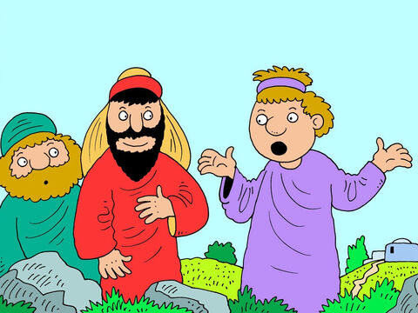
When Jesus entered Jerusalem,
the whole city was stirred and asked,

Slide 21
Who is this?

Slide 22
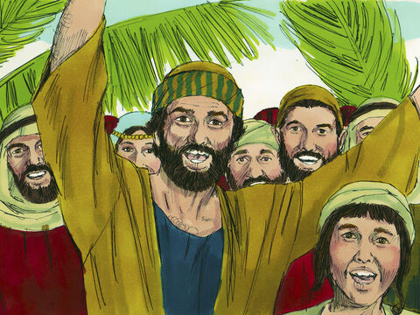
The crowds answered,
“This is Jesus,
the prophet from Nazareth in Galilee.”

Slide 23
Jesus at the Temple

Slide 24
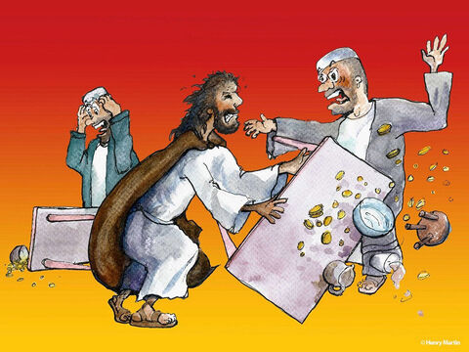
Jesus entered the temple courts and drove out all who were buying and selling there. He overturned the tables of the money changers

Slide 25
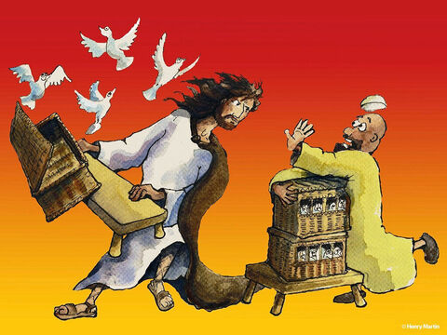
and the benches of those selling doves.

Slide 26
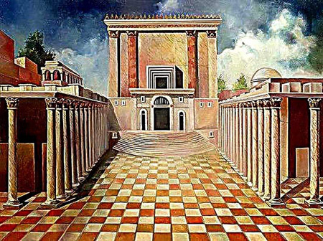
“It is written,”
he said to them,
“‘My house will be called a house of prayer,’
but you are making it
a ‘den of robbers.’ “

Slide 27
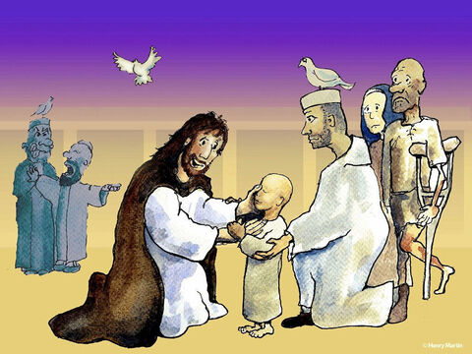
The blind and the lame came to Jesus at the temple, and He healed them

Slide 28
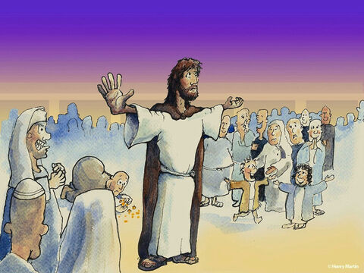
But when the chief priests and the teachers of the law saw the wonderful things he did and the children shouting in the temple courts.
“Hosanna to the Son of David,”

Slide 29
…they were indignant.
“Do you hear what these children are saying?”
they asked him.

Slide 30
“Yes,” replied Jesus, “have you never read,

Slide 31
‘From the lips of children and infants you, Lord, have called forth your praise?’”

Slide 32
And he left them and went out of the city to Bethany, where he spent the night.

Slide 33
The Greatest Commandment

Slide 34
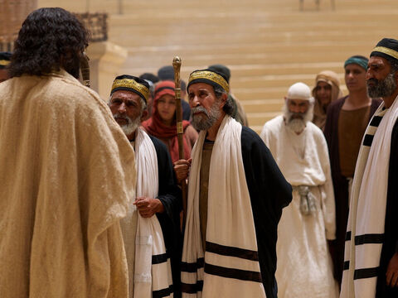
Hearing that Jesus had silenced the Sadducees, the Pharisees got together. One of them, an expert in the law, tested him with this question: “Teacher, which is the greatest commandment in the Law?”

Slide 35
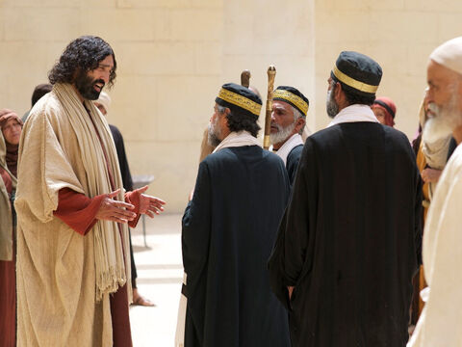
Jesus replied:
Love the Lord
your God
with all your heart
and with all your soul
and with all your mind.

Slide 36
This is the first and greatest commandment.

Slide 37
And the second is like it:
Love your neighbor as yourself.

Slide 38
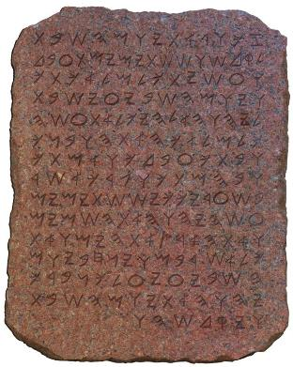
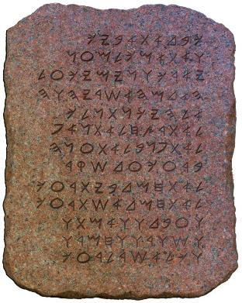
All the Law and the Prophets hang on these two commandments.

