Slide 1
Matthew
Dig Site 12
Matthew 18:10-14, 21-35
Matthew 19:13-30

Slide 2

Hide it in your
Matthew 19:14
DS#12

Slide 3
“Jesus said,
‘Let the little children come to me,
and do not hinder them,
for the kingdom of heaven
belongs to such as these.’”
Matthew 19:14
DS#12

Slide 4

The Truth
Jesus forgives and shows concern for people, and we must do the same.

Slide 5
What Do You Value?

Slide 6

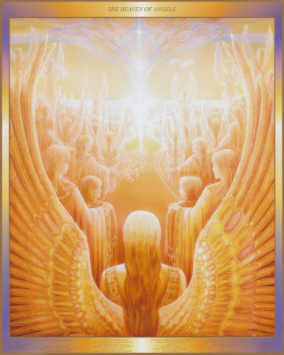
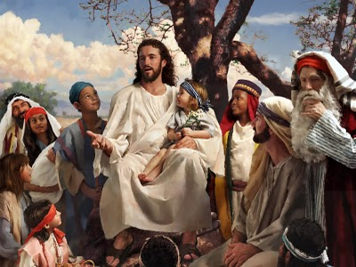
Jesus said, See that you do not despise one of these little ones. For I tell you that their angels in heaven always see the face of my Father in heaven.

Slide 7
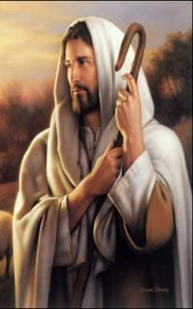
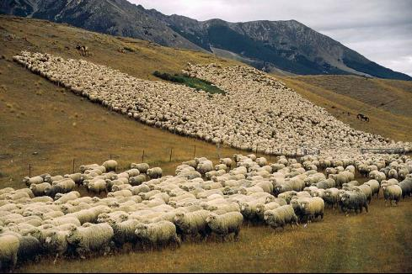
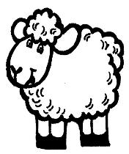
What do you think?
If a man owns a hundred sheep, and one of them wanders away, will he not leave the 99 on the hills and go to look
for the 1 that wandered off?

Slide 8
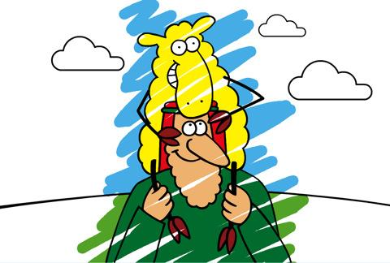
And if he finds it, truly I tell you, he is happier about that 1 sheep than about the 99 that did not wander off.

Slide 9
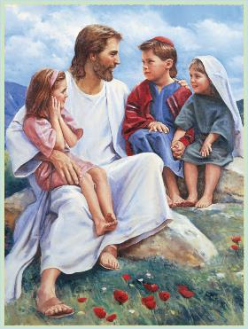
In the same way your Father in heaven is not willing that any of these little ones should perish.

Slide 10
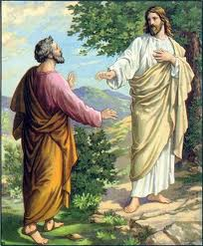
Then Peter came to Jesus and asked,
Lord, how many times shall I forgive my brother or sister who sins against me?
7 Times
Up to seven times?

Slide 11
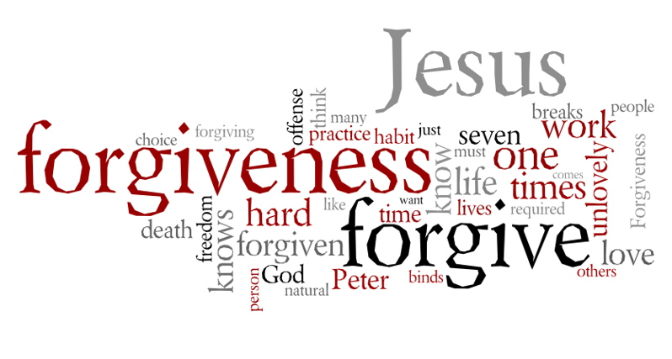
Jesus answered,
I tell you, not seven times, but seventy-seven times.
77 Times

Slide 12
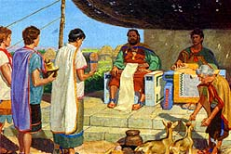
Therefore, the kingdom of heaven is like a king who wanted to settle accounts with his servants.

Slide 13
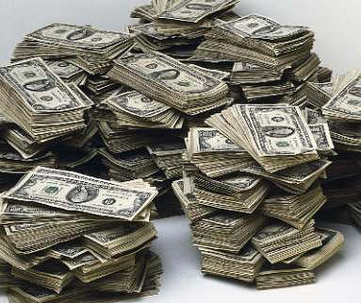
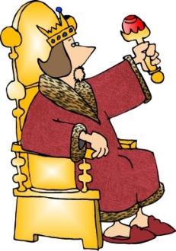
As he began the settlement, a man who owed him ten thousand bags of gold was brought to him.
That’s like a million dollars!!!

Slide 14
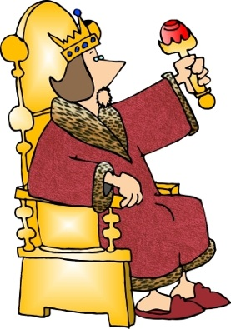

Since he was not able to pay, the master ordered that he and his wife and his children and all that he had be sold to repay the debt.

Slide 15
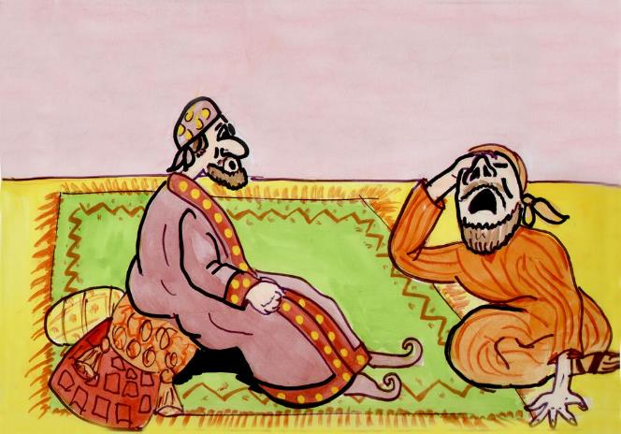
At this, the servant fell on his knees before him.
Be patient with me,
and I will pay back everything.
he begged,

Slide 16
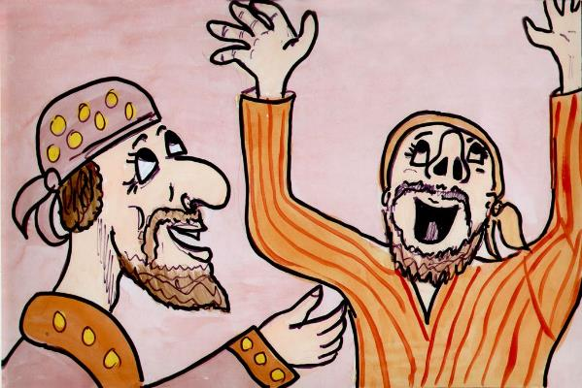
The servant’s master took pity on him, canceled the debt and let him go.

Slide 17
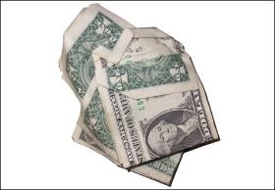
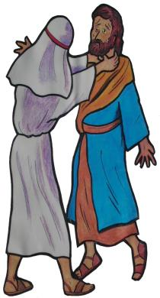
But when that servant went out, he found one of his fellow servants who owed him a hundred silver coins. He grabbed him and began to choke him.
Pay back what you owe me!
That’s just a few bucks!
he demanded.

Slide 18
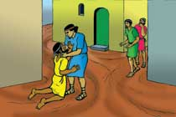
His fellow servant fell to his knees and begged him,
Be patient with me, and I will pay it back.

Slide 19
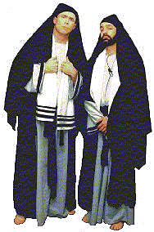
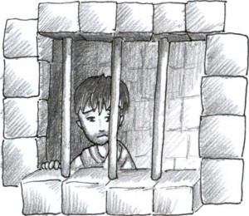
But he refused. Instead, he went off and had the man thrown into prison until he could pay the debt.
When the other servants saw what had happened, they were outraged and went and told their master everything that had happened.

Slide 20
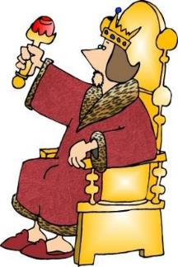
Then the master called the servant in.
You wicked servant, he said, I canceled all that debt of yours because you begged me to.

Slide 21
Shouldn’t you have had mercy on your fellow servant just as I had on you?

Slide 22
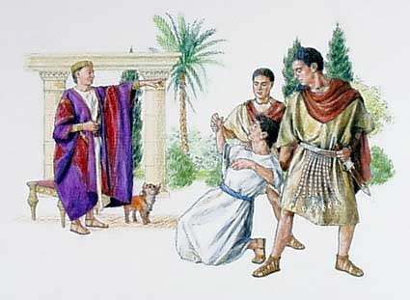
In anger his master handed him over to the jailers to be tortured, until he should pay back all he owed.

Slide 23

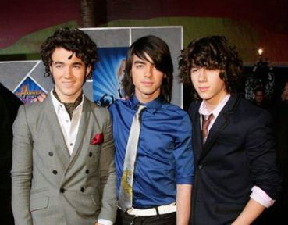

This is how my heavenly Father will treat each of you unless you forgive your brother or sister from your heart.

Slide 24
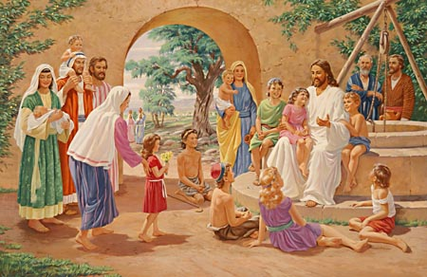
Then people brought little children to Jesus for him to place his hands on them and pray for them.

Slide 25
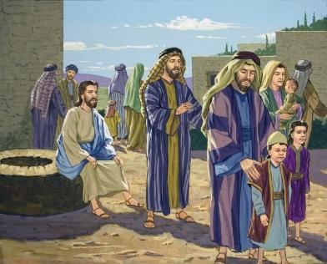
But the disciples rebuked them.

Slide 26
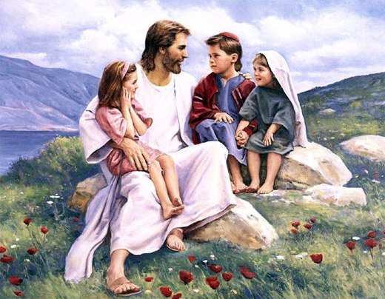
Let the little children come to me, and do not hinder them,
Jesus said,

Slide 27
for the kingdom of heaven
belongs to such as these.”

Slide 28
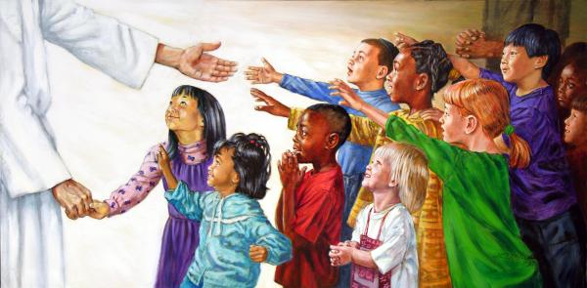
When he had placed his hands on them,

Slide 29
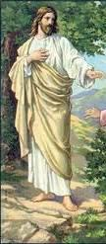
he went on from there.

Slide 30
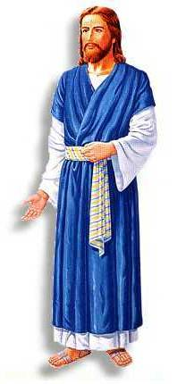
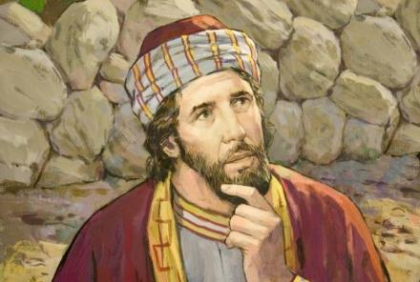
Just then a man came up to Jesus and asked,
Teacher, what good thing must I do to get eternal life?

Slide 31
Why do you ask me about what is good?
Jesus replied

Slide 32
There is only One who is good. If you want to enter life, keep the commandments.

Slide 33
Which ones?
he inquired.

Slide 34
Jesus replied,
You shall not murder,
you shall not commit adultery,
you shall not steal,

Slide 35
Jesus replied,
You shall not give false testimony,
Honor your father and mother,
And love your neighbor as yourself.

Slide 36
All these I have kept,
the young man said.

Slide 37
What do I still lack?

Slide 38
Jesus answered
If you want to be perfect, go, sell your possessions and give to the poor, and you will have treasure in heaven.

Slide 39
Then
come, follow me.

Slide 40
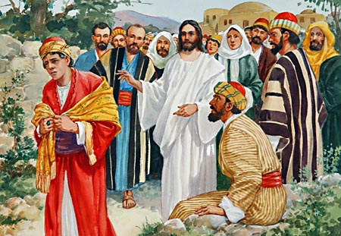
When the young man heard this,
he went away sad,
because he had great wealth

Slide 41
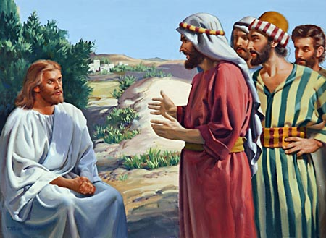
Then Jesus said to his disciples,
Truly I tell you, it is hard for someone who is rich to enter the kingdom of heaven.

Slide 42
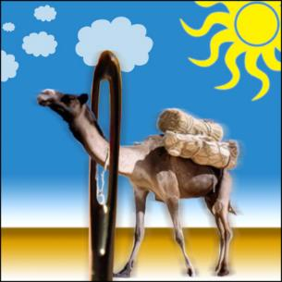
Again I tell you, it is easier for a camel to go through the eye of a needle

Slide 43
than for someone who is rich to enter the kingdom of God

Slide 44
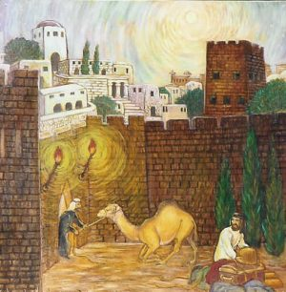
Actually, most people think that during Bible times, the phrase “eye of a needle” referred to a doorway in the wall of a city.
The Eye of the Needle

Slide 45
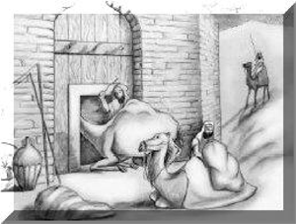
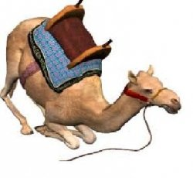
Camels with packs on their back
could not fit through the door.
Camels had to kneel and have their packs removed in order to fit through the door.

Slide 46
When the disciples heard this, they were greatly astonished and asked,
Who then can be saved?

Slide 47
Jesus looked at them and said,
With man this is impossible,
but with
GOD
all things are possible.

Slide 48
Peter answered him,
We have left everything to follow you! What then will there be for us?

Slide 49
Jesus said to them,
Truly I tell you, at the renewal of all things,

Slide 50
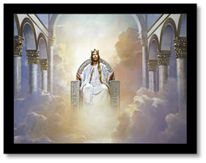
Jesus said to them,
when the Son of Man sits on his glorious throne,

Slide 51






You who have followed me will also sit on twelve thrones, judging the twelve tribes of Israel.

Slide 52



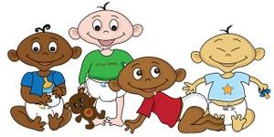
And everyone who has left houses or brothers or sisters or father or mother or wife or children

Slide 53
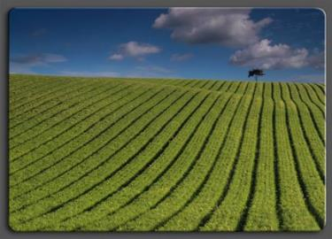
or fields for my sake will receive a hundred times as much and will inherit eternal life.
100 Times

Slide 54
But many who are first will be last
First
Last

Slide 55
and many who are last will be first.
Last
First

