Slide 1

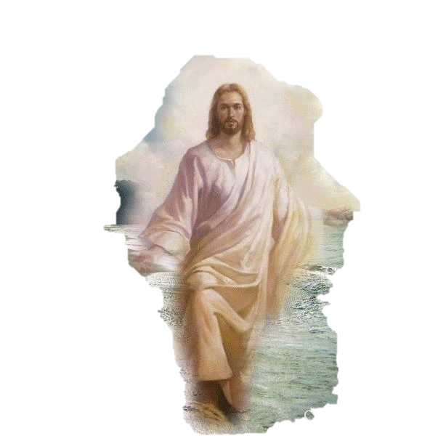
THE SON REVEALED
Dig Site 11
Matthew 15:21-28, 16:13-28; 17:1-9

Slide 2

Hide it in your
Matthew 16:16
DS#11

Slide 3
“Simon Peter answered,
‘You are the Messiah,
the son of the living God.”
Matthew 16:16
DS#11

Slide 4

The Truth
Jesus blesses those who believe that He is the Son of God

Slide 5
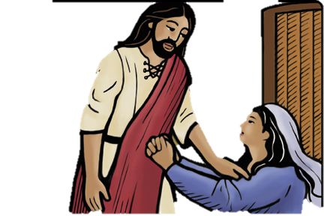
Leaving that place, Jesus withdrew to the region of Tyre and Sidon. A Canaanite woman from that vicinity came to him, crying out, “Lord, Son of David, have mercy on me! My daughter is demon-possessed and suffering terribly.”

Slide 6
Jesus did not answer a word.
So his disciples came to him and urged him, “Send her away, for she keeps
crying out after us.”

Slide 7

He answered, “I was sent only to the lost sheep of Israel.” The woman came and knelt before him. “Lord, help me!” she said.

Slide 8
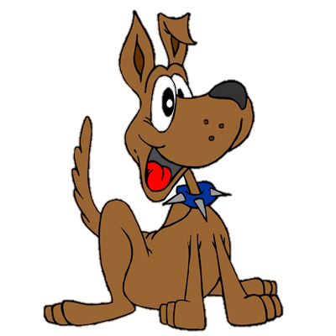

He replied, “It is not right to take the children’s bread and toss it to their dogs.”

Slide 9
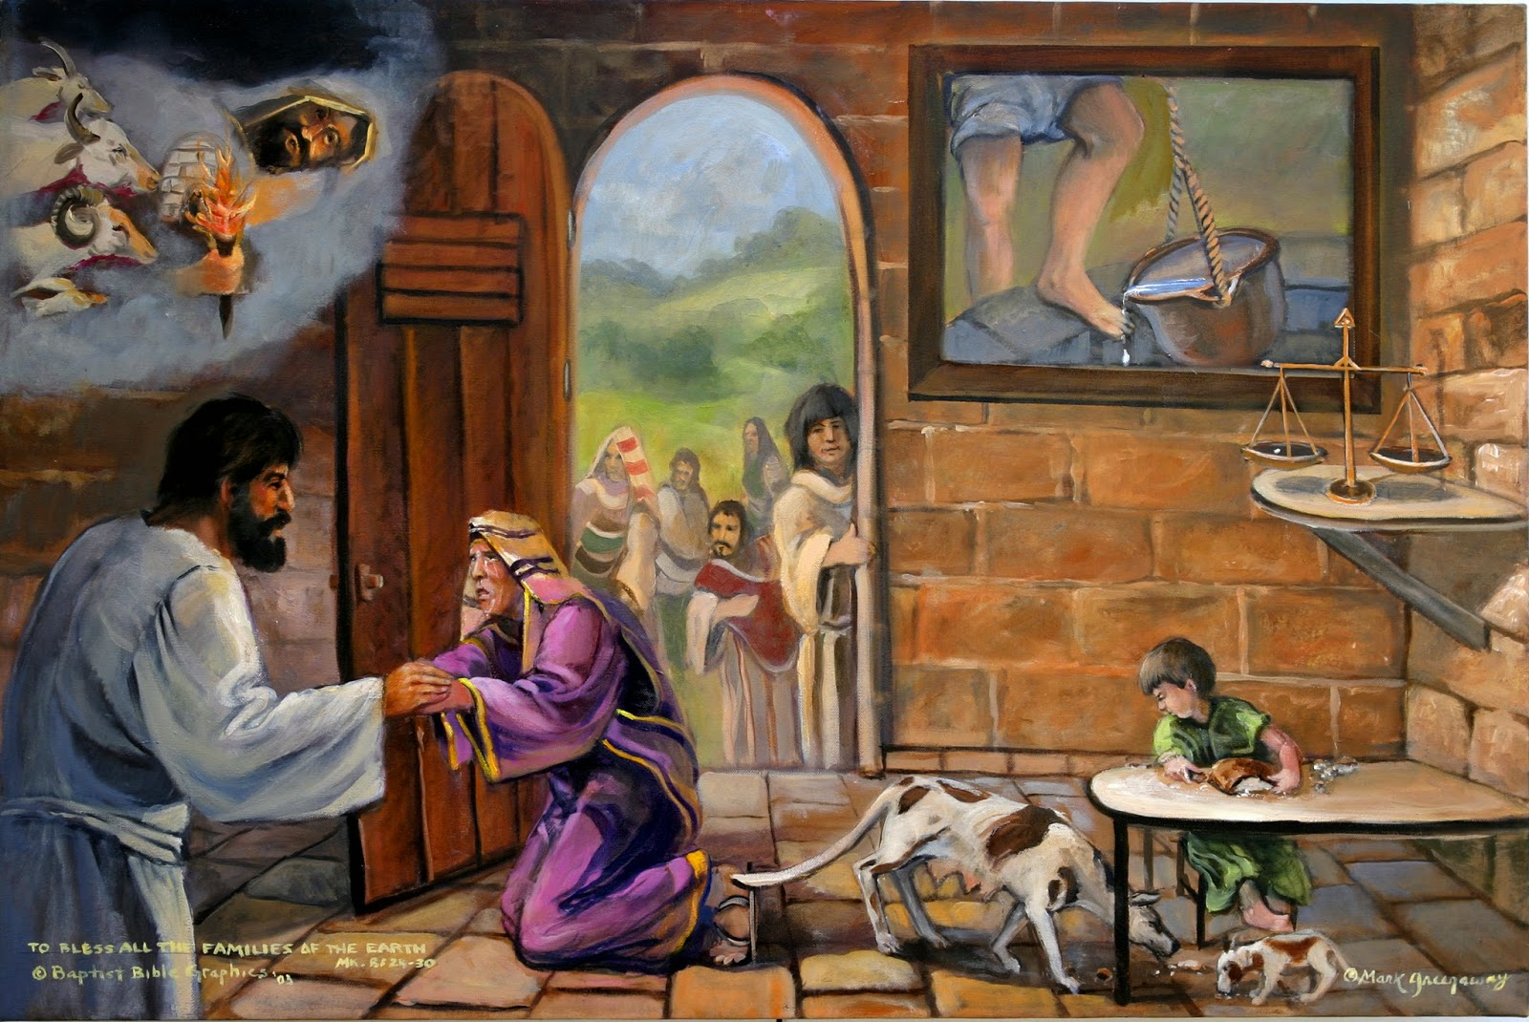
“Yes it is, Lord,” she said, “Even the dogs eat the crumbs that fall from their master’s table.”

Slide 10
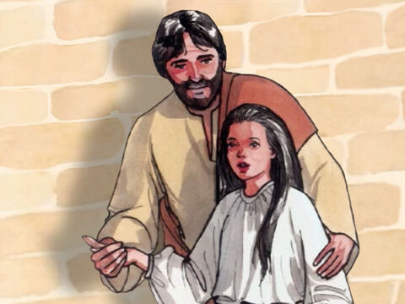
Then Jesus said to her, “Woman, you have great faith! Your request is granted.” And her daughter was healed at that moment.

Slide 11
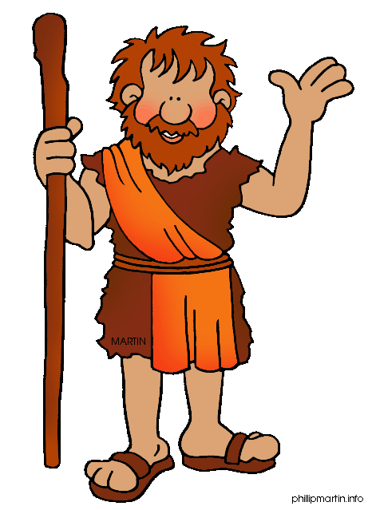


When Jesus came to the region of Caesarea Philippi, he asked his disciples,
“Who do people say the Son of Man is?”
They replied, “Some say John the Baptist;
others say Elijah; and still others,
Jeremiah or one of the prophets.”

Slide 12
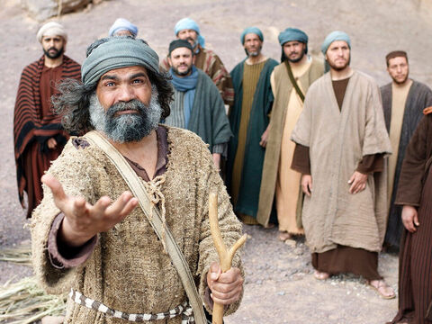
“But what about you?” he asked.
“Who do you say I am?”
Simon Peter answered,
“You are the Messiah, the Son of the living God.”

Slide 13
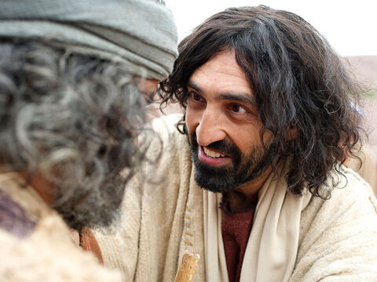
Jesus replied, “Blessed are you, Simon son of Jonah, for this was not revealed to you by flesh and blood, but by my Father in heaven. And I tell you that you are Peter, and on this rock I will build my church, and the gates of Hades will not overcome it.

Slide 14

I will give you the keys of the kingdom of heaven; whatever you bind on earth will be bound in heaven, and whatever you loose on earth will be loosed in heaven.”

Slide 15

Then he ordered his disciples not to tell anyone that he was the Messiah.

Slide 16
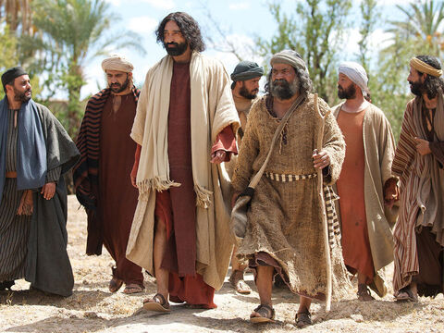
From that time on Jesus began to explain to his disciples that he must go to Jerusalem and suffer many things at the hands of the elders, chief priests and teachers of the law,

Slide 17
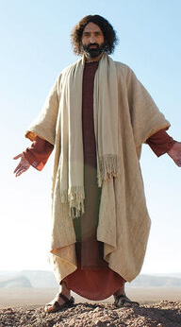
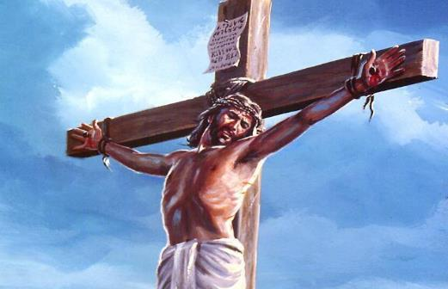
and that he must be killed and
on the 3rd day be raised to life.

Slide 18
Peter took him aside and began to rebuke him.
“Never, Lord!” he said.
“This shall never happen to you!”

Slide 19
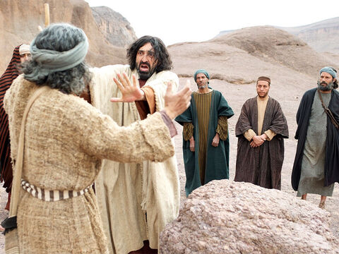
Jesus turned and said to Peter,
“Get behind me, Satan!
You are a stumbling block to me;
you do not have in mind the concerns of God,
but merely human concerns.”

Slide 20
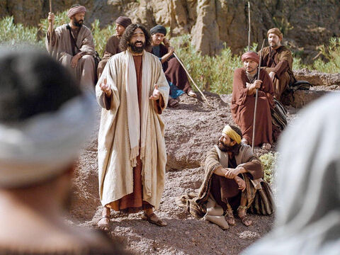
Then Jesus said to his disciples,
“Whoever wants to be my disciple must deny themselves and take up their cross and follow me. For whoever wants to save their life will lose it, but whoever loses their life for me will find it.

Slide 21
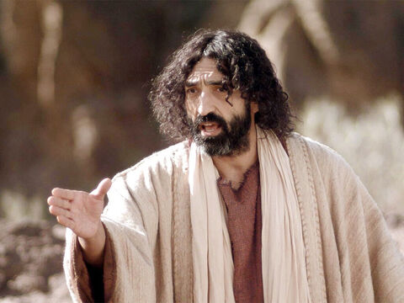
What good will it be for someone
to gain the whole world, yet forfeit their soul?
Or what can anyone give in exchange for their soul?

Slide 22
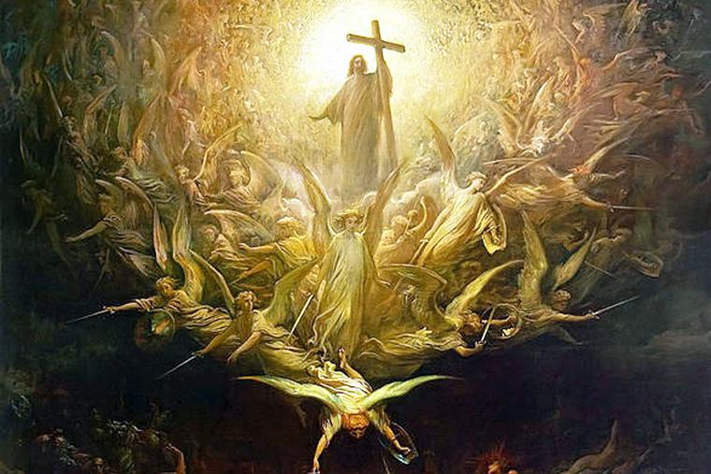
For the Son of Man is going to come in his Father’s glory with his angels,
and then he will reward each person
according to what they have done.

Slide 23
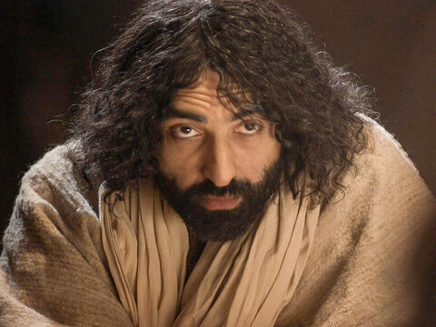
Truly I tell you, some who are standing here will not taste death before they see the Son of Man coming in his kingdom.”

Slide 24
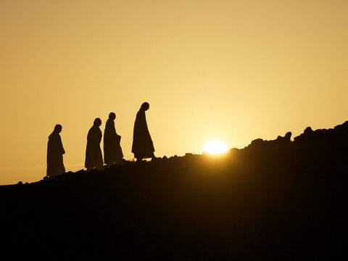
After six days Jesus took with him Peter, James and John the brother of James, and led them up a high mountain by themselves

Slide 25
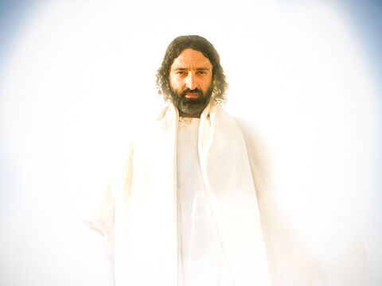
There he was transfigured before them. His face shone like the sun, and his clothes became as white as the light.

Slide 26
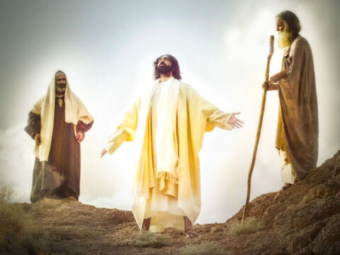
Just then there appeared before them Moses and Elijah, talking with Jesus.

Slide 27

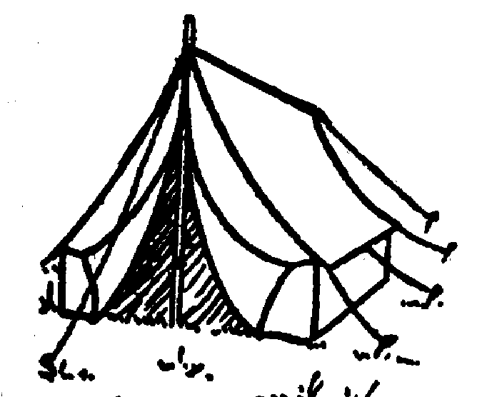
Peter said to Jesus, “Lord, it is good for us to be here. If you wish, I will put up three shelters—one for you, one for Moses and one for Elijah.”

Slide 28
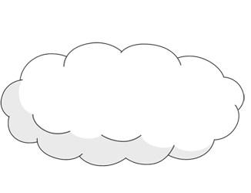
While he was still speaking, a bright cloud covered them, and a voice from the cloud said, “This is my Son, whom I love;
with him I am well pleased. LISTEN to him!”
This is my SON

Slide 29
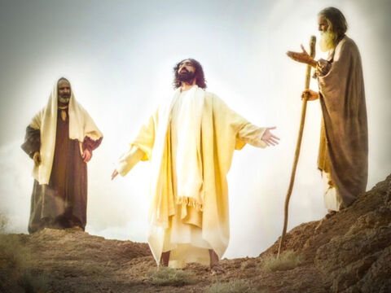
When the disciples heard this, they fell facedown to the ground, terrified. But Jesus came and touched them. “Get up,” he said. “Don’t be afraid.” When they looked up, they saw no one except Jesus.

Slide 30
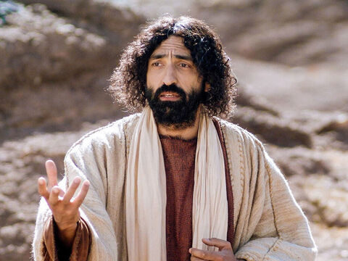
As they were coming down the mountain,
Jesus instructed them,
“Don’t tell anyone what you have seen,
until the Son of Man has been
raised from the dead.”

