Slide 1
Trust in a Caring God
Dig Site 10
Matthew 14:1-36

Slide 2

Hide it in your
Psalm 55:22
DS#10

Slide 3
Cast your cares on the Lord and he will sustain you;
He will never let the righteous be shaken
Psalm55:22
DS#10

Slide 4
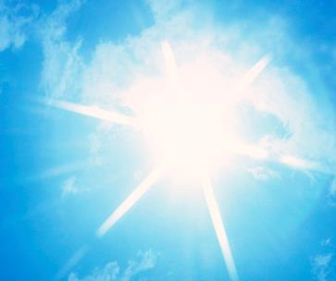
The Truth
Because Jesus cares for us, we can trust Him.

Slide 5
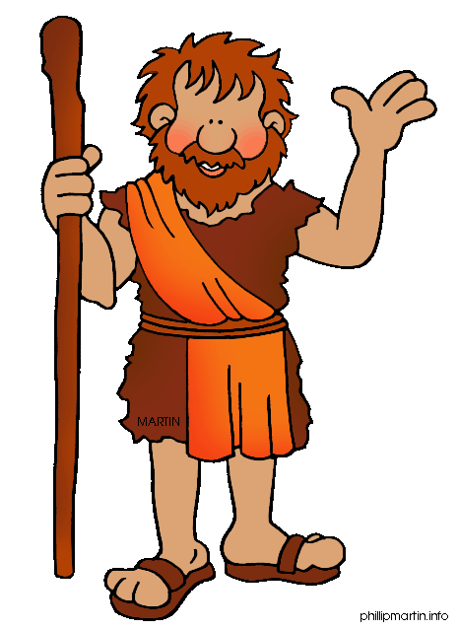
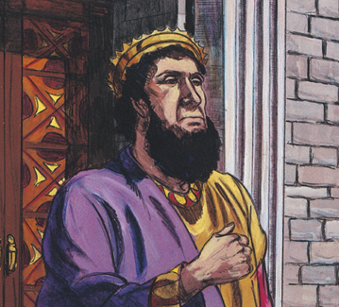
At that time Herod the tetrarch heard the reports about Jesus, and he said to his attendants,
“This is John the Baptist; he has risen from the dead! That is why miraculous powers are at work in him.”
MIRACULOUS POWERS

Slide 6
Now Herod had arrested John and bound him and put him in prison because of Herodias, his brother Philip’s wife,

Slide 7
for John had been saying to him:
“It is not lawful for you to have her.”
Herod wanted to kill John,
but he was afraid of the people,
because they considered John a prophet.

Slide 8
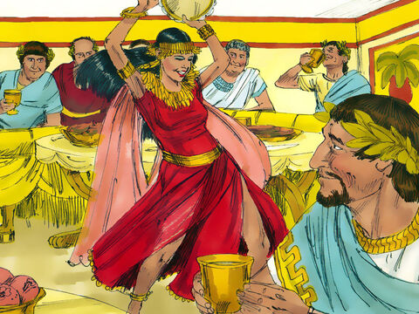
On Herod’s birthday the daughter of Herodias danced for them and pleased Herod so much that he promised with an oath to give her whatever she asked.

Slide 9
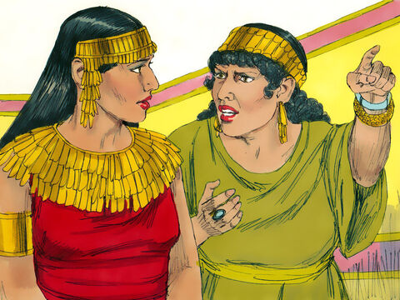
Prompted by her mother, she said,
“Give me here on a platter the head
of John the Baptist.”

Slide 10
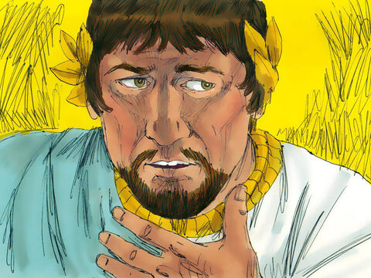
The king was distressed, but because of his oaths and his dinner guests, he ordered that her request be granted and had
John beheaded in the prison.

Slide 11
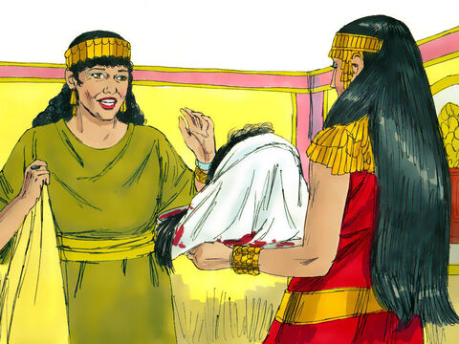
His head was brought in on a platter and given to the girl, who carried it to her mother.

Slide 12
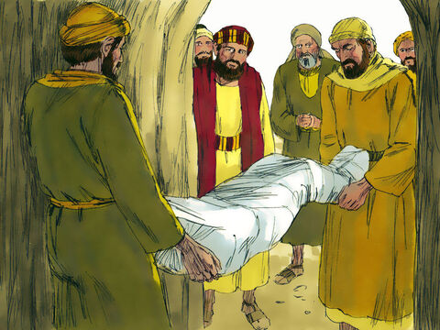
John’s disciples came and took his body and buried it. Then they went and told Jesus.

Slide 13
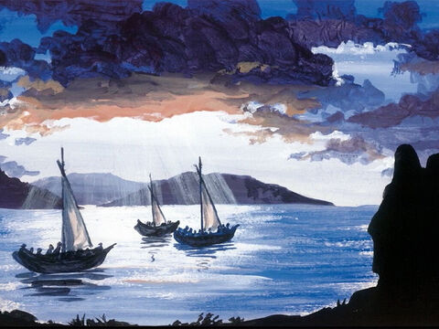
When Jesus heard what had happened,
he withdrew by boat privately to a solitary place.

Slide 14
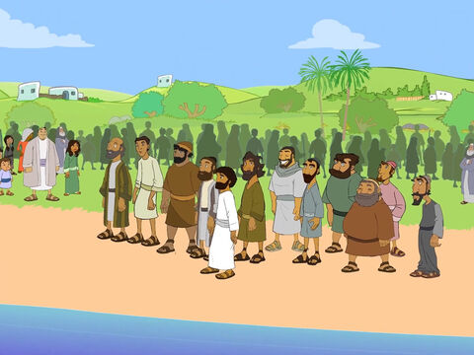
Hearing of this, the crowds followed him
on foot from the towns.

Slide 15
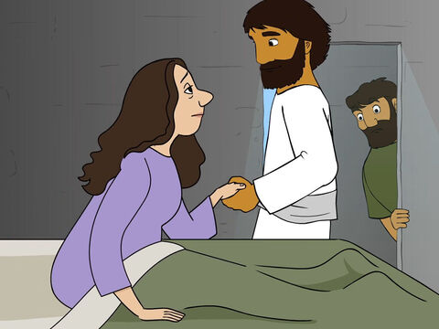
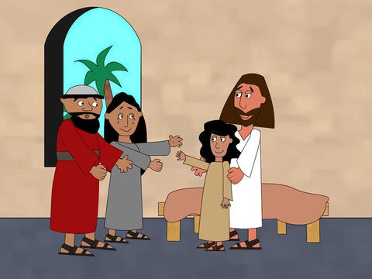
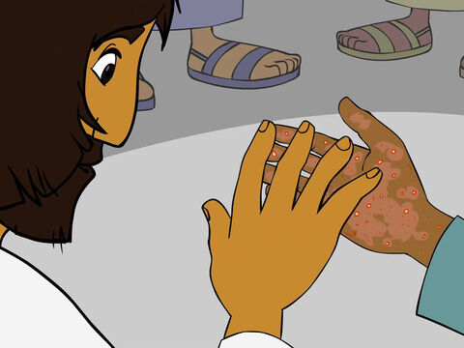
When Jesus landed and saw a large crowd,
he had compassion on them
and healed their sick.

Slide 16
As evening approached, the disciples came to him and said, “This is a remote place, and it’s already getting late. Send the crowds away, so they can go to the villages and buy themselves some food.”

Slide 17
Jesus replied,
“They do not need to go away.
You give them something to eat.”

Slide 18

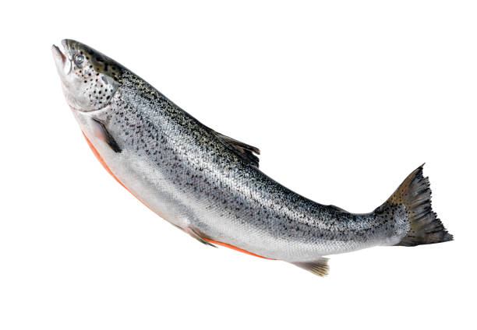
“We have here only five loaves of bread and two fish,” they answered.
5
2

Slide 19
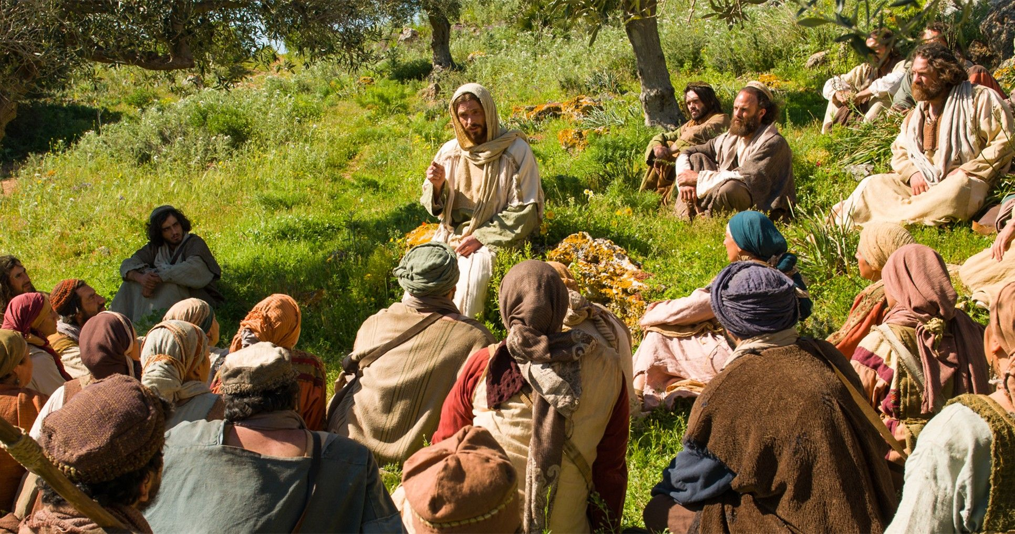
Bring them here to me,” he said.
And he directed the people to sit down on the grass.

Slide 20
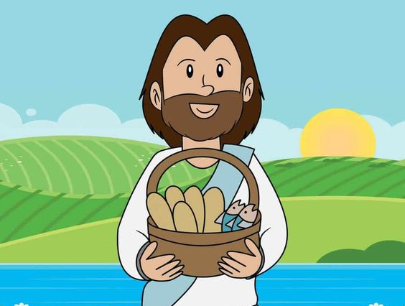
Taking the 5 loaves and the 2 fish
and looking up to heaven,
he gave thanks and broke the loaves.

Slide 21
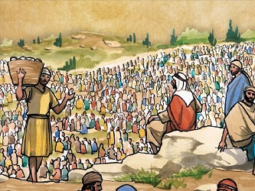
Then he gave them to the disciples,
and the disciples gave them to the people.

Slide 22
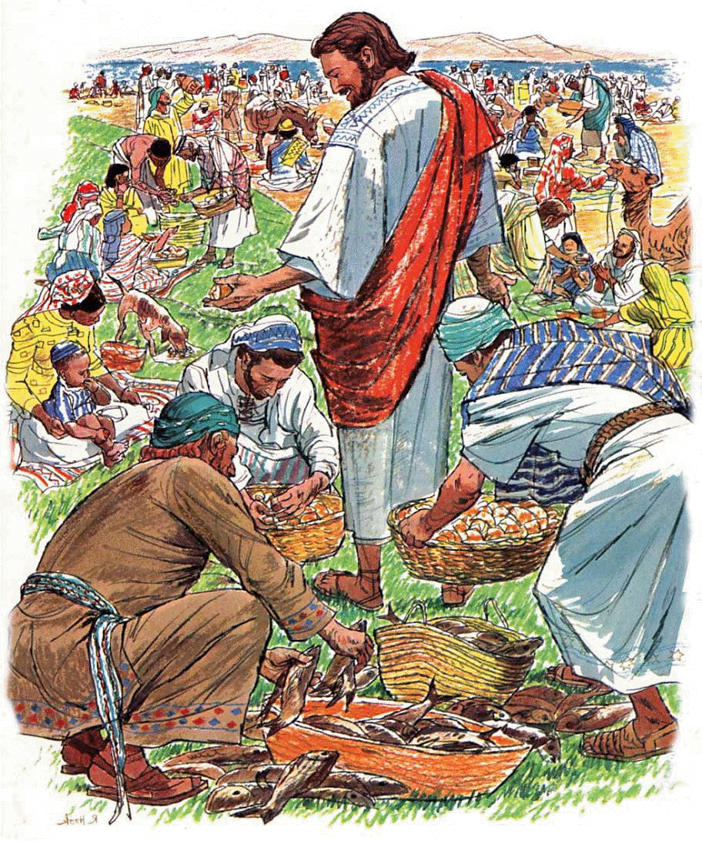
They all ate and were satisfied, and the disciples picked up 12 basketfuls of broken pieces that were left over

Slide 23
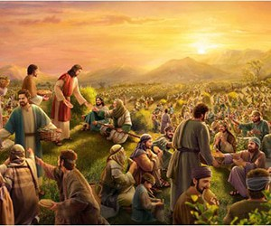
The number of those who ate was about 5000 men,
besides women and children.

Slide 24
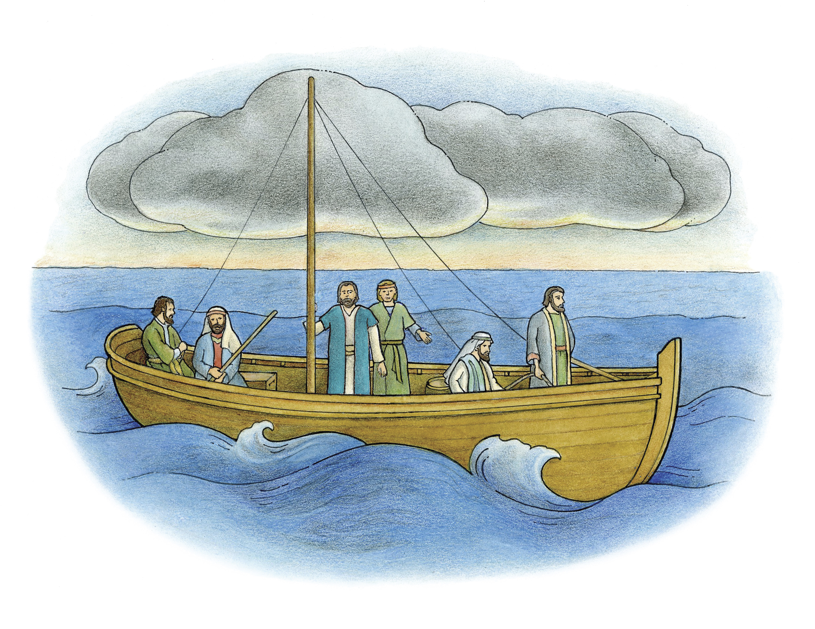
Immediately Jesus made the disciples
get into the boat
and go on ahead of him to the other side,
while he dismissed the crowd.

Slide 25
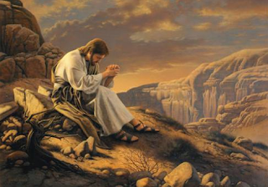
After he had dismissed them,
he went up on a mountainside
by himself to pray.

Slide 26
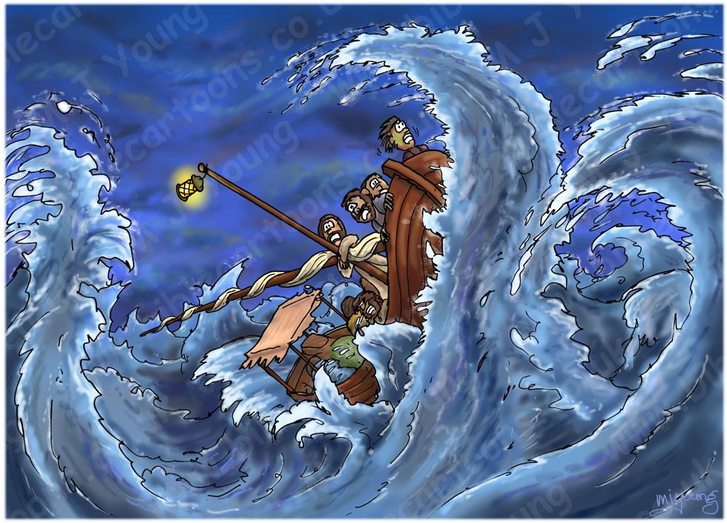
Later that night, he was there alone,
and the boat was already a considerable distance from land,
buffeted by the waves
because the wind was against it.

Slide 27
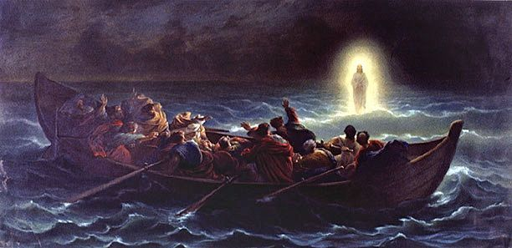
Shortly before dawn Jesus went out to them, walking on the lake.
When the disciples saw him walking
on the lake, they were terrified.

Slide 28
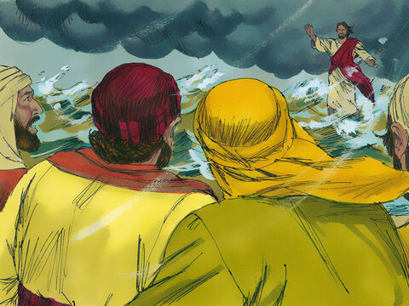
“It’s a ghost,” they said, and cried out in fear.
But Jesus immediately said to them:
“Take courage! It is I. Don’t be afraid.”

Slide 29
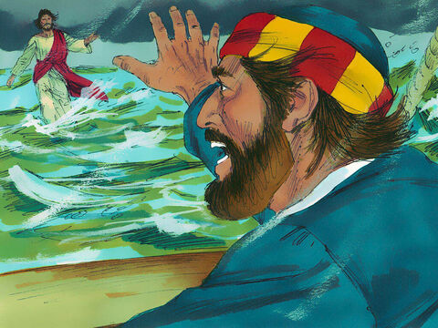
Lord, if it’s you,” Peter replied,
“tell me to come to you on the water.”
“Come,” he said.

Slide 30
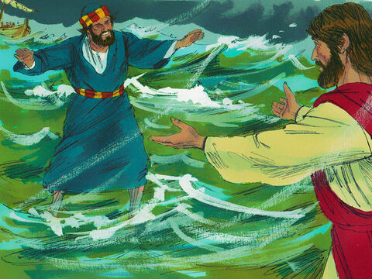
Then Peter got down out of the boat,
walked on the water and came toward Jesus.
But when he saw the wind, he was afraid and, beginning to sink,
cried out, “Lord, save me!”

Slide 31
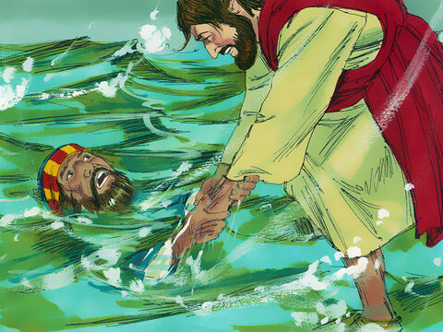
Immediately Jesus reached out his hand and caught him. “You of little faith,”
he said, “why did you doubt?”

Slide 32
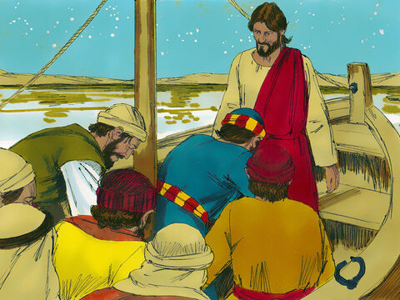
And when they climbed into the boat, the wind died down. Then those who were in the boat worshiped him, saying, “Truly you are the Son of God.”

Slide 33
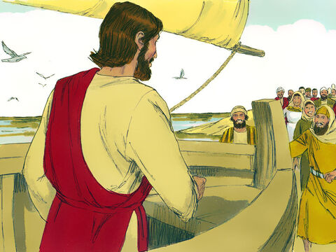
When they had crossed over, they landed at Gennesaret. And when the men of that place recognized Jesus, they sent word
to all the surrounding country.

Slide 34
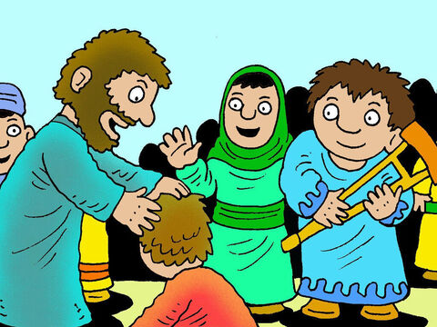
People brought all their sick to him and begged him to let the sick just touch the edge of his cloak, and all who touched it were healed.

