Slide 1
Matthew
Dig Site 8
Matthew 11:1-11, 25-30;
12:1-14

Slide 2

Hide it in your
Matthew 11:28-29a
DS#8

Slide 3
Come to me,
All you who are weary and burdened,
And I will give you rest.
Take my yoke upon you
and learn from me.
Matthew 11:28-29a
DS#8

Slide 4
Rest for the Weary

Slide 5
The Truth
Jesus Reveals the truth about himself and His kingdom to those who seek it!

Slide 6
Jesus and
John the Baptist

Slide 7
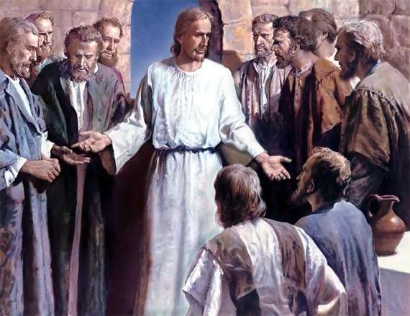
Picture of Jesus and disciples and or teaching and preaching
After Jesus had finished instructing his twelve disciples,

Slide 8
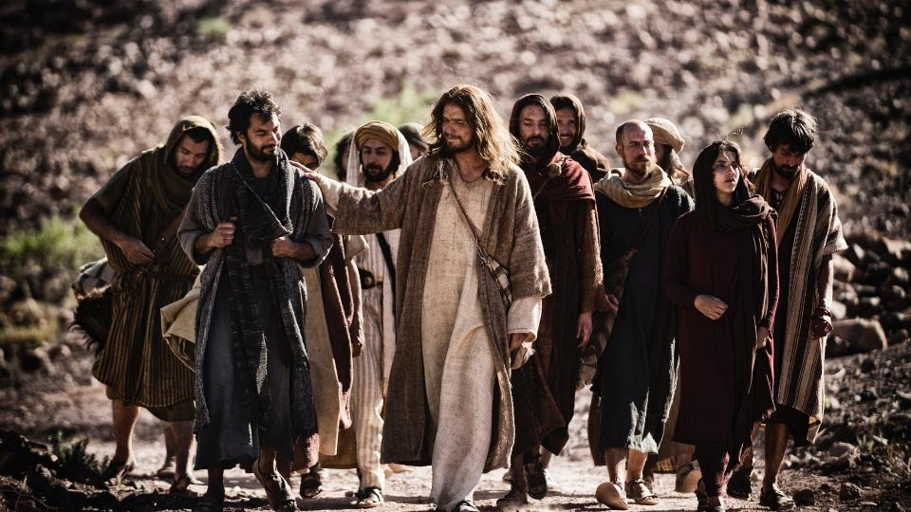
Picture of Jesus and disciples and or teaching and preaching
he went on from there to teach and preach in the towns of Galilee.

Slide 9
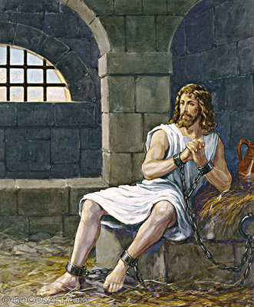
When John, who was in prison, heard about the deeds of the Messiah,
he sent his disciples to ask him,

Slide 10
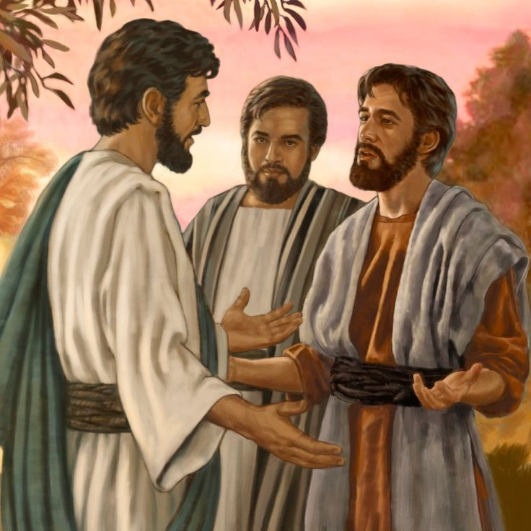
“Are you the one who is to come,
or should we expect someone else?”

Slide 11
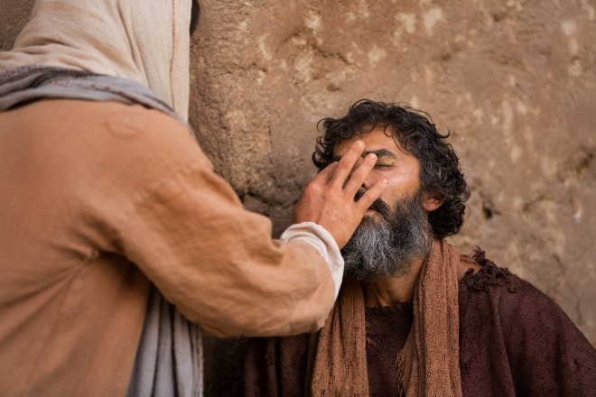
Jesus replied, “Go back and report to John what you hear and see:
The blind receive sight,

Slide 12
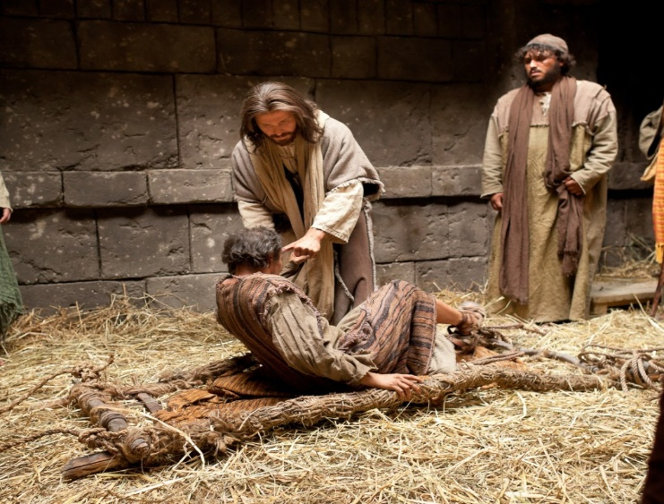
the lame walk,

Slide 13
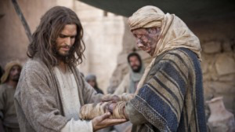
those who have leprosy are cleansed,

Slide 14
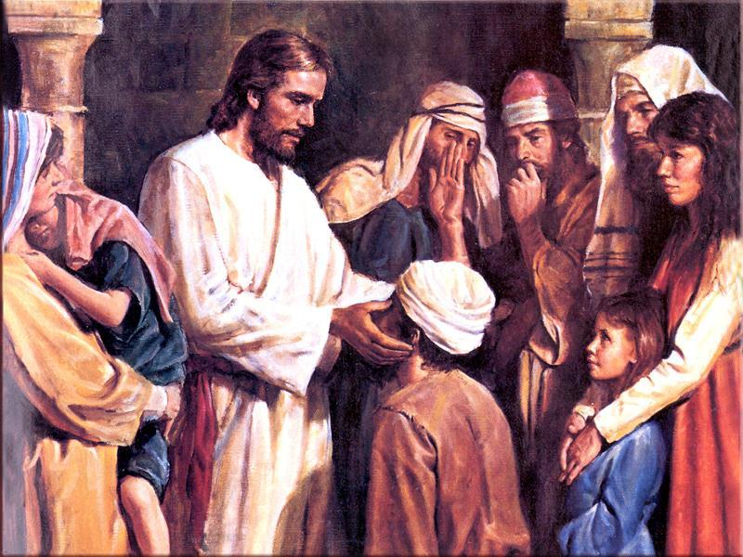
the deaf hear

Slide 15
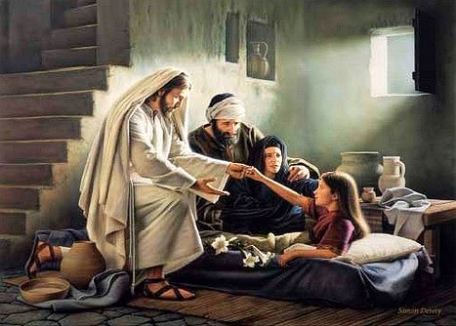
the dead are raised,

Slide 16
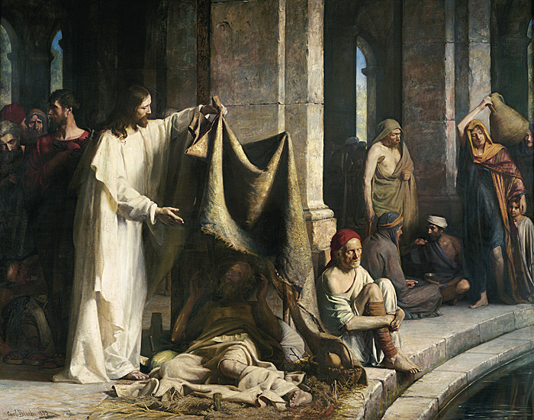
and the good news is proclaimed to the poor.

Slide 17
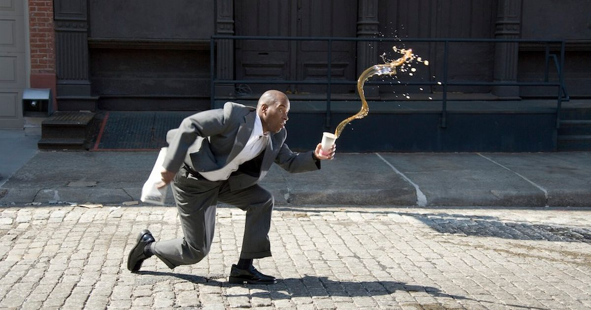
Blessed is anyone who does not stumble on account of me.”

Slide 18

As John’s disciples were leaving, Jesus began to speak to the crowd about John:
“What did you go out into the wilderness to see?
A reed swayed by the wind?

Slide 19
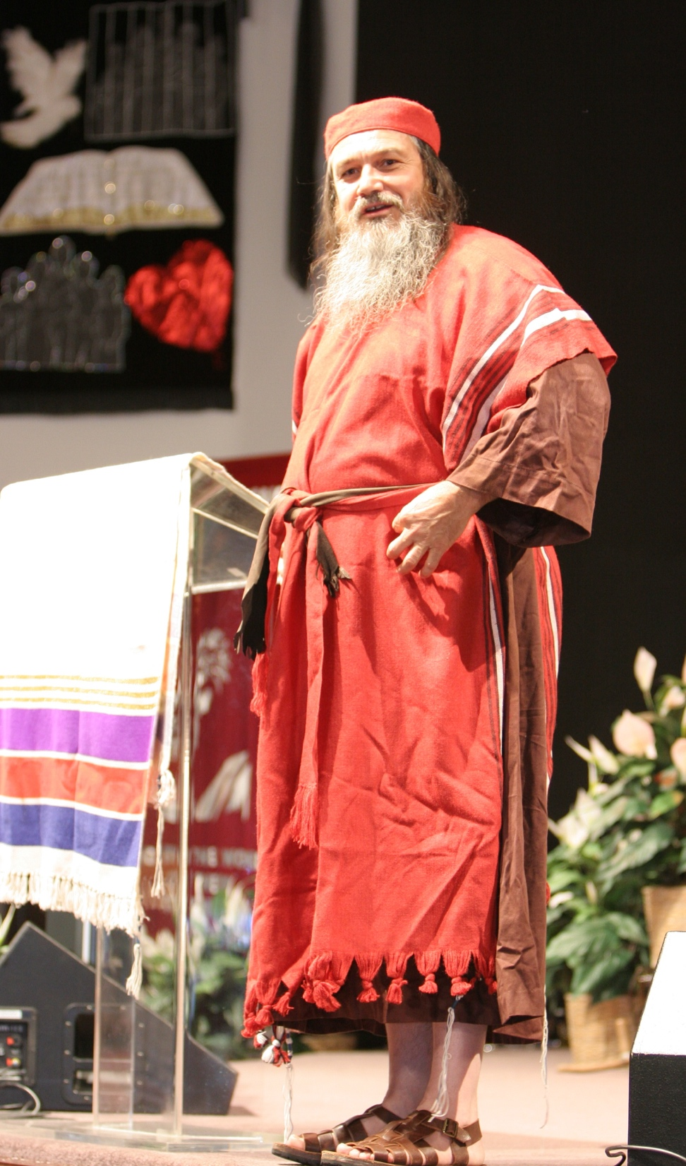
If not, what did you go out to see?
A man dressed in fine clothes?
No, those who wear fine clothes are in kings’ palaces.

Slide 20
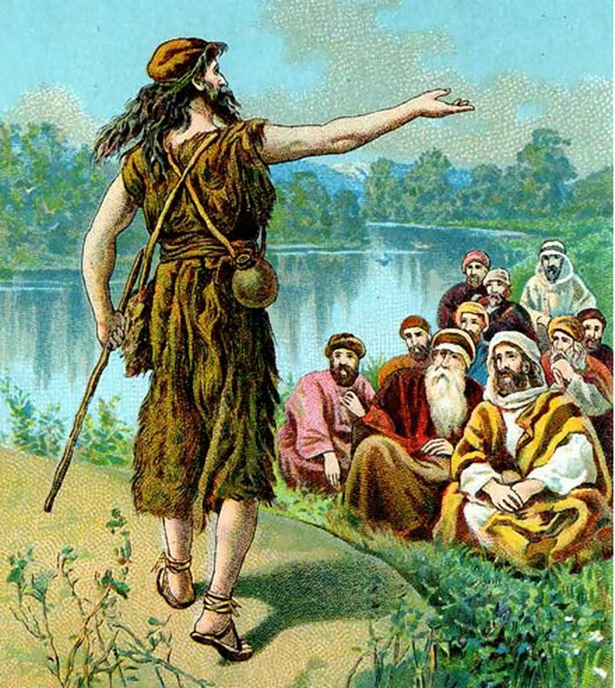
Then what did you go out to see? A prophet?
Yes, I tell you,
and more than a prophet.
This is the one about
whom it is written:
“‘I will send my messenger ahead of you,
who will prepare your way
before you.’

Slide 21
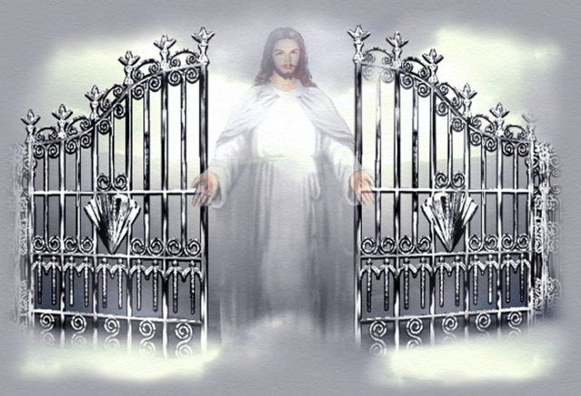
Truly I tell you, among those born of women there has not risen anyone greater than John the Baptist;
yet whoever is least in the kingdom of heaven
is greater than he.

Slide 22
Rest for the Weary

Slide 23
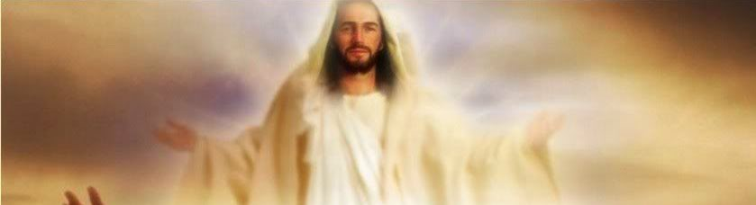
At that time Jesus said, “I praise you, Father, Lord of heaven and earth, because you have hidden these things from the wise and learned,
and revealed them to little children.
Yes, Father, for this is what you were pleased to do.

Slide 24
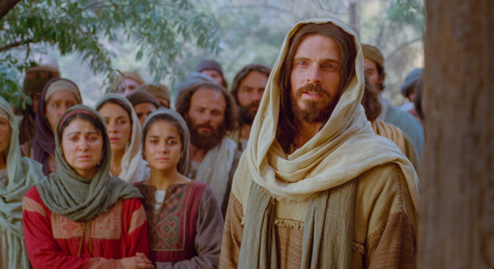
“All things have been committed to me by my Father. No one knows the Son except the Father, and no one knows the Father except the Son and those to whom
the Son chooses to reveal him.

Slide 25
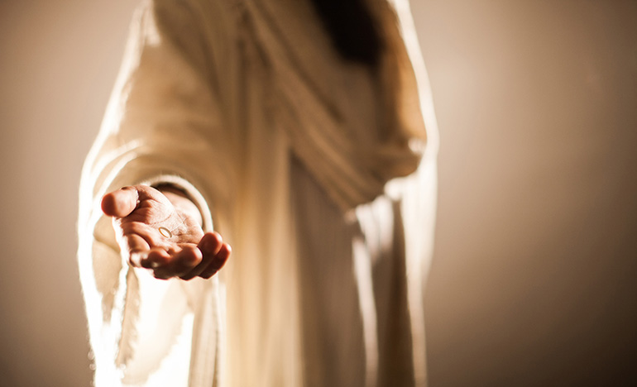
“Come to me, all you who are weary and burdened, and I will give you rest.

Slide 26
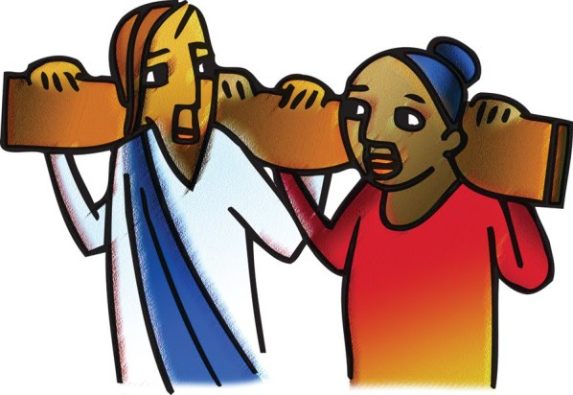
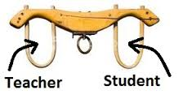
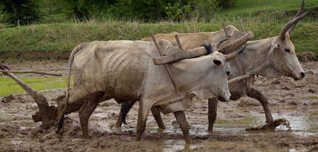
Take my yoke upon you and learn from me,
for I am gentle and humble in heart,
and you will find rest for your souls.
For my yoke is easy and my burden is light.”

Slide 27
Lord of the
Sabbath

Slide 28
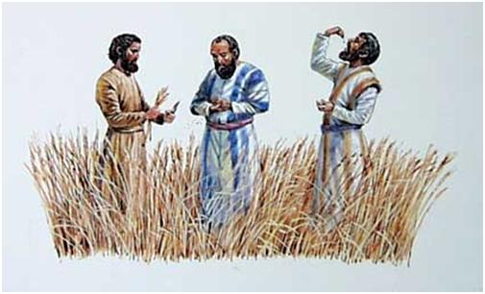
At that time Jesus went through the grain fields on the Sabbath. His disciples were hungry and began to pick some heads of grain and eat them.

Slide 29
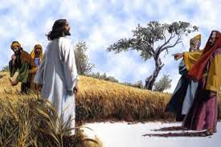
When the Pharisees saw this, they said to him, “Look! Your disciples are doing what is unlawful on the Sabbath.”

Slide 30
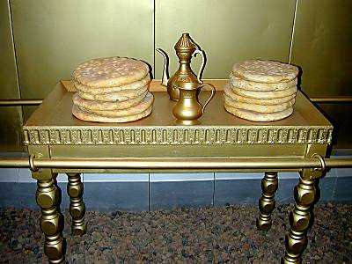
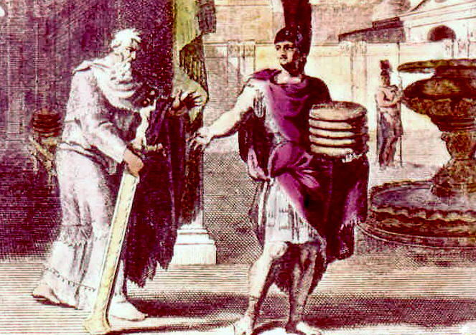
He answered,
“Haven’t you read what David did when he and his companions were hungry?

Slide 31
He entered the house of God, and he and his companions ate the consecrated bread—which was not lawful for them to do,
but only for the priests.
Or haven’t you read in the Law that the priests on Sabbath duty in the temple desecrate the Sabbath and yet are innocent?

Slide 32
I tell you that something greater
than the temple is here.
If you had known what these words mean,
‘I desire mercy, not sacrifice,’
you would not have condemned the innocent.

Slide 33
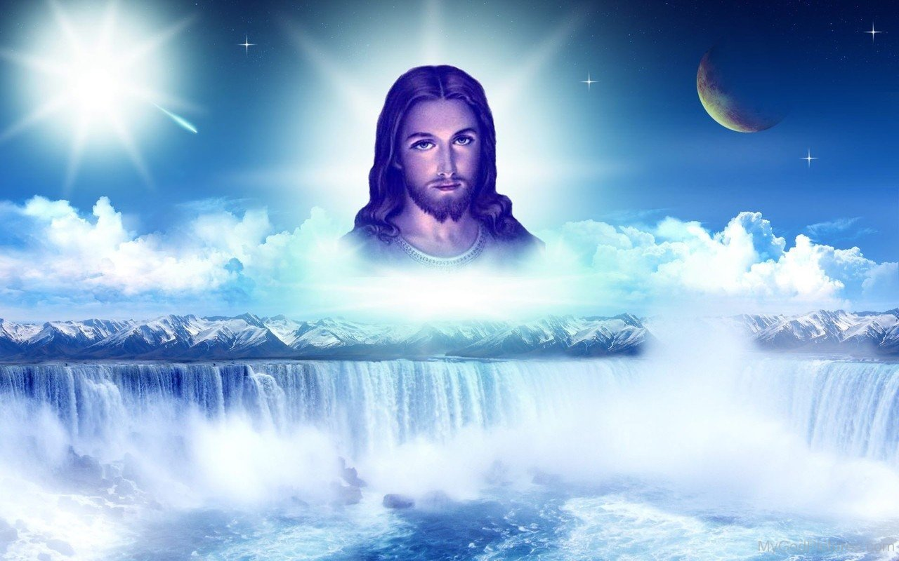
For the Son of Man is Lord of the Sabbath.”

Slide 34
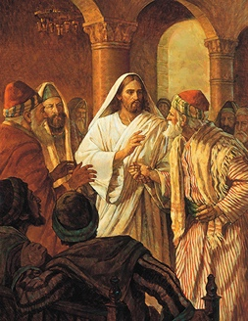
Going on from that place, he went into their synagogue, and a man with a shriveled hand was there.
Looking for a reason to bring charges against Jesus, they asked him,
“Is it lawful to heal
on the Sabbath?”

Slide 35
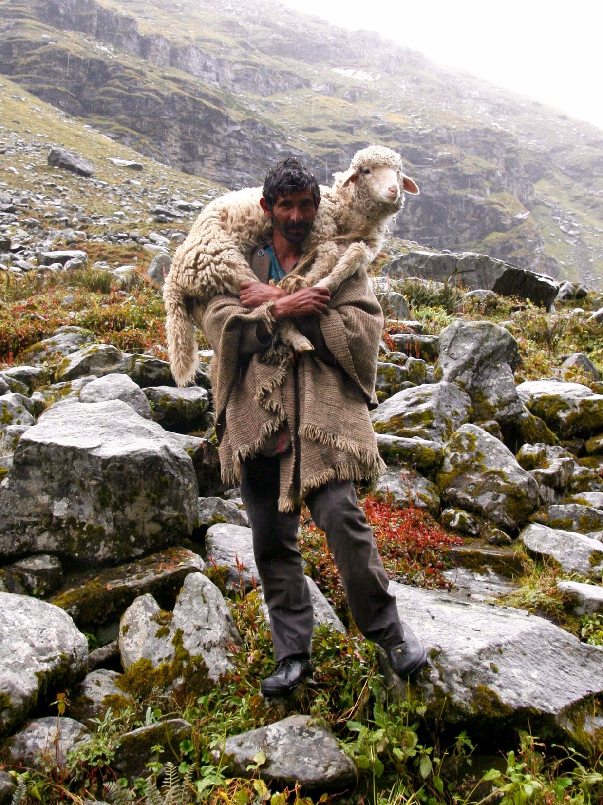
He said to them, “If any of you has a sheep and it falls into a pit on the Sabbath,
will you not take hold of it and lift it out?
How much more valuable is a person than a sheep! Therefore it is lawful to do good on the Sabbath.”
Do Good on the Sabbath

Slide 36
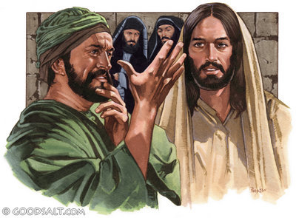
Then he said to the man,
“Stretch out your hand.”
So he stretched it out and it was completely restored, just as sound as the other.

Slide 37
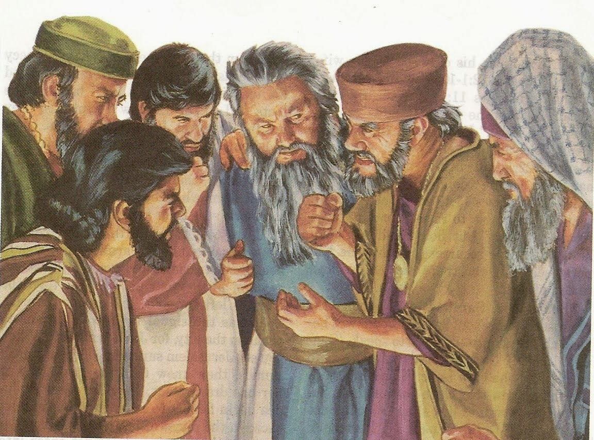
But the Pharisees went out and plotted how they might kill Jesus.

