Slide 1
Memory Verse
Then he said to his disciples, “The harvest is plentiful but the workers are few.
Ask the Lord of the harvest, therefore, to send out workers into his harvest field.”
Matthew 9:37-38
Lesson #7

Slide 2
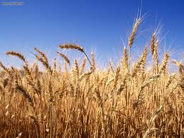
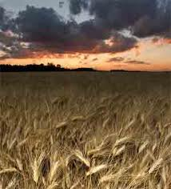
Time for the Harvest
Lesson #7
Matthew 9:9-13, 18-26, 35-38; 10:1-14

Slide 3
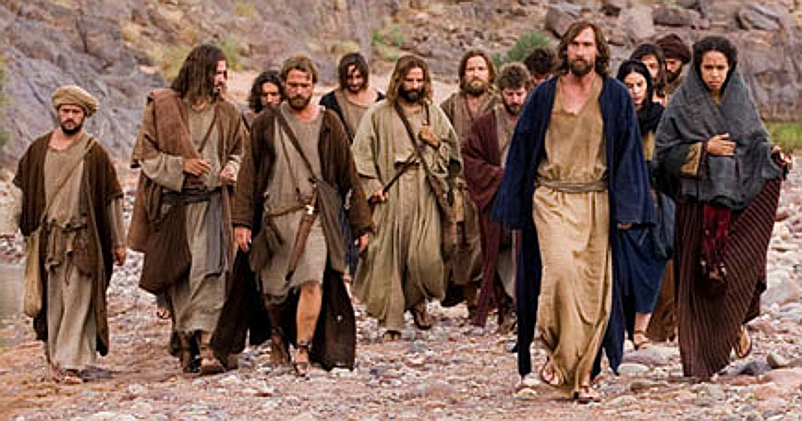
The Truth
Jesus invites us to become his disciples and join Him in building His kingdom!
Lesson #7

Slide 4
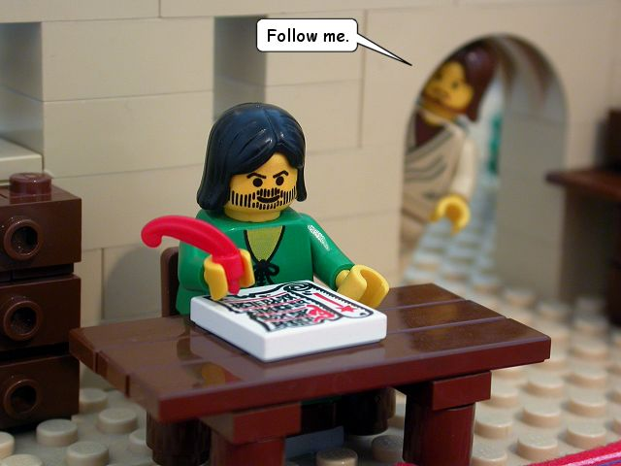
As Jesus went on from there, he saw a man named Matthew sitting at the tax collector’s booth. “Follow me,” he told him, and Matthew got up and followed him.
Tax Collector (Matthew)

Slide 5

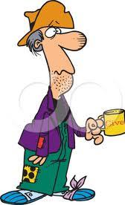
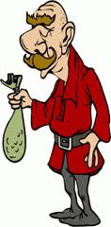
While Jesus was having dinner at Matthew’s house, many tax collectors and “sinners” came and ate with him and his disciples.
Tax Collectors
“sinners”
an
ephod

Slide 6
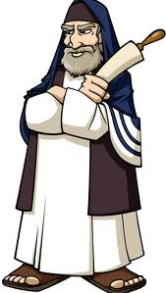
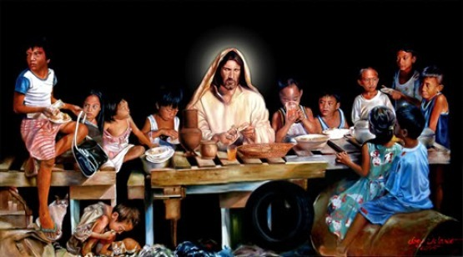
When the Pharisees saw this, they asked his disciples, “Why does your teacher eat with tax collectors and ‘sinners’?”
Pharisees →

Slide 7
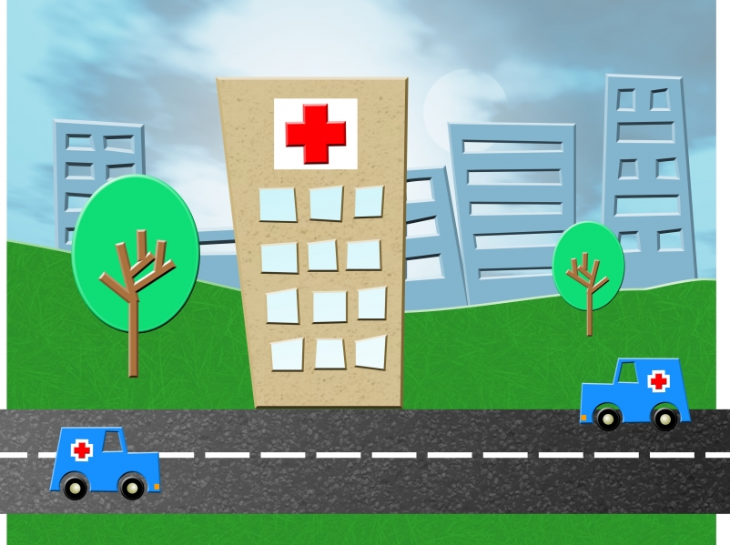


On hearing this, Jesus said, “It is not the healthy who need a doctor, but the sick.

Slide 8
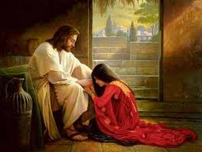
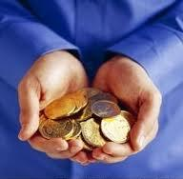
But go and learn what this means:
‘I desire mercy, not sacrifice.’
For I have not come to call the righteous, but sinners.”
X
Desire mercy
Not sacrifice

Slide 9
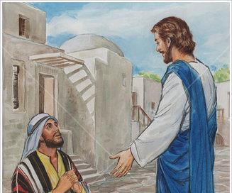
While he was saying this, a synagogue leader came and knelt before him and said,

Slide 10
My daughter has
just died.
But come and put your hand on her, and she will live.
Jesus got up and went with him,
and so did his disciples.

Slide 11
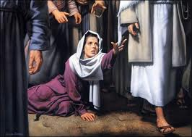
Just then a woman who had been subject to bleeding for twelve years came up behind him and touched the edge of his cloak.

Slide 12
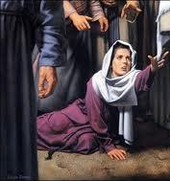
She said to herself,
If I only touch his cloak, I will be healed.

Slide 13
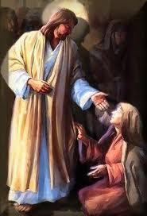
Jesus turned and saw her. “Take heart, daughter,” he said, “your faith has healed you.” And the woman was healed at that moment.

Slide 14
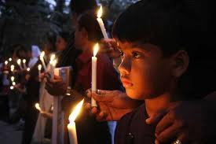

When Jesus entered the synagogue leader’s house and saw the noisy crowd and people playing pipes, he said, “Go away. The girl is not dead but asleep.” But they laughed at him.
Ha ! Ha !

Slide 15
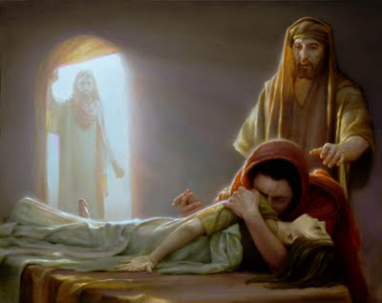
After the crowd had been put outside,
he went in
and took the
girl by the hand,

Slide 16
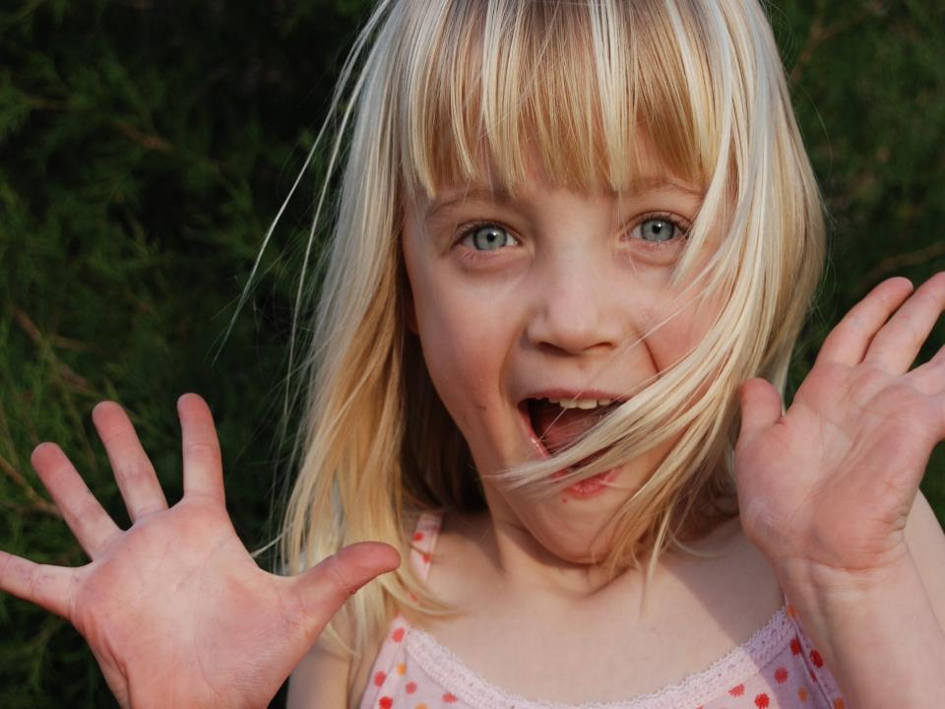
… and she got up.
News of this spread through all that region.

Slide 17
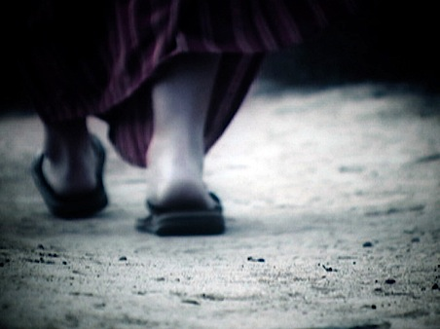
Jesus went through all the towns and villages,
teaching in their synagogues, proclaiming the good news of the kingdom
and healing every disease and sickness.

Slide 18
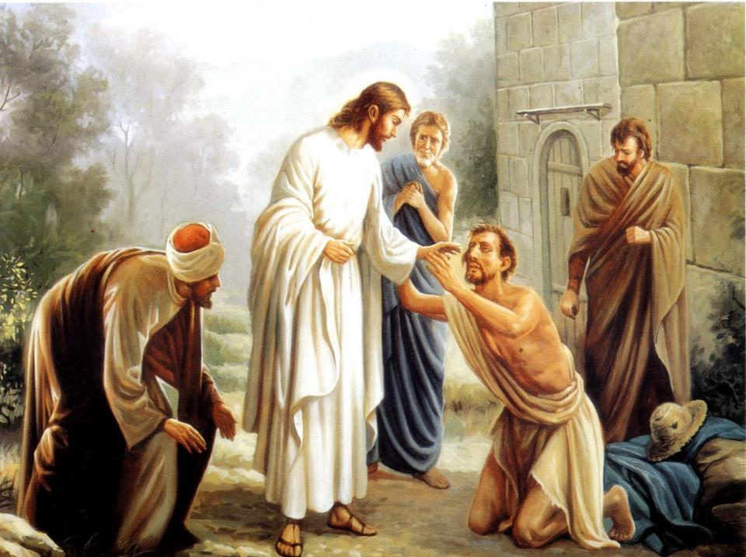
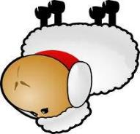
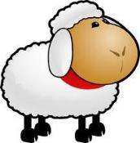
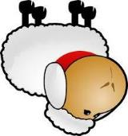
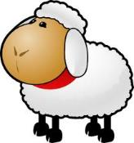
When he saw the crowds, he had compassion
on them,
because they were
harassed and helpless,
like sheep
without a shepherd.

Slide 19

Then he said to his disciples,
“The harvest is plentiful but the workers are few.
Ask the Lord of the harvest, therefore, to send out workers into his harvest field.”

Slide 20

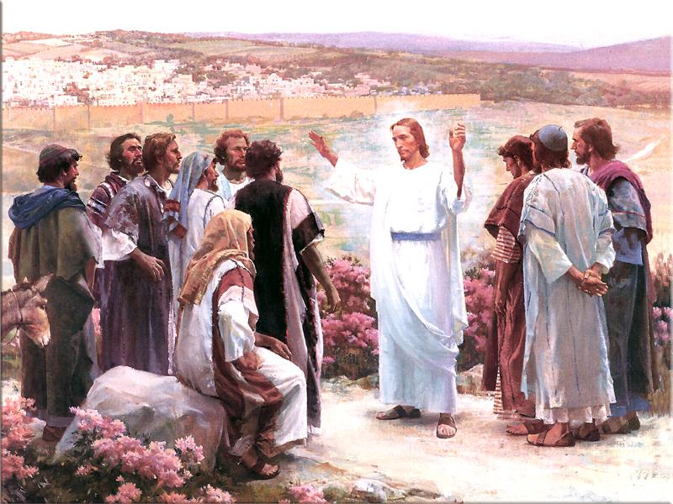

He called his twelve disciples to him and gave them authority to drive out impure spirits and to heal every disease and sickness.

Slide 21
These are the names of the twelve apostles: first,
1
Simon (who is called Peter)
2
and his brother Andrew
3
James son of Zebedee
4
and his brother John;
5
Philip
6
and Bartholomew

Slide 22
Thomas
7
8
and Matthew
the tax collector;
9
James son of Alphaeus,
10
and Thaddaeus;
11
Simon the Zealot
12
And Judas Iscariot,
who betrayed him.

Slide 23
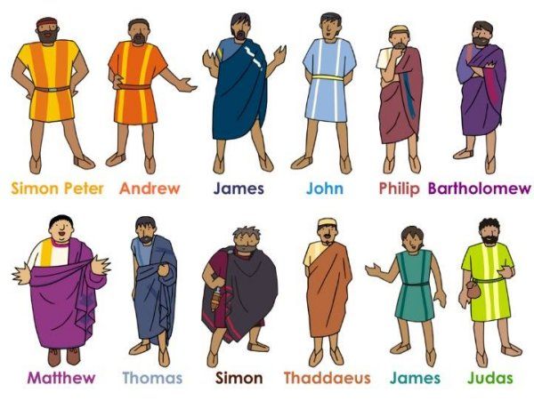
These twelve Jesus sent out with the following instructions:
This Photo by Unknown Author is licensed under CC BY-NC-ND

Slide 24
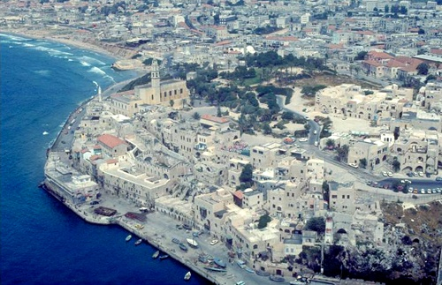
“Do not go among the Gentiles or enter any town of the Samaritans.

Slide 25

Go rather to the lost sheep of Israel.
As you go, proclaim this message:
‘The kingdom of heaven has come near.’

Slide 26
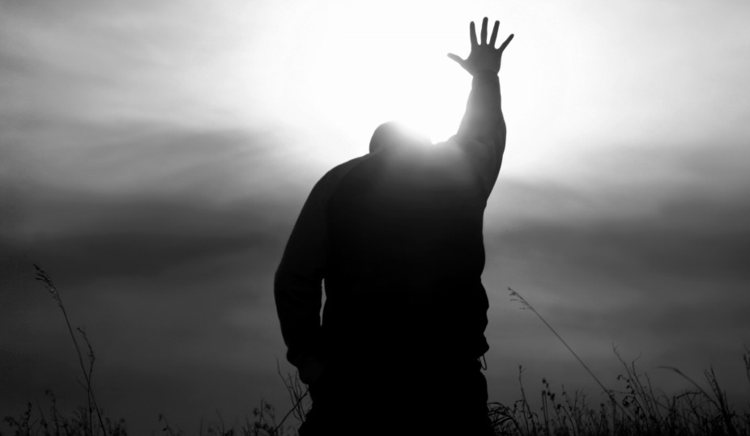

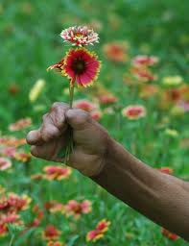
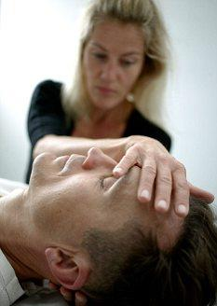
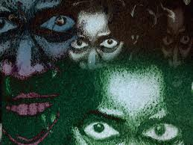
Heal the sick, raise the dead, cleanse
those who have leprosy, drive out demons.
Freely you have received, freely give.

Slide 27

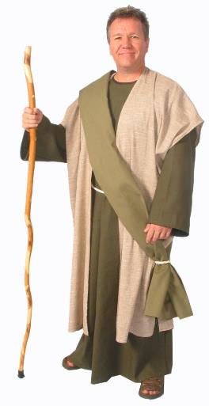
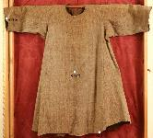
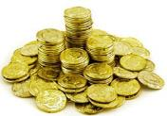
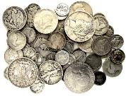
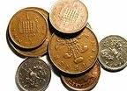

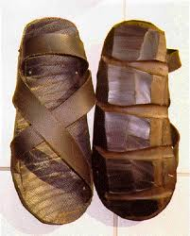
Do not get any gold or silver or copper to take with you in your belts, no bag for the journey, or extra shirt, or sandals or a staff;
for
the
worker
is
worth
his
keep.

Slide 28
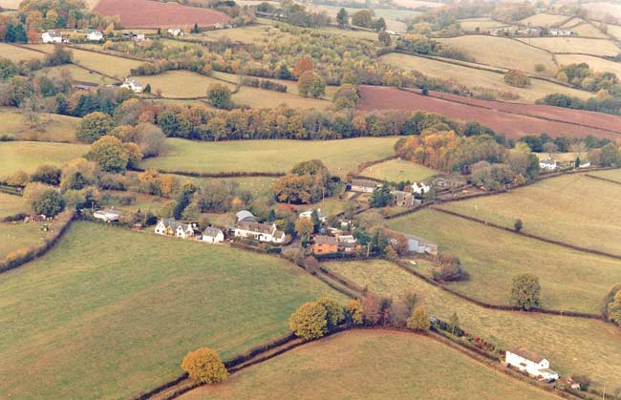
“Whatever town or village you enter, search there for some worthy person and stay at their house until you leave.

Slide 29
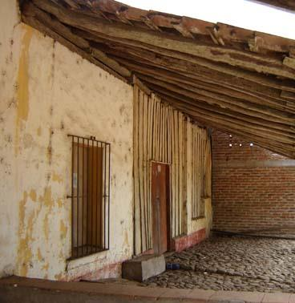
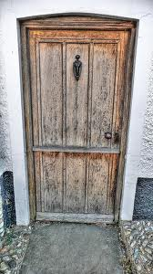
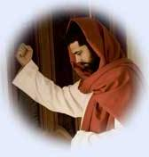
As you enter the home, give it your greeting.
If the home is deserving, let your peace rest on it; if it is not, let your peace return to you.
Greetings!
We have been expecting you.
Peace be with you.

Slide 30

If anyone will not welcome you or listen to your words, leave that home or town and shake the dust off your feet.

