Slide 1
The Birth of Samuel
Dig Site 1
1 Samuel 1:1–28; 2:11

Slide 2
Memory Verse
For the eyes of the Lord are on the righteous
and his ears are attentive to their prayer,
but the face of the Lord
is against those who do evil.
1 Peter 3:12
Lesson #1

Slide 3
The Truth
God cares for us and hears our prayers!
Lesson #1

Slide 4
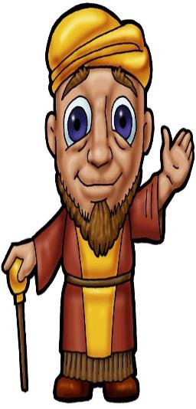
There was a certain man from Ramathaim, a Zuphite from the hill country of Ephraim, whose name was Elkanah son of Jeroham, the son of Elihu, the son of Tohu, the son of Zuph, an Ephraimite.
Elkanah

Slide 5
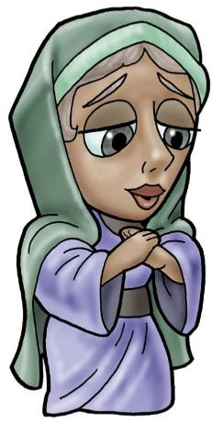
He had two wives;
one was called Hannah and the other Peninnah.
Peninnah had children, but Hannah had none.

Slide 6
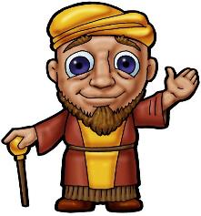
Year after year this man went up from his town to worship and sacrifice to the LORD Almighty at Shiloh*,
Elkanah

Slide 7
Mediterranean Sea
SHILOH
Jordan River
RAMAH
(Ramathaim)
Dead
Sea
EGYPT

Slide 8
where Hophni and Phinehas, the two sons of Eli, were priests of the LORD.

Slide 9
Whenever the day came for Elkanah to sacrifice, he would give portions of the meat to his wife Peninnah* and to all her sons and daughters.

Slide 10
But to Hannah he gave a double portion because he loved her, and the LORD had closed her womb.

Slide 11

Because the LORD had closed Hannah’s womb, her rival kept provoking her in order to irritate her*.
I bet you wish you had kids like I do!!

Slide 12
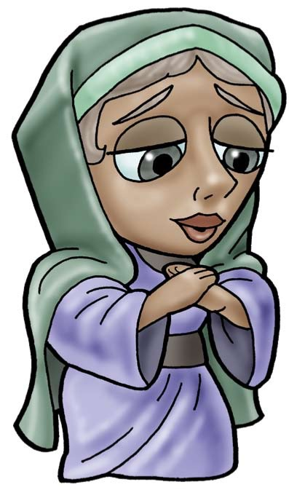
This went on year after year. Whenever Hannah went up to the house of the LORD, her rival provoked her till she wept and would not eat*.

Slide 13
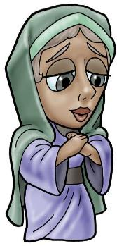

Her husband Elkanah her husband would say to her,
Hannah, why are you weeping? Why don't you eat? Why are you downhearted?

Slide 14

Don't I mean more to you than ten sons?"

Slide 15

Once when they had finished eating and drinking in Shiloh, Hannah stood up.

Slide 16
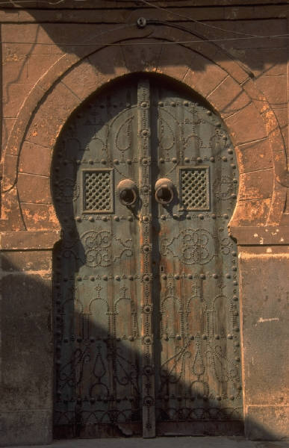
Now Eli the priest was sitting on a chair by the doorpost of the LORD's house.

Slide 17
In her deep anguish Hannah prayed to the LORD, weeping bitterly. And she made a vow, saying,
LORD Almighty, if you will only look on your servant's misery and remember me, and not forget your servant but give her a son, then I will give him to the LORD for all the days of his life, and no razor will ever be used on his head.

Slide 18
As she kept on praying to the LORD, Eli observed her mouth.

Slide 19
Hannah was praying in her heart, and her lips
were moving but her voice
was not heard.

Slide 20
Eli thought she was drunk and said to her*,
How long are you going to stay drunk?
Put away your wine.

Slide 21
Not so, my lord," Hannah replied, "I am a woman who is deeply troubled. I have not been drinking wine or beer; I was pouring out my soul to the LORD. Do not take your servant for a wicked woman; I have been praying here out of my great anguish and grief.”

Slide 22
Eli answered, "Go in peace, and may the God of Israel grant you what you have asked of him*."
She said, "May your servant find favor in your eyes.”

Slide 23
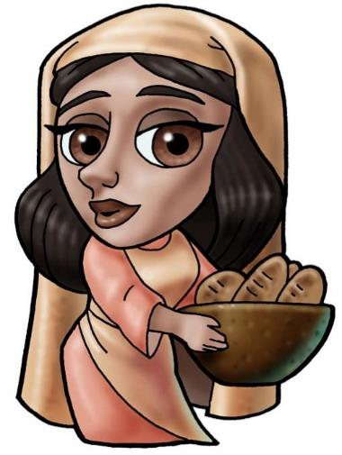
Then she went her way and ate something, and her face was no longer downcast.

Slide 24
Early the next morning they arose and worshiped before the LORD

Slide 25
…and then went back to their home at Ramah. Elkanah loved his wife Hannah, and the LORD remembered her.

Slide 26

So in the course of time Hannah became pregnant and gave birth to a son. She named him Samuel, saying,
Because I asked the LORD for him.

Slide 27
When the man Elkanah went up with all his family* to offer the annual sacrifice to the LORD and to fulfill his vow, Hannah did not go.

Slide 28
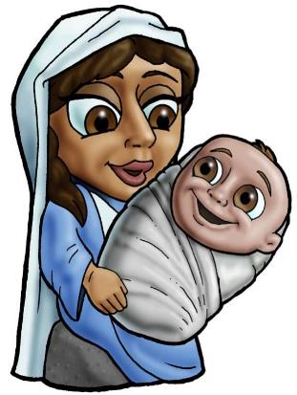
She said to her husband,
After the boy is weaned, I will take him and present him before the LORD, and he will live there always.

Slide 29

Do what seems best to you
her husband, Elkanah told her.
Stay here until you have weaned him; only may the LORD make good his word.
So the
woman stayed at home and nursed her son until she had weaned him.

Slide 30




After he was weaned, she took the boy with her*, young as he was, along with
a three-year-old bull*,
an ephah of flour*
and a skin of wine*,
and brought him
to the house of
the LORD
at Shiloh.

Slide 31



When the bull had been sacrificed, they brought the boy to Eli, and she said to him*,
Pardon me, my Lord. As surely as you live, I am the woman who stood here beside you
praying to
the LORD.

Slide 32
I prayed for this child, and the LORD has granted me what I asked of him. So now I give him to the LORD. For his whole life he will be given over to the LORD.

Slide 33


And he worshiped the LORD there.
Then Elkanah went home to Ramah,
but the boy ministered before the
LORD under Eli the priest.

