Slide 1
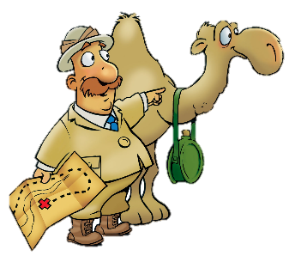
A Message of Hope
Judges 13:1-25

Slide 2
Faith Words
Hope
A feeling of certainty that God will keep His promises. Hope grows out of trust in God.

Slide 3
The Truth
God brings hope in times of deep trouble.

Slide 4
Memory Verse
“The LORD delights in those who fear Him, who put their hope in His unfailing love.”

Slide 5

Again the Israelites did evil in the eyes of the LORD, so the LORD delivered them into the hands of the Philistines for forty years.
Years

Slide 6
No children…
A certain man of Zorah, named Manoah, from the clan of the Danites, had a wife who was childless, unable to give birth.

Slide 7
The angel of the LORD appeared to her and said,
“You are barren and childless, but you are going to become pregnant and give birth to a son…”

Slide 8

”Now see to it that you drink no wine or other fermented drink and that you do not eat anything unclean.

Slide 9

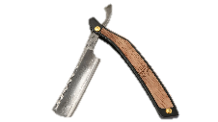
“You will become pregnant and have a son whose head is never to be touched by a razor because the boy is to be a Nazarite, dedicated to God from the womb.
He will take the lead in delivering Israel from the hands of the Philistines.”

Slide 10
Then the woman went to her husband and told him,
“A man of God came to me. He looked like an angel of God, very awesome. I didn’t ask him where he came from, and he didn’t tell me his name. But he said to me,

Slide 11
‘You will become pregnant and have a son. Now then, drink no wine or other fermented drink and do not eat anything unclean, because the boy will be a Nazarite of God from the womb until the day of his death.’”

Slide 12
Then Manoah prayed to the LORD:
“Pardon your servant, Lord. I beg you to let the man of God you sent to us come again to teach us how to bring up the boy who is to be born.

Slide 13
God heard Manoah, and the angel of God came again to the woman while she was out in the field; but her husband Manoah was not with her.

Slide 14
“He’s here! The man who appeared to me the other day!”

Slide 15
Manoah got up and followed his wife.
When he came to the man, he said,

Slide 16
“Are you the man who talked to my wife?”
“I am.”
When your words are fulfilled, what is to be the rule that governs the boy’s life and work?”

Slide 17

“Your wife must do all that I have told her. She must not eat anything that comes from the grapevine, nor drink any wine or other fermented drink nor eat anything unclean. She must do everything I have commanded her.”
Manoah said the the angel of the LORD, “We would like you to stay until we prepare a young goat for you.”

Slide 18
“Even though you detain me, I will not eat any of your food. But if you prepare a burnt offering, offer it to the LORD.”
(Manoah did not realize that it was the angel of the LORD.) Then Manoah inquired of the angel of the LORD,
“What is your name, so that we may honor you when your word comes true?

Slide 19
“Why do you ask my name? It is beyond understanding.
Then Manoah took a young goat, together with the grain offering, and sacrificed it on a rock to the LORD.

Slide 20
And the LORD did an amazing thing while Manoah and his wife watched: As the flame blazed up from the altar toward heaven, the angel of the LORD ascended in the flame.

Slide 21
Seeing this, Manoah and his wife fell with their faces to the ground. When the angel of the LORD did not show himself again to Manoah and his wife, Manoah realized that it was the angel of the LORD.

Slide 22
“We are doomed to die!
We have seen God!
“If the LORD had meant to kill us, he would not have accepted a burnt offering and grain offering from our hands, nor shown us all these things or now told us this.”

Slide 23
The woman gave birth to a boy and named him Samson.

Slide 24
He grew and the LORD blessed him, and the Spirit of the LORD began to stir him while he was in Mahaneh Dan, between Zorah and Eshtaol.

