Slide 1
Lesson #10
Every Promise Kept
Joshua 20:1-9; 21:1-8, 43-45

Slide 2
Memory Verse
“Not one of all the LORD’s good promises to Israel failed; every one was fulfilled.”
Joshua 21:45

Slide 3
The Truth
God keeps His promises to His faithful people!

Slide 4
FAITH WORD
PROMISE
To give your word that you will or will not do something. God always does what He says He will do.

Slide 5
Then the LORD said to Joshua:
“Tell the Israelites to designate the cities of refuge, as I instructed you through Moses, so that anyone who kills a person accidentally and unintentionally may flee there and find protection from the avenger of blood.”

Slide 6
“When they flee to one of these cities, they are to stand in the entrance of the city gate and state their case before the elders of that city. Then the elders are to admit the fugitive into their city and provide a place to live among them.

Slide 7
If the avenger of blood comes in pursuit, the elders must not surrender the fugitive, because the fugitive killed their neighbor unintentionally and without malice aforethought.

Slide 8

They are to stay in that city until they have stood trial before the assembly and until the death of the high priest who is serving at that time. Then they may go back to their own home in the town from which they fled.”

Slide 9
So they set apart Kedesh in Galilee in the hill country of Naphtali, Shechem in the hill country of Ephraim, and Kiriath Arba (that is Hebron) in the hill country of Judah.

Slide 10
East of the Jordan (on the other side from Jericho) they designated Bezer in the wilderness on the plateau in the tribe of Reuben, Ramoth in Gilead in the tribe of Gad, and Golan in Bashan in the tribe of Manasseh.

Slide 11
Any of the Israelites or any foreigner residing among them who killed someone accidentally could flee to these designated cities and not be killed by the avenger of blood prior to standing trial before the assembly.

Slide 12
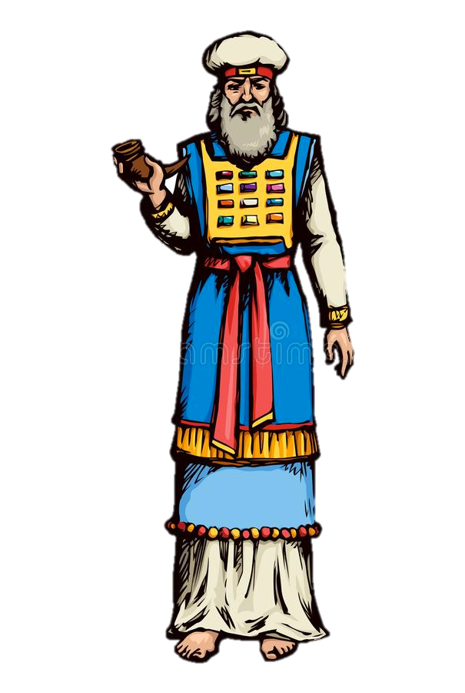
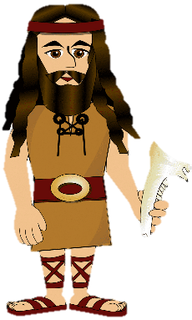
Now the family heads of the Levites approached Eleazar the priest, Joshua son of Nun, and the heads of the other tribal families of Israel at Shiloh in Canaan and said to them.

Slide 13

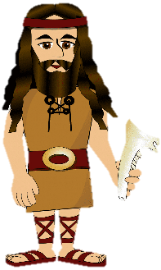
“The LORD commanded through Moses that you give us towns to live in, with pasturelands for our livestock.”

Slide 14
So, as the LORD had commanded, the Israelites gave the Levites the following towns and pasturelands out of their own inheritance:
KOHATHITES AND DESCENDANTS
13 TOWNS From Judah Simeon
Benjamin
10 TOWNS Ephraim
Dan
Half tribe of Manasseh

Slide 15
So, as the LORD had commanded, the Israelites gave the Levites the following towns and pasturelands out of their own inheritance:
GERSHON AND DESCENDANTS
13 TOWNS Issachar
Asher
Naphtali
Half-tribe of Manasseh

Slide 16
So, as the LORD had commanded, the Israelites gave the Levites the following towns and pasturelands out of their own inheritance:
MERARI AND DESCENDANTS
12 TOWNS Reuben
Gad
Zebulan

Slide 17
So the LORD gave Israel all the land he had sworn to give their ancestors, and they took possession of it and settled there.

Slide 18

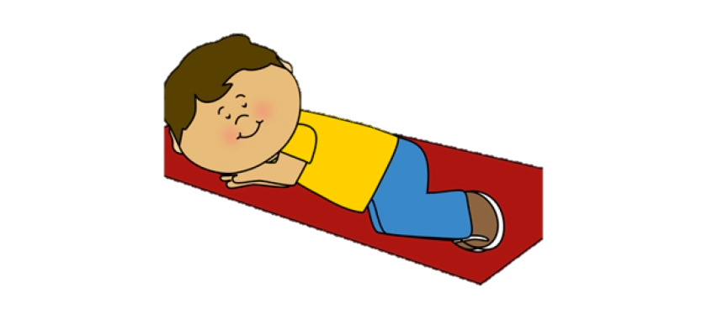
The LORD gave them rest on every side, just as He had sworn to their ancestors. Not one of their enemies withstood them; the LORD gave all their enemies into their hands.

Slide 19
“NOT ONE OF ALL THE LORD’S GOOD PROMISES TO ISRAEL FAILED; EVERY ONE WAS FULFILLED.”

