Slide 1
Lesson #9
Land at Last
Joshua 13:1-7 & 14:1-15

Slide 2
Memory Verse
And whatever you do, whether in word or deed, do it all in the name of the Lord Jesus, giving thanks to God the Father through him.
Colossians 3:17

Slide 3
The Truth
God blesses those who serve him wholeheartedly!

Slide 4
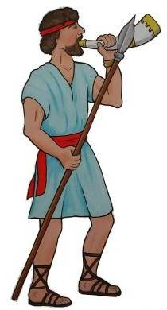
When Joshua had grown old, the Lord said to him, “You are now very old, and there are still very large areas of land to be taken over.

Slide 5
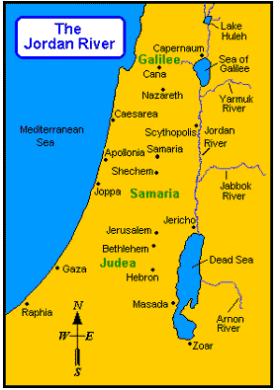
This is the land that remains: all the regions of the Philistines and Geshurites, from the Shihor River on the east of Egypt to the territory of Ekron on the north,
Ekron
Philistines
Shihor River

Slide 6
all of it counted as Canaanite though held by the five Philistine rulers in Gaza, Ashdod, Ashkelon, Gath and Ekron; the territory of the Avvites on the south;
Canaanite
Ashdod
Ekron
Ashkelon
Gath

Slide 7
all the land of the Canaanites, from Arah of the Sidonians
as far as Aphek
SIDON
APHEK

Slide 8
Byblos
Palestine
and the border of the Amorites; the area of Byblos;

Slide 9
Mt.
Hermon
Lebo
Hamath
and all Lebanon to the east, from Baal Gad below Mount Hermon to Lebo Hamath.

Slide 10
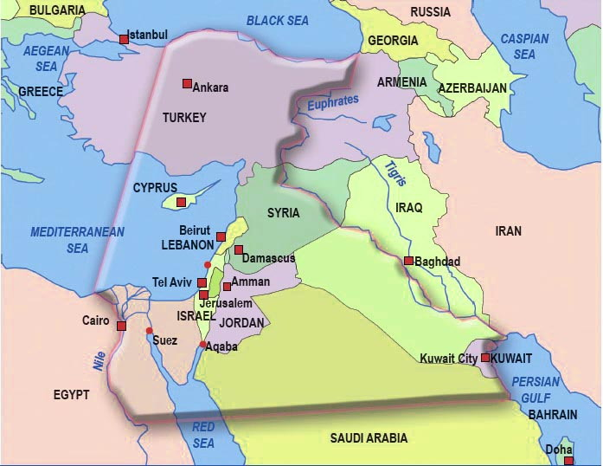
Land promised to Israelites

Slide 11
As for all the inhabitants of the mountain regions from Lebanon to Misrephoth Maim, that is, all the Sidonians, I myself will drive them out before the Israelites.

Slide 12
Be sure to allocate this land to Israel for an inheritance, as I have instructed you, and divide it as an inheritance among the nine tribes and half of the tribe of Manasseh.

Slide 13
Now these are the areas the Israelites received as an inheritance in the land of Canaan, which Eleazar the priest, Joshua son of Nun and the heads of the tribal clans of Israel allotted to them. Their inheritances were assigned by lot to the nine and a half tribes, as the Lord had commanded through Moses.

Slide 14
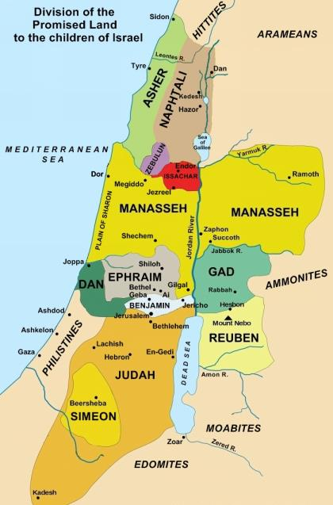
Moses had granted the two and a half tribes their inheritance east of the Jordan but had not granted the Levites an inheritance among the rest, for Joseph’s descendants had become two tribes—Manasseh and Ephraim.
JOSEPH
Manasseh Ephraim

Slide 15
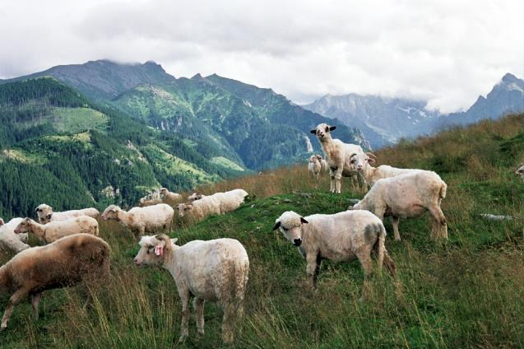
The Levites received no share of the land but only towns to live in, with pasturelands for their flocks and herds. So the Israelites divided the land, just as the Lord had commanded Moses.
No land for Levites—
only cities & pasture

Slide 16

You know what the Lord said to Moses the man of God at Kadesh Barnea about you and me.
Now the people of Judah approached Joshua at Gilgal, and Caleb son of Jephunneh the Kenizzite said to him,

Slide 17

I was forty years old when Moses the servant of the Lord sent me from Kadesh Barnea to explore the land. And I brought him back a report according to my convictions, but my fellow Israelites who went up with me made the hearts of the people melt in fear. I, however, followed the Lord my God wholeheartedly.
40

Slide 18

So on that day Moses swore to me, ‘The land on which your feet have walked will be your inheritance and that of your children forever, because you have followed the Lord my God wholeheartedly.’

Slide 19

Now then, just as the Lord promised, he has kept me alive for forty-five years since the time he said this to Moses, while Israel moved about in the wilderness.
45

Slide 20
So here I am today, eighty-five years old! I am still as strong today as the day Moses sent me out; I’m just as vigorous to go out to battle now as I was then.
85

Slide 21
Now give me this hill country that the Lord promised me that day.

Slide 22

You yourself heard then that the Anakites were there and their cities were large and fortified, but, the Lord helping me, I will drive them out just as he said.

Slide 23
Then Joshua blessed Caleb son of Jephunneh and gave him Hebron as his inheritance.

Slide 24
So Hebron has belonged to Caleb son of Jephunneh the Kenizzite ever since, because he followed the Lord, the God of Israel, wholeheartedly.
(Hebron used to be called Kiriath Arba after Arba, who was the greatest man among the Anakites.)

Slide 25

Then the land had rest from war.

