Slide 1
Lesson #6
The sin of Achan
Joshua 7:1-26

Slide 2
The Truth:
God cannot
overlook sin!

Slide 3

But the Israelites were unfaithful in regard to the devoted things;

Slide 4
Devoted Things
People or things that belonged completely to God
Stealing devoted things = stealing from God

Slide 5

Achan son of Karmi, the son of Zimri, the son of Zerah, of the tribe of Judah, took some of them. So the LORD's anger burned against Israel.
Tribe of Judah
Zerah
Zimri
Karmi
Achan

Slide 6
“The Lord’s anger burned against Israel.”
God’s anger was so strong that it was like a burning fire. This anger could only be stopped by making things right.

Slide 7

Achan was from what tribe?

Slide 8
Achan was from what tribe?
THE TRIBE OF JUDAH

Slide 9
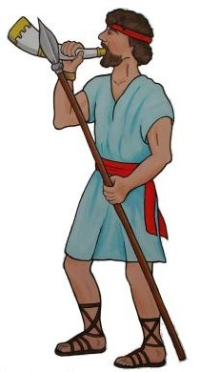
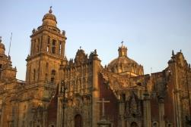
Now Joshua sent men from Jericho to Ai, which is near Beth Aven to the east of Bethel, and told them,
SPY
Go up and spy out the region.
Ai
SPY
So the men went up and spied out Ai.
Jericho

Slide 10
Ai
A city north of Jericho
Name means “The Ruin”

Slide 11

When they returned to Joshua, they said,
Not all the army will have to go up against Ai. Send 2000 or 3000 men to take it and do not weary the whole army, for only a few people live there.
Ai
SPY
SPY
Jericho

Slide 12
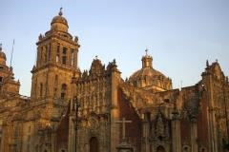

So about three thousand men went up…
3000
Ai
Jericho

Slide 13

…but they were routed by the men of Ai, who killed about 36 of them.
3000
Ai
-36

Slide 14
How many soldiers were sent to Ai?

Slide 15
How many soldiers were sent to Ai?
3000

Slide 16
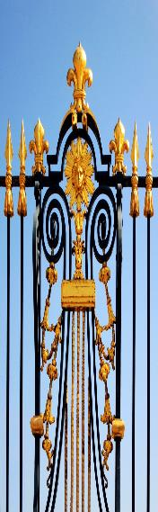
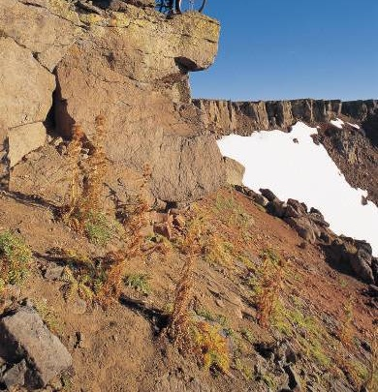
They chased the Israelites from the city gate as far as the stone quarries and struck them down on the slopes.

Slide 17



At this the hearts of the people melted in fear and became like water.

Slide 18

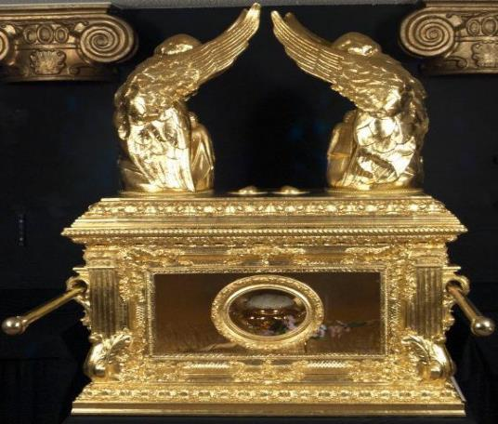
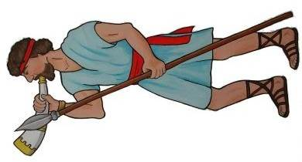
Then Joshua tore his clothes and fell facedown to the ground before the ark of the LORD, remaining there till evening.

Slide 19


The elders of Israel did the same, and sprinkled dust on their heads.

Slide 20
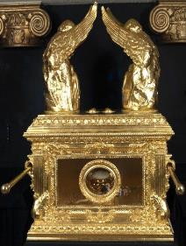
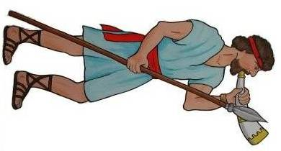
And Joshua said, "Ah, Sovereign LORD, why did you ever bring this people across the Jordan to deliver us into the hands of the Amorites to destroy us? If only we had been content to stay on the other side of the Jordan!

Slide 21
Pardon your servant, Lord. What can I say, now that Israel has been routed by its enemies? The Canaanites and the other people of the country will hear about this and they will surround us and wipe out our name from the earth. What then will you do for your own great name?"

Slide 22
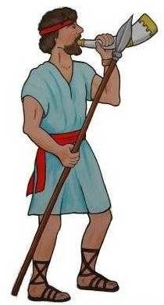

The LORD said to Joshua, "Stand up! What are you doing down on your face?

Slide 23
Israel has sinned; they have violated my covenant, which I commanded them to keep. They have taken some of the devoted things; they have stolen, they have lied, they have put them with their own possessions.

Slide 24
Sin
Disobeying God
Doing something God said not to do
Not doing what God said to do

Slide 25
What three sins did the people commit in Ai?

Slide 26
What three sins did the people commit in Ai?
Took devoted things
Stole
Lied

Slide 27
That is why the Israelites cannot stand against their enemies; they turn their backs and run because they have been made liable to destruction. I will not be with you anymore unless you destroy whatever among you is devoted to destruction.

Slide 28
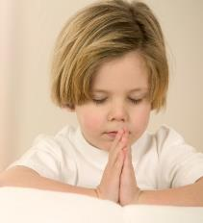
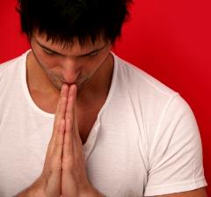
Go, consecrate the people. Tell them, 'Consecrate yourselves in preparation for tomorrow; for this is what the LORD, the God of Israel, says: There are devoted among you, Israel. You cannot stand against your enemies until you remove them.

Slide 29


In the morning, present yourselves
tribe by tribe.

Slide 30
The tribe the LORD chooses shall come forward clan by clan; the clan the LORD chooses shall come forward family by family;* and the family the LORD chooses shall come forward man by man.

Slide 31
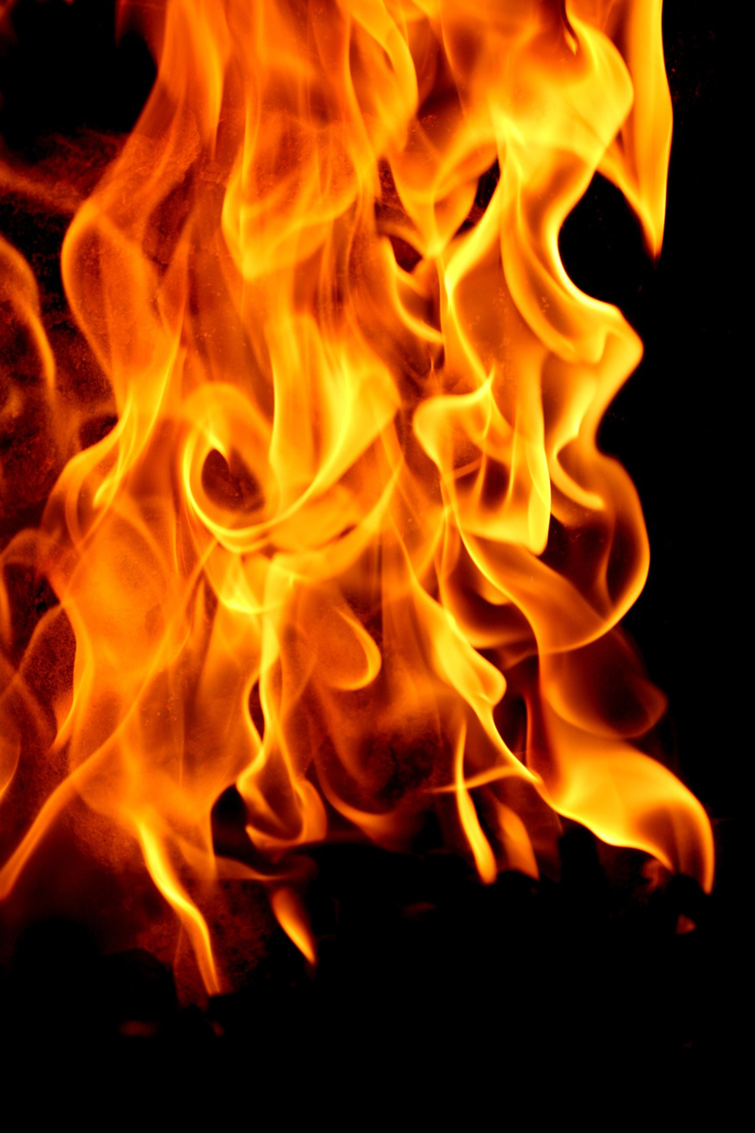
Whoever is caught with the devoted things shall be destroyed by fire, along with all that belongs to him. He has violated the covenant of the LORD and has done an outrageous thing in Israel!'"

Slide 32
Early the next morning Joshua had Israel come forward by tribes, and Judah was chosen.
Judahites

Slide 33
Clan of Judah
Families that descended from Jacob’s son Judah
One of the 12 tribes of Israel

Slide 34
The clans of Judah came forward, and the Zerahites were chosen.
Judahites
Zerahites

Slide 35
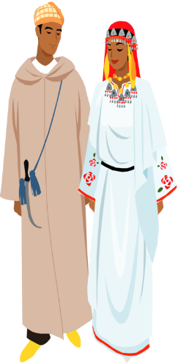
He had the clan of the Zerahites come forward by families, and Zimri was choosen.
Zerahites
Zimri

Slide 36
Joshua had his family come forward man by man, and Achan son of Karmi, the son of Zimri, the son of Zerah, of the tribe of Judah, was chosen.
Achan
son of Karmi

Slide 37

Then Joshua said to Achan,
My son, give glory to the LORD, the God of Israel, and honor him. Tell me what you have done; do not hide it from me.

Slide 38


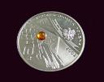
Achan replied,
It is true! I have sinned against the LORD, the God of Israel. This is what I have done: When I saw in the plunder a beautiful robe from Babylonia, two hundred shekels of silver and a bar of gold weighing fifty shekels, I coveted them* and took them.
50
200

Slide 39


What is plunder?
The great stuff you bring back from winning a war. Like…

Slide 40
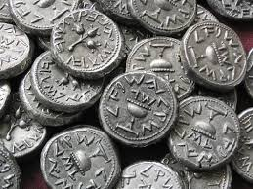
Shekel
A common Hebrew coin that weighed about half an ounce
200 shekels = a bunch of money

Slide 41


They are hidden in the ground inside my tent, with the silver underneath.

Slide 42
What 3 things did Achan take from the plunder?

Slide 43
What 3 things did Achan take from the plunder?
1) a beautiful robe from Babylonia
2) 200 shekels of silver
3) a bar of gold weighing 50 shekels

Slide 44
So Joshua sent messengers, and they ran to the tent, and there it was, hidden in his tent, with the silver underneath.

Slide 45


They took the things from the tent, brought them to Joshua and all the Israelites and spread them out before the LORD.
50
200

Slide 46


Then Joshua, together with all Israel, took Achan son of Zerah, the silver, the robe, the gold bar, his sons and daughters, his cattle, donkeys and sheep, his tent and all that he had, to the Valley of Achor.
50
200

Slide 47
Valley of Achor
A valley somewhere between Jericho and Jerusalem when Achan was stoned
Name means “trouble”

Slide 48

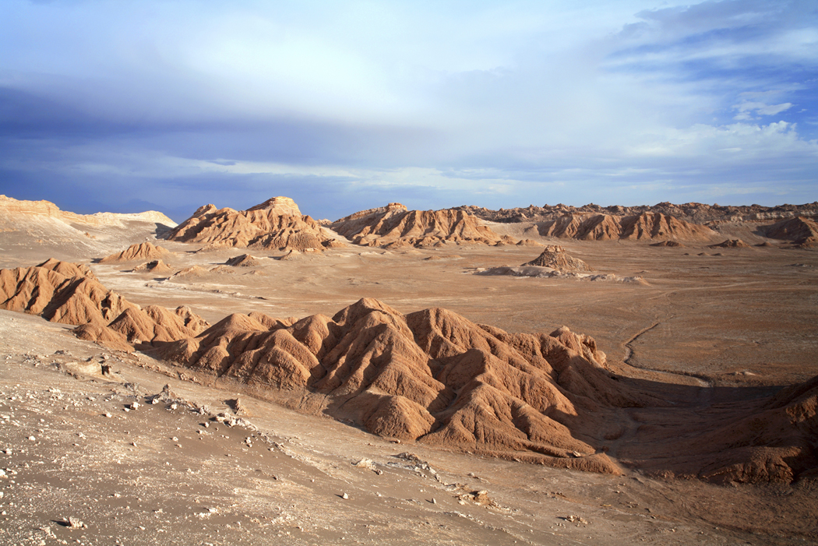

Joshua said,
Why have you brought this trouble on us? The LORD will bring trouble on you today.
50
200

Slide 49


Then all Israel stoned him, and after they had stoned the rest, they burned them.
50
200

Slide 50

Over Achan they heaped up a large pile of rocks, which remains to this day.

Slide 51
Then the LORD turned from his fierce anger. Therefore that place has been called the Valley of Achor ever since.

Slide 52
Whom do we now have to go between us and the Lord’s anger?
JESUS

Slide 53
Memory Verse
There is a way that appears to be right, but in the end it leads to death.
Proverbs 14:12
#6

