Slide 1
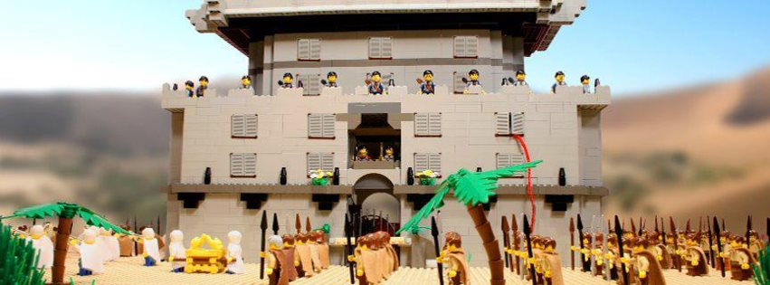
Lesson #5
Joshua 5:13–6:25

Slide 2

Hide it in your
Deuteronomy 27:10

Slide 3
“Obey the LORD your God and follow his commands and decrees that I give you today.”
Deuteronomy 27:10
DS#5

Slide 4
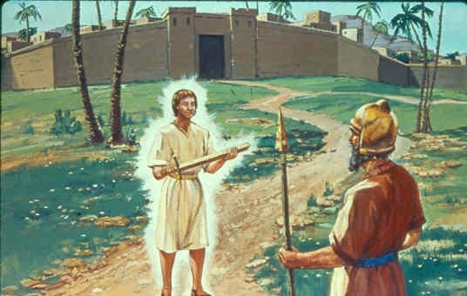
Now when Joshua was near Jericho, he looked up and saw a man standing in front of him with a drawn sword in his hand.

Slide 5

Joshua went up to him and asked,
Are you for us or for our enemies?

Slide 6

Neither, but as commander of the army of the Lord I have now come.

Slide 7

Who was the man
Joshua met near Jericho?

Slide 8
Who was the man
Joshua met near Jericho?
Commander of the
army of the Lord

Slide 9
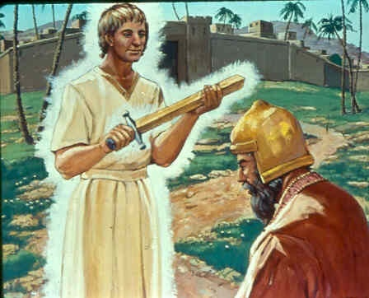
Then Joshua fell facedown to the ground in reverence, and asked him,
What message does my Lord have for his servant?

Slide 10
The commander of the Lord’s army replied,
Take off your sandals, for the place where you are standing is holy.

Slide 11
And Joshua did so.

Slide 12
Why did Joshua have to take off his sandals?

Slide 13
Why did Joshua have to take off his sandals?
The place he was
standing was holy ground.

Slide 14
Now the gates of Jericho were securely barred because of the Israelites. No one went out and no one came in.

Slide 15
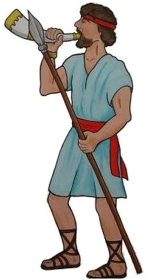
Then the Lord said to Joshua, “See, I have delivered Jericho into your hands, along with its king and its fighting men.

Slide 16
March around the city once with all the armed men. Do this for six days.

Slide 17
For how many days did the Israelites need to march around Jericho just one time?

Slide 18
For how many days did the Israelites need to march around Jericho just one time?
6 days

Slide 19



Have seven priests carry trumpets of rams’ horns in front of the ark. On the seventh day, march around the city seven times, with the priests blowing the trumpet.

Slide 20
How many priests carried rams’ horns?

Slide 21
How many priests carried rams’ horns?
SEVEN

Slide 22
When you hear them sound a long blast on the trumpets, have the whole army give a loud shout; then the wall of the city will collapse and the army will go up, everyone straight in.

Slide 23
What comes first, the horn or the yell?

Slide 24
What comes first, the horn or the yell?
THE HORN

Slide 25

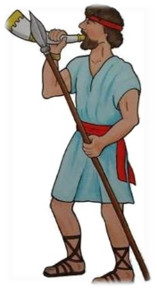

So Joshua son of Nun called the priests and said to them,
Take up the ark of the covenant of the Lord and have seven priests carry trumpets in front of it.

Slide 26
What comes first: the ark or the priests?

Slide 27
What comes first: the ark or the priests?
THE PRIESTS

Slide 28
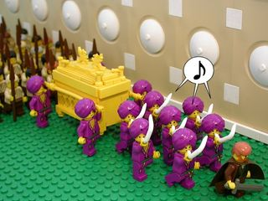
And he ordered the army, “Advance! March around the city, with an armed guard going ahead of the ark of the Lord.”

Slide 29
When Joshua had spoken to the people, the seven priests carrying the seven trumpets before the Lord went forward, blowing their trumpets, and the ark of the Lord’s covenant followed them.

Slide 30
What is God’s perfect number of completion?

Slide 31
What is God’s perfect number of completion?
7

Slide 32
The armed guard marched ahead of the priests who blew the trumpets, and the rear guard followed the ark.

Slide 33
Who was in front of the priests?

Slide 34
Who was in front of the priests?
THE ARMED GUARD

Slide 35
All this time the trumpets were sounding. But Joshua had commanded the army, “Do not give a war cry, do not raise your voices, do not say a word until the day I tell you to shout. Then shout!”

Slide 36

War Cry
A battle cry that was a part of the ritual of fighting an enemy
Many sports teams have a war cry. The team and crowd chant to show support and to scare their opponent.

Slide 37

So he had the ark of the Lord carried around the city, circling it once. Then the army returned to camp and spent the night there.
1 time around

Slide 38
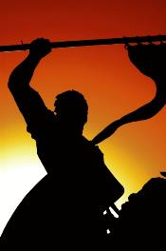
Joshua got up early the next morning and the priests took up the ark of the Lord.
The seven priests carrying the seven trumpets went forward, marching before
the ark of the Lord and blowing the trumpets.

Slide 39
The armed men went ahead of them and the rear guard followed the ark of the Lord, while the trumpets kept sounding.

Slide 40
So on the second day they marched around the city once and returned to the camp.
1 time around again

Slide 41
They did this for six days.

Slide 42
How many times did they circle Jericho on the sixth day?

Slide 43
How many times did they circle Jericho on the sixth day?
JUST ONCE

Slide 44
On the seventh day, they got up at daybreak and marched around the city seven times in the same manner, except that on that day they circled the city seven times.

Slide 45
On the seventh day, they got up at daybreak and marched around the city seven times in the same manner, except that on that day they circled the city seven times.

Slide 46
On the seventh day, they got up at daybreak and marched around the city seven times in the same manner, except that on that day they circled the city seven times.

Slide 47
On the seventh day, they got up at daybreak and marched around the city seven times in the same manner, except that on that day they circled the city seven times.

Slide 48
On the seventh day, they got up at daybreak and marched around the city seven times in the same manner, except that on that day they circled the city seven times.

Slide 49
On the seventh day, they got up at daybreak and marched around the city seven times in the same manner, except that on that day they circled the city seven times.

Slide 50
On the seventh day, they got up at daybreak and marched around the city seven times in the same manner, except that on that day they circled the city seven times.

Slide 51
How many times did they circle Jericho on the 7th day?

Slide 52
How many times did they circle Jericho on the 7th day?
7 TIMES

Slide 53
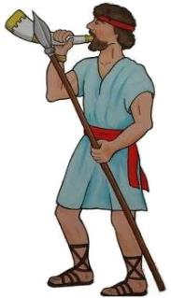
The seventh time around, when the priests sounded the trumpet blast, Joshua commanded the army,
Shout! For the LORD
has given you the city!

Slide 54
7 is God’s perfect number of _______?

Slide 55
7 is God’s perfect number of _______?
COMPLETION

Slide 56

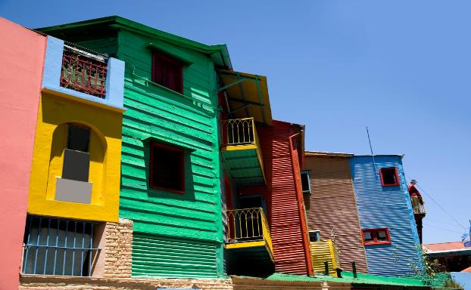




The city and all that is in it are to be devoted to the Lord. Only Rahab the prostitute and all who are with her in her house shall be spared, because she hid the spies we sent.

Slide 57
Was everyone in Jericho killed?

Slide 58
Was everyone in Jericho killed?
NO, RAHAB & THOSE IN HER HOUSE SURVIVED.

Slide 59
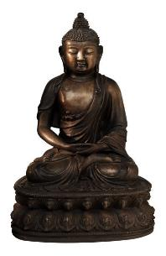
But keep away from the devoted things, so that you will not bring about your own destruction by taking any of them. Otherwise you will make the camp of Israel liable to destruction and bring trouble on it.

Slide 60
Devoted Things
Things that were given completely to the Lord
Sometimes the Lord told the people to completely destroy these items

Slide 61
What do the Israelites have to stay away from?

Slide 62
What do the Israelites have to stay away from?
DEVOTED THINGS

Slide 63
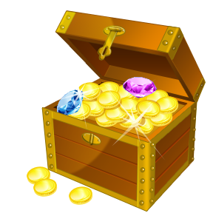
All the silver and gold and the articles of bronze and iron are sacred to the Lord and must go into his treasury.

Slide 64
The Lord’s Treasury:
A place where all the gold, silver, and valuable items were kept to be used in service to the Lord. It was probably in or near the Tabernacle.

Slide 65
Where do the gold items belong?
IN GOD’S TREASURY

Slide 66
Where do the gold items belong?

Slide 67
When the trumpets sounded, the army shouted, and at the sound of the trumpet, when the men gave a loud shout, the wall collapsed;

Slide 68
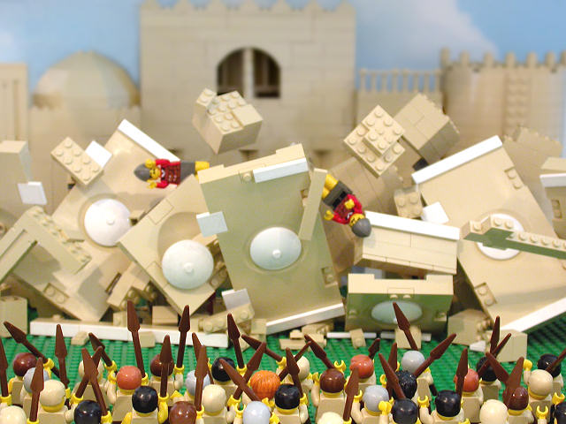

Slide 69
so everyone charged straight in, and they took the city. They devoted the city to the Lord and destroyed with the sword every living thing in it—men and women, young and old, cattle, sheep and donkeys.

Slide 70

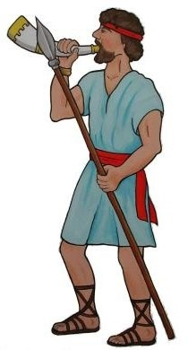
Joshua said to the two men who had spied out the land,
Go into the prostitute’s house and bring her out and all who belong to her, in accordance with your oath to her.
SPY 1
SPY 2

Slide 71
Who was told to get Rahab and her family?

Slide 72
Who was told to get Rahab and her family?
THE SPIES THAT SHE HAD HELPED

Slide 73


So the young men who had done the spying went in and brought out Rahab, her father and mother, her brothers and sisters and all who belonged to her.

Slide 74
They brought out her entire family and put them in a place outside the camp of Israel.

Slide 75

Then they burned the whole city and everything in it,

Slide 76
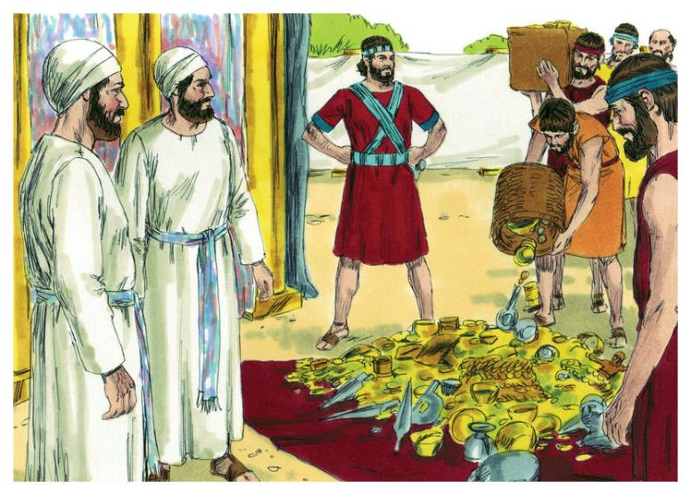
but they put the silver and gold and the articles of bronze and iron into the treasury of the Lord’s house.

Slide 77
What did the Israelites do just before they left?

Slide 78
What did the Israelites do just before they left?
BURNED
DOWN
JERICHO

Slide 79
But Joshua spared Rahab the prostitute, with her family and all who belonged to her, because she hid the men Joshua had sent as spies to Jericho—and she lives among the Israelites to this day.

Slide 80
Hide it in your
Deuteronomy 27:10

Slide 81
“Obey the LORD your God and follow his commands and decrees that I give you today.”
Deuteronomy 27:10
DS#5

