Slide 1
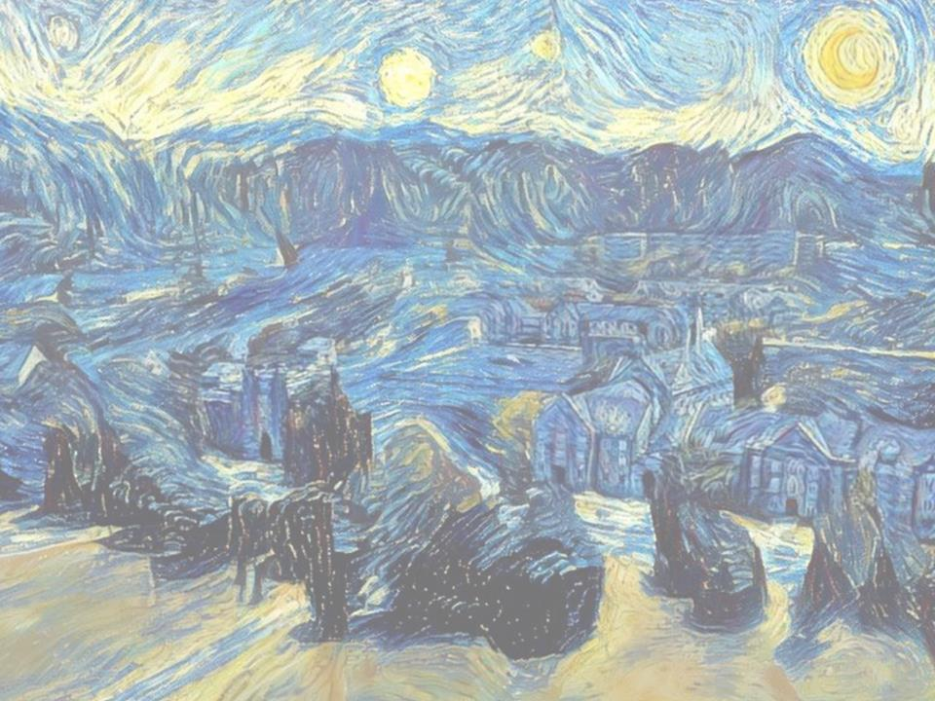
DigSite
#4
A Tale of 12 Stones

Slide 2
Joshua
4:1-24
5:10-12

Slide 3

Hide it in your
Joshua 1:9

Slide 4
Have I not commanded you?
Be strong and courageous.
Do not be afraid;
do not be discouraged,
for the LORD your God
will be with you
wherever you go.
Joshua 1:9
DS#1

Slide 5
Hide it in your
Acts 10:34-35

Slide 6

Then Peter began to speak:
I know realize
how true it is that God does not show favoritism
but accepts from every nation
the one who fears him
and does what is right
Acts 10:34-35
DS#2

Slide 7
Hide it in your
Joshua 3:5

Slide 8
Joshua told the people
"Consecrate yourselves,
for tomorrow
the LORD will do
amazing things among you."
Joshua 3:5
DS#3

Slide 9
Hide it in your
Joshua 4:21-22

Slide 10
He said to the Israelites,
In the future
when your descendants ask their parents,
“What do these stones mean?”
Tell them,
“Israel crossed the Jordan on dry ground”
Joshua 4:21-22
DS#4

Slide 11
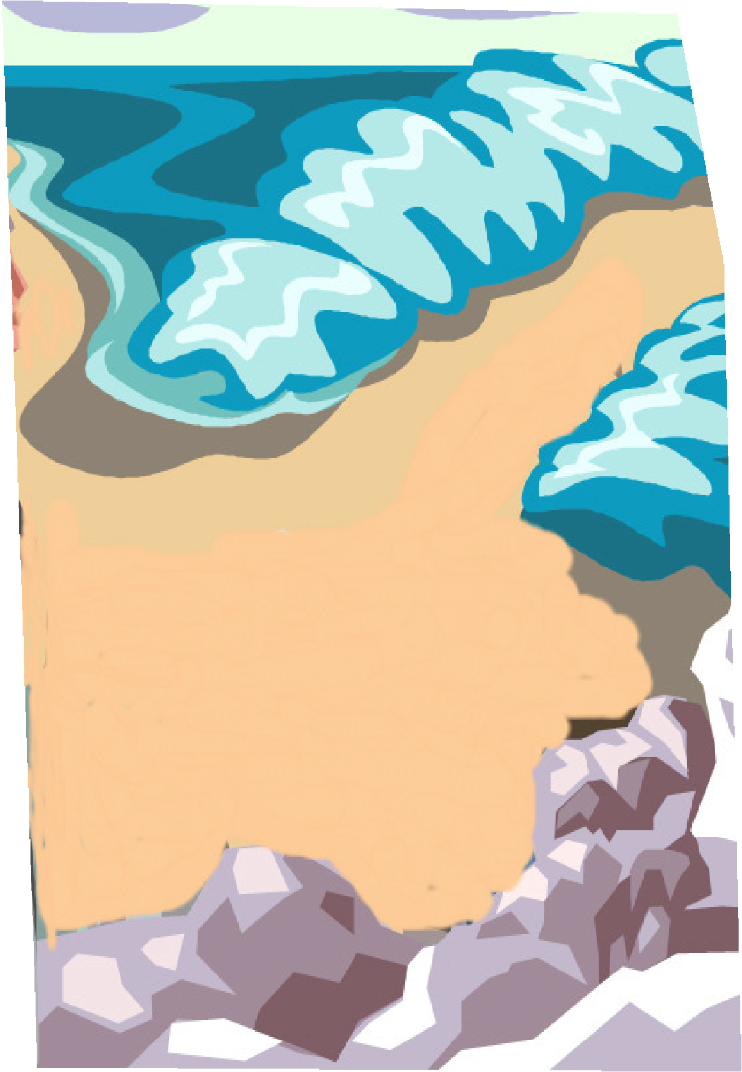

When the whole nation
Had finished crossing the Jordan,
The Lord said to Joshua,

Slide 12


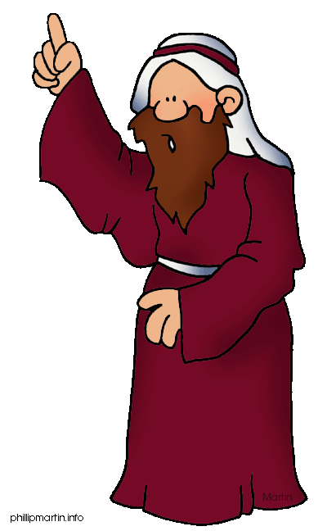


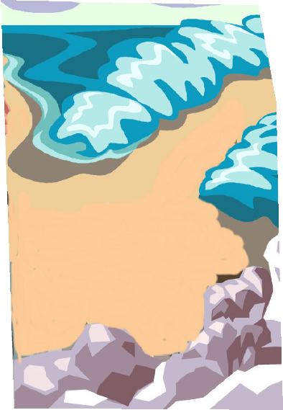
Reuben
Simeon
Levi
Judah
Issachar
Zebulun
Benjamin
Dan
Naphtali
Gad
Asher
Joseph (E&M)
Choose 12 men from among the people, one from
each tribe, and tell them to take up 12 stones from the
middle of the Jordan, from right where the priests are standing,
and carry them over with you and put them down at the place
where you stay tonight.
Jacob’s (Israel’s) sons

Slide 13
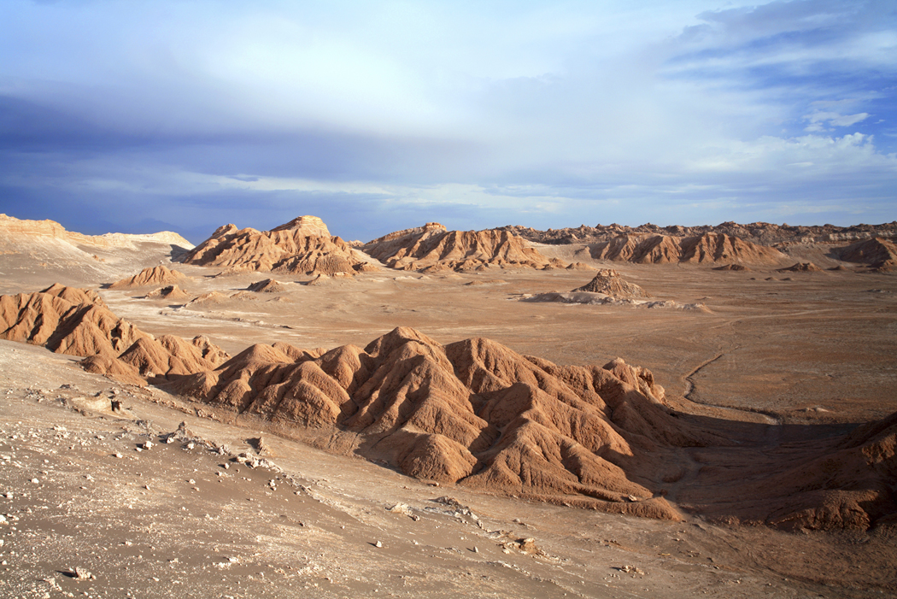

So Joshua called together the 12 men he had appointed from the Israelites, one from each tribe, and said to them*,

Slide 14
Go over before the ark of the Lord your God into the middle of the Jordan.

Slide 15
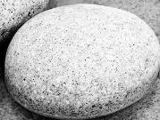
Each of you is to take up a stone on his shoulder, according to the number of the tribes of the Israelites, to serve as a sign among you.

Slide 16
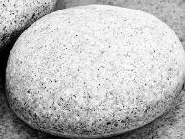
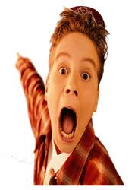
In the future, when your children ask you, ‘What do these stones mean?’

Slide 17
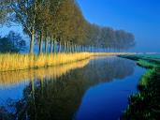


tell them that the flow of the Jordan was cut off

Slide 18
before the ark of the covenant of the Lord.

Slide 19

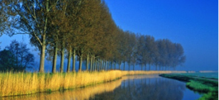
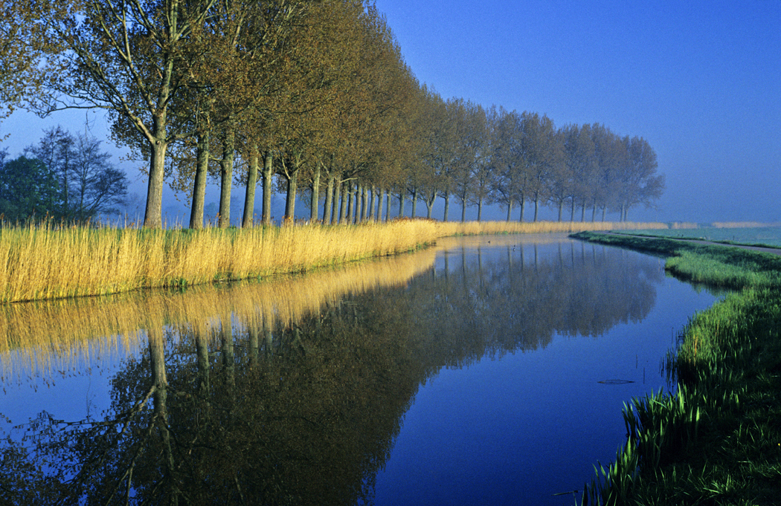
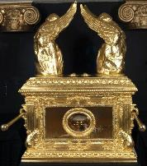

When it crossed the Jordan, the waters of the Jordan were cut off.

Slide 21

These stones are to be a memorial to the people of Israel forever.
IN MEMORY OF THE ISRAELITES

Slide 22





So the
Israelites
did as Joshua commanded them.

Slide 23






They took 12 stones from
the middle of the Jordan, according to the number of tribes of the Israelites, as the Lord had told Joshua;

Slide 24



And they carried them over with them to their camp,

Slide 25
where they put them down.

Slide 26

Joshua set up the twelve stones that had been in the middle of the Jordan at the spot where the priests who carried the ark of the covenant had stood. And they are there to this day.

Slide 27


Now the priests who carried the ark remained standing in the middle of the Jordan until everything the Lord had commanded Joshua was done by the people, just as Moses directed Joshua.

Slide 28
The people hurried over, and as soon as all of them had crossed,

Slide 29
the ark of the Lord and the priests came to the other side while the people watched.

Slide 30
The men of Reuben, Gad and the half-tribe of Manasseh crossed over,

Slide 31
ready for battle, in front of the Israelites, as Moses had directed them.

Slide 32
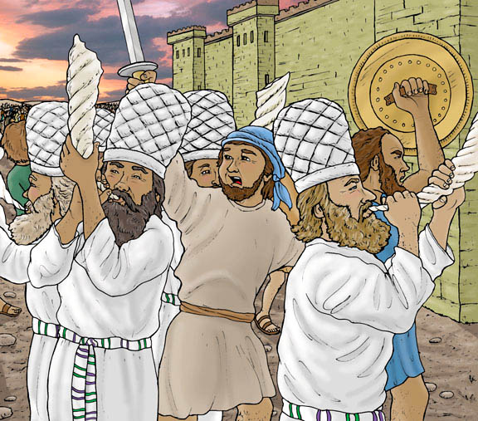
40,000
About 40,000 armed for battle crossed over before the Lord to the plains of Jericho for war.

Slide 33
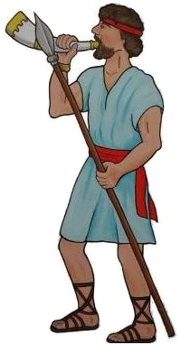
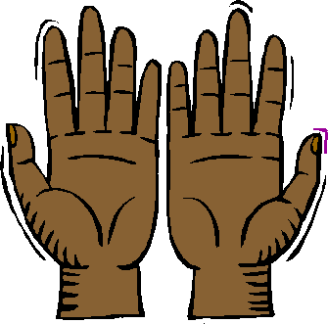
That day the Lord exalted Joshua in the sight of all Israel; and they stood in awe of him all the days of his life, just as they had stood in awe of Moses.

Slide 34
Command the
priests carrying the
ark of the covenant law
to come up out of the
Jordan.
Then the Lord said to Joshua,

Slide 35
So Joshua
commanded the
priests,
Come up
out of the Jordan.

Slide 36
And the priests came up out of the river carrying the ark of the covenant of the Lord.

Slide 37
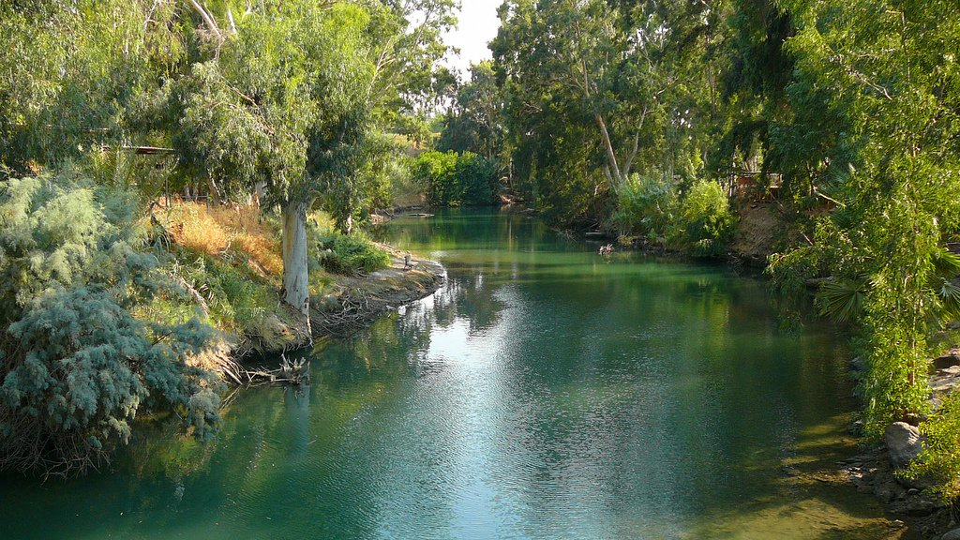
No sooner had they set their feet on the dry ground than the waters of the Jordan returned to their place and ran at flood stage as before.

Slide 38
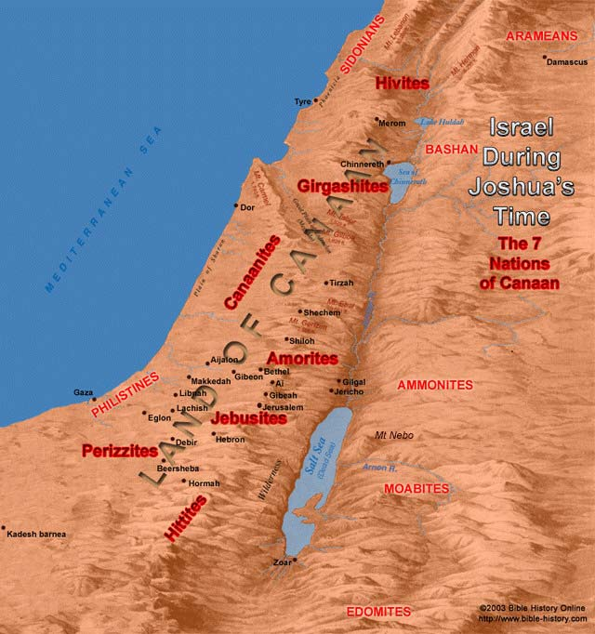

1st Month
10
On the 10th day of the 1st month the people went up from the Jordan and camped at Gilgal on the eastern border of Jericho.


Slide 39
Gilgal
And Joshua set up at Gilgal the twelve stones they had taken out of the Jordan.

Slide 40
Memory Verse
He said to the Israelites,
In the future when your descendants ask their parents,
“What do these stones mean?”
tell them, “Israel crossed the Jordan on dry ground.”
Joshua 4:21-22
#4

Slide 41


For the Lord your God dried up the Jordan before you until you had crossed over.

Slide 42
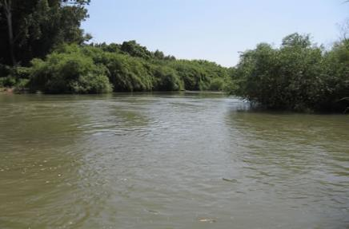
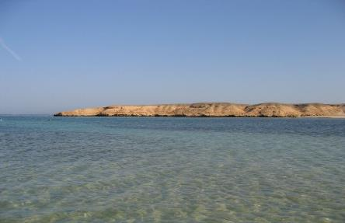
=
Jordan River
Red Sea
The Lord your God did to the Jordan just what he had done to the Red Sea when he dried it up before us until we had crossed over.

Slide 43
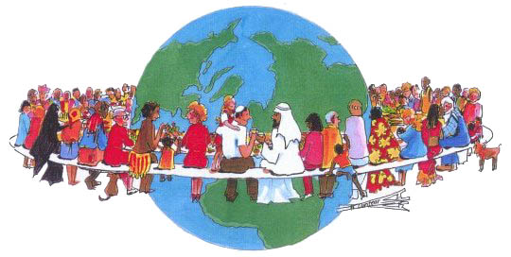
He did this so that all the peoples of the earth

Slide 44
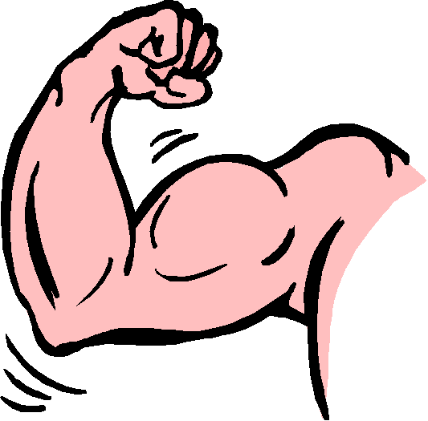
might know that the hand of the Lord is powerful

Slide 45
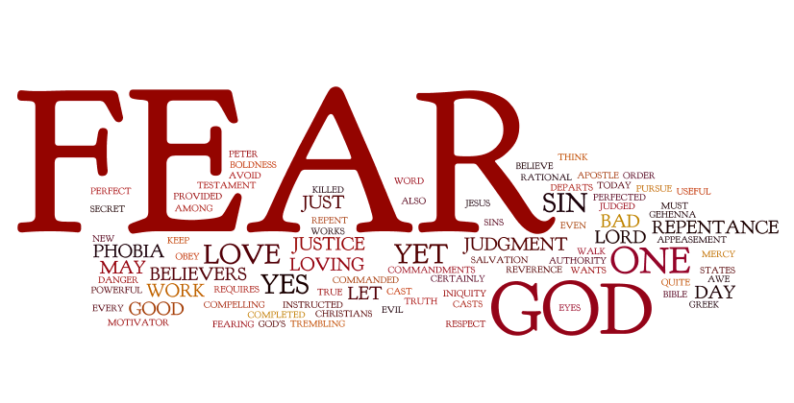
And so that you might always fear
the Lord your God.

Slide 46
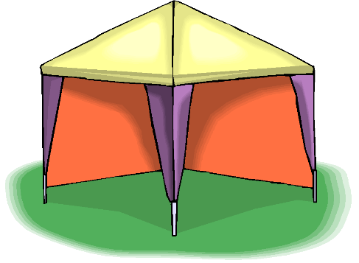
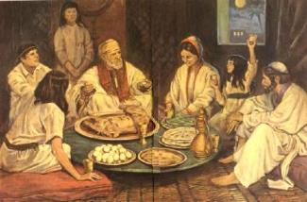
Gilgal
14th
Passover
On the evening of the 14th day of the month, while camped at Gilgal on the plains of Jericho, the Israelites celebrated the Passover.

Slide 47


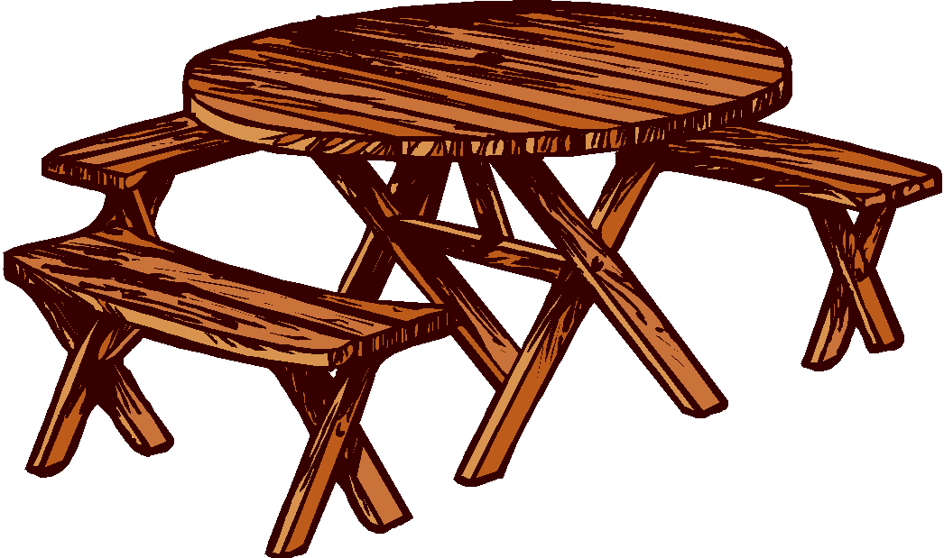
The day after the Passover, that very day, they ate some of the produce of the land; unleavened bread and roasted grain.

Slide 48

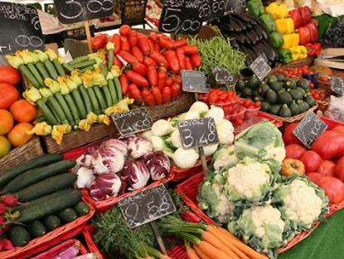
MANNA
Canaan’s Produce Market
The manna stopped the day after they ate this food from the land; there was no longer any manna for the Israelites, but that year they ate the produce of Canaan.

Slide 49
An amazing act that God does to help people to show them His character and help them trust Him
FAITH WORDS
Miracle
#4

Slide 50
A person’s children, grandchildren, and great-grandchildren
FAITH WORDS
Descendants
#4

Slide 51
Israel’s first campsite in Canaan, located on the plains not far from Jericho
People
Gilgal
#4

Slide 52
An object, event, or place that helps people remember a special event or person
OT Terms
Memorial
#4

Slide 53
A feast to celebrate the Israelites’ deliverance from slavery in Egypt; God “passed over” the Israelite homes and did not kill their firstborn sons
OT Terms
Passover
#4

Slide 54
The special bread God provided for the Israelites in the desert; means “What is it?”
OT Terms
Manna
#4

Slide 55
The men of the tribes of Reuben, Gad, and half of Manasseh asked Moses if they and their families could stay on the east side of the Jordan and not cross into the Promised land.
Did You Know?
Moses agreed, under one condition. The men had to cross the Jordan and help their brothers fight for their land.
#4

