Slide 1
Dig Site 18
A Really Bad Decision
Exodus 32:1-30

Slide 2





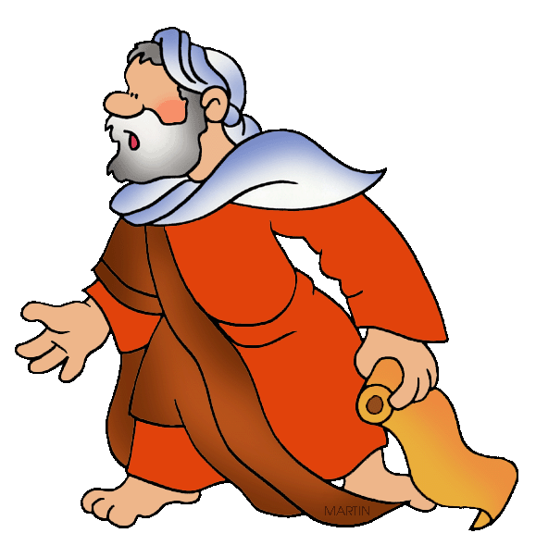
When the people saw that Moses was so long in coming down from the mountain, they gathered around Aaron and said,
“Come, make us gods who will go before us. As for this fellow Moses who brought us up out of Egypt, we don’t know what has happened to him.”
?
?
?

Slide 3
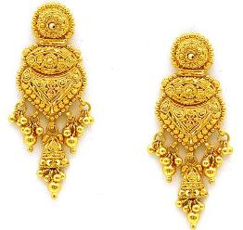
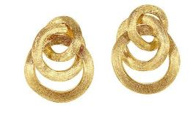
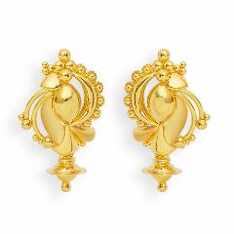
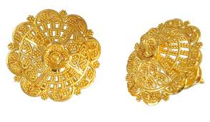
Aaron answered them, “Take off the gold earrings that your wives, your sons and your daughters are wearing, and bring them to me.” So all the people took off their earrings and brought them to Aaron.

Slide 4
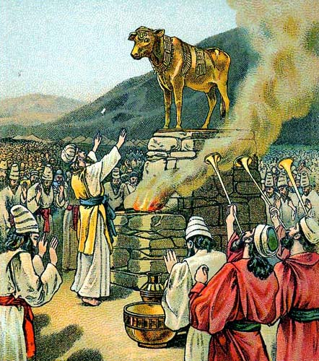
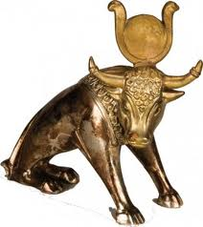
He took what they handed him and made it into an idol cast in the shape of a calf, fashioning it with a tool. Then they said,
“These are your gods, Israel, who brought you up out of Egypt.”

Slide 5
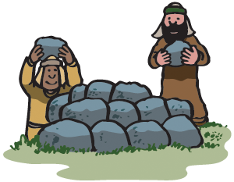
When Aaron saw this, he built an altar in front of the calf and announced,
“Tomorrow there will be a festival to the LORD.”

Slide 6

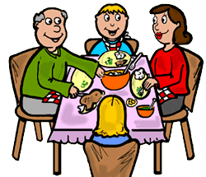
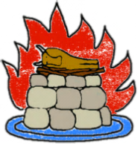

So the next day the people rose early and sacrificed burnt offerings and presented fellowship offerings. Afterward they sat down to eat and drink and got up to indulge in revelry.

Slide 7
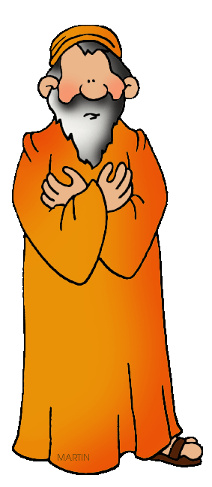
Then the LORD said to Moses,
“Go down, because your people, whom you brought up out of Egypt, have become corrupt. They have been quick to turn away from what I commanded them and have made themselves an idol cast in the shape of a calf. They have bowed down to it and sacrificed to it and have said, ‘These are your gods, Israel, who brought you up out of Egypt.’

Slide 8

“I have seen these people,” the LORD said to Moses, “and they are a stiff-necked people. Now leave me alone so that my anger may burn against them and that I may destroy them. Then I will make you into a great nation.”

Slide 9
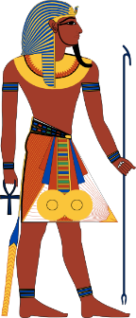
But Moses sought the favor of the LORD his God.
“LORD,” he said, “why should your anger burn against your people, whom you brought out of Egypt with great power and a mighty hand? Why should the Egyptians say,
‘It was with evil intent that he brought them out, to kill them in the mountains and to wipe them off the face of the earth’?

Slide 10
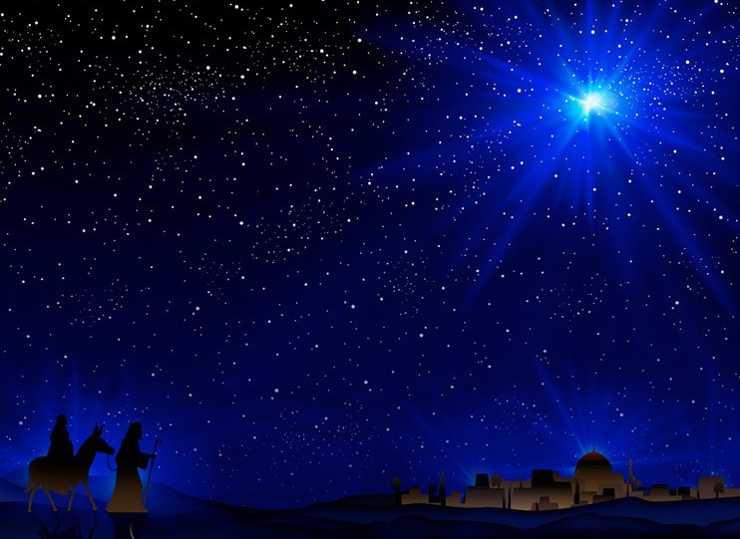
Turn from your fierce anger; relent and do not bring disaster on your people. Remember your servants Abraham, Isaac and Israel, to whom you swore by your own self: ‘I will make your descendants as numerous as the stars in the sky and I will give your descendants all this land I promised them, and it will be their inheritance forever.’”

Slide 11
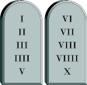
Then the LORD relented and did not bring on his people the disaster he had threatened. Moses turned and went down the mountain with the two tablets of the covenant law in his hands. They were inscribed on both sides, front and back. The tablets were the work of God; the writing was the writing of God, engraved on the tablets.

Slide 12
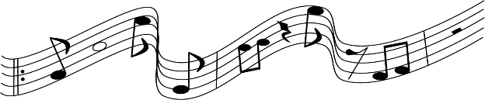
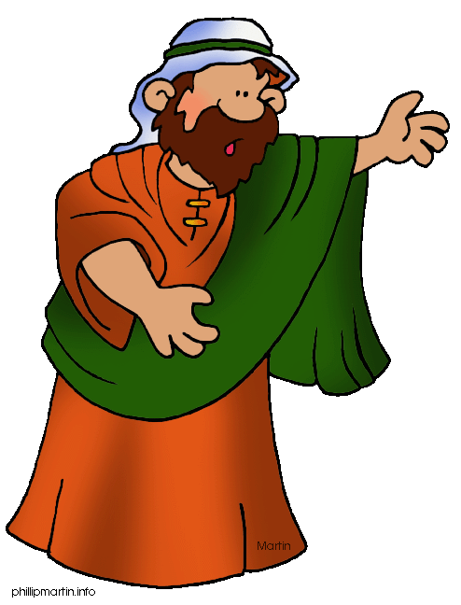
When Joshua heard the noise of the people shouting, he said to Moses,
“There is the sound of war in the camp.”
Moses replied: “It is not the sound of victory, it is not the sound of defeat; it is the sound of singing that I hear.”

Slide 13

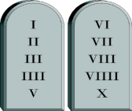
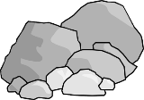
When Moses approached the camp and saw the calf and the dancing, his anger burned and he threw the tablets out of his hands, breaking them to pieces at the foot of the mountain.

Slide 14


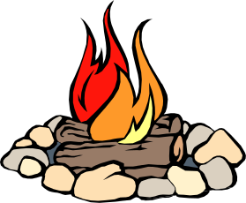
And he took the calf the people had made and burned it in the fire;

Slide 15




then he ground it to powder, scattered it on the water and made the Israelites drink it.

Slide 16

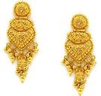
He said to Aaron,
“Do not be angry, my lord,” Aaron answered. “You know how prone these people are to evil. They said to me, ‘Make us gods who will go before us. As for this fellow Moses who brought us up out of Egypt, we don’t know what has happened to him.’ So I told them, ‘Whoever has any gold jewelry, take it off.’ Then they gave me the gold, and I threw it into the fire, and out came this calf!”
“What did these people do to you, that you led them into such great sin?”
Ta da!!

Slide 17
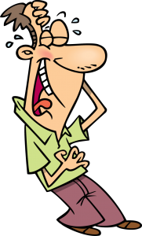

Moses saw that the people were running wild and that Aaron had let them get out of control and so become a laughingstock to their enemies.

Slide 18
So he stood at the entrance to the camp and said,
And all the Levites rallied to him. Then he said to them,
“This is what the LORD, the God of Israel, says: ‘Each man strap a sword to his side. Go back and forth through the camp from one end to the other, each killing his brother and friend and neighbor.’”
“Whoever is for the LORD, come to me.”

Slide 19
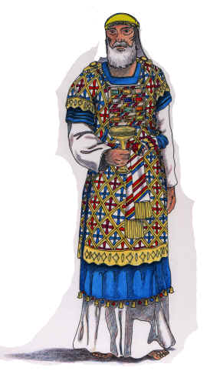

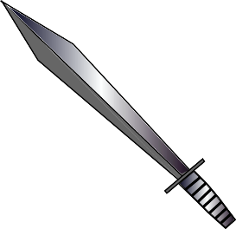
The Levites did as Moses commanded, and that day about three thousand of the people died.
x 3000

Slide 20
Then Moses said,
“You have been set apart to the LORD today, for you were against your own sons and brothers, and he has blessed you this day.”
The next day Moses said to the people,
“You have committed a great sin. But now I will go up to the LORD; perhaps I can make atonement for your sin.”

