Slide 1
Dig Site 17
Setting Up God’s House
Exodus 25:23-28:5; 30:1-10, 17-21

Slide 2
Memory Verse
Exodus 20:13-16
You shall not murder.
You shall not commit adultery.
You shall not steal.
You shall not give false testimony against your neighbor.

Slide 3
Leaders
Today’s selection can be a little dry with just the reading and pictures. I have included an opening activity to get the kids thinking about following instructions and how with even detailed instructions, different pictures can come out.
Print off slide 2 for each child and slides 3-8 for your instructions. The scripture follows.

Slide 4
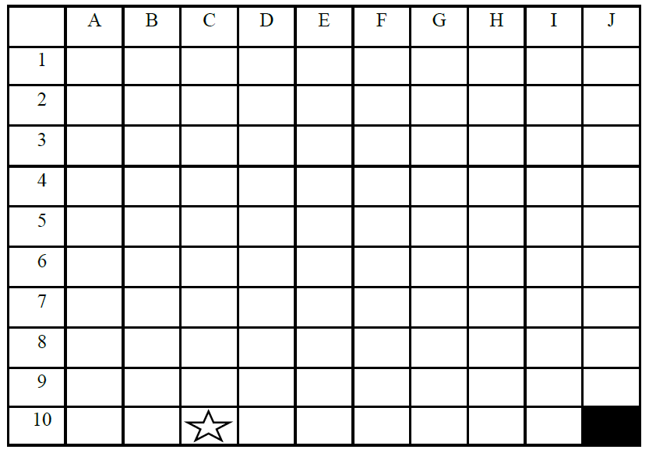
Notes:
Print off this slide for each student

Slide 5
Directions:
1. Put your pencil on the black box in the lower right hand corner of the paper. (J-10). This is where the story is going to start.
2. Finally, after months of waiting, the day you are leaving for summer camp has arrived. The bus ride to camp is very long and you do not get there until the sun has set. Move your pencil seven boxes to the left. (Pause) When you walk out of the bus you look up and see more stars than you have ever seen before. There should be a star on the box your pencil landed on (C-10). If your pencil did not land on the box with the start you did not correctly follow the directions. Be careful to listen closely to my directions. Make sure your pencil is on the box with the star.

Slide 6
3. Once everyone is off the bus your camp counselor finds you and you walk down a straight gravel road to what you think is a little house. Move your pencil up six spaces. (Pause) This is your cabin and it is where you will be sleeping during your time at camp. The cabin has a door and just one window. Draw your cabin in the box your pencil is (C-4). (Pause)

Slide 7
4. You walk into your cabin, unpack, lie down on your bed and quickly fall asleep. Before you know it you hear a bell ringing in the distance. You know the bell means it is time to get up. You make your bed and head out the door for breakfast. You really don’t know where you are going but you just follow the crowd down a straight road. Move your pencil four spaces to the right (Pause). You sit down at the table with 5 other campers. On the table are large plates of food and a smaller circular plate for each of the campers. The large plates of food are passed around and each camper takes what he/she wants. You take 2 pieces of bacon, one spoonful of scrambled eggs and one cinnamon roll. Draw your plate in the box where your pencil is (G-4).
(Pause)

Slide 8
5. After breakfast you head down a winding road to your first activity, swimming. Move your pencil down three spaces, (Pause) to the left five spaces (Pause) and down two spaces (Pause). When you get to the lake your counselor says, “The sun is smiling down on you today so make sure you put on sunblock.” Draw the sun the counselor is talking about in the box where your pencil is
(B-9). (Pause)

Slide 9
6. Because you are such a good swimmer you are put into the advanced swimmer group. You take a long walk on a curvy dock to deeper water. Move your pencil up seven spaces, (Pause) three spaces to the right, (Pause) down four spaces (Pause) and two spaces to the right (Pause). Finally you reach the end of the long dock. The counselor explains each swimmer will get a partner and each pair will get a swimming number. The swimming numbers will be counted off whenever the lifeguard blows her whistle. You are excited because your partner is the camper who shares a bunk bed with you. It is very important for you to remember your swimming number. It is your lucky number, which is 3, added to itself. Three plus three, simple. Write your swimming number in the box where your pencil is (G-6). (Pause)

Slide 10
7. When you are finished swimming you get out and sit on the bank to dry off. You are watching two sail boats the race around a complicated course. The sail boats must go around buoys in a specific order. You trace the course with your finger. Move your pencil two spaces to the right, (Pause) up four spaces, (Pause) and to the left 4 spaces (Pause). The sails on the boats are shaped like triangles and have two circles on each of them. Draw a picture of the sail in the box your pencil is in (E-2).

Slide 11
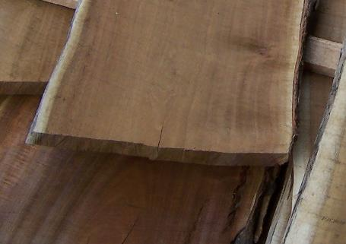
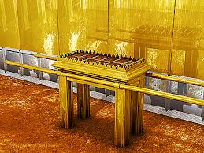
The Table
²³ “Make a table of acacia wood—two cubits long, a cubit wide and a cubit and a half high. ²⁴ Overlay it with pure gold and make a gold molding around it. ²⁵ Also make around it a rim a handbreadth wide and put a gold molding on the rim.

Slide 12
The Table
²⁶ Make four gold rings for the table and fasten them to the four corners, where the four legs are. ²⁷ The rings are to be close to the rim to hold the poles used in carrying the table. ²⁸ Make the poles of acacia wood, overlay them with gold and carry the table with them.

Slide 13
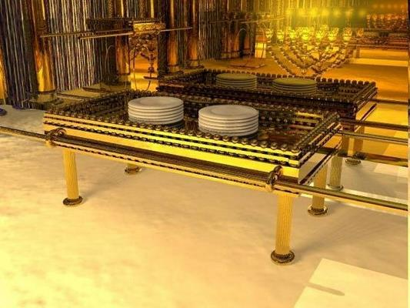
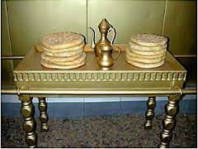
The Table
²⁹ And make its plates and dishes of pure gold, as well as its pitchers and bowls for the pouring out of offerings.* ³⁰ Put the bread of the Presence on this table to be before me at all times.

Slide 14
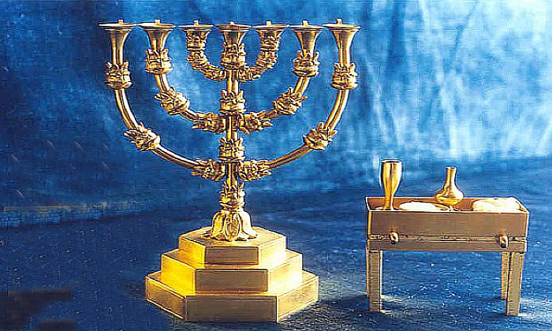
The Lampstand
³¹ “Make a lampstand of pure gold. Hammer out its base and shaft, and make its flowerlike cups, buds and blossoms of one piece with them. ³² Six branches are to extend from the sides of the lampstand—three on one side and three on the other.

Slide 15
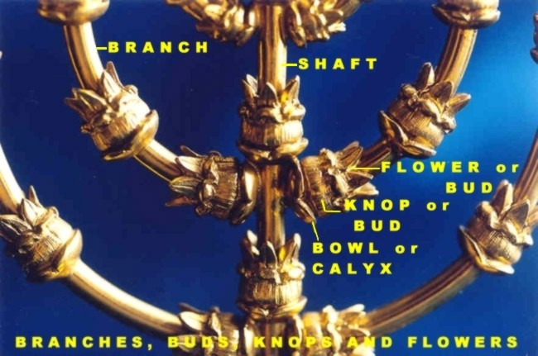
The Lampstand
³³ Three cups shaped like almond flowers with buds and blossoms are to be on one branch, three on the next branch, and the same for all six branches extending from the lampstand.

Slide 16
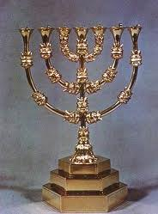
The Lampstand
³⁴ And on the lampstand there are to be four cups shaped like almond flowers with buds and blossoms. ³⁵ One bud shall be under the first pair of branches extending from the lampstand, a second bud under the second pair, and a third bud under the third pair—six branches in all. ³⁶ The buds and branches shall all be of one piece with the lampstand, hammered out of pure gold.

Slide 17
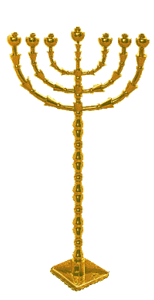

The Lampstand
³⁷ “Then make its seven lamps and set them up on it so that they light the space in front of it.*³⁸ Its wick trimmers and trays are to be of pure gold. ³⁹ A talent of pure gold is to be used for the lampstand and all these accessories. ⁴⁰ See that you make them according to the pattern shown you on the mountain.

Slide 18
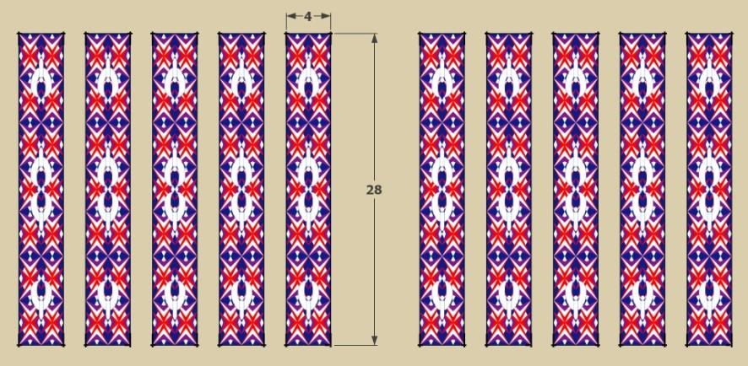
The Tabernacle
26 “Make the tabernacle with ten curtains of finely twisted linen and blue, purple and scarlet yarn, with cherubim woven into them by a skilled worker. ² All the curtains are to be the same size—twenty-eight cubits long and four cubits wide.

Slide 19
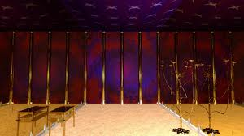
The Tabernacle
³ Join five of the curtains together, and do the same with the other five. ⁴ Make loops of blue material along the edge of the end curtain in one set, and do the same with the end curtain in the other set.

Slide 20

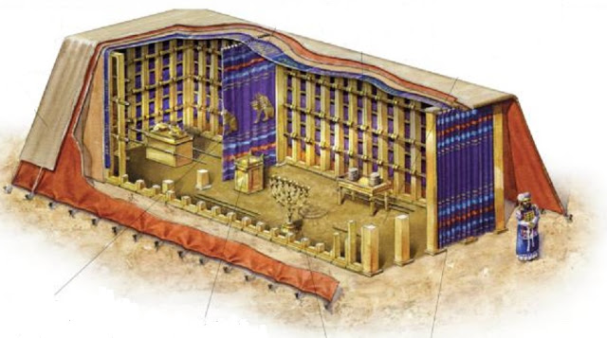
The Tabernacle
⁵ Make fifty loops on one curtain and fifty loops on the end curtain of the other set, with the loops opposite each other. ⁶ Then make fifty gold clasps and use them to fasten the curtains together so that the tabernacle is a unit.

Slide 21
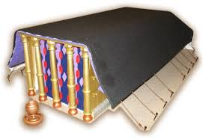
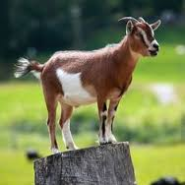
The Tabernacle
⁷ “Make curtains of goat hair for the tent over the tabernacle—eleven altogether. ⁸ All eleven curtains are to be the same size—thirty cubits long and four cubits wide.

Slide 22
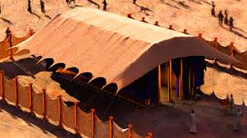
The Tabernacle
⁹ Join five of the curtains together into one set and the other six into another set. Fold the sixth curtain double at the front of the tent. ¹⁰ Make fifty loops along the edge of the end curtain in one set and also along the edge of the end curtain in the other set.

Slide 23
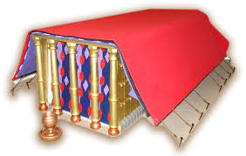
The Tabernacle
¹¹ Then make fifty bronze clasps and put them in the loops to fasten the tent together as a unit. ¹² As for the additional length of the tent curtains, the half curtain that is left over is to hang down at the rear of the tabernacle.

Slide 24
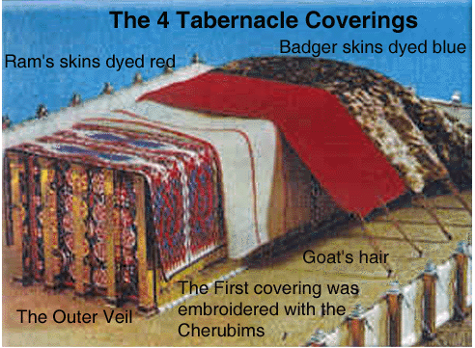
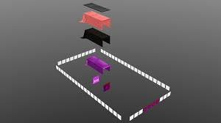
The Tabernacle
¹³ The tent curtains will be a cubit longer on both sides; what is left will hang over the sides of the tabernacle so as to cover it. ¹⁴ Make for the tent a covering of ram skins dyed red, and over that a covering of the other durable leather.*

Slide 25
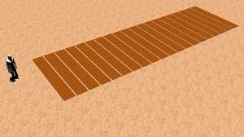
The Tabernacle
¹⁵ “Make upright frames of acacia wood for the tabernacle. ¹⁶ Each frame is to be ten cubits long and a cubit and a half wide, ¹⁷ with two projections set parallel to each other. Make all the frames of the tabernacle in this way.

Slide 26
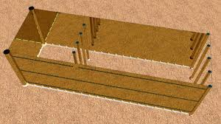
The Tabernacle
¹⁸ Make twenty frames for the south side of the tabernacle ¹⁹ and make forty silver bases to go under them—two bases for each frame, one under each projection.

Slide 27
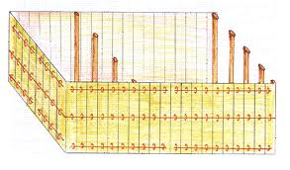
The Tabernacle
²⁰ For the other side, the north side of the tabernacle, make twenty frames ²¹ and forty silver bases—two under each frame. ²² Make six frames for the far end, that is, the west end of the tabernacle, ²³ and make two frames for the corners at the far end.

Slide 28
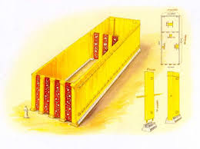
The Tabernacle
²⁴ At these two corners they must be double from the bottom all the way to the top and fitted into a single ring; both shall be like that. ²⁵ So there will be eight frames and sixteen silver bases—two under each frame.

Slide 29
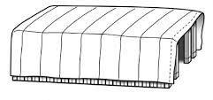
The Tabernacle
²⁶ “Also make crossbars of acacia wood: five for the frames on one side of the tabernacle, ²⁷ five for those on the other side, and five for the frames on the west, at the far end of the tabernacle. ²⁸ The center crossbar is to extend from end to end at the middle of the frames. ²⁹ Overlay the frames with gold and make gold rings to hold the crossbars. Also overlay the crossbars with gold.

Slide 30
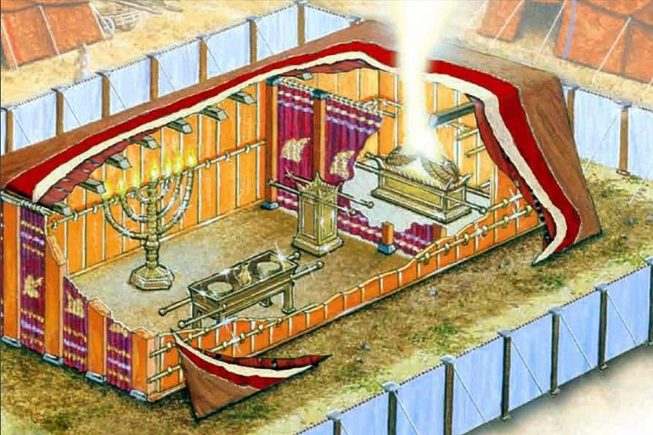
The Tabernacle
³⁰ “Set up the tabernacle according to the plan shown you on the mountain.

Slide 31
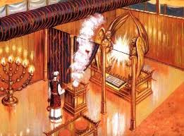
The Tabernacle
³¹ “Make a curtain of blue, purple and scarlet yarn and finely twisted linen, with cherubim woven into it by a skilled worker. ³² Hang it with gold hooks on four posts of acacia wood overlaid with gold and standing on four silver bases.

Slide 32
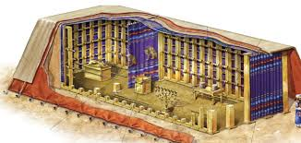
The Tabernacle
³³ Hang the curtain from the clasps and place the ark of the covenant law behind the curtain. The curtain will separate the Holy Place from the Most Holy Place. ³⁴ Put the atonement cover on the ark of the covenant law in the Most Holy Place. ³⁵ Place the table outside the curtain on the north side of the tabernacle and put the lampstand opposite it on the south side.

Slide 33
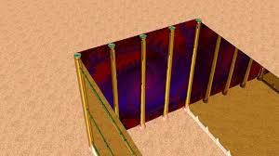
The Tabernacle
³⁶ “For the entrance to the tent make a curtain of blue, purple and scarlet yarn and finely twisted linen—the work of an embroiderer. ³⁷ Make gold hooks for this curtain and five posts of acacia wood overlaid with gold. And cast five bronze bases for them.

Slide 34
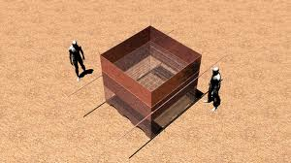
The Altar and Burnt Offering
27 “Build an altar of acacia wood, three cubits high; it is to be square, five cubits long and five cubits wide. ² Make a horn at each of the four corners, so that the horns and the altar are of one piece, and overlay the altar with bronze.

Slide 35
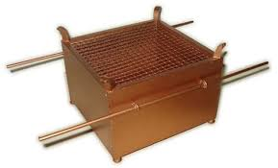
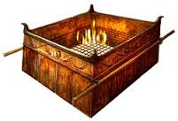
The Altar and Burnt Offering
⁵ Put it under the ledge of the altar so that it is halfway up the altar. ⁶ Make poles of acacia wood for the altar and overlay them with bronze. ⁷ The poles are to be inserted into the rings so they will be on two sides of the altar when it is carried. ⁸ Make the altar hollow, out of boards. It is to be made just as you were shown on the mountain.

Slide 36
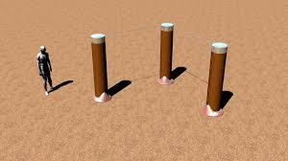
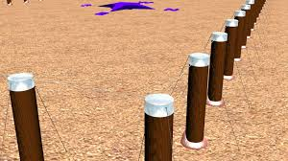
The Courtyard
⁹ “Make a courtyard for the tabernacle. The south side shall be a hundred cubits long and is to have curtains of finely twisted linen, ¹⁰ with twenty posts and twenty bronze bases and with silver hooks and bands on the posts.

Slide 37
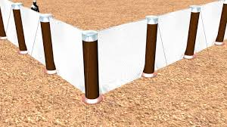
The Courtyard
¹¹ The north side shall also be a hundred cubits long and is to have curtains, with twenty posts and twenty bronze bases and with silver hooks and bands on the posts.

Slide 38
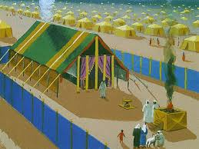
The Courtyard
¹² “The west end of the courtyard shall be fifty cubits wide and have curtains, with ten posts and ten bases. ¹³ On the east end, toward the sunrise, the courtyard shall also be fifty cubits wide.

Slide 39
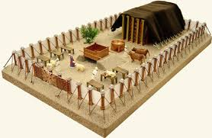
The Courtyard
¹⁴ Curtains fifteen cubits long are to be on one side of the entrance, with three posts and three bases, ¹⁵ and curtains fifteen cubits long are to be on the other side, with three posts and three bases.

Slide 40
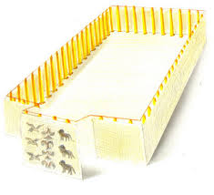
The Courtyard
¹⁶ “For the entrance to the courtyard, provide a curtain twenty cubits long, of blue, purple and scarlet yarn and finely twisted linen—the work of an embroiderer—with four posts and four bases. ¹⁷ All the posts around the courtyard are to have silver bands and hooks, and bronze bases.

Slide 41
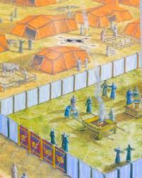
The Courtyard
¹⁸ The courtyard shall be a hundred cubits long and fifty cubits wide, with curtains of finely twisted linen five cubits high, and with bronze bases. ¹⁹ All the other articles used in the service of the tabernacle, whatever their function, including all the tent pegs for it and those for the courtyard, are to be of bronze.

Slide 42
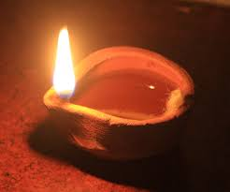
Oil for the Lampstand
²⁰ “Command the Israelites to bring you clear oil of pressed olives for the light so that the lamps may be kept burning.

Slide 43
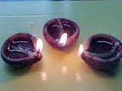
Oil for the Lampstand
²¹ In the tent of meeting, outside the curtain that shields the ark of the covenant law, Aaron and his sons are to keep the lamps burning before the Lord from evening till morning. This is to be a lasting ordinance among the Israelites for the generations to come.

Slide 44

The Priestly Garments
28 “Have Aaron your brother brought to you from among the Israelites, along with his sons Nadab and Abihu, Eleazar and Ithamar, so they may serve me as priests. ² Make sacred garments for your brother Aaron to give him dignity and honor. ³ Tell all the skilled workers to whom I have given wisdom in such matters that they are to make garments for Aaron, for his consecration, so he may serve me as priest.

Slide 45
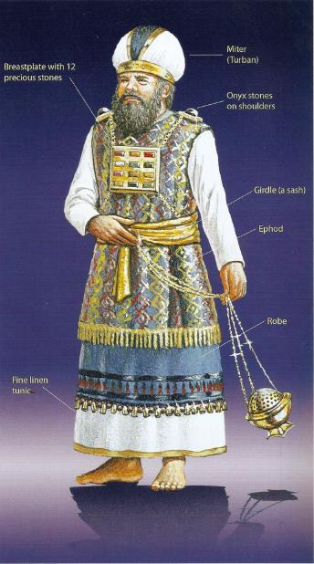
The Priestly Garments
⁴ These are the garments they are to make: a breastpiece, an ephod, a robe, a woven tunic, a turban and a sash. They are to make these sacred garments for your brother Aaron and his sons, so they may serve me as priests. ⁵ Have them use gold, and blue, purple and scarlet yarn, and fine linen.

Slide 46
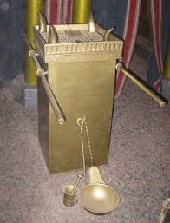
Altar of Incense
30 “Make an altar of acacia wood for burning incense. ² It is to be square, a cubit long and a cubit wide, and two cubits high—its horns of one piece with it. ³ Overlay the top and all the sides and the horns with pure gold, and make a gold molding around it.

Slide 47
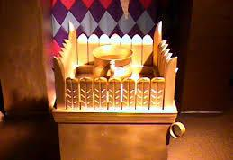
Altar of Incense
⁴ Make two gold rings for the altar below the molding—two on each of the opposite sides—to hold the poles used to carry it. ⁵ Make the poles of acacia wood and overlay them with gold. ⁶ Put the altar in front of the curtain that shields the ark of the covenant law—before the atonement cover that is over the tablets of the covenant law—where I will meet with you.

Slide 48
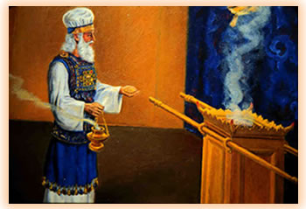
Altar of Incense
⁷ “Aaron must burn fragrant incense on the altar every morning when he tends the lamps. ⁸ He must burn incense again when he lights the lamps at twilight so incense will burn regularly before the Lord for the generations to come.

Slide 49
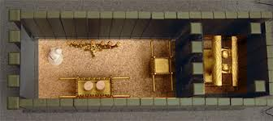
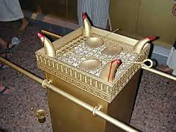
Altar of Incense
⁹ Do not offer on this altar any other incense or any burnt offering or grain offering, and do not pour a drink offering on it. ¹⁰ Once a year Aaron shall make atonement on its horns. This annual atonement must be made with the blood of the atoning sin offering for the generations to come. It is most holy to the Lord.”

Slide 50
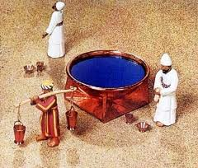
Basin for Washing
¹⁷ Then the Lord said to Moses, ¹⁸ “Make a bronze basin, with its bronze stand, for washing. Place it between the tent of meeting and the altar, and put water in it. ¹⁹ Aaron and his sons are to wash their hands and feet with water from it.

Slide 51
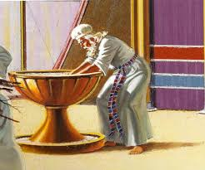
Basin for Washing
²⁰ Whenever they enter the tent of meeting, they shall wash with water so that they will not die. Also, when they approach the altar to minister by presenting a food offering to the Lord, ²¹ they shall wash their hands and feet so that they will not die. This is to be a lasting ordinance for Aaron and his descendants for the generations to come.”

