Slide 1
I Wish to Dwell Among You
Exodus 25:1-22
Lesson #16

Slide 2
Memory Verse
Exodus 20:12
Honor your father and your mother
so that you may live long in the land
the Lord your God
is giving you.
Dig Site #16

Slide 3

Sacrifice
To give up something or to do something hard in order to please God. A special gift given to God.

Slide 4
Acacia Wood
Orange-brown wood from a large, thorny tree. The wood is hard
and not easily destroyed by insects.

Slide 5
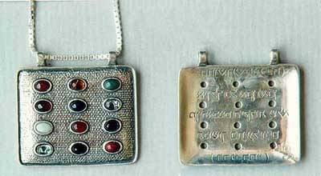
Ephod
A special vest the high priest wore when he served
at the altar.

Slide 6
Tabernacle
The tent for Israelite worship. God met with His people there.

Slide 7
Cherubim
Angels who often served as messengers for God.

Slide 8
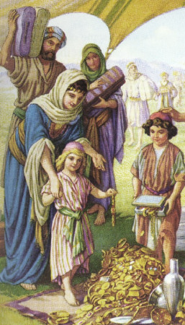
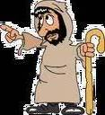
The LORD said to Moses,
"Tell the Israelites to bring me an offering. You are to receive the offering for me from each man whose heart prompts them to give.

Slide 9
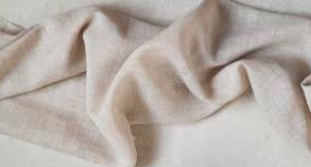
These are the offerings you are
to receive from them:
gold, silver and bronze
blue, purple
and scarlet yarn
and fine linen;
goat hair;

Slide 10
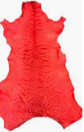
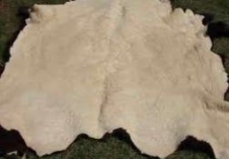
ram skins dyed red
and another
type of
durable leather;
acacia wood; olive oil for the light;

Slide 11

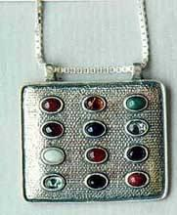
spices for the anointing oil
and for the fragrant incense;
and onyx stones
and other gems
to be mounted
on the ephod
and breastpiece.

Slide 12

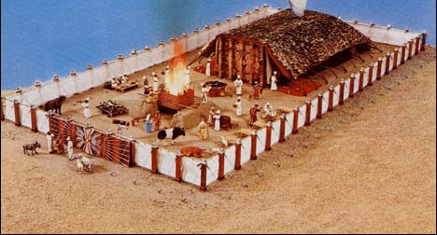
Then have them make a sanctuary for me,
and I will dwell among them.
Make this tabernacle and all its furnishings exactly like the pattern I will show you.

Slide 13
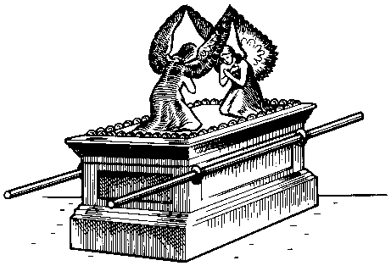
Have them make
an ark of acacia wood —
2½ cubits long,
1½ cubit wide,
and 1½ cubit high.

Slide 14
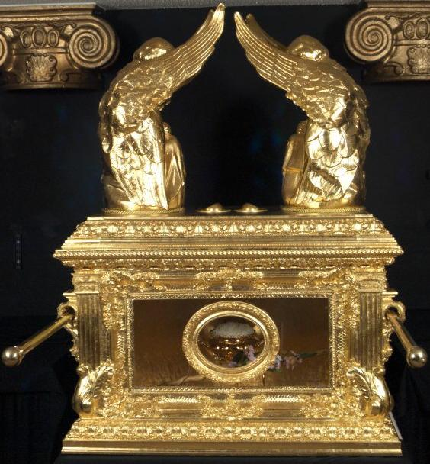
Overlay it with pure gold, both inside and out, and make a gold molding around it.
Cast 4 gold rings for it and fasten them to its 4 feet, with 2 rings on one side and 2 rings on the other.

Slide 15
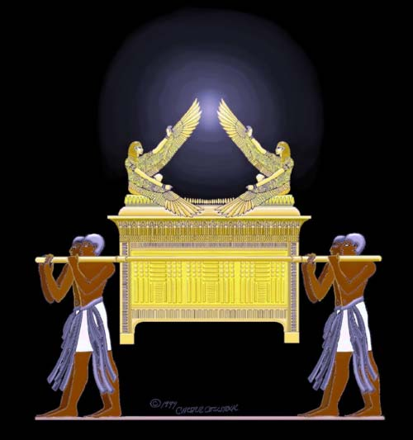
Then make poles of acacia wood and overlay them with gold.
Insert the poles into the rings on the sides of the ark to carry it.
The poles are to remain in the rings of this ark; they are not to be removed.

Slide 16
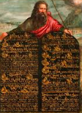
Then put in
the ark
the tablets
of the covenant law, which I
will give you.

Slide 17
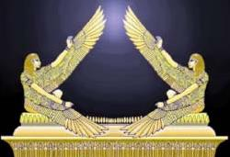
Make an atonement cover of pure gold— 2½ cubits long and 1½ cubits wide.
And make 2 cherubim out of hammered gold at the ends of the cover.
Make 1 cherub on one end and the 2nd cherub on the other; make the cherubim of one piece with the cover, at the 2 ends.

Slide 18
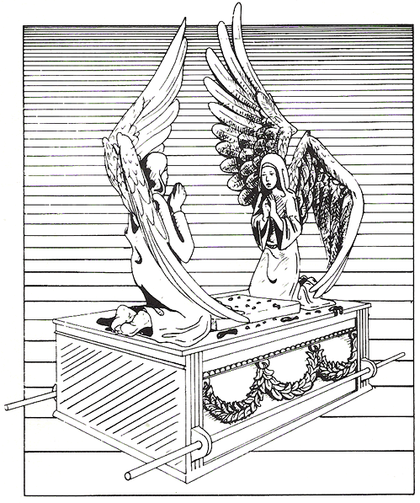
The cherubim are to have their wings spread upward, overshadowing the cover with them.
The cherubim are to face each other, looking toward the cover.

Slide 19

Place the cover on top of the ark and put in the ark the tablets of the covenant law that I will give you.
There, above the cover between the 2 cherubim that are over the ark of the covenant law, I will meet with you and give you all my commands for the Israelites.

