Slide 1
Dig Site #15

Slide 2
Exodus 24:1-18

Slide 3
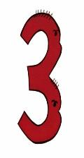
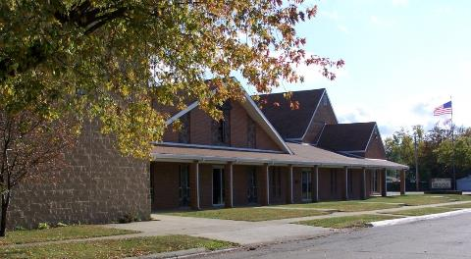
Memory Verse
4
You shall not misuse the name of the LORD your God, for the LORD will not hold anyone guiltless who misuses his name.
Remember the Sabbath day by keeping it holy.
Exodus 20:7-8

Slide 4
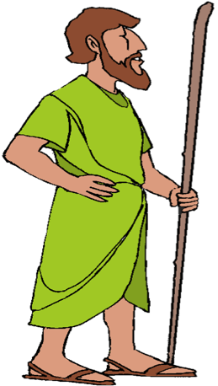
Then the Lord said to Moses, "Come up to the LORD, you and Aaron, Nadab and Abihu, and 70 of the elders of Israel.
Nadab
&
Abihu
+70
Aaron

Slide 5
You are to worship at a distance, but Moses alone is to approach the LORD; the others must not come near. And the people may not come up with him.
+70

Slide 6
When Moses went and told the people all the LORD's words and laws, they responded with one voice
Everything the LORD has said we will do.

Slide 7
Moses then wrote down everything the LORD had said.

Slide 8

He got up early the next morning and built an altar at the foot of the mountain and set up 12 stone pillars representing the 12 tribes of Israel.

Slide 9

Then he sent young Israelite men, and they offered burnt offerings and sacrificed young bulls as fellowship offerings to the LORD.

Slide 10




Moses took half of the blood and put it in bowls, and the other half he splashed
against the
altar.

Slide 11
Then he took the Book of the Covenant and read it to the people. They
responded,
We will obey.
We will do everything the LORD has said;

Slide 12
Moses then took the blood, sprinkled it on the people and said,
This is the blood of the covenant that the LORD has made with you in accordance with all these words.

Slide 13
Moses and Aaron, Nadab and Abihu, and the seventy elders of Israel went up and saw the God of Israel. Under his feet was something like a pavement made of lapis lazuli, as bright blue as the sky.
Nadab
&
Abihu
Aaron
+70

Slide 14
But God did not raise his hand against these leaders of the
Israelites;
they saw God,
and they ate and drank.

Slide 15
The LORD said to Moses, "Come up to me on the mountain and stay here, and I will give you the tablets of stone, with the law and commandments I have written for their instruction."

Slide 16
Then Moses set out with Joshua his aide, and Moses went up on the mountain of God.
He said to the elders, "Wait here for us until we come back to you. Aaron and Hur are with you,
and anyone involved in a dispute can go to them."

Slide 17
When Moses went up on the mountain, the cloud covered it, and the glory of the LORD settled on Mount Sinai. For 6 days the cloud covered the mountain, and on the 7th day the LORD called to Moses from within the cloud.

Slide 18
To the Israelites the glory of the LORD looked like a consuming fire on top of the mountain.

Slide 19
Then Moses entered the cloud as he went on up the mountain. And he stayed on the mountain 40 days and 40 nights.

