Slide 1
Memory Verse
Now if you obey me fully and keep my covenant, then out of all nations you will be my treasured possession. Although the whole earth is mine, you will be for me a kingdom of priests and a holy nation.
Exodus 19:5-6a
Lesson #13

Slide 2
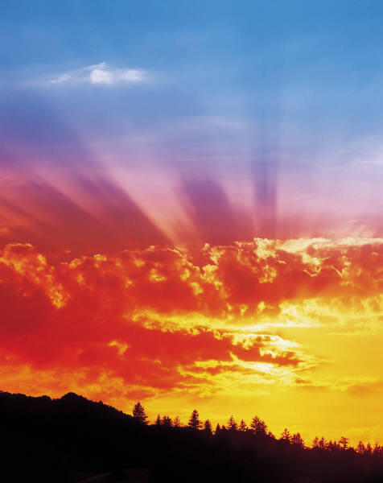
Moses on the Mountain
Exodus 19:1-25
Lesson #13

Slide 3
On the 1st day of the 3rd month after the Israelites left Egypt—on that very day—they came to the Desert of Sinai.
1st
3rd
2nd

Slide 4
After they set out from Rephidim, they entered the Desert of Sinai, and Israel camped there in the desert in front of the mountain.

Slide 5
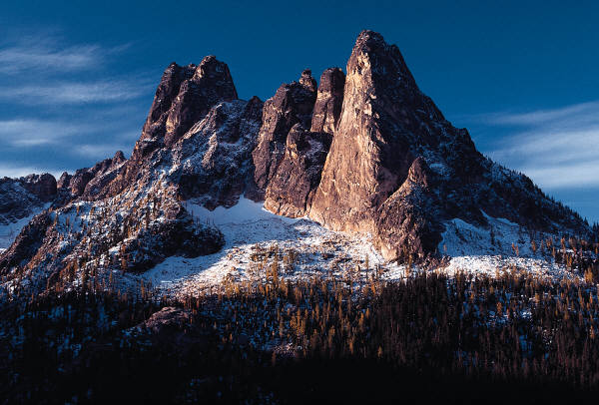
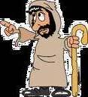
Then Moses went up to God, and the LORD called to him from the mountain and said,
"This is what you are to say to the descendants of Jacob and what you are to tell the people of Israel:

Slide 6
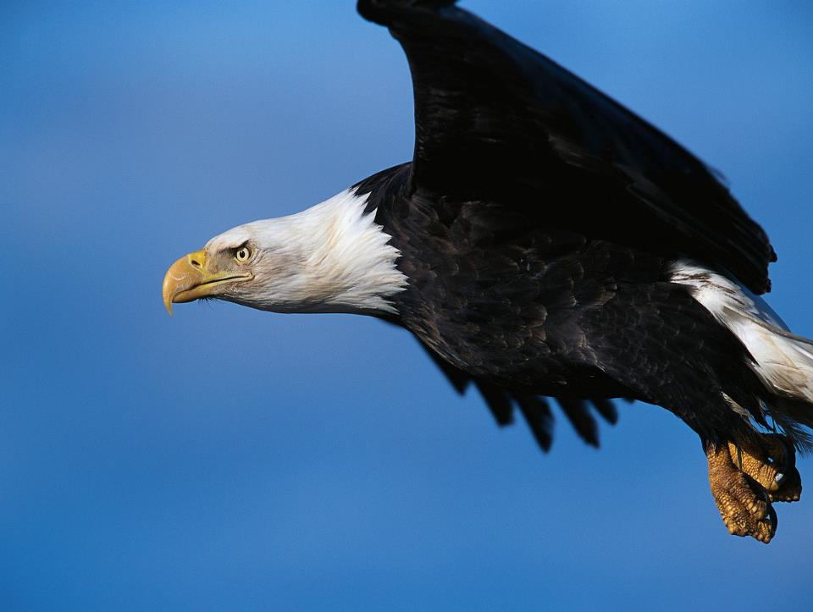
'You yourselves have seen what I did to Egypt, and how I carried you on eagles' wings and brought you to myself.

Slide 7
Now if you obey me fully and keep my covenant, then out of all nations you will be my treasured possession. Although the whole earth is mine,

Slide 8
you will be for me a kingdom of priests and a holy nation.
These are the words you are to speak to the Israelites.

Slide 9
So Moses went back and summoned the elders of the people and set before them all the words the LORD had commanded him to speak.

Slide 10
The people all responded together,
We will do everything the LORD has said.

Slide 11
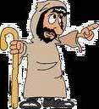
So Moses brought their answer back to the LORD.

Slide 12

The LORD said to Moses, "I am going to come to you in a dense cloud, so that the people will hear me speaking with you and will always put their trust in you."

Slide 13
Then Moses told the LORD what the people had said.

Slide 14
And the LORD said to Moses, "Go to the people and consecrate them today and tomorrow. Have them wash their clothes

Slide 15

and be ready by the 3rd day, because on that day the LORD will come down on Mount Sinai in the sight of all the people.

Slide 16
Put limits for the people around the mountain and tell them, 'Be careful that you do not approach the mountain or touch the foot of it.

Slide 17
Whoever touches the mountain is to be put to death.

Slide 18

They are to be stoned or shot with arrows; not a hand is to be laid on them. No person or animal shall be permitted to live.' Only when the ram's horn sounds a long blast may they approach the mountain."

Slide 19
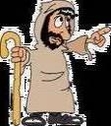
After Moses had gone down the mountain to the people, he consecrated them, and they washed their clothes.

Slide 20
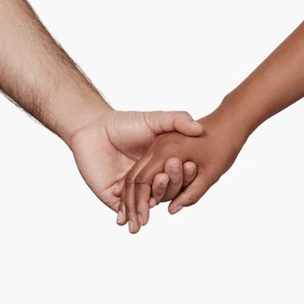
Then he said to the people,
"Prepare yourselves for the 3rd day. Abstain from sexual relations."

Slide 21
On the morning of the 3rd day there was thunder and lightning, with a thick cloud over the mountain, and a very loud trumpet blast. Everyone in the camp trembled.

Slide 22
Then Moses led the people out of the camp to meet with God, and they stood at the foot of the mountain.

Slide 23

Mount Sinai was covered with smoke, because the LORD descended on it in fire. The smoke billowed up from it like smoke from a furnace, and the whole mountain trembled violently.

Slide 24
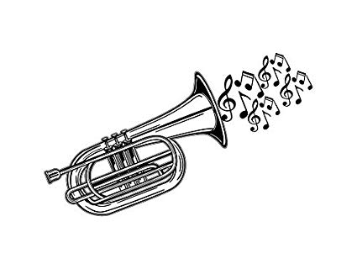
As the sound of the trumpet grew louder and louder, Moses spoke and the voice of God answered him.

Slide 25
The LORD descended to the top of Mount Sinai and called Moses to the top of the mountain.
So Moses went up

Slide 26
and the LORD said to him,
"Go down and warn the people so they do not force their way through to see the LORD and many of them perish.

Slide 27
Even the priests, who approach the LORD, must consecrate themselves,
or the LORD will break out against them.

Slide 28
Moses said to the LORD, "The people cannot come up Mount Sinai, because you yourself warned us, 'Put limits around the mountain and set it apart as holy.'

Slide 29

The LORD replied,
"Go down and bring Aaron up with you.
But the priests and the people must not force their way through to come up to the LORD, or he will break out against them."

Slide 30

So Moses went down to the people and told them.

