Slide 1
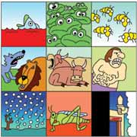
Dig Site 9
Exodus 10:1–11:10
Egypt
is Ruined!

Slide 2
The Plague of Locusts (#8)

Slide 3
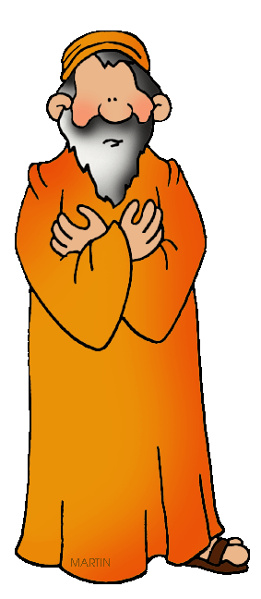
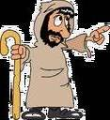
Then the LORD said to Moses
Go to Pharaoh, for I have hardened his heart and the hearts of his officials so that I may perform these signs of mine among them that you may tell your children and grandchildren how I dealt harshly with the Egyptians and how I performed my signs among them,
and that you may know that
I am the LORD.

Slide 4
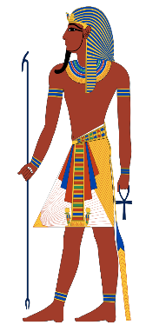
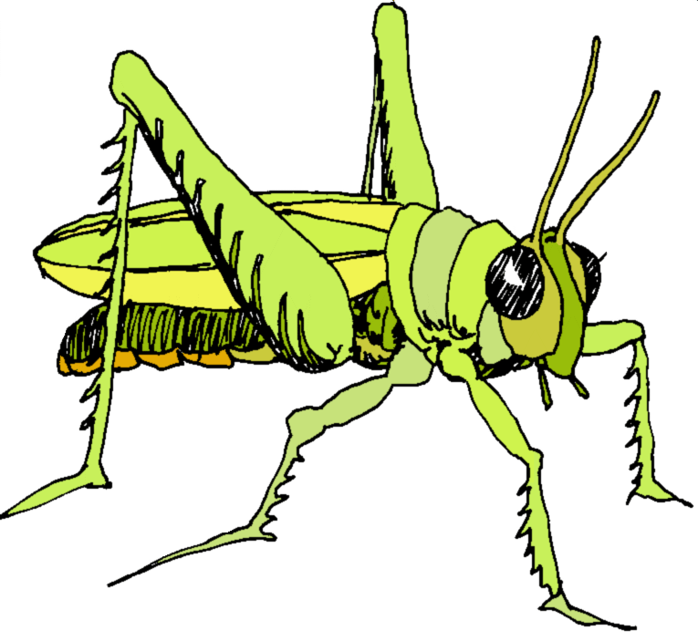
So Moses and Aaron went
to Pharaoh and said to him,
“This is what the LORD, the God of the Hebrews, says:
How long will you refuse to humble yourself before me? Let my people go, so that they may worship me.

Slide 5

If you refuse to
let them go,
I will bring locusts into your country tomorrow. They will cover the face of the ground so
that it cannot be seen.

Slide 6
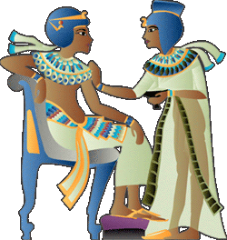
They will devour what little you have left after the hail, including every tree that is growing in your fields.
They will fill your houses and those of all your officials
and all the Egyptians—something neither your parents nor your
ancestors have ever seen
from the day they settled in this land till now.

Slide 7
Then Moses turned and left Pharaoh. Pharaoh’s officials said to him,
How long will this man be a snare to us? Let the people go, so that they may worship the LORD their God. Do you not yet realize that Egypt is ruined?

Slide 8

Then Moses and Aaron were brought back to Pharaoh.
Go, worship the LORD your God
he said
But tell me who will be going.

Slide 9

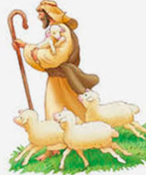
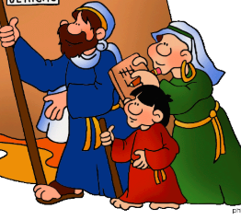
Moses answered,
We will go with our young and our old,
with our sons and our daughters,
and with our flocks and herds, because we are to celebrate a festival to the LORD.

Slide 10

Pharaoh said,
The LORD be with you—if I let you go, along with your women and children! Clearly you are bent on evil.
No!
Have only the men go and worship the LORD, since that’s what you have been asking for.

Slide 11
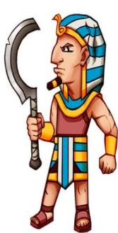
Then Moses and Aaron were driven out of Pharaoh’s presence.

Slide 12
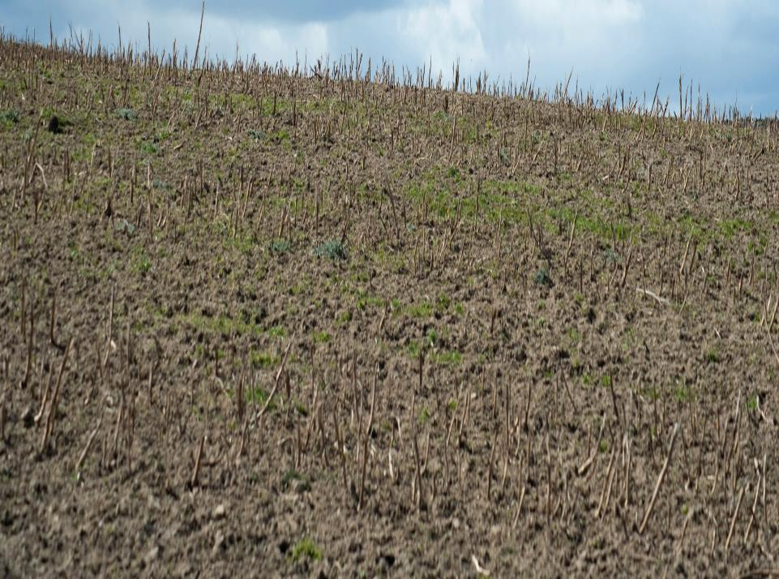
And the LORD said to Moses,
Stretch out your hand over Egypt so that locusts swarm over the land and devour everything growing in the fields, everything left by the hail.

Slide 13
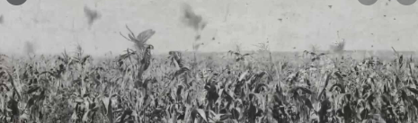
So Moses stretched out his staff over Egypt, and the LORD made an east wind blow across the land all that day
and all that night.
By morning the wind had brought the locusts; they invaded all Egypt and settled down in every area of the country in
great numbers.

Slide 14
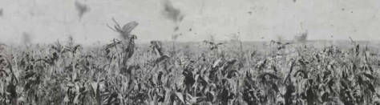
Never before had there been such a plague of locusts, nor will there ever be again. They covered all the ground until it was black.

Slide 15
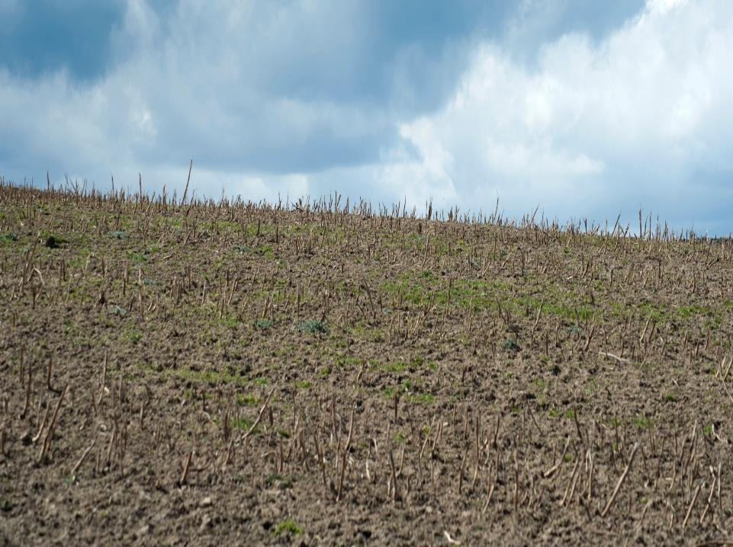
They devoured all that was left after the
hail — everything growing in the fields
and the fruit on the trees.
Nothing green remained on tree or plant
in all the land of Egypt.

Slide 16
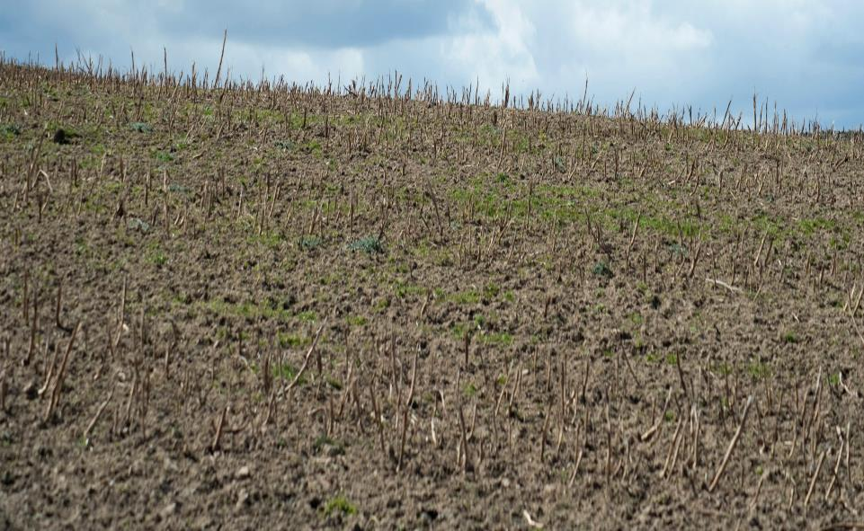

Pharaoh quickly summoned Moses and Aaron and said,
I have sinned against
the LORD your God and against you.
Now forgive my sin once more and pray to the LORD your God to take this deadly plague
away from me.

Slide 17
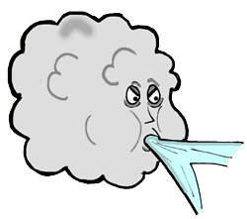
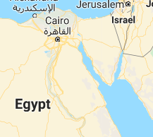
Moses then left Pharaoh and prayed to the LORD. And the LORD changed the wind to a very strong west wind, which caught up the locusts and carried them into the Red Sea.

Slide 18

Not a locust was left anywhere in Egypt.
But the LORD hardened
Pharaoh’s heart,
and he would not let the Israelites go.

Slide 19
The Plague of Darkness

Slide 20

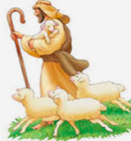
Then the LORD said to Moses,
Stretch out your hand toward the sky so that darkness spreads over Egypt—darkness that can be felt.
So Moses stretched out his hand
toward the sky, and total darkness covered all Egypt for 3 days. No one could see anyone else or move about for 3 days.
Yet all the Israelites
had light in the places
where they lived.

Slide 21
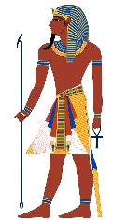
Then Pharoah summoned Moses and said,
Go, worship the LORD. Even your women and children may go with you; only leave your flocks and herds behind.
But
Moses
said,
You must allow us to have sacrifices and burnt offerings to present to the LORD our God. Our livestock too must go with us; not a hoof is to be left behind. We have to use some of them in worshiping the LORD our God, and until we get there we will not know what we are to use to worship the LORD.

Slide 22

But the LORD hardened Pharaoh’s heart,
and he was not willing to let them go.
Pharaoh said to Moses,
Get out of my sight!
Make sure you do not appear before me again! The day you see my face you will die.
Just as you say
Moses replied
I will never appear before you again.

Slide 23
The Plague of the Firstborn

Slide 24


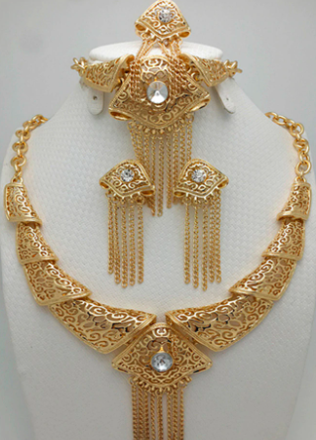



Now the LORD had said to Moses,
I will bring 1 more plague on Pharaoh and on Egypt. After that, he will let you go from here, and when he does,
he will drive you out completely.
Tell the people that men and women alike are to ask their neighbors for articles of silver and gold.
(The LORD made the Egyptians favorably disposed toward the
people, and Moses himself was
highly regarded in Egypt by
Pharaoh’s officials and by
the people.)

Slide 25
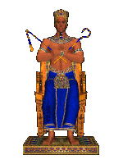
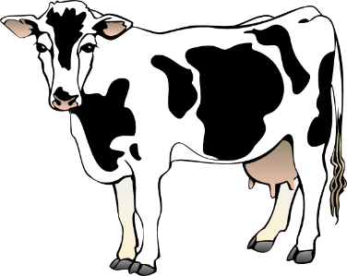
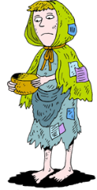

So Moses said,
‘About midnight I will go throughout Egypt. Every firstborn son in Egypt will die, from the firstborn son of Pharaoh, who sits on the throne, to the firstborn son of the female slave, who is at her hand mill, and all the firstborn of the cattle as well.
This is what the LORD says:

Slide 26
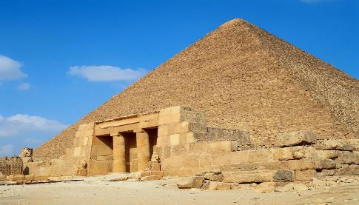


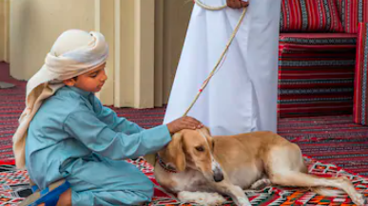
EGYPT
There will be loud wailing throughout Egypt—worse than there has ever been or ever will be again. But among the Israelites not a dog will bark at any person or animal.
GOSHEN

Slide 27

Then you will know that the LORD makes a distinction between Egypt and Israel. All these officials of yours will come to me, bowing down before me and saying,
‘Go, you and all the people who follow you!’ After that I will leave.”
EGYPT
GOSHEN

Slide 28


Then Moses, hot with anger, left Pharaoh.
The LORD had said to Moses, .
Pharaoh will refuse to listen to you—so that my wonders may be multiplied in Egypt.
Moses and Aaron performed all these wonders before Pharaoh, but the LORD hardened Pharaoh’s heart,
and he would not let the Israelites go out of his country.

