Slide 1
Memory Verse
Know that the Lord has set apart his faithful servant for himself; the Lord hears when I call to him. Psalm 4:3
#7

Slide 2

Exodus Lesson #7
Exodus 7:25 – 8:32
Frogs, Gnats
and Flies...
Oh My!

Slide 3
The Plague of Frogs Exodus 7:25-8:15

Slide 4
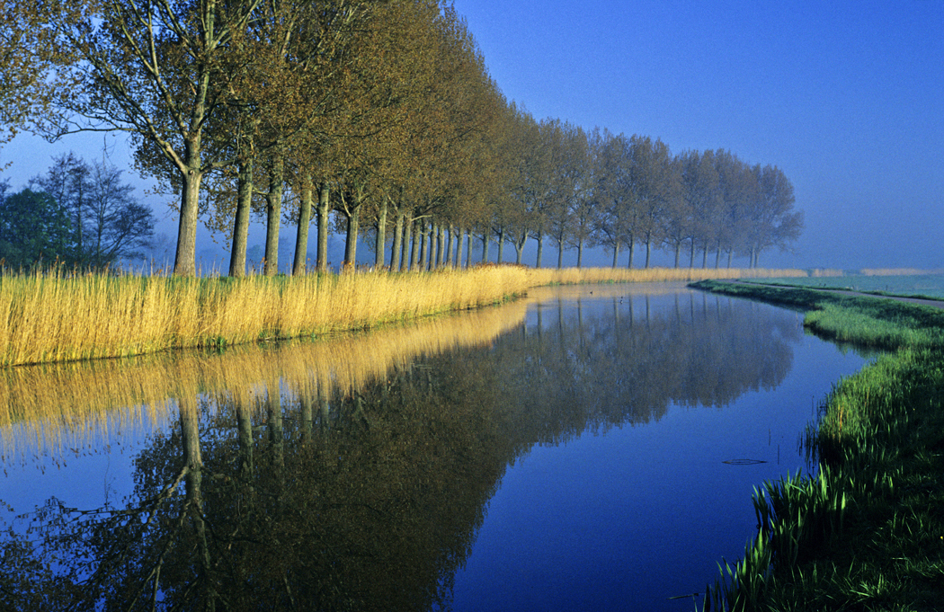
7 days passed after the Lord struck the Nile.

Slide 5
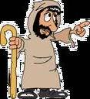
Then the Lord said to Moses
Go to Pharaoh and say to him, “This is what the Lord says:
Let my people go,
so that they may worship me.
If you refuse to let them go,
I will send a plague of frogs on your whole country.
The Nile will teem with frogs.”

Slide 6
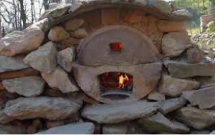
They will come up into your palace and your bedroom and onto your bed,
into the houses of your officials and on your people, and into your ovens and kneading troughs.
The frogs will come up on you and your people and all your officials.

Slide 7
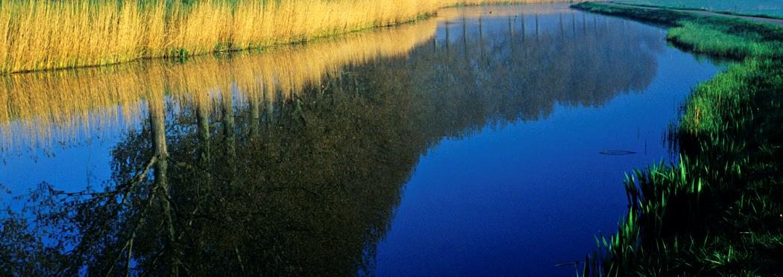
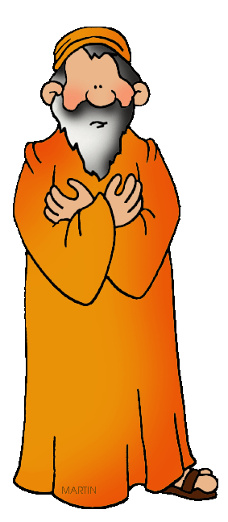

Then the Lord said to Moses,
Tell Aaron, “Stretch out your hand with your staff over the streams and canals and ponds, and make frogs come up on the land of Egypt.”
So Aaron stretched out his hand over
the waters of Egypt, and the frogs came
up and covered the land.

Slide 8
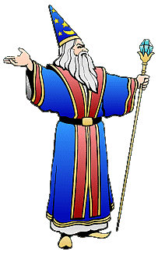
But the magicians did the same things by their secret arts;
they also made frogs come
up on the land of Egypt.

Slide 9
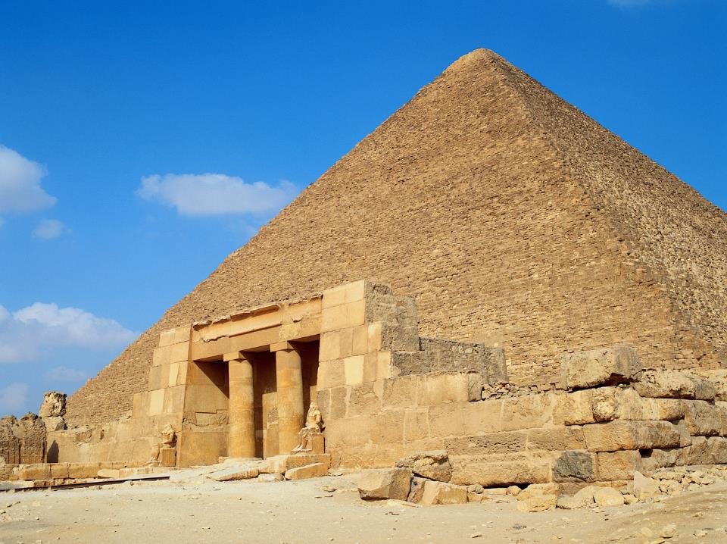
Pharaoh summoned Moses and Aaron and said,
Pray to the Lord to take the frogs away from me and my people, and I will let your people go to offer sacrifices to the Lord.

Slide 10
Moses said to Pharaoh,
I leave to you the honor of setting the time for me to pray for you and your officials and your people that you and your houses may be rid of the frogs, except for those that remain in the Nile.

Slide 11
Tomorrow
Pharaoh said.
It will be as you say, so that you may know there is no one like the LORD our God. The frogs will leave you and your houses, your officials and your people; they will remain only in the Nile.

Slide 12
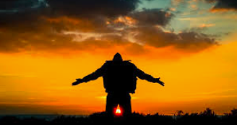


After Moses and Aaron left Pharaoh, Moses cried out to the LORD about the frogs he had brought on Pharaoh.

Slide 13

And the LORD did what Moses asked.
The frogs died in the houses, the courtyards and in the fields. They were piled into heaps, and the land reeked of them. But when Pharaoh saw that there was relief, he hardened his heart and would not listen to Moses and Aaron,
just as the LORD had said.

Slide 14
How many days had passed since the Lord struck the Nile?
3 days
7 days
The Bible does not say

Slide 15
How many days had passed since the Lord struck the Nile?
3 days
7 days
The Bible does not say

Slide 16
What did Moses tell Pharaoh his people wanted to do?
Have a party
Take a day off because they were tired
Worship the Lord

Slide 17
What did Moses tell Pharaoh his people wanted to do?
Have a party
Take a day off because they were tired
Worship the Lord

Slide 18
Where did Moses say the frogs would go?
On their beds and their kneading troughs
Into their ovens and on the officials
Both answers are correct

Slide 19
Where did Moses say the frogs would go?
On their beds and their kneading troughs
Into their ovens and on the officials
Both answers are correct

Slide 20
What did Pharaoh say he would allow the Israelites to do if Moses would ask the Lord to make the frogs go away?
Take more breaks at work
Allow the Israelites to make sacrifices to the Lord
Have extra food to eat

Slide 21
What did Pharaoh say he would allow the Israelites to do if Moses would ask the Lord to make the frogs go away?
Take more breaks at work
Allow the Israelites to make sacrifices to the Lord
Have extra food to eat

Slide 22
The Plague of Gnats Exodus 8:16-19

Slide 23
Then the Lord said to Moses
Tell Aaron,
“Stretch out your staff and strike the dust of the ground,”
and throughout the land of Egypt the dust will become gnats.

Slide 24
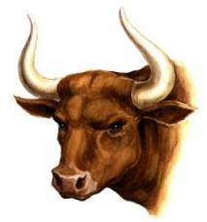
They did this,
and when Aaron stretched out his hand with the staff and struck the dust of the ground, gnats came on people and animals.

Slide 25
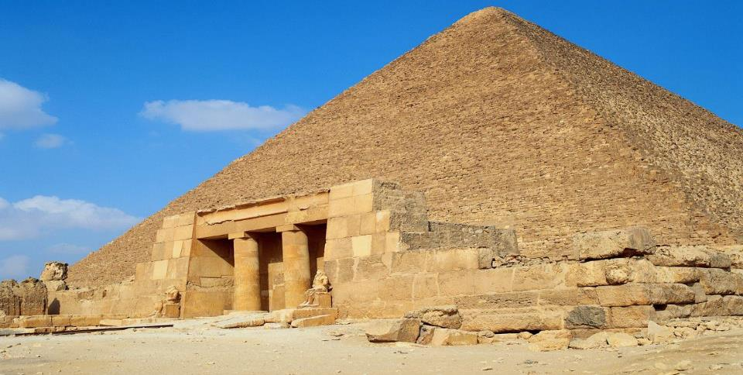
All the dust throughout the land of Egypt became gnats.
But when the magicians tried to produce gnats by their secret arts, they could not.
Since the gnats were on people and animals everywhere.

Slide 26
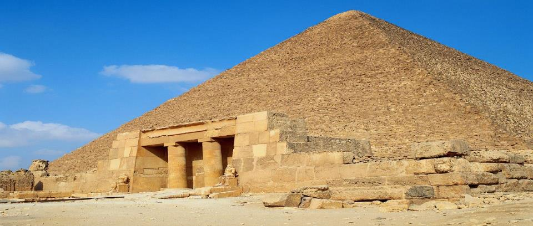
The magicians said to Pharaoh,
This is the finger of God.
But Pharaoh's heart was hard and he would not listen, just as the LORD had said.

Slide 27
What was Aaron to do to make the gnats appear?
Strike his staff on the dust of the ground
Say hocus pocus, gnats in focus
Both answers are correct

Slide 28
What was Aaron to do to make the gnats appear?
Strike his staff on the dust of the ground
Say hocus pocus, gnats in focus
Both answers are correct

Slide 29
Where did the gnats go?
On all the people
On all the animals
Both answers are correct

Slide 30
Where did the gnats go?
On all the people
On all the animals
Both answers are correct

Slide 31
Who was able to make the gnats appear?
Aaron
The magicians
Both answers are correct

Slide 32
Who was able to make the gnats appear?
Aaron
The magicians
Both answers are correct

Slide 33
The Plague of Flies Exodus 8:20-32

Slide 34
Then the Lord said to Moses,
Get up early in the morning and confront Pharaoh
as he goes to the river and say to him,
“This is what the Lord says: Let my people go, so that they may worship me.”

Slide 35
“If you do not let my people go, I will send swarms of flies on you and your officials, on your people and into your houses.
The houses of the Egyptians will be full of flies;
even the ground will be covered with them.”

Slide 36
But on that day I will deal differently with the land of Goshen, where my people live; no swarms of flies will be there,
so that you will know that I, the Lord,
am in this land.
I will make a distinction between my people and your people.
This sign will occur tomorrow.
EGYPT
GOSHEN

Slide 37

And the Lord did this. Dense swarms of flies poured into Pharaoh’s palace and into the houses of his officials; throughout Egypt the land was ruined by the flies.

Slide 38
Then Pharaoh summoned Moses and Aaron and said,
Go, sacrifice to your
God here in the land.

Slide 39

But Moses said,
That would not be right.
The sacrifices we offer the Lord our God would be detestable to the Egyptians.
And if we offer sacrifices that are detestable in their eyes, will they not stone us?

Slide 40

We must take a 3-day journey into the wilderness to offer sacrifices to the Lord our God, as he commands us.

Slide 41
Pharaoh said,
I will let you go to offer sacrifices to the Lord your God in the wilderness, but you must not go very far. Now pray for me.

Slide 42
Moses answered,
As soon as I leave you, I will pray to the Lord, and tomorrow the flies will leave Pharaoh and his officials and his people.
Only let Pharaoh be
sure that he does not act deceitfully again by not letting the people go to offer sacrifices
to the Lord.

Slide 43
Then Moses left Pharaoh and prayed to the Lord,
and the Lord did what Moses asked.
The flies left Pharaoh and his officials and his people;
not a fly remained.

Slide 44

But this time also Pharaoh hardened his heart and would not let the people go.

Slide 45
How did Moses confront Pharaoh after the gnats were gone?
He met Pharaoh early the next morning
He met Pharaoh when he was on his way to the river
Both answers are correct

Slide 46
How did Moses confront Pharaoh after the gnats were gone?
He met Pharaoh early the next morning
He met Pharaoh when he was on his way to the river
Both answers are correct

Slide 47
What did Moses mean when he said God would deal differently with the Israelites?
Flies would be everywhere in Egypt
There wouldn’t be any flies in Goshen
There would be big flies in Egypt and little flies in Goshen

Slide 48
Where did Moses mean when he said God would deal differently with the Israelites?
Flies would be everywhere in Egypt
There wouldn’t be any flies in Goshen
There would be big flies in Egypt and little flies in Goshen

Slide 49
Where did Pharaoh say about Moses and his people and their sacrifices?
Make your sacrifices here in this land
Go and make your sacrifices but not very far
Both answers are correct

Slide 50
Where did Pharaoh say about Moses and his people and their sacrifices?
Make your sacrifices here in this land
Go and make your sacrifices but not very far
Both answers are correct

Slide 51
When was Pharaoh’s heart hardened?
After the plague of frogs and the plague of gnats and plague of flies
Only after the plague of flies
His heart wasn’t hardened

Slide 52
When was Pharaoh’s heart hardened?
After the plague of frogs and the plague of gnats and plague of flies
Only after the plague of flies
His heart wasn’t hardened

