Slide 1

DigSite #5
Exodus 5:1-23
6:1-9

Slide 2


Exodus 6:5
Moreover,
I have heard the groaning of the Israelites,
whom the Egyptians are enslaving,
and I have remembered my covenant.

Slide 3

DigSite #5
Going
to Pharoah

Slide 4
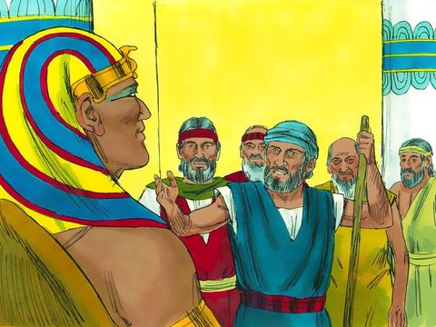
Afterward Moses and
Aaron went to Pharaoh
and said,
This is what the LORD, the God of Israel, says: 'Let my people go, so that they may hold a festival to me in the wilderness.’

Slide 5
Pharaoh said,
Who is the Lord, that I should obey him and let Israel go?
I do not know the Lord and I will not let Israel go.

Slide 6
Then they said,
The God of the Hebrews has met with us. Now let us take a
3-day journey into the wilderness to offer sacrifices to the Lord our God, or he may strike us with plagues or with the sword.

Slide 7
But the king of Egypt
said,
Moses and Aaron, why are you taking the people away from their labor?
Get back to your work!

Slide 8
Then Pharaoh said,
Look, the people of the land are now numerous, and you are stopping them from working.

Slide 9
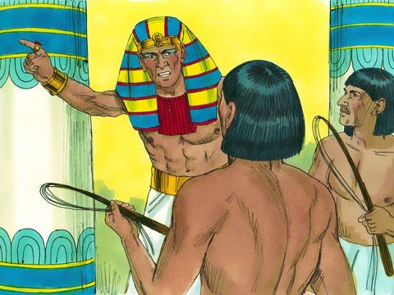
That same day Pharaoh gave this order to the slave drivers and overseers in charge of the people:
You are no longer to supply the people with straw for making bricks; let them go and gather their own straw.

Slide 10
But require them to make the same number of bricks as before;
don’t reduce the quota.

Slide 11
They are lazy; that is why they are crying out,
‘Let us go and sacrifice to our God.’

Slide 12
Make the work harder for the people so that they keep working and pay no attention to lies.

Slide 13
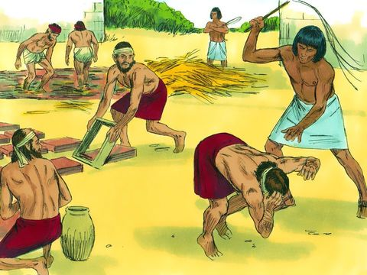
Then the slave drivers and the overseers went out and said to the people,
This is what Pharaoh says: ‘I will not give you any more straw. Go and get your own straw wherever you can find it, but your work will not be reduced at all.’

Slide 14
So the people scattered all over Egypt to gather stubble to use for straw.

Slide 15
The slave drivers kept pressing them, saying,
Complete the work required of you for each day, just as when you had straw.

Slide 16
And Pharaoh’s slave drivers beat the Israelite overseers they had appointed, demanding,
Why haven’t you met your quota of bricks yesterday or today, as before?

Slide 17
Then the Israelite overseers went and appealed to Pharaoh:
Why have you treated your servants this way? Your servants are given no straw, yet we are told, ‘Make bricks!’

Slide 18
Your servants are being beaten, but the fault is with your own people.

Slide 19
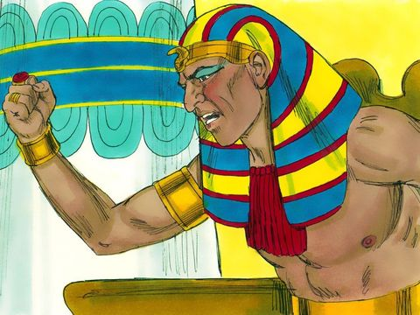
Pharaoh said,
Lazy, that’s what you are—lazy! That is why you keep saying, ‘Let us go and sacrifice to the Lord.’

Slide 20
Now get to work. You will not be given any straw, yet you must produce your full quota of bricks.

Slide 21
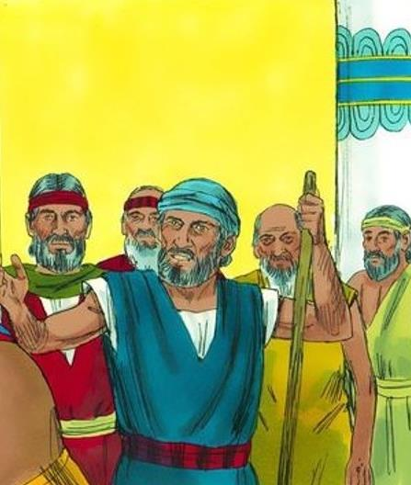
The Israelite overseers realized they were in trouble when they were told,
“You are not to reduce the number of bricks required of you for each day.”

Slide 22
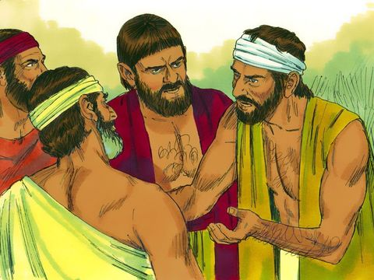
When they left Pharaoh, they found Moses and Aaron waiting to meet them.
May the Lord look on you and judge you!

Slide 23
You have made us obnoxious to Pharaoh and his officials and have put a sword in their hand to kill us.”

Slide 24
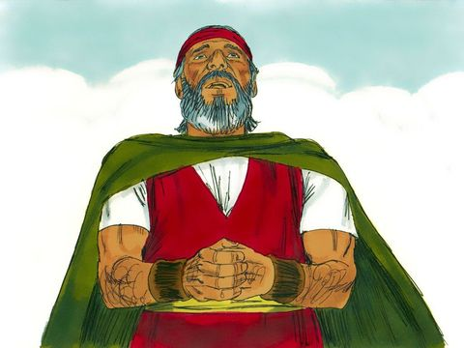
Moses returned to the Lord and said,
Why, Lord, why have you brought trouble on this people? Is this why you sent me?

Slide 25
Ever since I went to Pharaoh to speak in your name, he has brought trouble on this people, and you have not rescued your people at all.

Slide 26
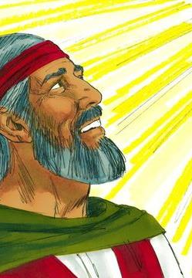
Then the Lord said to Moses, “Now you will see what I will do to Pharaoh:
Because of my mighty hand he will let them go; because of my mighty hand he will drive them out of his country.”

Slide 27
God also said to Moses, “I am the Lord. I appeared to Abraham, to Isaac, and to Jacob
as God Almighty.
but by my name the Lord I did not make myself fully known to them.

Slide 28
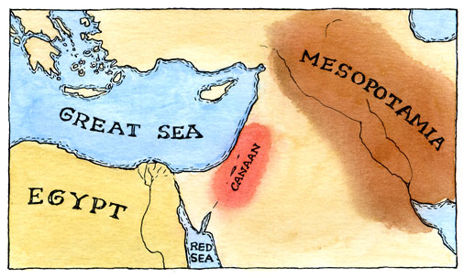
I also established my covenant with them to give them the land of Canaan,
where they resided as foreigners.

Slide 29
Moreover, I have heard the groaning of the Israelites,
whom the Egyptians are enslaving, and I have remembered my covenant,

Slide 30
“Therefore, say to the Israelites:
‘I am the Lord, and I will bring you out from under the yoke of the Egyptians.

Slide 31
I will free you from being slaves to them,
and I will redeem you with an outstretched arm and with mighty acts of judgment.

Slide 32
I will take you as my own people, and I will be your God.
Then you will know that I am the Lord your God, who brought you out from under the yoke of the Egyptians.

Slide 33
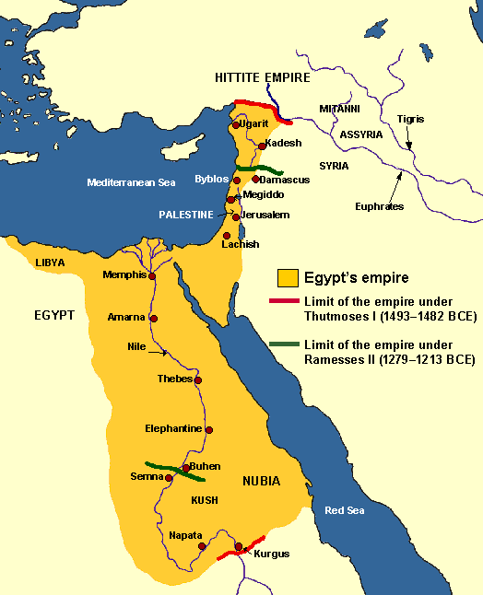
And I will bring you to the land I swore with uplifted hand to give to Abraham,
to Isaac and to Jacob.
I will give it to you as a possession. I am the Lord.’”

Slide 34
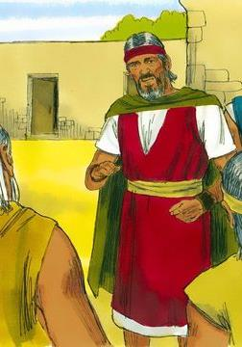
Moses reported this to the Israelites, but they did not listen to him because of their discouragement and harsh labor.

