Slide 1

Lesson #4
Exodus 4:1-21, 27-31

Slide 2


Psalm 9:10
Those who know your name trust in you, for you, Lord,
Have never forsaken those who seek you.

Slide 3
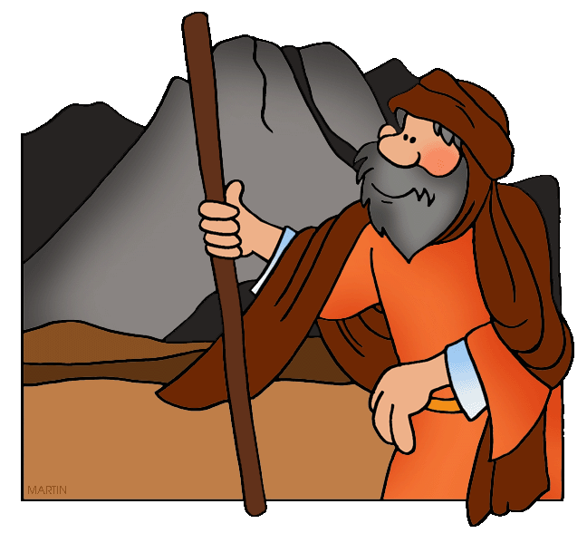
Moses answered, “What if they do not believe me or listen to me and say,
‘The Lord did not appear to you’?”
Then the Lord said to him,
“What is that in your hand?”
“A staff,” he replied.

Slide 4
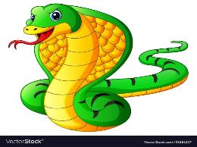
The Lord said, “Throw it on the ground.” Moses threw it on the ground and it became a snake, and he ran from it.

Slide 5
Then the Lord said to him, “Reach out your hand and take it by the tail.”
So Moses reached out and took hold of the snake and it turned back into a staff in his hand.

Slide 6

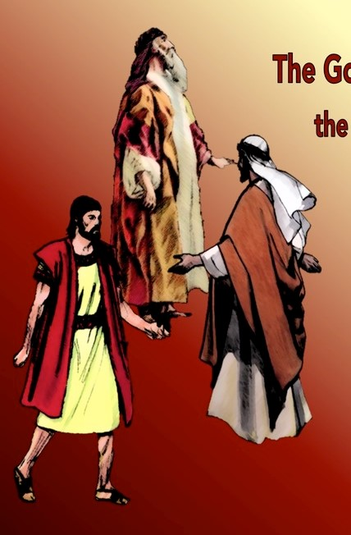
“This,” said the Lord, “is so that they may believe that the Lord, the God of their fathers—the God of Abraham, the God of Isaac and the God of Jacob—has appeared to you.”
Abraham
Isaac & Jacob

Slide 7
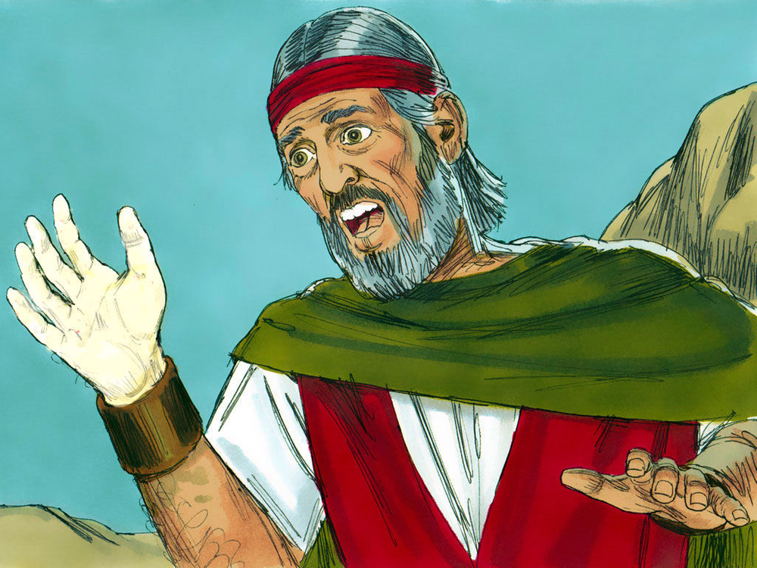
Then the Lord said, “Put your hand inside your cloak.” So Moses put his hand into his cloak, and when he took it out, the skin was leprous—it had become as white as snow.

Slide 8
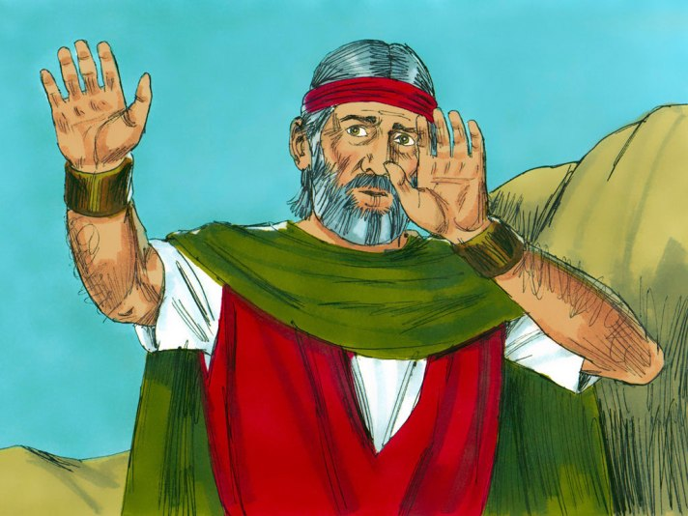
“Now put it back into your cloak,” he said. So Moses put his hand back into
his cloak, and when he took it out, it was restored, like the rest of his flesh.

Slide 9
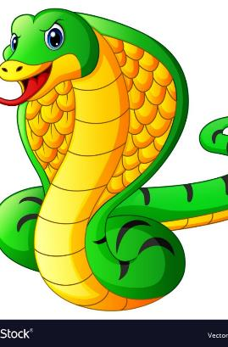
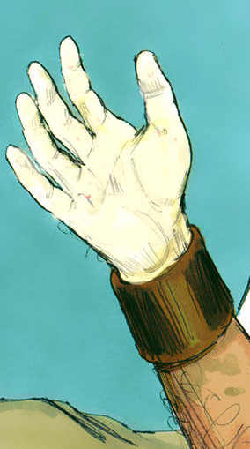
Then the Lord said, “If they do not believe you or pay attention to the first sign, they may believe the second.

Slide 10
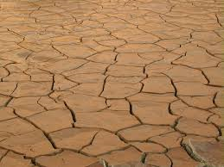
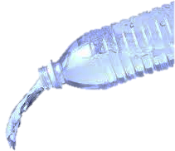
But if they do not believe these two signs or listen to you, take some water from the Nile and pour it on the dry ground. The water you take from the river will become blood on the ground.”

Slide 11

Moses said to the Lord, “Pardon your servant, Lord. I have never been eloquent, neither in the past nor since you have spoken to your servant. I am slow of speech and tongue.”

Slide 12

The Lord said to him, “Who gave human beings their mouths?
Who makes them deaf or mute?

Slide 13
Who gives them
sight or makes them blind?
Is it not I, the Lord?
Now go; I will help you speak and will teach you what to say.”

Slide 14
But Moses said, “Pardon your servant, Lord. Please send someone else.”

Slide 15
Then the Lord’s anger burned against Moses and he said, “What about your brother, Aaron the Levite?
I know he can speak well.

Slide 16
He is already on his way to meet you,
and he will be glad
to see you.

Slide 17
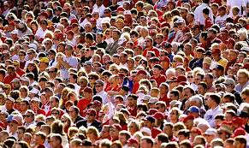
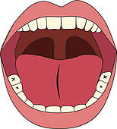
You shall speak to him and put words in his mouth; I will help both of you speak and will teach you what to do.
He will speak to the people for you, and it will be as if he were your mouth and as if you were God to him.
WORDS

Slide 18
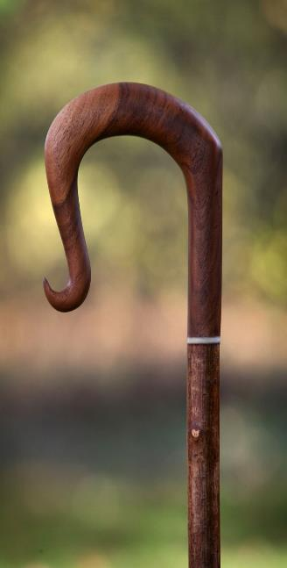
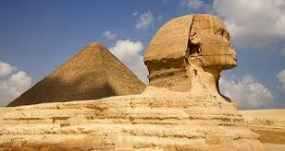
But take this staff in your hand so you can perform the signs with it.”

Slide 19
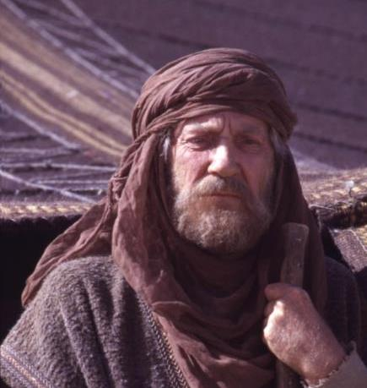
Then Moses went back to Jethro his father-in-law and said to him, “Let me return to my own people in Egypt to see if any of them are still alive.”
Jethro said,
“Go, and I wish you well.”

Slide 20
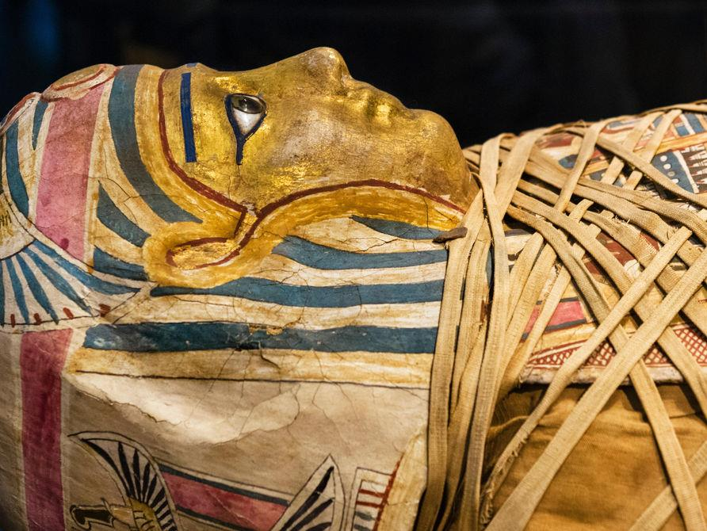
Now the Lord had said to Moses in Midian,
“Go back to Egypt, for all those who wanted to kill you are dead.”

Slide 21
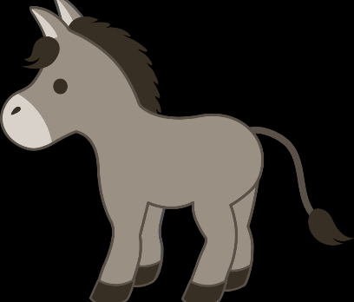
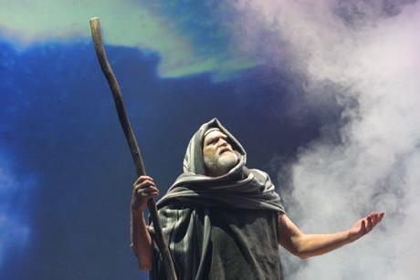
So Moses took his wife and sons, put them on a donkey and started back to Egypt. And he took the staff of God in his hand.

Slide 22
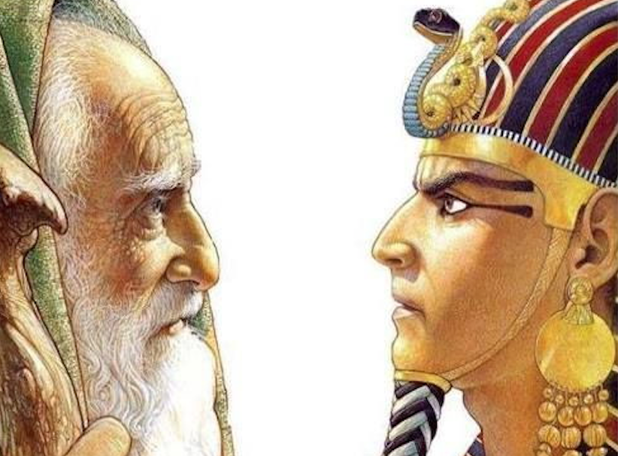
The Lord said to Moses, “When you return to Egypt, see that you perform before Pharaoh all the wonders I have given you the power to do.

Slide 23
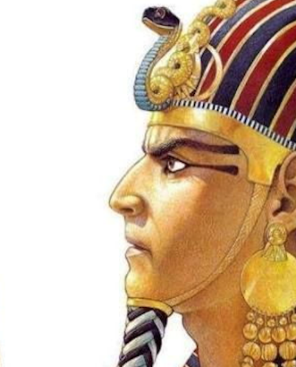

But I will harden his heart so that he will not let the people go.

Slide 24
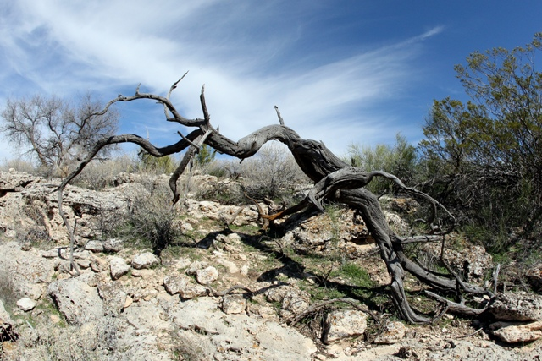
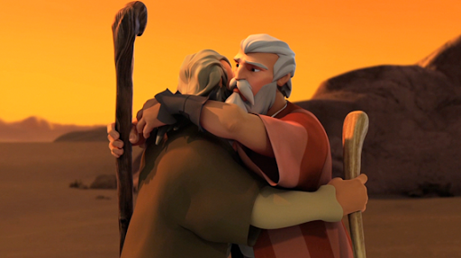
The Lord said to Aaron,
“Go into the wilderness to meet Moses.”
So he met Moses at the mountain of God and kissed him.

Slide 25
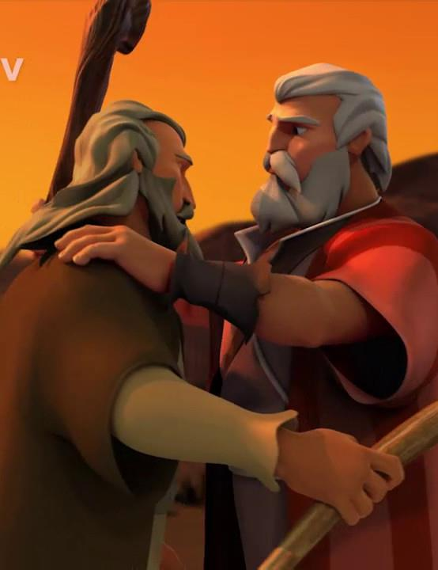
Then Moses told Aaron everything the Lord had sent him to say, and also about all the signs he had commanded him to perform.

Slide 26
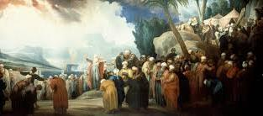
Moses and Aaron brought together all the elders of the Israelites, and Aaron told them everything the Lord had said to Moses.

Slide 27
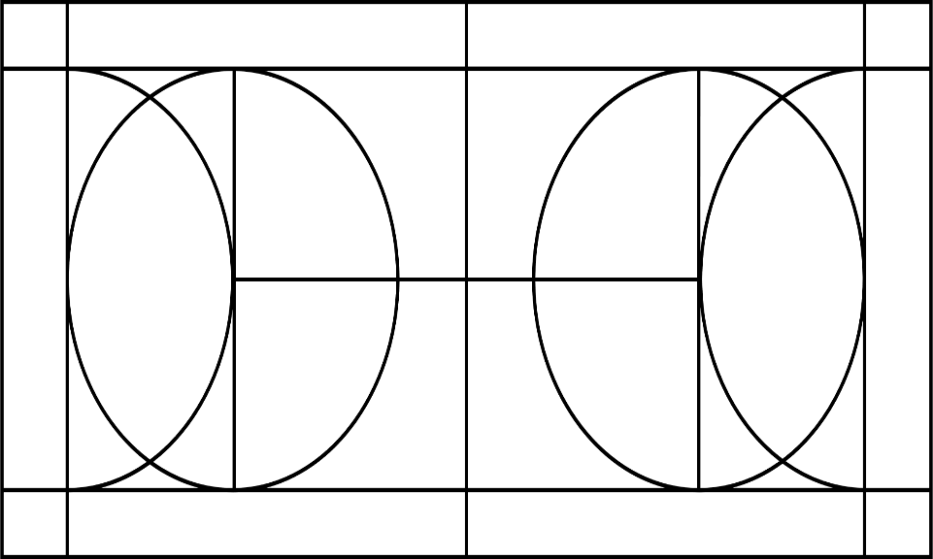
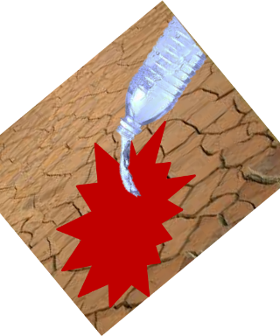
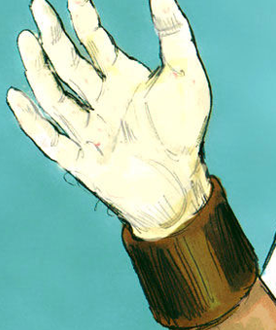
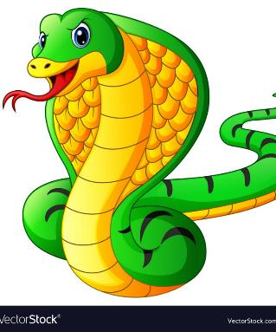
He also performed the signs before the people, and they believed.

Slide 28
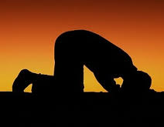
And when they heard that the Lord was concerned about them and had seen their misery,
they bowed down and worshiped.

