Slide 1
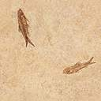

DigSite #3
Exodus 2:23-3:22

Slide 2


Exodus 3:14
God said to Moses,
“I AM WHO I AM.
This is what you are to say to the Israelites:
‘I AM has sent me to you.’ ”

Slide 3


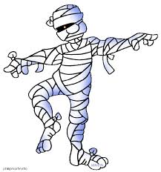
During that long period, the king of Egypt died. The Israelites groaned in their slavery and cried out, and their cry for help because of their slavery went up to God.

Slide 4
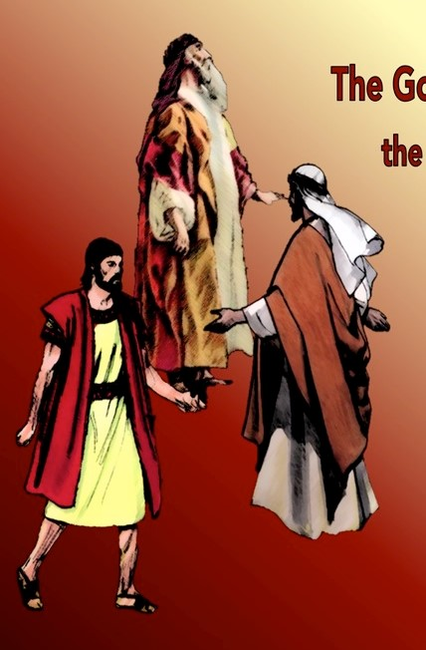
Abraham
Isaac
Jacob
God heard their groaning and he remembered his covenant with Abraham, with Isaac and with Jacob.

Slide 5
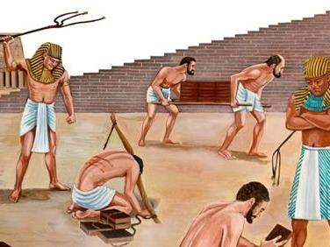
So God looked on
the Israelites and
was concerned
about them.

Slide 6
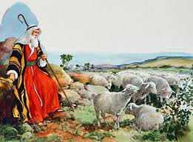
Now Moses was tending the flock of Jethro his father-in-law, the priest of Midian, and he led the flock to the far side of the wilderness and came to Horeb, the mountain of God.

Slide 7
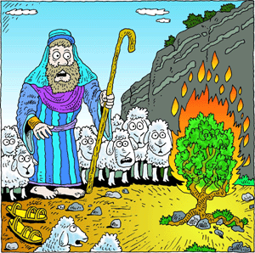
There the angel of the Lord appeared to him in flames of fire from within a bush. Moses saw that though the bush was on fire it did not burn up.

Slide 8
So Moses thought, “I will go over and see this strange sight— why the bush does not burn up.”

Slide 9
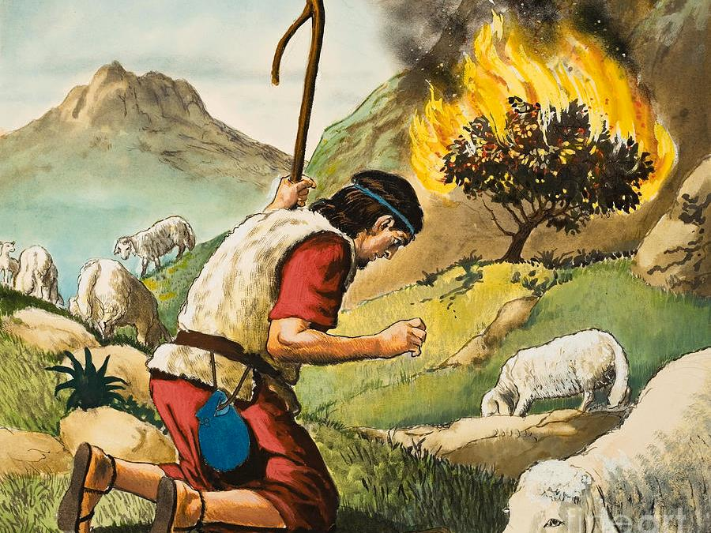
When the Lord saw that he had gone over to look, God called to him from within the bush, “Moses! Moses!”

Slide 10
And Moses said, “Here I am.”

Slide 11
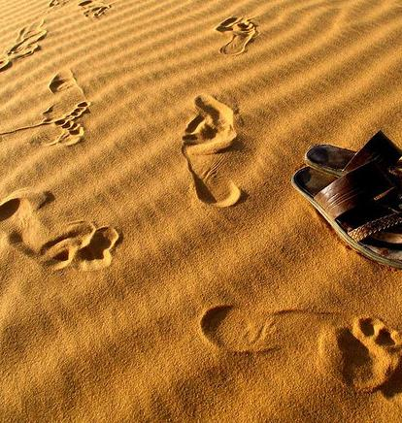
“Do not come any closer,” God said. “Take off your sandals, for the place where you are standing is holy ground.”

Slide 12
Then he said, “I am the God of your father, the God of Abraham, the God of Isaac and the God of Jacob.”

Slide 13
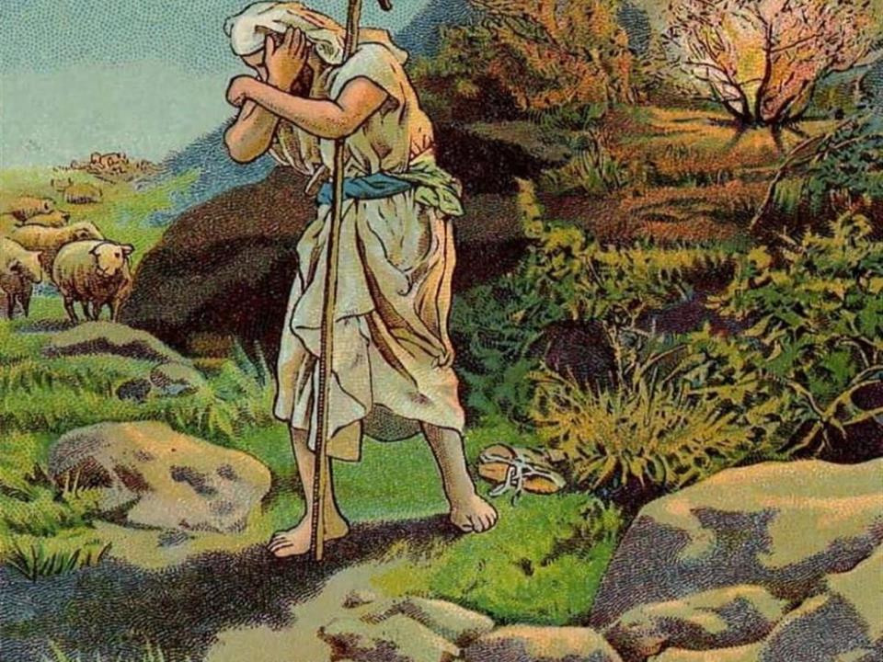
At this, Moses hid his face, because he was afraid to look at God.

Slide 14
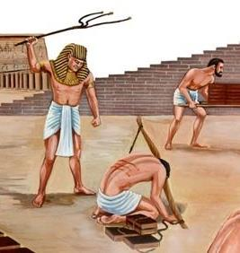
The Lord said, “I have indeed seen the misery of my people in Egypt. I have heard them crying out because of their slave drivers, and
I am concerned about their suffering.

Slide 15
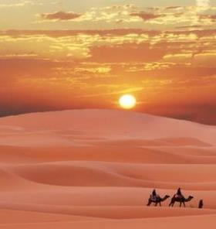
So I have come down to rescue them from the hand of the Egyptians and to bring them up out of that land into a good and spacious land,

Slide 16
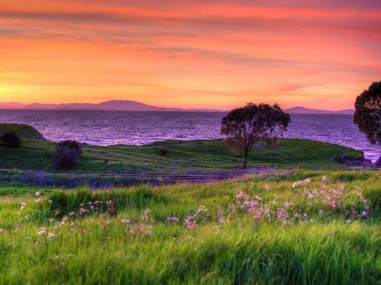
a land flowing with
milk and honey,
the home of the Canaanites, Hittites, Amorites, Perizzites, Hivites and Jebusites.

Slide 17
And now the cry of the Israelites has reached me, and I have seen the way the Egyptians are oppressing them.

Slide 18
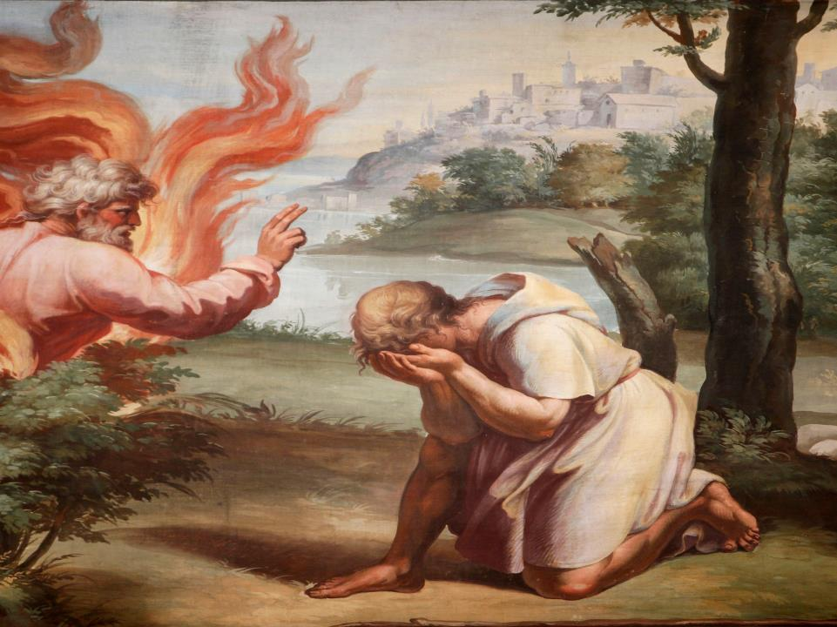
So now, go. I am sending you to Pharaoh to bring my people the Israelites out of Egypt.”

Slide 19
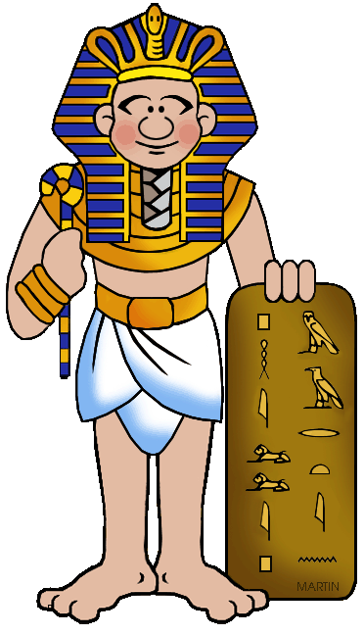
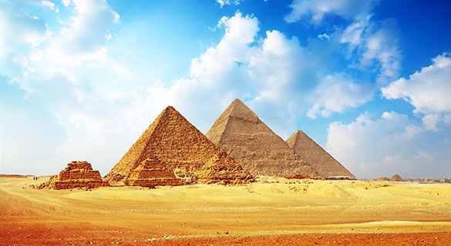
But Moses said to God, “Who am I that I should go to Pharaoh and bring the Israelites out of Egypt?”

Slide 20
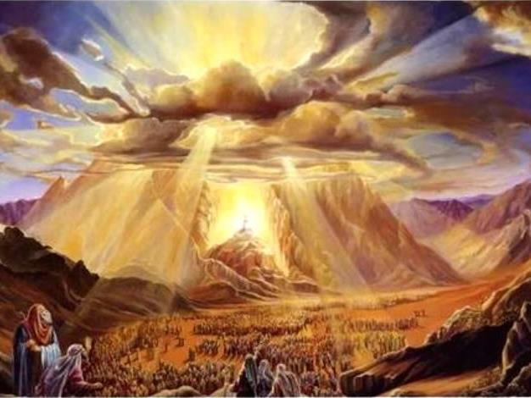
And God said,
“I will be with you. And this will be the sign to you that it is I who have sent you: When you have brought the people out of Egypt, you will worship God on this mountain.”

Slide 21
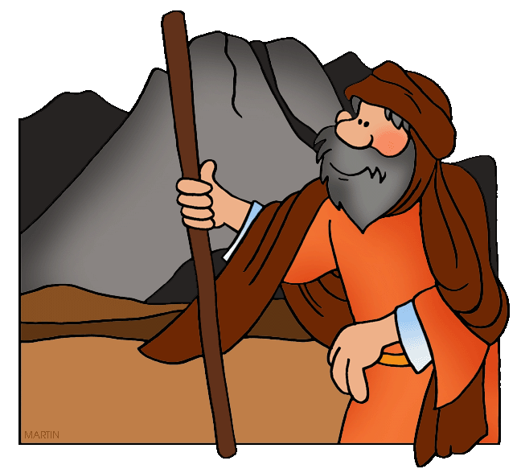
Moses said to God
“Suppose I go to the Israelites and say to them, ‘The God of your fathers has sent me to you,’ and they ask me, ‘What is his name?’ Then what shall I tell them?”
Moses said to God,

Slide 22
God said to Moses, “I am who I am. This is what you are to say to the Israelites: ‘I am has sent me to you.’”
I am who I am

Slide 23
God also said to Moses, “Say to the Israelites, ‘The Lord, the God of your fathers—the God of Abraham, the God of Isaac and the God of Jacob—has sent me to you.’

Slide 24
  “This is my name forever, the name you shall call me from generation to generation.

Slide 25
“Go, assemble the elders of Israel and say to them, ‘The Lord, the God of your fathers—the God of Abraham, Isaac and Jacob—appeared to me and said: I have watched over you and have seen what has been done to you in Egypt.

Slide 26
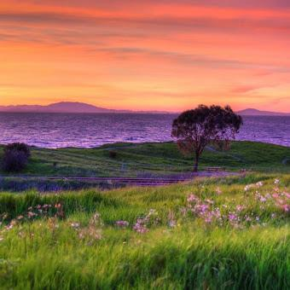
And I have promised to bring you up out of your misery in Egypt into the land of the Canaanites, Hittites, Amorites, Perizzites, Hivites and Jebusites – a land flowing with milk and honey.

Slide 27
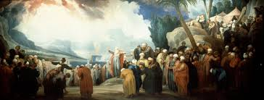
“The elders of Israel will listen to you. Then you and the elders are to go to the king of Egypt and say to him,

Slide 28

‘The Lord, the God of the Hebrews, has met with us. Let us take a three-day journey into the wilderness to offer sacrifices to the Lord our God.’

Slide 29

But I know that the king of Egypt will not let you go unless a mighty hand compels him.

Slide 30

So I will stretch out my hand and strike the Egyptians with all the wonders that I will perform among them.
After that, he will let you go.

Slide 31
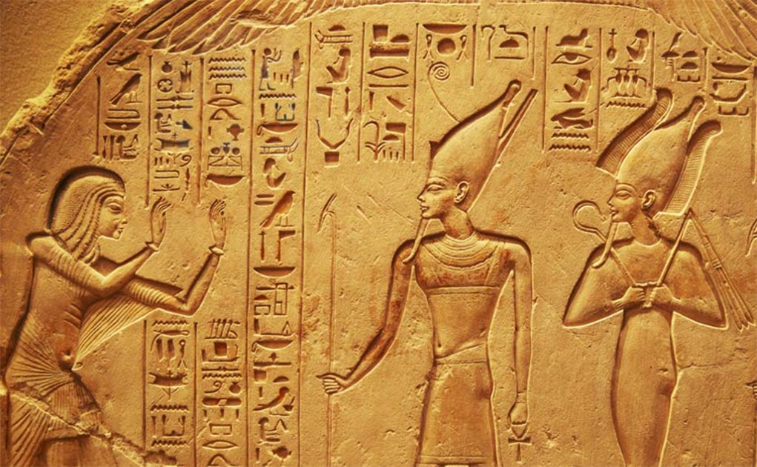


“And I will make the Egyptians favorably disposed toward this people, so that when you leave you will not go empty-handed.

Slide 32
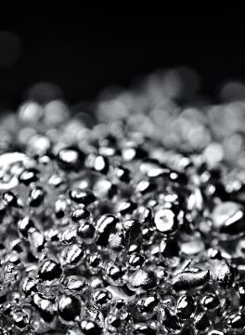
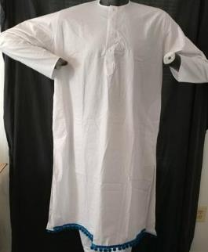
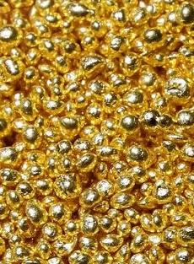
Every woman is to ask her neighbor and any woman living in her house for articles of silver and gold and for clothing, which you will put on your sons and daughters. And so you will plunder the Egyptians.”

