Slide 1

DigSite #2
Exodus 2:1-22

Slide 2


Psalm 7:10
My shield is
God Most High,
who saves the upright in heart

Slide 3
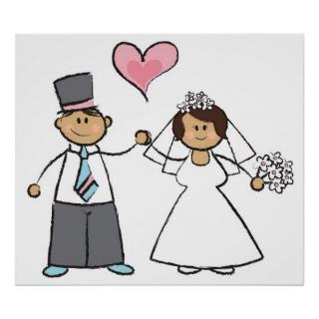
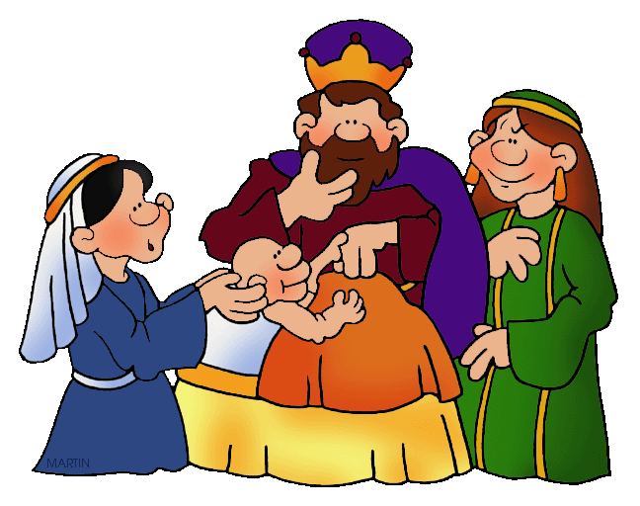
Now a man of the tribe of Levi married a Levite woman, and she became pregnant and gave birth to a son.

Slide 4
When she saw that he was a fine child, she hid him for three months.

Slide 5
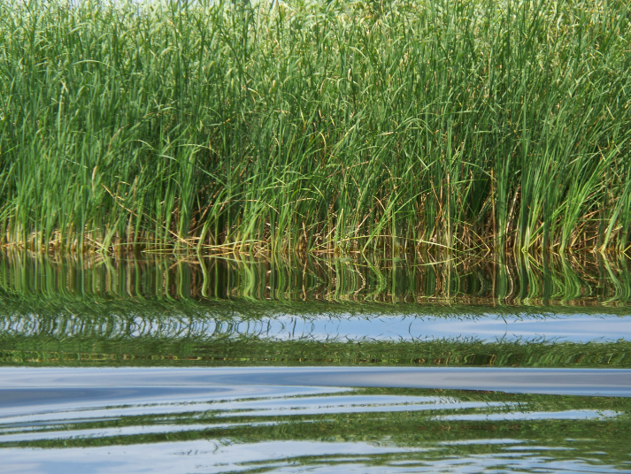
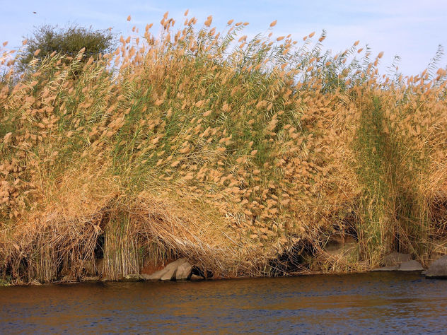
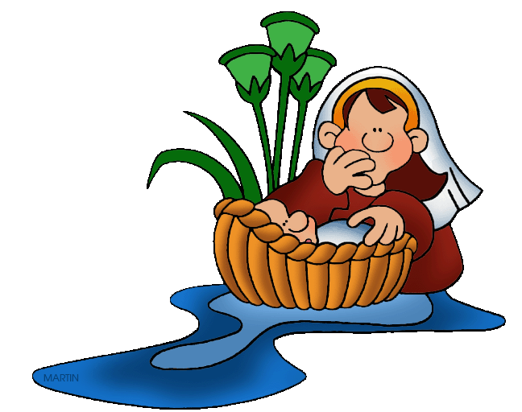
But when she could hide him no longer, she got a papyrus basket for him and coated it with tar and pitch. Then she placed the child in it and put it among the reeds along the bank of the Nile.

Slide 6
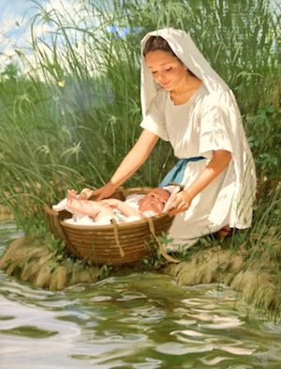
His sister stood at a distance to see what would happen to him.

Slide 7

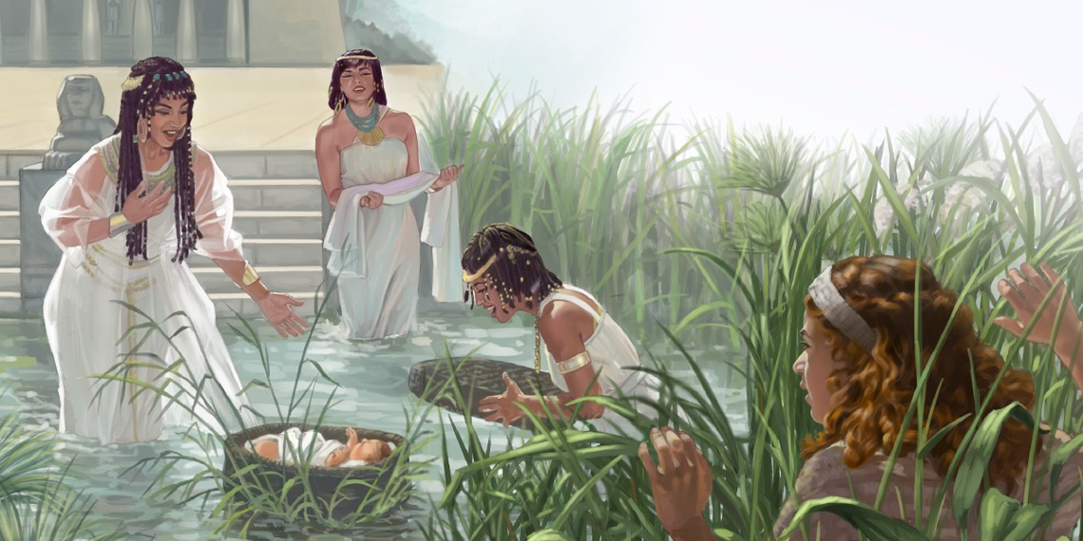
Then Pharaoh’s daughter went down to the Nile to bathe, and her attendants were walking along the riverbank. She saw the basket among the reeds and sent her female slave to get it.

Slide 8
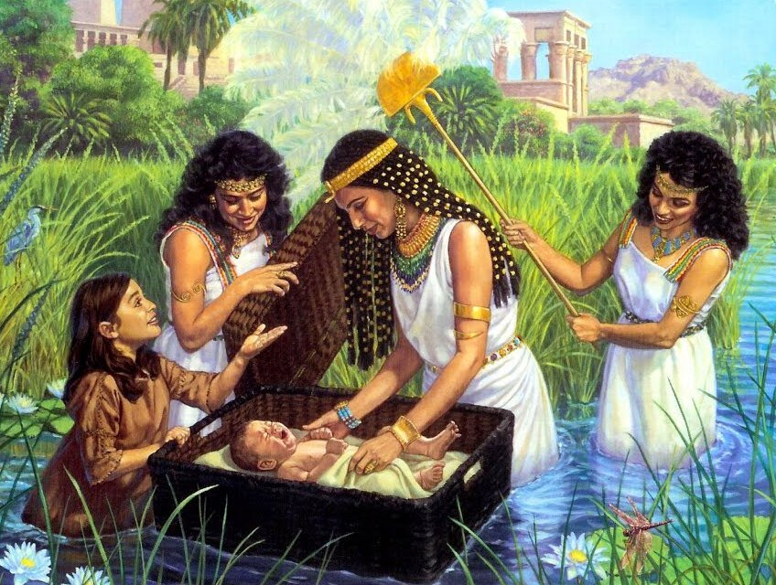
She opened it and saw the baby. He was crying, and she felt sorry for him. “This is one of the Hebrew babies,” she said.

Slide 9
Then his sister asked Pharaoh’s daughter,
“Shall I go and get one of the Hebrew women to nurse the baby for you?”

Slide 10
“Yes, go,” she answered. So the girl went and got the baby’s mother.

Slide 11

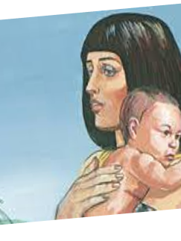
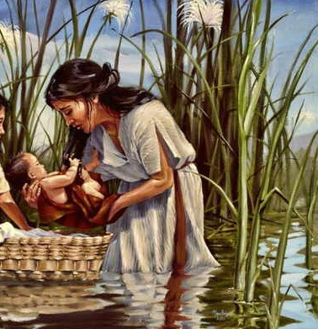
Pharaoh’s daughter
said to her, “Take this baby and nurse him for
me, and I will pay you.” So the woman took the baby
and nursed
him.

Slide 12
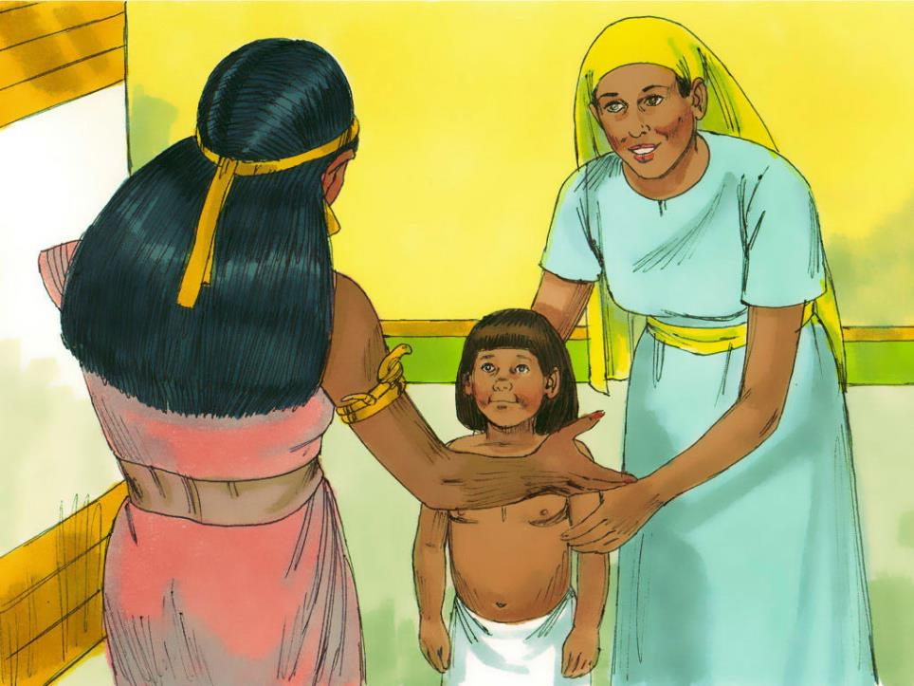
When the child grew older, she took him to Pharaoh’s daughter and he became her son. She named him Moses, saying, “I drew him out of the water.”

Slide 13
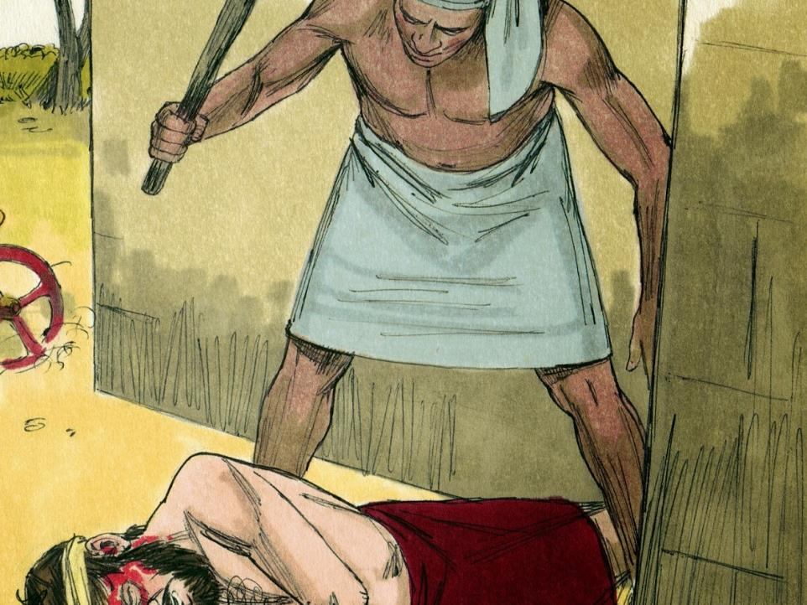
One day, after Moses had grown up, he went out to where his own people were and watched them at their hard labor. He saw an Egyptian beating a Hebrew, one of his own people. Looking this way and that and seeing no one, he killed the Egyptian and hid him in the sand.

Slide 14
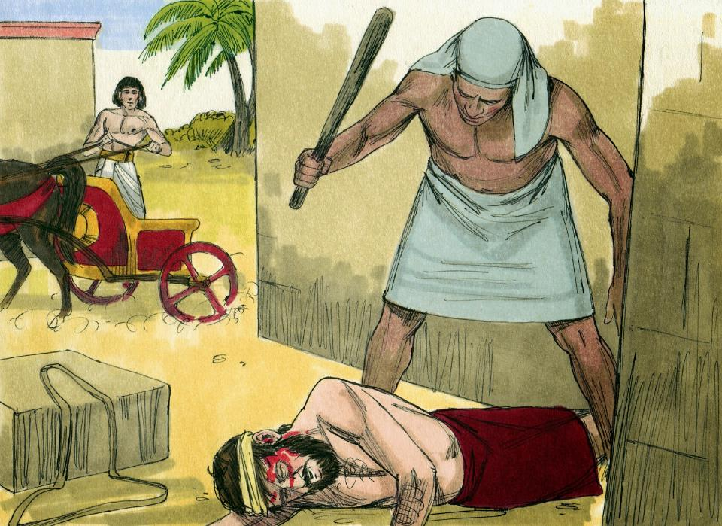
The next day he went out and saw two Hebres fighting. He asked the one in the wrong, “Why are you hitting your fellow Hebrew?

Slide 15
The man said, “Who made you ruler and judge over us? Are you thinking of killing me as you killed the Egyptian?” Then Moses was afraid and thought, “What I did must have become known.”

Slide 16
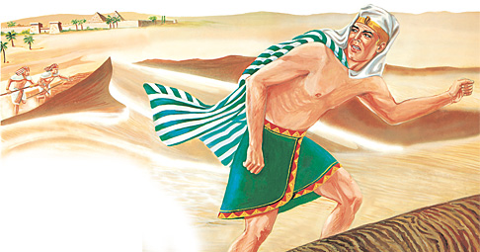
When Pharaoh
heard of this, he
tried to kill Moses,
but Moses fled from Pharaoh and went to live in Midian, where he sat down by a well.

Slide 17
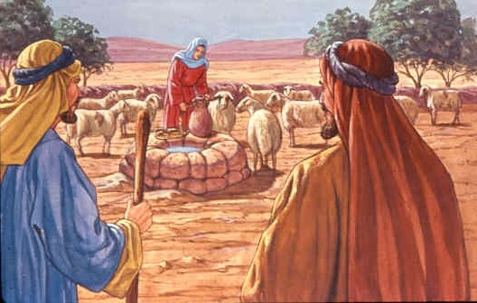
Now a priest of Midian had seven daughters, and they came to draw water and fill the troughs to water their father’s flock.

Slide 18
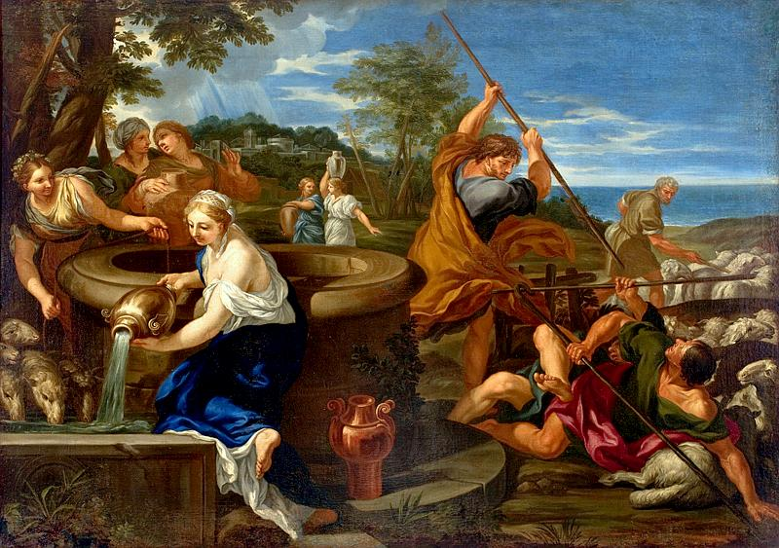
Some shepherds came along and drove them away, but Moses got up and came to their rescue and watered their flock.

Slide 19
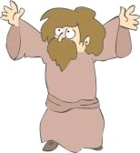
When the girls returned to Reuel their father, he asked them, “Why have you returned so early today?”

Slide 20
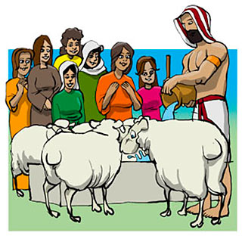
They answered, “An Egyptian rescued us from the shepherds. He even drew water for us and watered the flock.”

Slide 21
“And where is he? Why did you leave him?”
Reuel asked his daughters.
“ Invite him to have something to eat.”

Slide 22
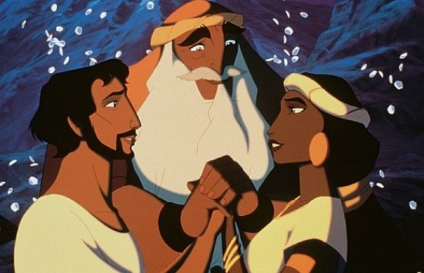
Moses agreed to stay with the man, who gave his daughter Zipporah to Moses in marriage.

Slide 23
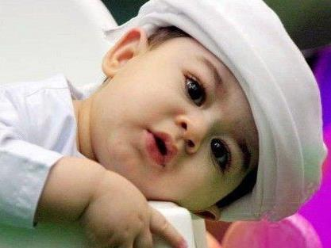
Zipporah gave birth to a son, and Moses named him Gershom, saying, “I have become a foreigner in a foreign land.”

