Slide 1
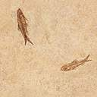

Lesson #1
Exodus 1:1-22

Slide 2


Exodus 3:7
The LORD said,
"I have indeed seen the misery of my people in Egypt.
I have heard them crying out because of their slave drivers,
and I am concerned about their suffering.

Slide 3

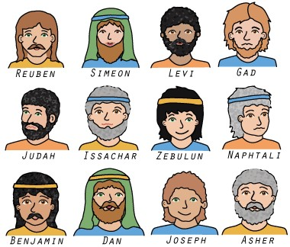
These are the names of the sons of Israel who went to Egypt with Jacob, each with his family:
Reuben
Simeon
Levi
Judah
Dan
Naphtali
Gad
Asher
x
Issachar
Zebulun
Benjamin

Slide 4

The descendants of Jacob numbered 70 in all; Joseph was already in Egypt.
66 in all
+ Israel (Jacob)
+ Joseph
+ 2 sons
= 70

Slide 5
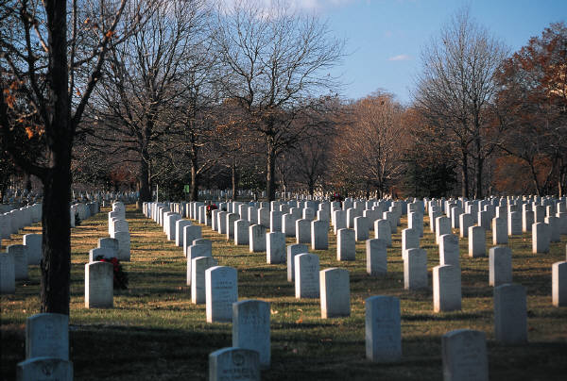
Now Joseph and all his brothers and all that generation died,

Slide 7
but the Israelites were exceedingly fruitful. They multiplied greatly, increased in numbers, and became so numerous that the land was filled with them.

Slide 8
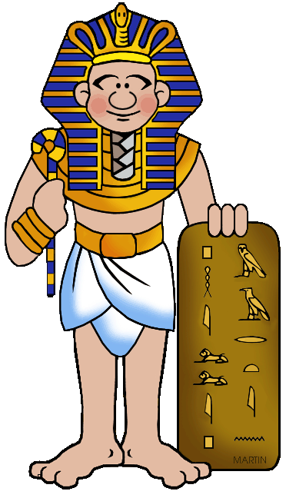
Then a new king, to whom Joseph meant nothing, came to power in Egypt.
Joseph WHO?
?

Slide 9
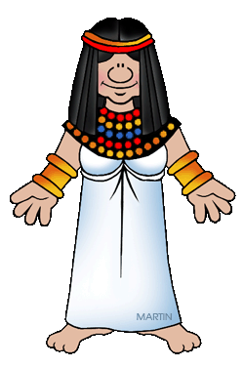
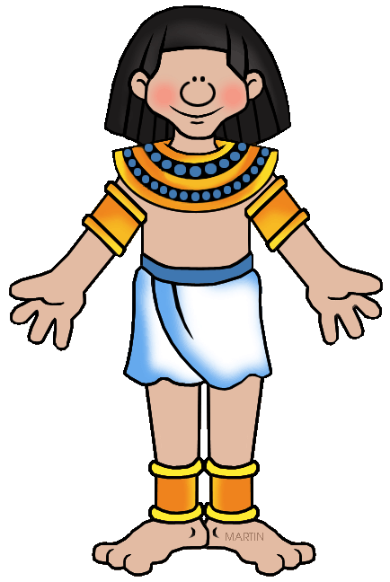
Look, he said to his people
the Israelites have become far too numerous for us.

Slide 10
Come, we must deal shrewdly with them or they will become even more numerous

Slide 11
and, if war breaks out, will join our enemies, fight against us and leave the country.

Slide 12

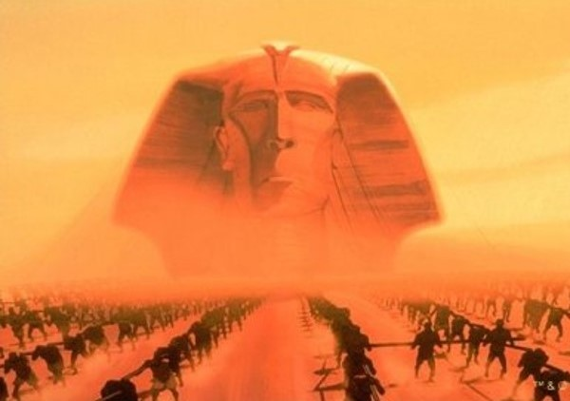
So they put slave masters over them to oppress them with forced labor

Slide 13
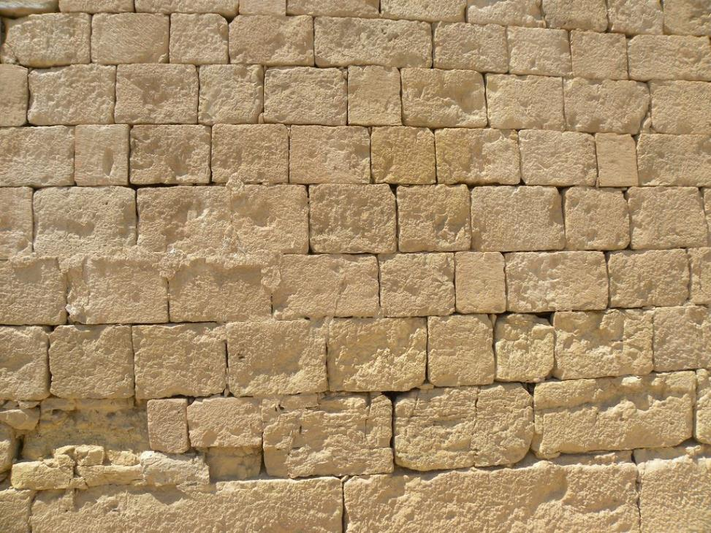
and they built Pithom and Rameses as store cities for Pharaoh.

Slide 14
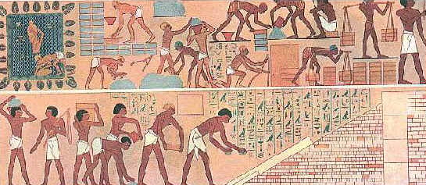
But the more they were oppressed, the more they multiplied and spread; so the Egyptians came to dread the Israelites and worked them ruthlessly.

Slide 15
They made their lives bitter with harsh labor in brick and mortar and with all kinds of work in the fields;

Slide 16
in all their harsh labor the Egyptians worked them ruthlessly.

Slide 17
The king of Egypt said to the Hebrew midwives, whose names were Shiphrah and Puah,
“When you are helping the Hebrew women during childbirth on the delivery stool, if you see that the baby is a boy, kill him; but if it is a girl, let her live.”

Slide 18
The midwives, however, feared God and did not do what the king of Egypt had told them to do; they let the boys live.

Slide 19
Then the king of Egypt summoned the midwives and asked them,
Why have you done this?
Why have you let the boys live?

Slide 20
The midwives answered Pharaoh,
Hebrew women are not like Egyptian women;
They are vigorous and give birth before the midwives arrive.

Slide 21
So God was kind to the midwives and the people increased and became even more numerous.

Slide 22
And because the midwives feared God, He gave them families of their own.

Slide 23
Then Pharaoh gave this order to all his people:
Every Hebrew boy that is born you must throw into the Nile, but let every girl live.

Slide 24
Exodus 3:7
The LORD said,
"I have indeed seen the misery of my people in Egypt.
I have heard them crying out because of their slave drivers,
and I am concerned about their suffering.

