Slide 1
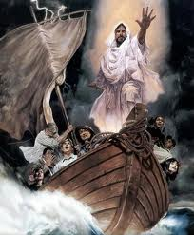
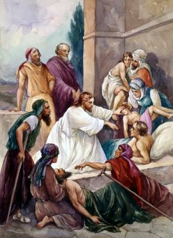
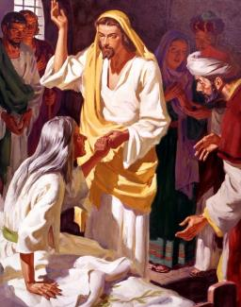
Lesson #6
MESSIAH MIRACLES
Matthew 8:1-17, 23-34; 9:1-8

Slide 2
Memory Verse
Your ways, God, are holy. What god is as great as our God? You are the God who performs miracles; you display your power among the peoples.
Psalm 77:13-14
Lesson #6

Slide 3
The Truth
Jesus’s miracles
show us His power
and teach us to have faith in Him!
Lesson #6

Slide 4
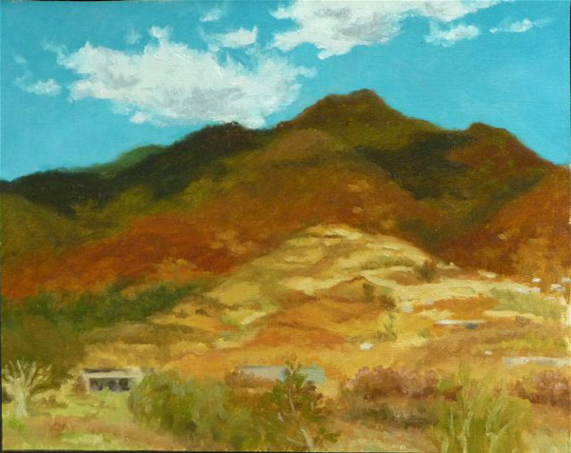
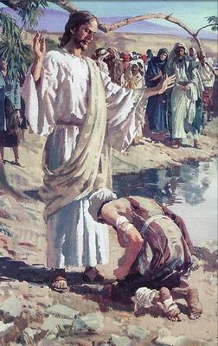
When Jesus came down from the mountainside, large crowds followed him. A man with leprosy came and knelt before
him and said,
Lord, if you are willing, you can make me clean.

Slide 5
Jesus reached out his hand and touched the man.*
“I am willing,” he said.
“Be clean!*
Immediately he was cleansed of his leprosy. Then Jesus said to him,*
See that you don’t tell anyone. But go, show yourself to the priest and offer the gift Moses commanded, as a testimony to them.

Slide 6
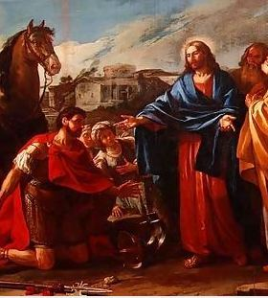
When Jesus had entered Capernaum, a centurion came to him, asking for help.
Jesus said to him,
Lord (he said)
my servant lies at home paralyzed, suffering terribly.
Shall I come and heal him?

Slide 7
The centurion replied,
Lord, I do not deserve to have you come under my roof. But just say the word, and my servant will be healed.

Slide 8
For I myself am a man under authority, with soldiers under me. I tell this one, ‘Go,’ and he goes; and that one, ‘Come,’ and he comes. I say to my servant,
‘Do this,’ and he does it.

Slide 9
When Jesus heard this, he was amazed and said to those following him,
I tell you the truth,
I have not found anyone in Israel with such great faith.

Slide 10
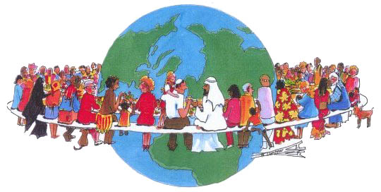

I say to you that many will come from the east and the west, and will take their places at the feast with Abraham, Isaac and Jacob in the kingdom of heaven.

Slide 11


But the subjects of the kingdom will be thrown outside, into the darkness, where there will be weeping and gnashing of teeth.

Slide 12
Then Jesus said to the centurion,
Go! Let it be done just as you believed it would.
And his servant was healed at that moment.
When was the servant healed??
At that moment!

Slide 13
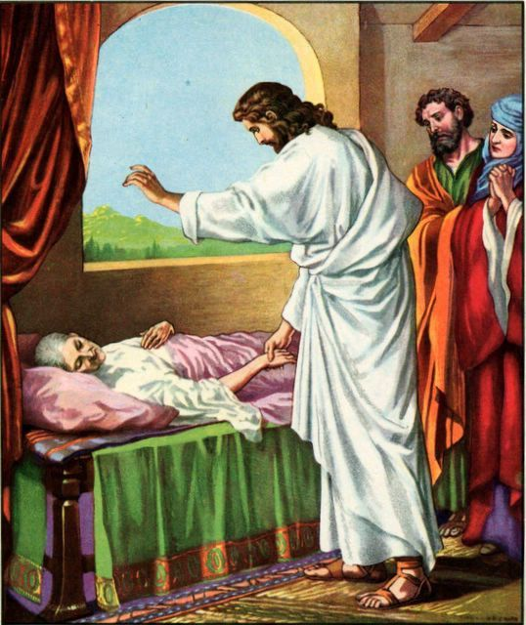
When Jesus came into Peter’s house, he saw Peter’s mother-in-law lying in bed with a fever.

Slide 14
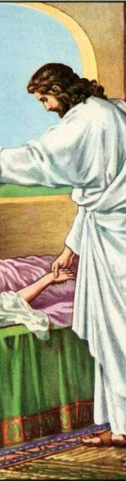

He touched her hand and the fever left her, and she got up and began to wait on him.

Slide 15
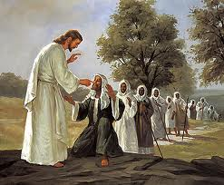
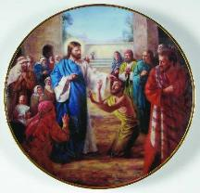
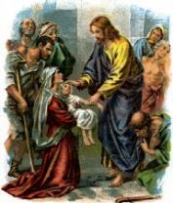
When evening came, many who were demon-possessed were brought to him, and he drove out the spirits with a word and healed all the sick.
This was to fulfill what was spoken through the prophet Isaiah:
“He took up our infirmities
and bore our diseases.”
[Isaiah 53:4]

Slide 16
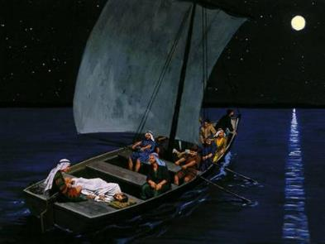
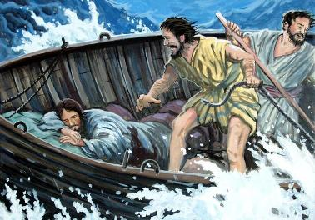
Then he got into the boat and his disciples followed him. Suddenly a furious storm came up on the lake, so that the waves swept over the boat. But Jesus was sleeping.

Slide 17

The disciples went and woke him, saying,
Lord, save us! We’re going to drown!

Slide 18
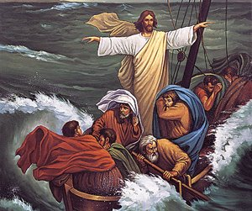
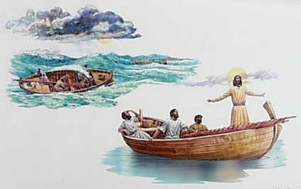
He replied,
Then he got up and rebuked the winds and the waves, and it was completely calm.
You of little faith, why are you so afraid?

Slide 19
The men were amazed and asked,
What kind of man is this? Even the winds and the waves obey him!

Slide 20
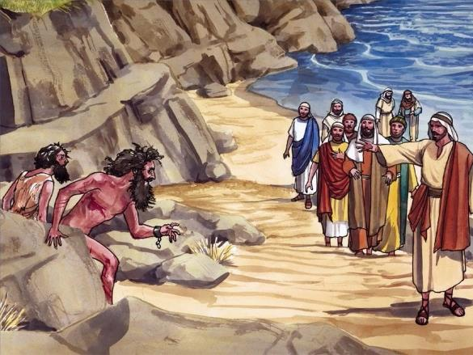
When he arrived at the other side in the region of the Gadarenes, two demon-possessed men coming from the tombs met him.
They were so violent that no one could pass that way.

Slide 21
What do you want with us, Son of God?
they shouted.
Have you come here to torture us before the appointed time?

Slide 22
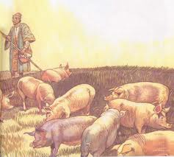
Some distance from them a large herd of pigs was feeding.
The demons begged Jesus,
If you drive us out,
send us into the herd of pigs.

Slide 23
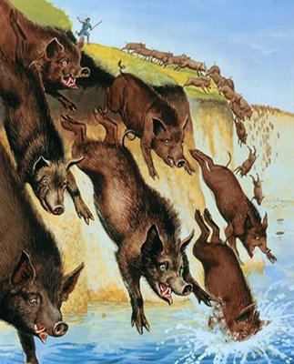
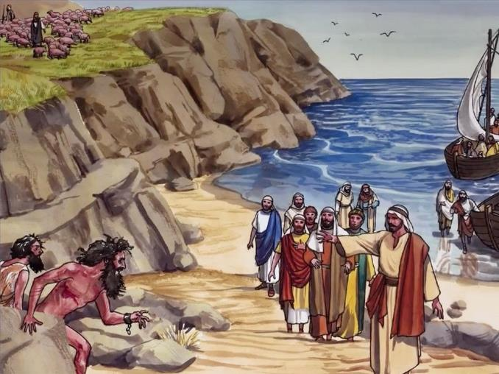
He said to them, “Go!” So they came out and went into the pigs, and the whole herd rushed down the steep bank into the lake and died in the water.
Those tending the pigs ran off, went into the town and reported all this, including what had happened to the demon-possessed men.

Slide 24
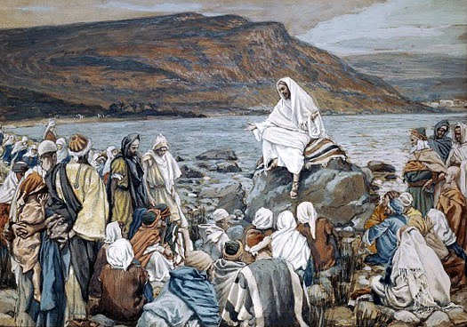
Then the whole town went out to meet Jesus. And when they saw him, they pleaded with him to leave their region.

Slide 25
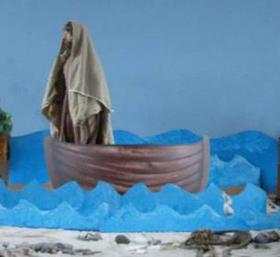
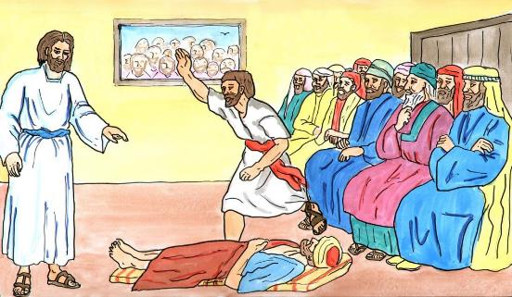
Jesus stepped into a boat, crossed over and came to his own town.
Some men brought to him a paralyzed man, lying on a mat. When Jesus saw their faith, he said to the man,
Take heart, son; your sins are forgiven.
Notes:
rt

Slide 26
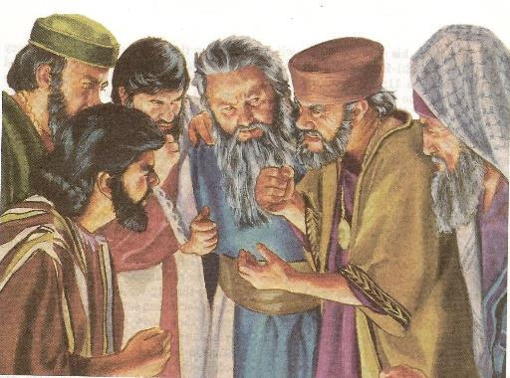
At this, some of the teachers of the law said to themselves,
This fellow is blaspheming!
Note from Leader’s Guide: The rabbis believed only God could forgive sins. It was blasphemous for anyone to believe they could do what only God could do.
But we know that Jesus is God!

Slide 27
Knowing their thoughts, Jesus said,
Why do you entertain evil thoughts
in your hearts? Which is easier: to say,
‘Your sins are forgiven,’ or to say, ‘Get up and walk’?

Slide 28
But I want you to know that the Son of Man has authority on earth to forgive sins.

Slide 29
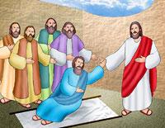
So he said to the paralyzed man,
Get up, take your mat and go home.

Slide 30
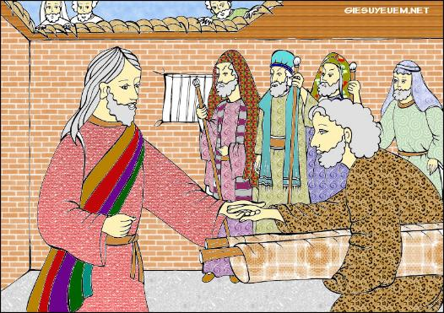
Then the man got up and went home.

Slide 31
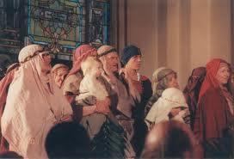
When the crowd saw this, they were filled with awe; and they praised God, who had given such authority to man.
HALLELUJAH
PRAISE GOD!!!
WOO HOO!!

