Slide 1
Matthew
Dig Site 5
Matthew 7:1-29

Slide 2
The Truth
Jesus has authority to teach us how to live because He is God!

Slide 3
Memory Verse
Blessed are you when people insult you,
persecute you and falsely say all kinds of evil against you because of me.
Rejoice and be glad,
because great is your reward in heaven,
for in the same way they persecuted
the prophets who were before you.
Matthew 5:11-12

Slide 4
Beatitudes
Review

Slide 5
Memory Verse
“Blessed are the poor in spirit,
for theirs is the kingdom of Heaven.
Blessed are those who mourn,
for they will be comforted.
Blessed are the meek,
for they will inherit the earth.
Blessed are those who hunger and thirst for righteousness,
for they will be filled.”
Matthew 5:3-6

Slide 6
Memory Verse
“Blessed are the merciful,
for they will be shown mercy.
Blessed are the pure in heart,
for they will see God.
Blessed are the peacemakers,
for they will be called
children of God.
Blessed are those who are persecuted because of righteousness,
for theirs is the kingdom of heaven.
Matthew 5:7-10

Slide 7
Memory Verse
Blessed are you when people insult you,
persecute you and falsely say all kinds of evil against you because of me.
Rejoice and be glad,
because great is your reward in heaven,
for in the same way they persecuted
the prophets who were before you.
Matthew 5:11-12

Slide 8
A Word to the Wise

Slide 9

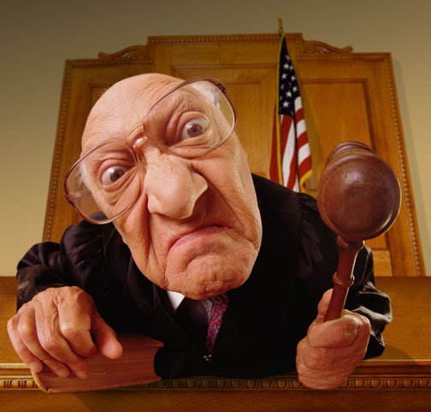
¹“Do not judge,
or you too will be judged.

Slide 10
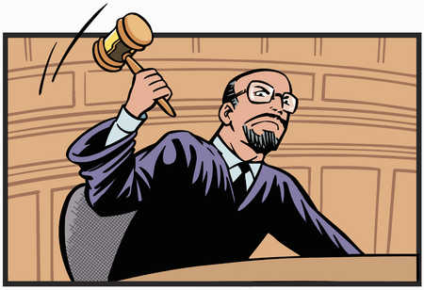

^{2a} For in the same way you judge others,
you will be judged,

Slide 11

you
others
^{2b}and with the measure you use,
it will be measured to you.

Slide 12
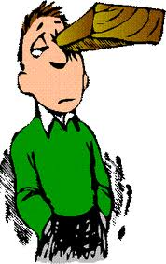
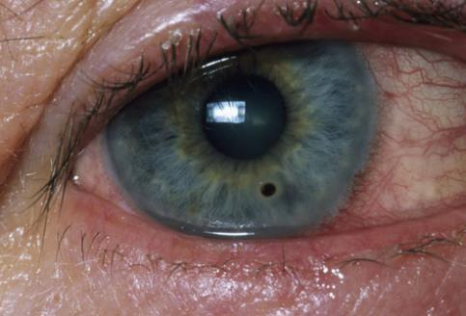
³ “Why do you look at the speck of sawdust in your brother’s eye and pay no attention to the plank in your own eye?

Slide 13
⁴ How can you say to your brother, ‘Let me take the speck out of your eye,’ when all the time there is a plank in your own eye?

Slide 14
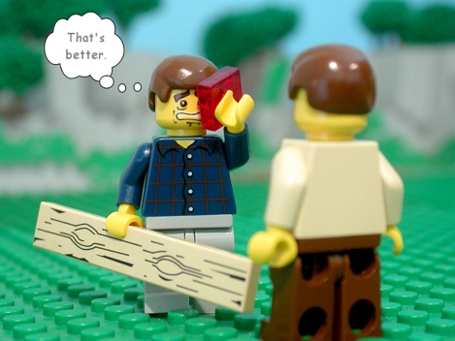
⁵ You hypocrite, first take the plank out of your own eye, and then you will see clearly to remove the speck from your brother’s eye.

Slide 15
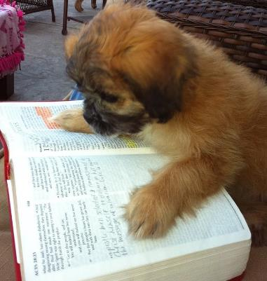
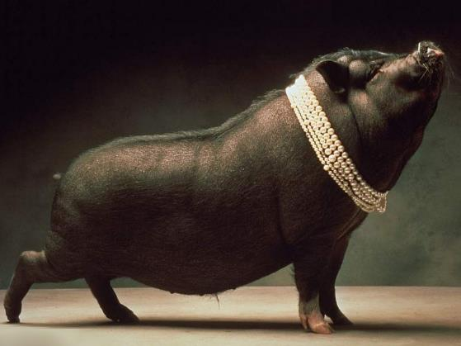
^{6 a}“Do not give dogs what is sacred; do not throw your pearls to pigs.

Slide 16

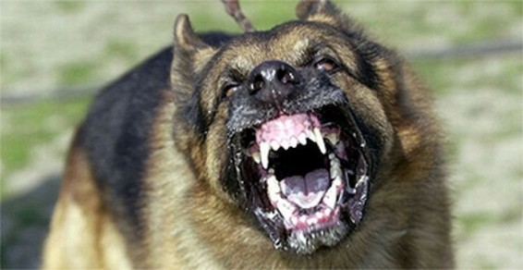
^{6b}If you do, they may trample them under their feet, and turn and tear you to pieces.

Slide 17
⁷ “Ask* and it will be given to you; seek* and you will find; knock* and the door will be opened to you.
A
S
K
sk
eek
nock

Slide 18
A
S
K
sk
⁸ For everyone who asks receives;
eek
the one who seeks finds;
and to the one who knocks,
the door will be opened.
nock

Slide 19
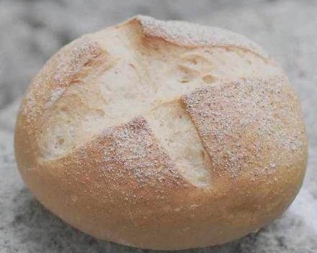
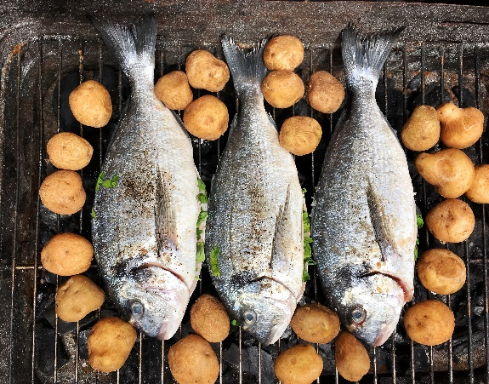
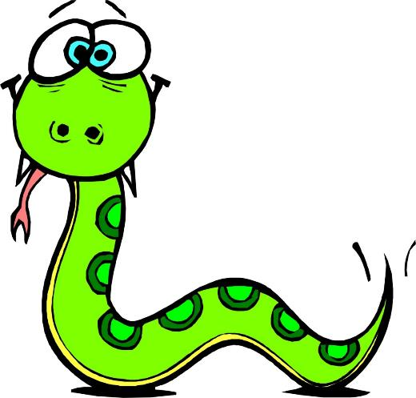

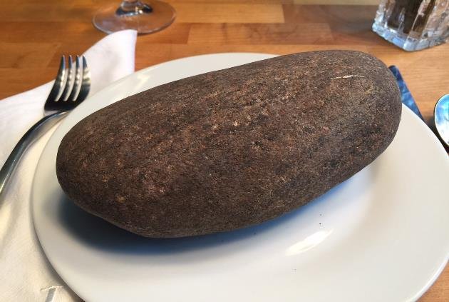
⁹ “Which of you, if your son asks for bread, will give him a stone?
¹⁰ Or if he asks for a fish, will give him a snake?

Slide 20


¹¹ If you, then, though you are evil, know how to give good gifts to your children, how much more will your Father in heaven give good gifts to those who ask him!

Slide 21

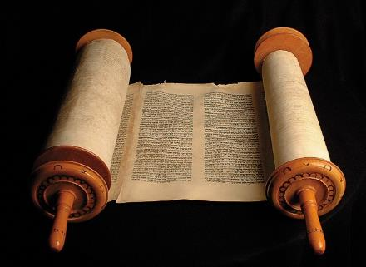
¹² So in everything, do to others what you would have them do to you, for this sums up the Law and the Prophets.
Law and the
Prophets
=

Slide 22
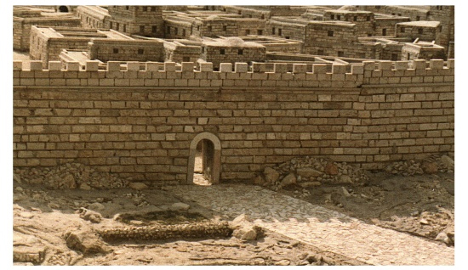
^{13a} “Enter through the narrow gate.

Slide 23
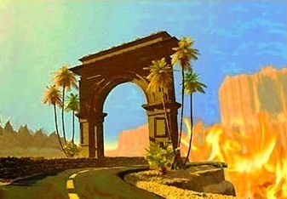
^{13b}For wide is the gate and broad is the road that leads to destruction, and many enter through it.
TO
DESTRUCTION

Slide 24
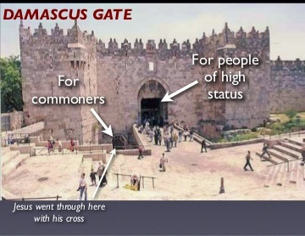
¹⁴ But small is the gate and narrow the road that leads to life, and only a few find it.

Slide 25
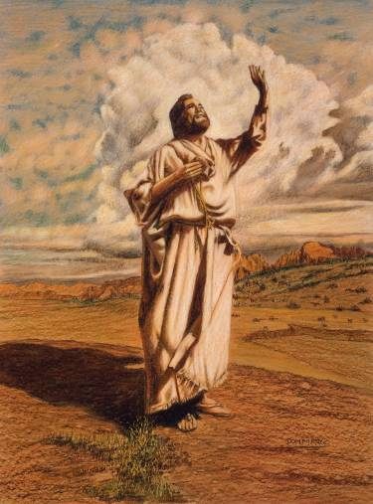
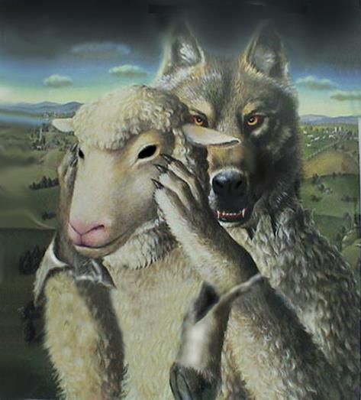
¹⁵ “Watch out for false prophets. They come to you in sheep’s clothing, but inwardly they are ferocious wolves.

Slide 26
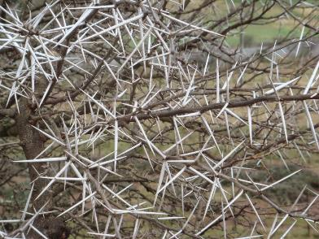
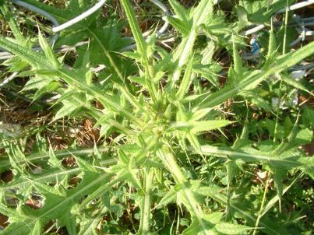
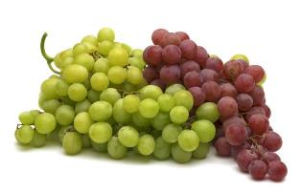
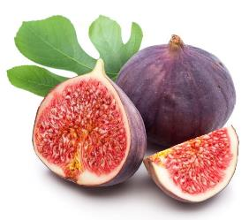
¹⁶ By their fruit you will recognize them. Do people pick grapes from thorn bushes, or figs from thistles?

Slide 27
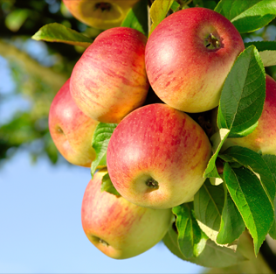
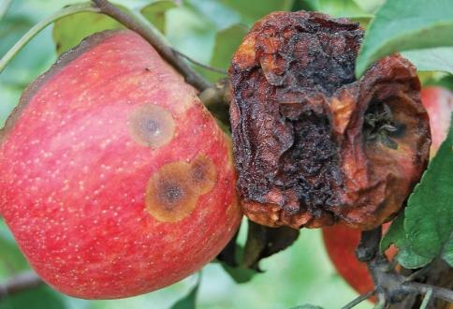
¹⁷ Likewise, every good tree bears good fruit, but a bad tree bears bad fruit.
¹⁸ A good tree cannot bear bad fruit, and a bad tree cannot bear good fruit.

Slide 28
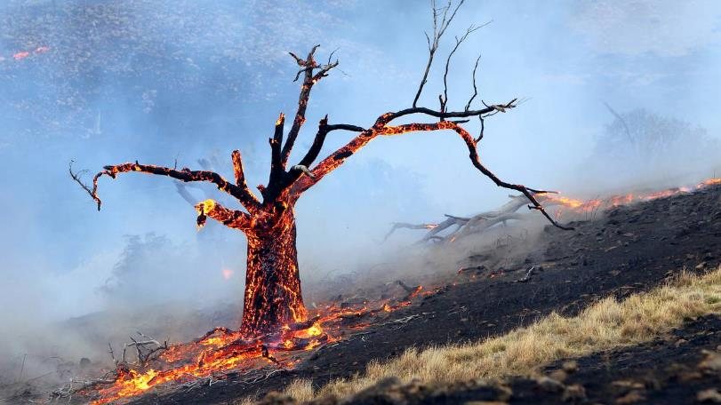
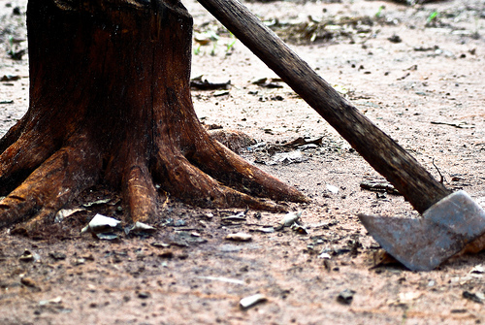
¹⁹ Every tree that does not bear good fruit is cut down and thrown into the fire. ²⁰ Thus, by their fruit you will recognize them.

Slide 29

²¹ “Not everyone who says to me, ‘Lord, Lord,’ will enter the kingdom of heaven, but only the one who does the will of my Father who is in heaven.

Slide 30
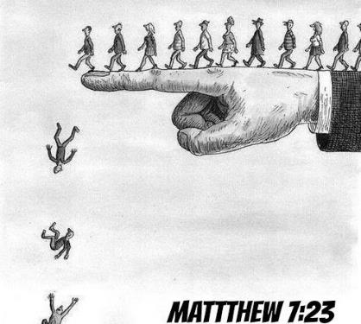

²² Many will say to me on that day, ‘Lord, Lord, did we not prophesy in your name and in your name drive out demons and in your name perform many miracles?’ ²³ Then I will tell them plainly, ‘I never knew you. Away from me, you evildoers!’

Slide 31
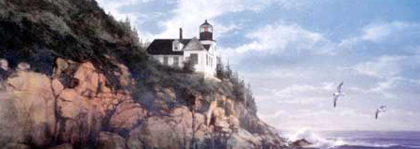
²⁴ “Therefore everyone who hears these words of mine and puts them into practice is like a wise man who built his house on the rock. ²⁵ The rain came down, the streams rose, and the winds blew and beat against that house; yet it did not fall, because it had its foundation on the rock.

Slide 32
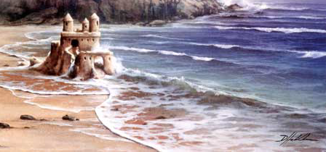
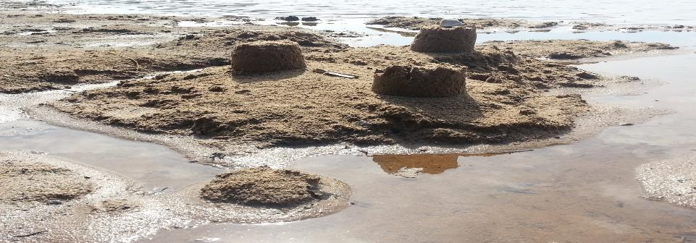
²⁶ But everyone who hears these words of mine and does not put them into practice is like a foolish man who built his house on sand. ²⁷ The rain came down, the streams rose, and the winds blew and beat against that house, and it fell with a great crash.”

Slide 33
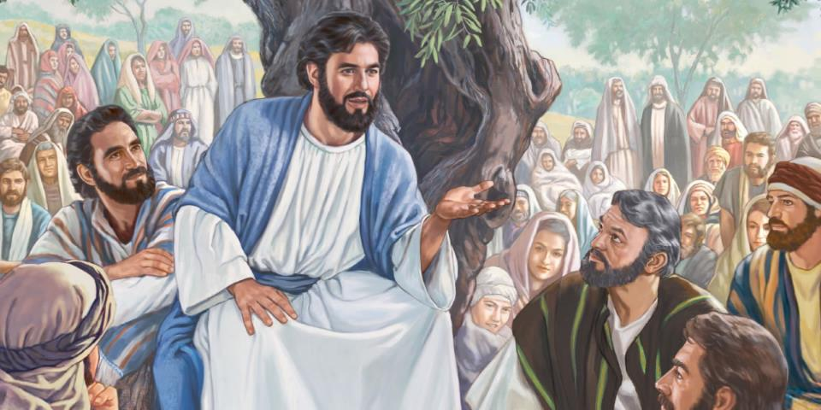
²⁸ When Jesus had finished saying these things, the crowds were amazed at his teaching, ²⁹ because he taught as one who had authority, and not as their teachers of the law.

