Slide 1


Romans 12:18
If it is possible,
as far as it
depends on you,
live at peace
with everyone.
Hide it in your
DigSite #15
Notes:
5

Slide 2
Memory Verse
If it is _____________,
as far as it _______ on you,
live at ______ with everyone.
Romans 12:____
Hide it in your
DigSite #15
Notes:
5

Slide 3
The Truth
God blesses peacemakers!
DigSite #15
Notes:
5

Slide 4


David, Nabal and Abigail
1 Samuel
25:1-42
STOP
… the bloodshed?
Can Abigail

Slide 5
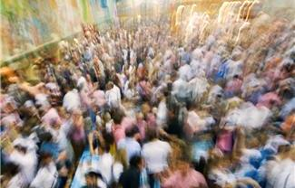
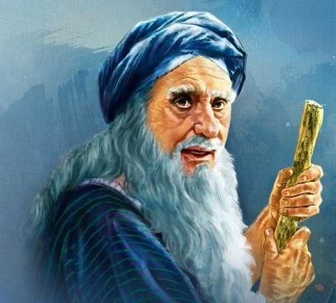
Now Samuel died,
and all Israel assembled and mourned for him; and they buried him at his home in Ramah.

Slide 6
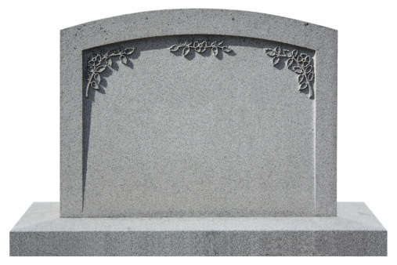
Now Samuel died,
and all Israel assembled and mourned for him; and they buried him at his home in Ramah.
Here
lies
Samuel
in
Ramah

Slide 7
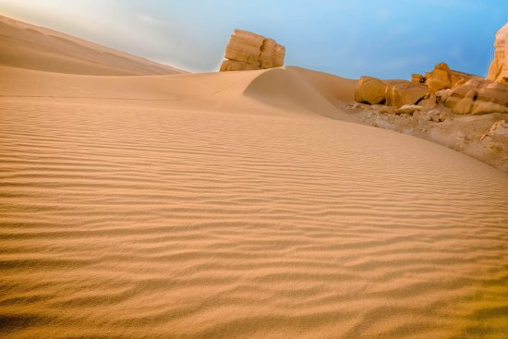
Then David moved down into the
Desert of Paran.
Paran

Slide 8


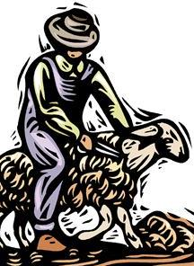

A certain man in Maon, who had property there at Carmel, was very wealthy. He had 1000 goats and 3000 sheep, which he was shearing in Carmel.

Slide 9
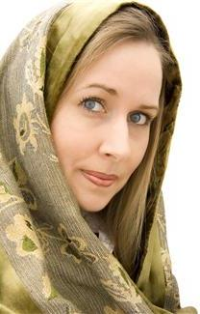
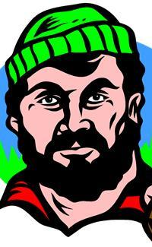
His name was Nabal and his wife’s name was Abigail. She was an intelligent and beautiful woman, but her husband was surly and mean in his dealings—he was a Calebite.
NABAL
ABIGAIL
(Calebite)
(Intelligent)

Slide 10
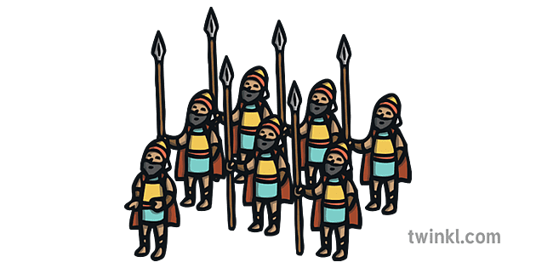
While David was in the wilderness, he heard that Nabal was shearing sheep. So he sent ten young men and said to them, “Go up to Nabal at Carmel and greet him in my name.
CARMEL

Slide 11
Say to him:
Long life to you!
Good health to you and your household!
And good health to all that is yours!

Slide 12
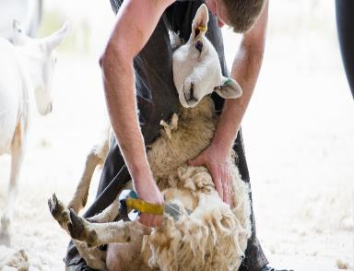
Now I hear
that it is
sheep-shearing time.

Slide 13
When your shepherds were with us, we did not mistreat them,

Slide 14
and the whole time they were at Carmel nothing of theirs was missing.

Slide 15

Ask your own servants and they will tell you. Therefore be favorable toward my men, since we come at a festive time.

Slide 16
Please give your servants and your son David whatever you can find for them.

Slide 17
Please?
When David’s men arrived, they gave Nabal this message in David’s name.
Then they waited.

Slide 18

Nabal answered David’s servants,
“Who is this David?
Who is this son of Jesse?
Many servants are breaking away from their masters these days.

Slide 19



Why should I take my bread and water, and the meat I have slaughtered for my shearers,
and give it to men coming from who knows where?”

Slide 20
Nope!
X
X
X
X

Slide 21
David’s men turned around and went back. When they arrived, they reported every word. David said to his men, “Each of you strap on your sword!”

Slide 22
So they did, and David strapped his on as well. About 400 men went up with David,
while 200 stayed with the supplies.
400
Supplies
200

Slide 23

One of the servants told Abigail, Nabal’s wife, “David sent messengers from the wilderness to give our master his greetings, but he hurled insults at them.

Slide 24
Yet these men were very good to us.
They did not mistreat us,
and the whole time we were out in the fields
near them nothing was missing.”

Slide 25
Night and day they were a wall around us the whole time we were herding our sheep near them.

Slide 26
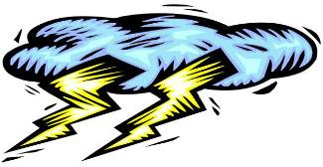

Now think it over and see what you can do, because disaster is hanging over our master and his whole household.

Slide 27


He is such a wicked man that no one can talk to him.”
La, La, La, Not Listening!

Slide 28
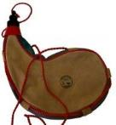
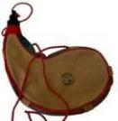

Abigail acted quickly. She took
200 loaves of bread
2 skins of wine

Slide 29
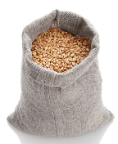
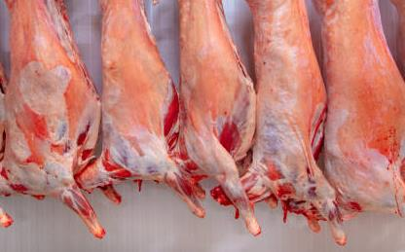
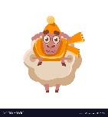
5 dressed sheep (slaughtered sheep)
5 seahs of roasted grain

Slide 30






200
red
cakes of pressed figs
100 Cakes of Raisins

Slide 31
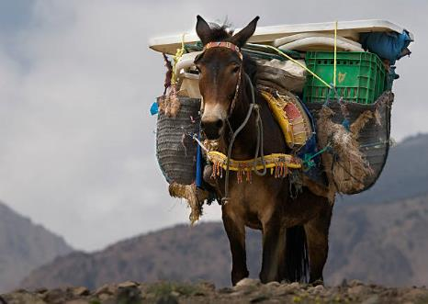
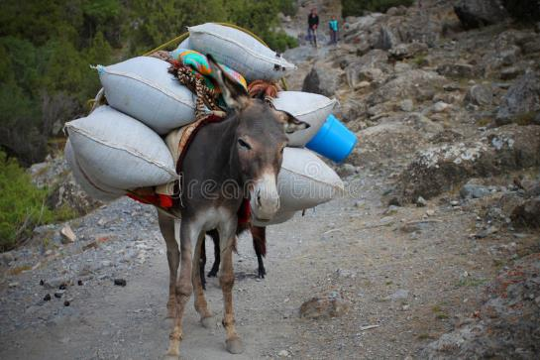
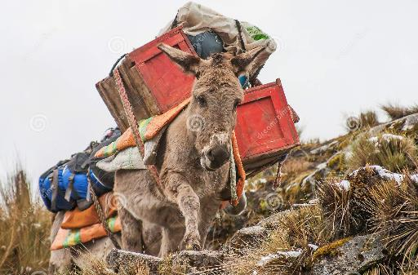
and loaded them on donkeys.

Slide 32
Then she told her servants,
“Go on ahead; I’ll follow you.”
But she did not tell her husband Nabal.
SHHHHH!!

Slide 33
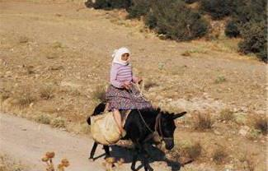

It’s been useless—all my watching over this fellow’s property in the wilderness so that nothing of his was missing.
As she came riding her donkey into a mountain ravine, there were David and his men descending toward her, and she met them. David had just said,

Slide 34
He has paid me back evil for good. May God deal with David, be it ever so severely, if by morning I leave alive one male of all who belong to him!

Slide 35
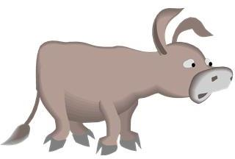
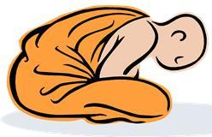

When Abigail saw David, she quickly got off her donkey and bowed down before David with her face to the ground.

Slide 36
She fell at his feet and said:
“Pardon your servant, my lord,
and let me speak to you;
hear what your servant has to say.

Slide 37
Please pay no attention, my lord, to that wicked man Nabal. He is just like his name—his name means Fool, and folly goes with him.
And as for me, your servant, I did not see the men my lord sent.

Slide 38

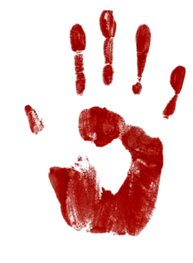
And now, my lord, as surely as the Lord your God lives and as you live, since the Lord has kept you from bloodshed and from avenging yourself with your own hands,

Slide 39




may your enemies and all who are intent on harming my lord be like Nabal.
And let this gift, which your servant has brought to my lord, be given to the men who follow you.
2
5
200
5
200
100

Slide 40
Please forgive your servant’s presumption. The Lord your God will certainly make a lasting dynasty for my lord, because you fight the Lord’s battles, and no wrongdoing will be found in you as long as you live.

Slide 41
Even though someone is pursuing you to take your life, the life of my lord will be bound securely in the bundle of the living by the Lord your God, but the lives of your enemies he will hurl away as from the pocket of a sling.

Slide 42
When the Lord has fulfilled for my lord every good thing he promised concerning him and has appointed him ruler over Israel, my lord will not have on his conscience the staggering burden of needless bloodshed or of having avenged himself.

Slide 43
And when the Lord your God has brought my lord success, remember your servant.
Remember Me …

Slide 44
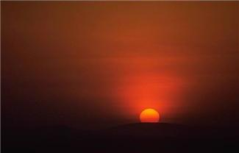
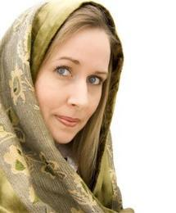
David said to Abigail, “Praise be to the Lord, the God of Israel, who has sent you today to meet me. May you be blessed for your good judgment and for keeping me from bloodshed this day and from avenging myself with my own hands.
“BLESSED”

Slide 45
Otherwise, as surely as the Lord, the God of Israel, lives, who has kept me from harming you, if you had not come quickly to meet me, not one male belonging to Nabal would have been left alive by daybreak.”
“BLESSED”

Slide 46

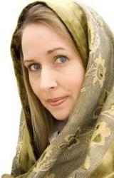
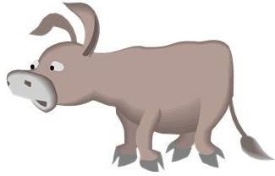
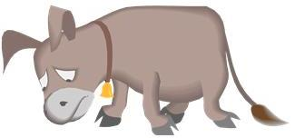
Then David accepted from her hand what she had brought him and said, “Go home in peace. I have heard your words and granted your request.”
PEACE

Slide 47
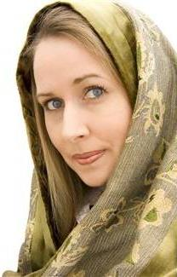
When Abigail went to Nabal, he was in the house holding a banquet like that of a king. He was in high spirits and very drunk. So she told him nothing at all until daybreak.
XX

Slide 48

Then in the morning, when Nabal was sober, his wife told him all these things, and his heart failed him and he became like a stone.

Slide 49
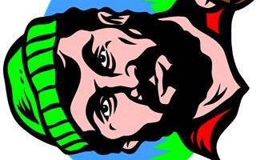
About ten days later, the Lord struck Nabal
and he died.
10
X
X

Slide 50
When David heard that Nabal was dead, he said,
Praise be to the Lord, who has upheld my cause against Nabal for treating me with contempt.

Slide 51
When David heard that Nabal was dead, he said,
He has kept his servant from doing wrong and has brought Nabal’s wrongdoing down on his own head.

Slide 52

Then David sent word to Abigail, asking her to become his wife. His servants went to Carmel and said to Abigail,
David has sent us to you to take you to become his wife.

Slide 53
She bowed down with her face to the ground and said,
I am your servant and am ready to serve you and wash the feet of my lord’s servants.

Slide 54
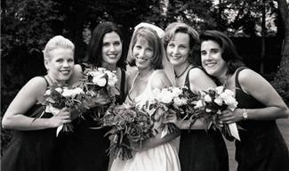
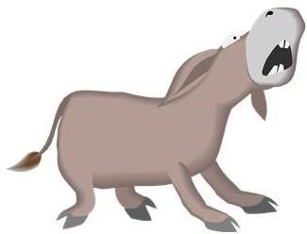

Abigail quickly got on a donkey and, attended by her five female servants,

Slide 55
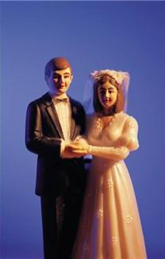
went with David’s messengers and became his wife.

