Slide 1
Long Live the King
1 Samuel 9:1-10:1, 17-24

Slide 2



Hide it in your
For God is the King
of all the earth;
sing to him
a psalm of praise.
Psalm 47:7
DigSite #6

Slide 3
Hide it in your
Look to the Lord and His strength;
Seek His face always.
Remember the wonders he has done,
His miracles,
And the judgements
He pronounced.
1 Chronicles 16:11-12
DigSite #5

Slide 4
There was a Benjamite,
a man of standing, whose name
was Kish son of Abiel,
the son of Zeror,
the son of Becorath,
the son of Aphiah of Benjamin.
Kish son of
Abiel son of
Zeror son of
Becorath son of
Aphiah of Benjamin

Slide 5
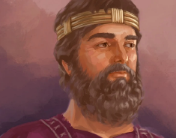
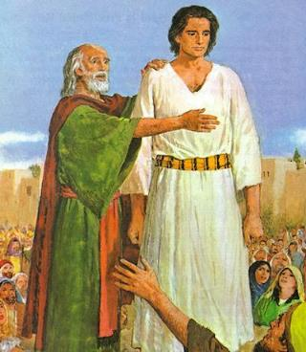
Kish had a son named Saul, as handsome a young man as could be found anywhere in Israel, and he was a head taller than anyone else.
Kish
Saul, son of Kish

Slide 6
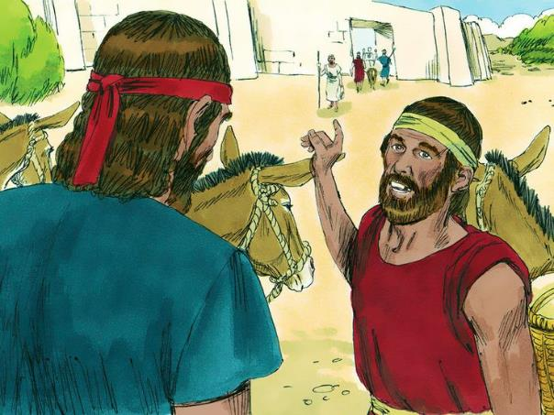
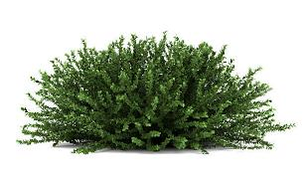
Now the donkeys belonging to Saul's father Kish were lost, and Kish said to his son Saul, "Take one of the servants with you and go and look for the donkeys.”

Slide 7
So he passed through the hill country of Ephraim and through the area around Shalisha,
but they did not find them.
Shalisha
Ephraim

Slide 8
They went on into the district of Shaalim, but the donkeys were not there.
Then he passed through the territory of Benjamin,
but they did not find them.
Shaalim
Benjamin

Slide 9
When they reached the district of Zuph, Saul said to the servant who was with him, "Come, let's go back, or my father will stop thinking about the donkeys and start worrying about us."
ZUPH

Slide 10
But the servant replied, "Look, in this town there is a man of God; he is highly respected, and everything he says comes true.
Let's go there now. Perhaps he will tell us what way to take."

Slide 11
Saul said to his servant, "If we go, what can we give the man?
The food in our sacks is gone. We have no gift to take to the man of God.
What do we have?"

Slide 12

The servant answered him again. "Look," he said, "I have a quarter of a shekel of silver. I will give it to the man of God so that he will tell us what way to take."
(Formerly in Israel, if someone went to inquire of God, they would say,
"Come, let us go to the seer," because the prophet of today used to be called a seer.)

Slide 13


"Good," Saul said to his servant. "Come, let's go." So they set out for the town where the man of God was.
As they were going up the hill to the town, they met some young women coming out to draw water, and they asked them,
"Is the seer here?"

Slide 14
"He is," they answered. "He's ahead of you. Hurry now; he has just come to our town today, for the people have a sacrifice at the high place. As soon as you enter the town, you will find him before he goes up to the high place to eat.

Slide 15
The people will not begin eating until he comes, because he must bless the sacrifice; afterward, those who are invited will eat. Go up now; you should find him about this time."

Slide 16
They went up to the town, and as they were entering it, there was Samuel, coming toward them on his way up to the high place.

Slide 17
Now the day before Saul came, the LORD had revealed this to Samuel:
"About this time tomorrow I will send you a man from the land of Benjamin. Anoint him ruler over my people Israel; he will deliver them from the hand of the Philistines. I have looked on my people, for their cry has reached me."

Slide 18
When Samuel caught sight of Saul, the LORD said to him,
"This is the man I spoke to you about;
he will govern my people."
Saul approached Samuel in the gateway and asked,
"Would you please tell me where the seer's house is?"

Slide 19
"I am the seer," Samuel replied. "Go up ahead of me to the high place, for today you are to eat with me, and in the morning I will send you on your way and will tell you all that is in your heart. As for the donkeys you lost three days ago, do not worry about them; they have been found. And to whom is all the desire of Israel turned, if not to you and your whole family line?"

Slide 20
Saul answered, "But am I not a Benjamite, from the smallest tribe of Israel, and is not my clan the least of all the clans of the tribe of Benjamin?
Why do you say such a thing to me?"

Slide 21

Then Samuel brought Saul and his servant into the hall and seated them at the head of those who were invited—about thirty in number. Samuel said to the cook,
"Bring the piece of meat I gave you,
the one I told you to lay aside."
x3

Slide 22
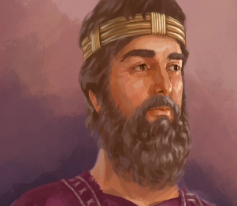
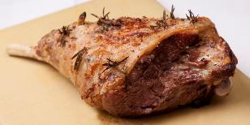
So the cook took up the thigh with what was on it and set it in front of Saul. Samuel said,
"Here is what has been kept for you. Eat, because it was set aside for you for this occasion, from the time I said, 'I have invited guests.' "
And Saul dined with Samuel that day.

Slide 23
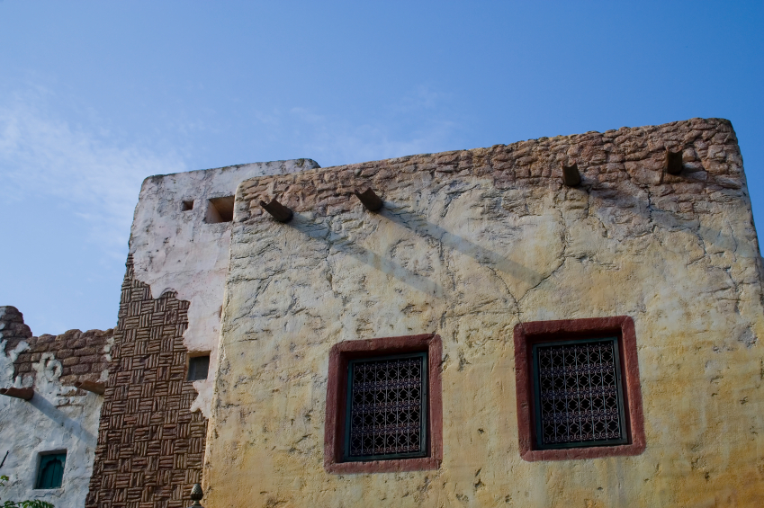


After they came down from the high place to the town, Samuel talked with Saul on the roof of his house. They rose about daybreak and Samuel called to Saul on the roof,
"Get ready, and I will send you on your way."

Slide 24
When Saul got ready, he and Samuel went outside together. As they were going down to the edge of the town, Samuel said to Saul, "Tell the servant to go on ahead of us"-and the servant did so-
"but you stay here for a while, so that I may give you a message from God.“
ZUPH

Slide 25
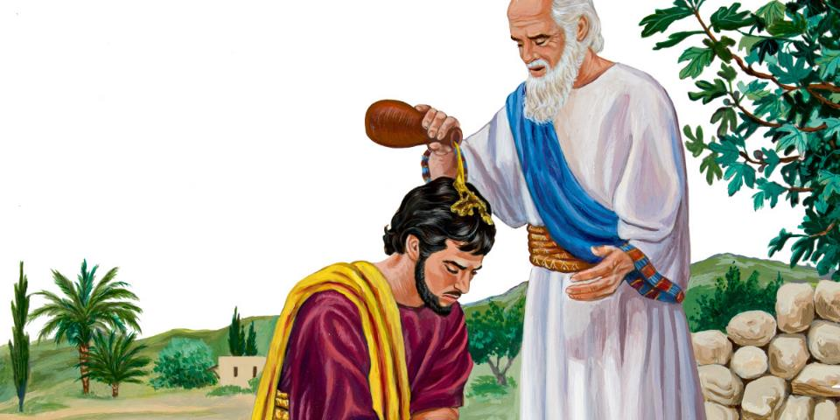
Then Samuel took a flask of olive oil and poured it on Saul's head and kissed him, saying,
"Has not the LORD anointed you ruler over his inheritance?

Slide 26
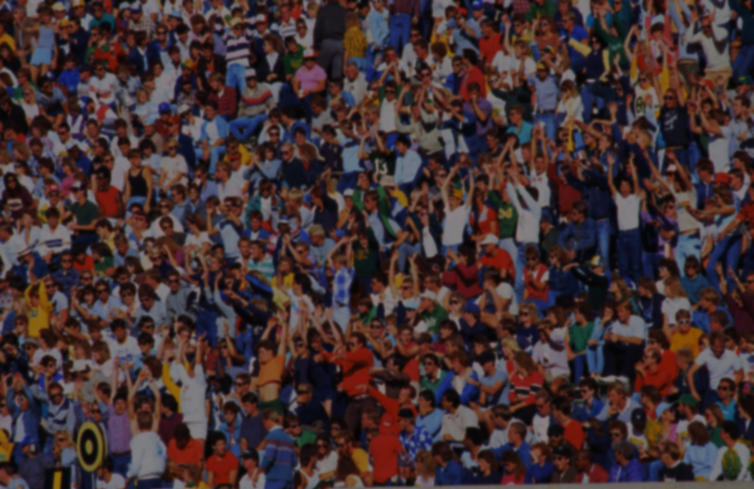
Samuel summoned the people of Israel to the LORD at Mizpah and said to them, "This is what the LORD, the God of Israel, says:’
‘I brought Israel up out of Egypt, and I delivered you from the power of Egypt and all the kingdoms that oppressed you.’

Slide 27
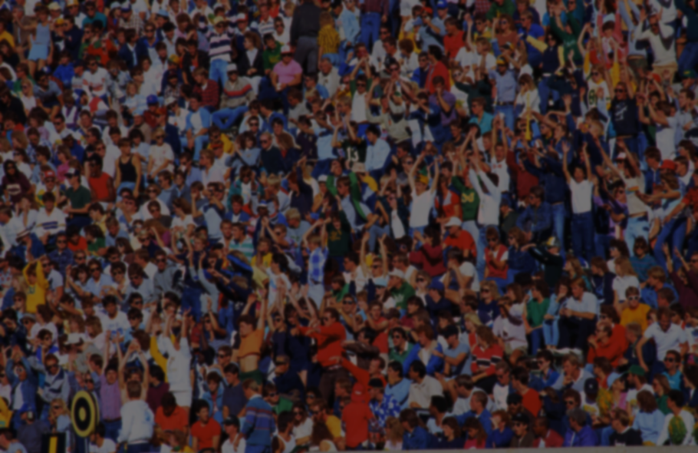
But you have now rejected your God, who saves you out of all your disasters and calamities. And you have said,
‘No, appoint a king over us.’
So now present yourselves before the LORD by your tribes and clans."

Slide 28
When Samuel had all Israel come forward by tribes, the tribe of Benjamin was taken by lot.
Then he brought forward the tribe of Benjamin, clan by clan, and
Matri's clan was taken.
Finally Saul, son of Kish was taken.
Israelites
Benjamin
Matri
Kish
Saul

Slide 29
But when they looked for him, he was not to be found.
So they inquired further of the LORD,
Has the man come yet?
Israelites
Benjamin
/
Matri
Kish
Saul

Slide 30
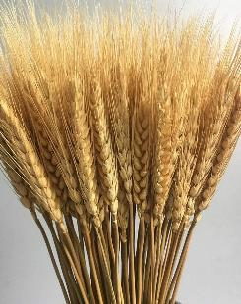

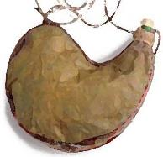

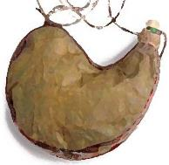


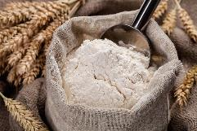


And the LORD said,
"Yes, he has hidden himself among the supplies."

Slide 31

They ran and brought him out,
and as he stood among the people he was a head taller than any of the others.

Slide 32
Samuel said to all the people,
"Do you see the man the LORD has chosen? There is no one like him among all the people."

Slide 33
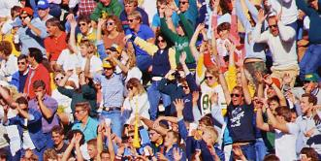
Then the people shouted,
“LONG LIVE THE KING!”

