Slide 1

Hide it in your
Look to the Lord and His strength;
Seek His face always.
Remember the wonders he has done,
His miracles,
And the judgements
He pronounced.
1 Chronicles 16:11-12
DigSite #5

Slide 2
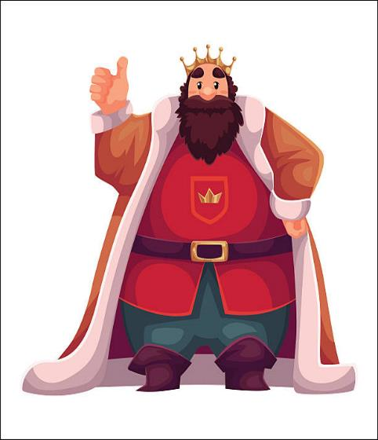
“We Want a King!”
Dig Site #5
1 Samuel 7:2-8:22

Slide 3
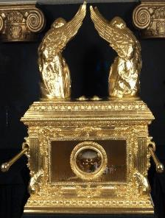
The ark remained at Kiriath Jearim a long time--
20 years
in all.

Slide 4
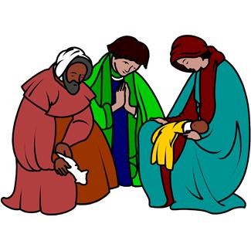
Then all the people of Israel turned back to the Lord.

Slide 5
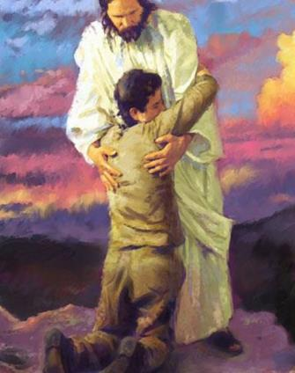
So Samuel said to all the Israelites, “If you are returning to the LORD with all your hearts,

Slide 6
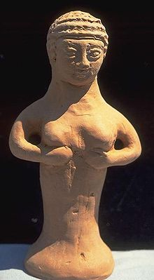
then rid yourselves of the foreign gods and the Ashoreths and commit yourselves to the LORD and serve Him only,

Slide 7
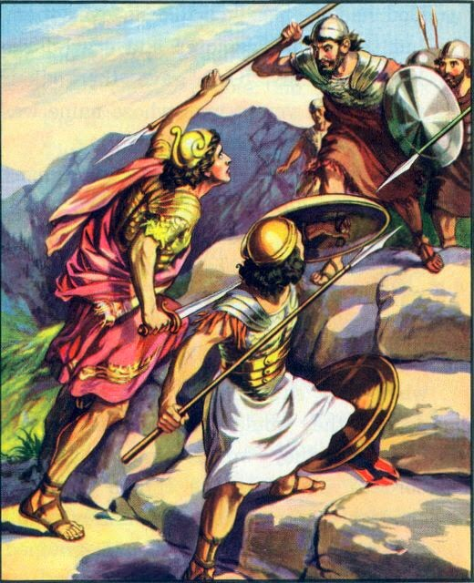

and He will deliver you out of the hand of the Philistines.

Slide 8
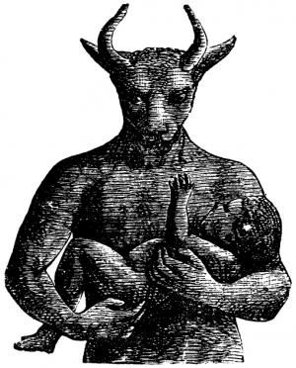
So the Israelites put away their Baals and Ashtoreths,
X
X

Slide 9
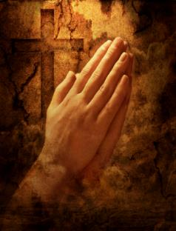
and served the LORD only.

Slide 10
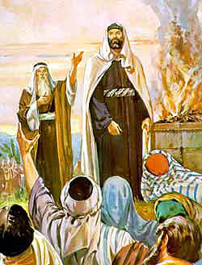
Then Samuel said, “Assemble all Israel at Mizpah and I will intercede with the LORD for you.”

Slide 11

When they had assembled at Mizpah, they drew water and poured it out before the LORD.

Slide 12
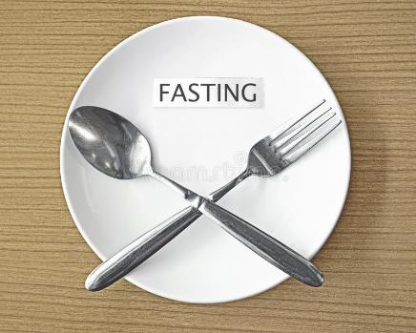
On that day they fasted
No eating!

Slide 13
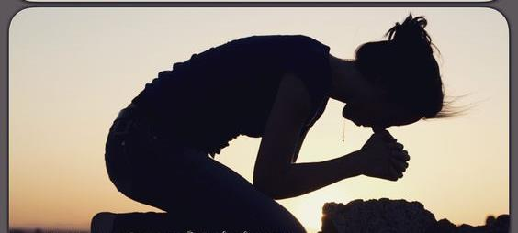
and there they confessed, “We have sinned against the LORD.”

Slide 14
Now Samuel was serving as leader of Israel at Mizpah.

Slide 15
When the Philistines heard that Israel had assembled at Mizpah, the rulers of the Philistines came up to attack them.

Slide 16
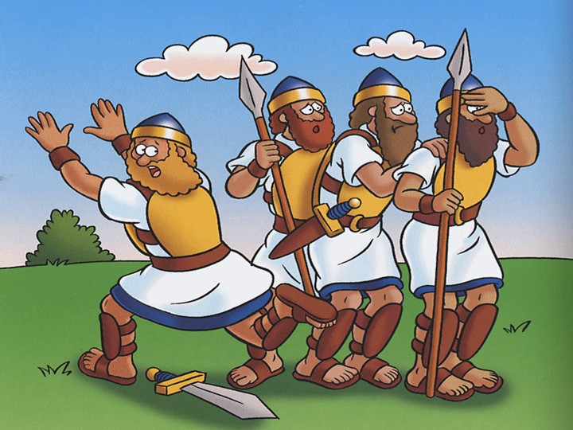
When the Israelites heard of it, they were afraid because of the Philistines.

Slide 17
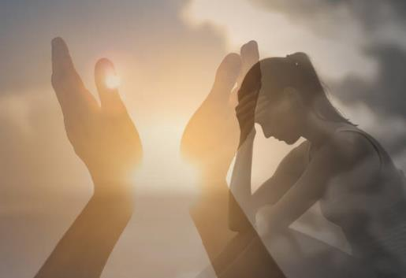
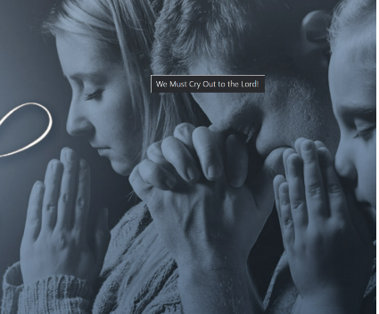
They said to Samuel, “Do not stop crying out to the LORD our God for us, that He may rescue us from the hand of the Philistines.

Slide 18
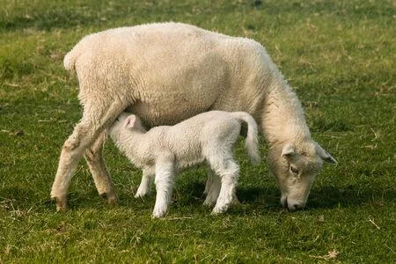
Then Samuel took a suckling lamb

Slide 19
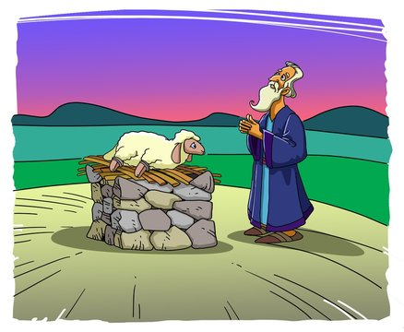
and sacrificed it as a whole burnt offering to the LORD.

Slide 20
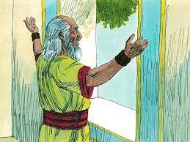
He cried out to the LORD on Israel’s behalf, and the LORD answered him.

Slide 21
While Samuel was sacrificing the burnt offering, the Philistines drew near to engage Israel in battle.

Slide 22
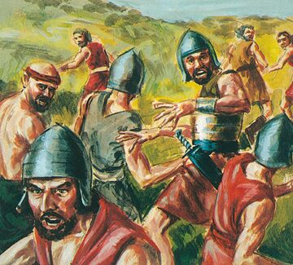
But that day the LORD thundered with loud thunder against the Philistines and threw them into
such a panic that
they were routed
before the
Israelites.

Slide 23
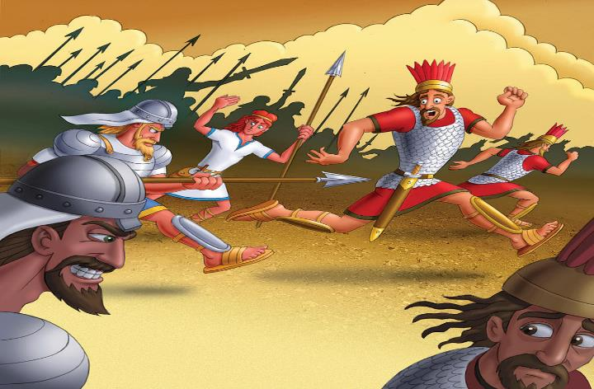
The men of Israel rushed out of Mizpah and pursued the Philistines, slaughtering them along the way to a point below Beth Kar.

Slide 24

Then Samuel took a stone and set it up between Mizpah and Shen. He named it Ebenezer, saying, “Thus far the LORD has helped us.”
Mizpah
Shen

Slide 25
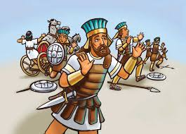
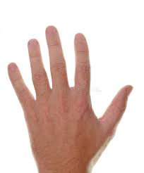
So the Philistines were subdued and they stopped invading Israel’s territory. Throughout Samuel’s lifetime, the hand of the LORD was against the Philistines.

Slide 26
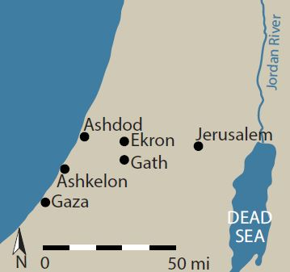
The towns from Ekron to Gath that the Philistines had captured from Israel were restored to Israel, and Israel delivered the neighboring territory from the hands of the Philistines.

Slide 27

And there was peace between Israel and the Amorites.

Slide 28

Samuel continued as Israel’s leader all the days of his life. From year to year he went on a circuit from Bethel to Gilgal to Mizpah, judging Israel in all those places.

Slide 29
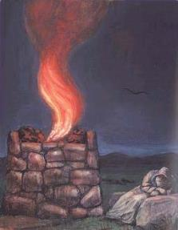
But he always went back to Ramah, where his home was, and there he also held court for Israel. And he built an altar there to the LORD.
Ramah

Slide 30
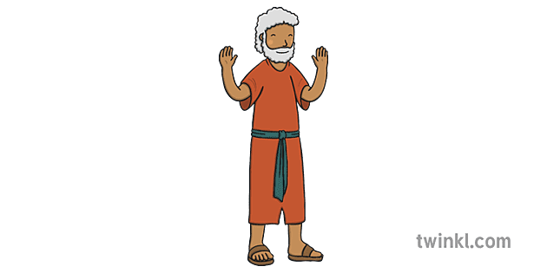
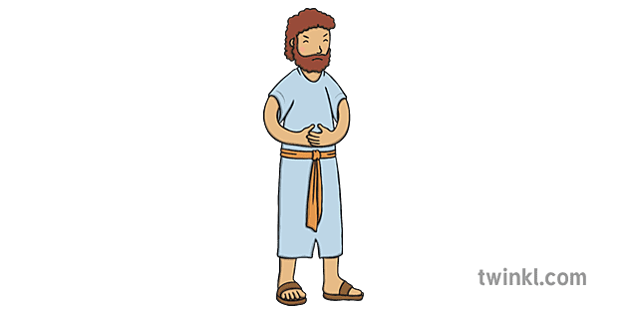
When Samuel grew old, he appointed his sons as Israel’s leaders. The name of his firstborn was Joel and the name of his second was Abijah, and they served at Beersheba.
Joel
Abijah

Slide 31
But his sons did not follow his ways.
Joel
Abijah

Slide 32

They turned aside after dishonest gain and accepted bribes and perverted justice.
Joel
Abijah

Slide 33
So all the elders of Israel gathered together and came to Samuel at Ramah. They said to him, “You are old, and your sons do not follow your ways;

Slide 34

now appoint a king to lead us, such as all the other nations have.

Slide 35
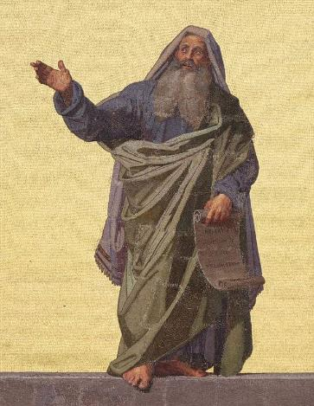

But when they said, “Give us a king to lead us,” this displeased Samuel; so he prayed to the LORD.

Slide 36


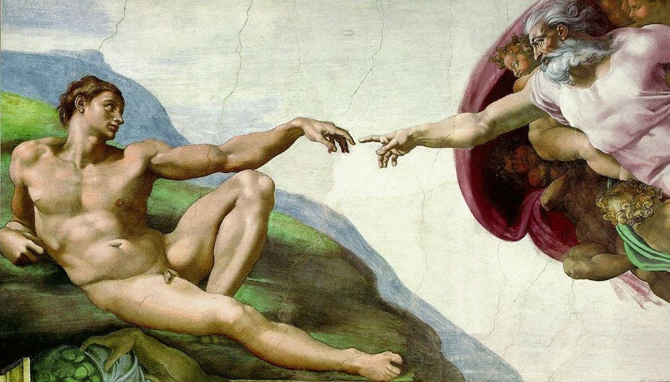
And the LORD told him: “Listen to all that the people are saying to you; it is not you they have rejected, but they have rejected me as their King.

Slide 37
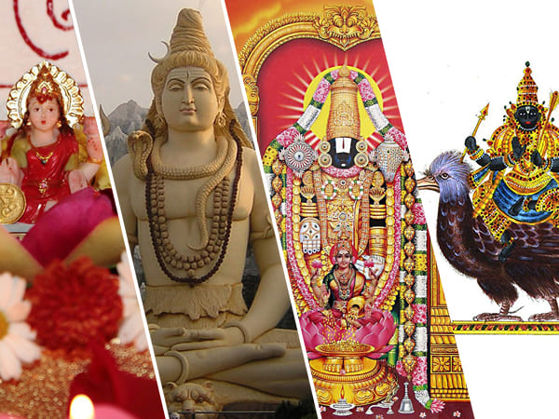
As they have done from the day I brought them up out of Egypt until this day, forsaking me and serving other gods, so they are doing to you.

Slide 38
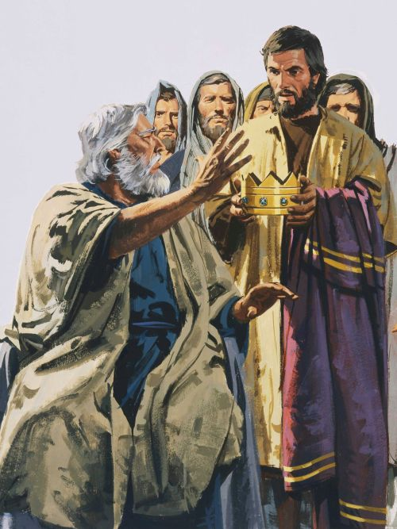
Now listen to them; but warn them solemnly and let them know what the king who will reign over them will claim as his rights.

Slide 39
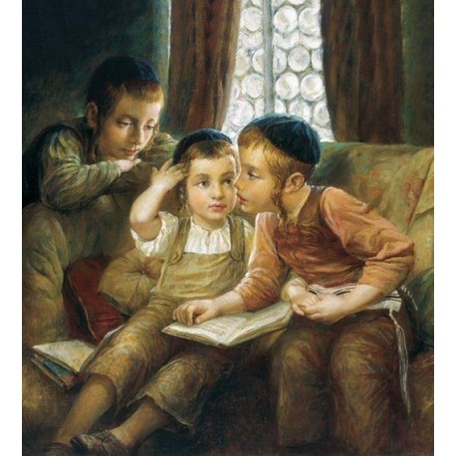
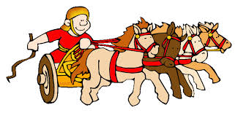
Samuel told all the words of the LORD to the people who were asking him for a king. He said, “This is what the king who will reign over you will claim as his rights: He will take your sons* and make them serve with his chariots* and horses, and they will run in front of his chariots.

Slide 40
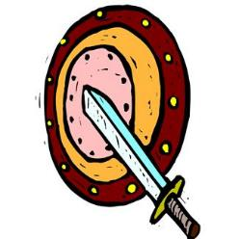
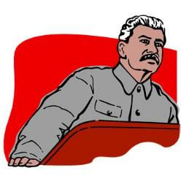
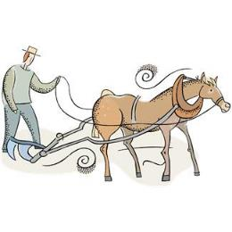
Some he will assign to be commanders of thousands and commanders of fifties, and others to plow his ground and reap his harvest, and still others to make weapons of war and equipment for his chariots.
Commanders of
1000s
50s

Slide 41
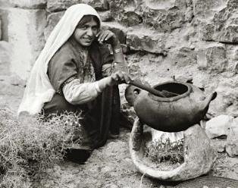
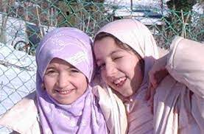
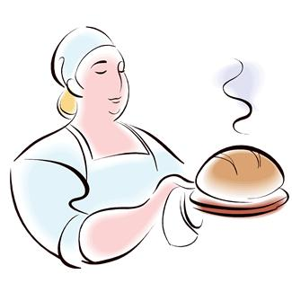

He will take your daughters to be perfumers and cooks and bakers.

Slide 42



He will take the best of your fields and vineyards and olive groves and give them to his attendants.

Slide 43
He will take a tenth of your grain and of your vintage and give it to his officials and attendants. 10th

Slide 44
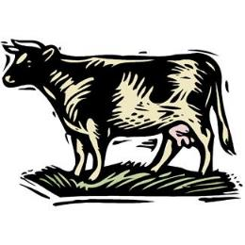
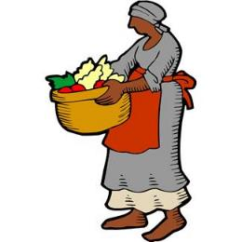


Your male and female servants and the best of your cattle and donkeys he will take for his own use.

Slide 45
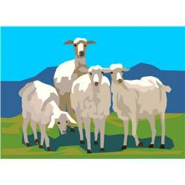
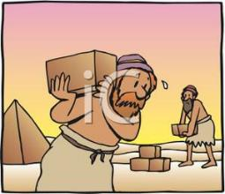
He will take a tenth of your flocks,
10th
and you yourselves will become his slaves.

Slide 46

When that day comes, you will cry out for relief from the king you have chosen,
but the LORD will not
answer you in that day.

Slide 47
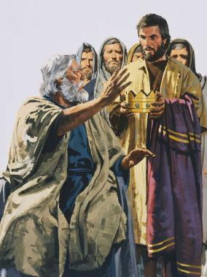
But the people refused to listen to Samuel,
“No!” they said. “We want a king over us. Then we will be like all the other nations, with a king to lead us and to go out before us and fight our battles.

