Slide 1
DigSite 4 Returning and Rejoicing
1 Samuel 6:1–7:1

Slide 2

Hide it in your
Your ways, God ,
are holy.
What god is as great
as our God?
Psalm 77:13
DigSite #4

Slide 3
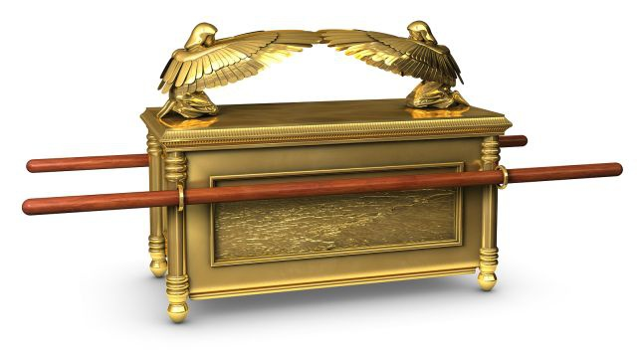
The Ark Returned to Israel

Slide 4
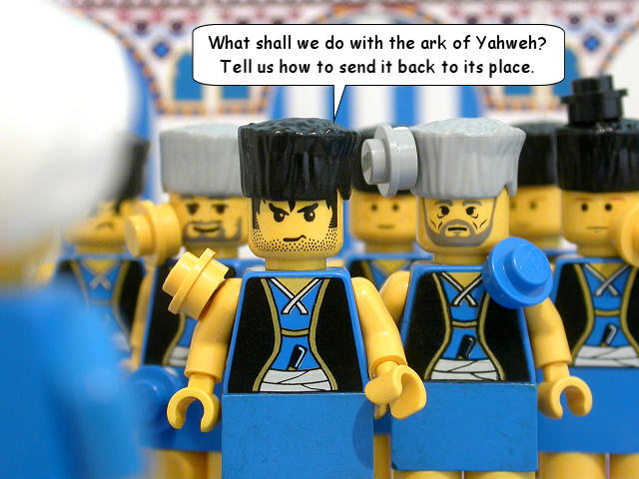
When the ark of the Lord had been in Philistine territory seven months, the Philistines called for the priests and the diviners and said,
What shall we do with the ark of the Lord? Tell us how we should send it back to its place.

Slide 5
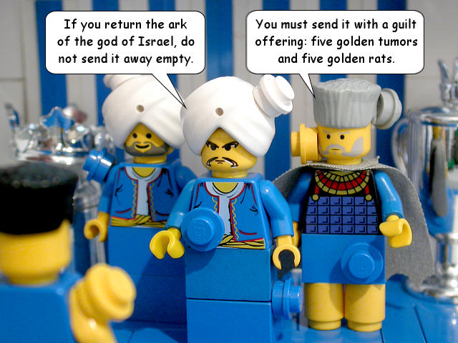
They answered,
If you return the ark of the god of Israel, do not send it back to him without a gift; by all means send a guilt offering to him.

Slide 6
They answered,
Then you will be healed, and you will know why his hand has not been lifted from you.

Slide 7
The Philistines asked,
What guilt offering should we send to him?

Slide 8
They replied,
If you return the ark of the god of Israel, do not send it back to him without a gift; by all means send a guilt offering to him.
Five gold tumors and five gold rats, according to the number of the Philistine rulers, because the same plague has struck both you and your rulers.

Slide 9
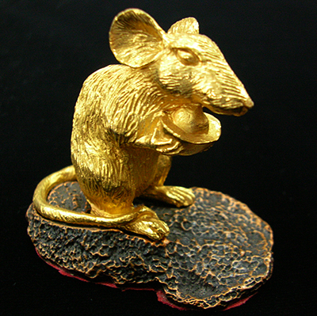
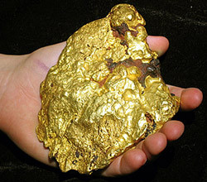
Make models of the tumors and of the rats that are destroying the country, and give glory to Israel’s god. Perhaps he will lift his hand from you and your gods and your land.

Slide 10


Slide 11
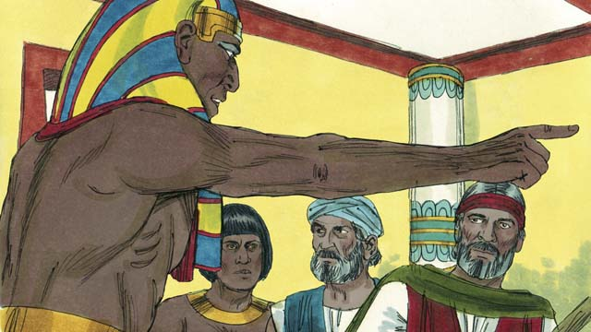
Why do you harden your hearts as the Egyptians and Pharaoh did? When Israel’s god dealt harshly with them, did they not send the Israelites out so they could go on their way?

Slide 12
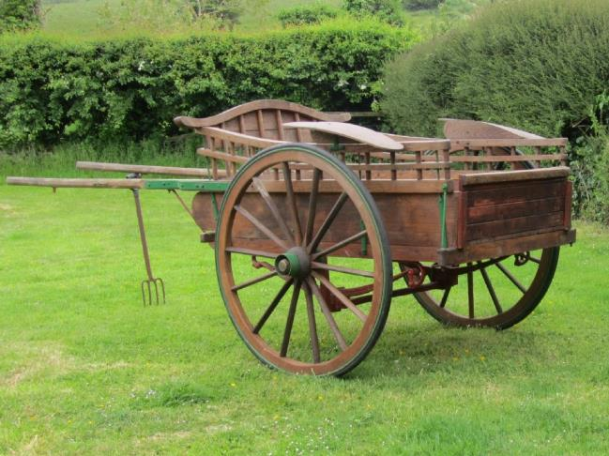
Now then, get a new cart ready, with two cows that have calved and have never been yoked.

Slide 13

Hitch the cows to the cart, but take their calves away and pen them up.

Slide 14
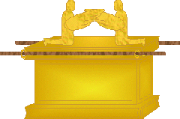

Take the ark of the Lord and put it on the cart, and in a chest beside it

Slide 15
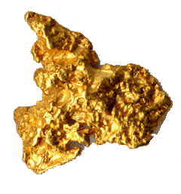

put the gold objects you are sending back to him as a guilt offering. Send it on its way, but keep watching it.

Slide 16

If it goes up to its own territory, toward Beth Shemesh, then the Lord has brought this great disaster on us.
Beth Shemesh

Slide 17
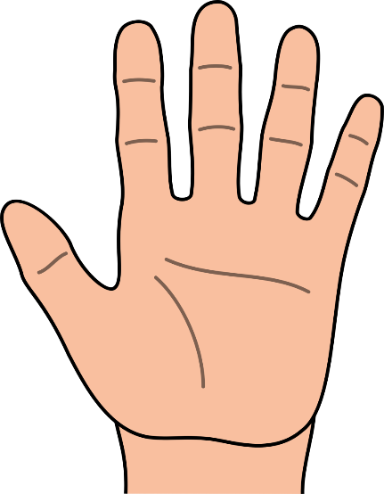

But if it does not, then we will know that it was not his hand that struck us but that it happened to us by chance.

Slide 18
So they did this. They took two such cows and hitched them to the cart and penned up their calves. They placed the ark of the Lord on the cart and along with it the chest containing the gold rats and the models of the tumors.

Slide 19



Then the cows went straight up toward Beth Shemesh, keeping on the road and lowing all the way; they did not turn to the right or to the left. The rulers of the Philistines followed them as far as the border of Beth Shemesh.
Beth Shemesh

Slide 20
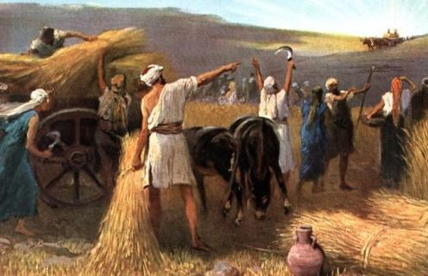
Now the people of Beth Shemesh were harvesting their wheat in the valley, and when they looked up and saw the ark, they rejoiced at the sight.

Slide 21
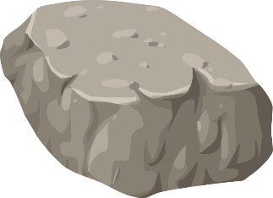
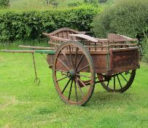

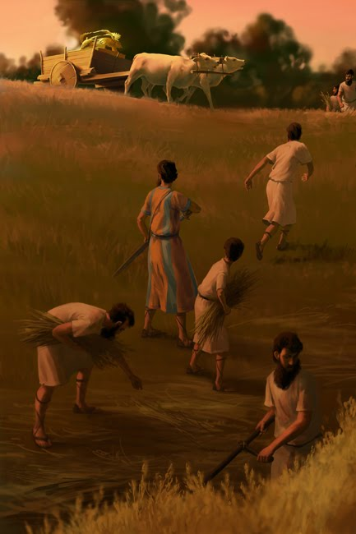

The cart came to the field of Joshua of Beth Shemesh, and there it stopped beside a large rock.

Slide 22
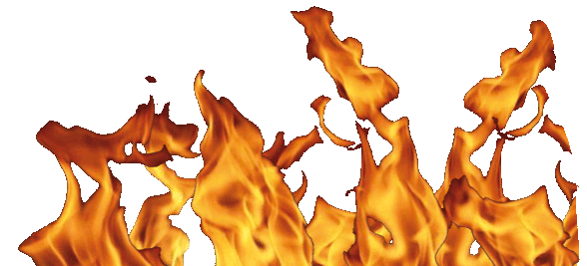

The people chopped up the wood of the cart and sacrificed the cows as a burnt offering to the Lord.

Slide 23


The Levites took down the ark of the Lord, together with the chest containing the gold objects, and placed them on the large rock. On that day the people of Beth Shemesh offered burnt offerings and made sacrifices to the Lord.

Slide 24
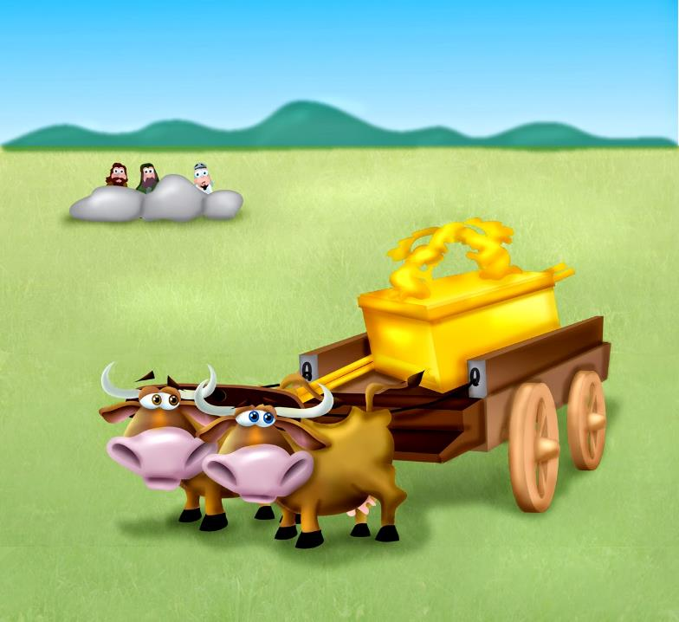
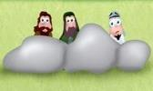
The five rulers of the Philistines saw all this and then returned that same day to Ekron.

Slide 25
These are the gold tumors the Philistines sent as a guilt offering to the Lord—one each for Ashdod, Gaza, Ashkelon, Gath and Ekron.

Slide 26

And the number of the gold rats was according to the number of Philistine towns belonging to the five rulers—the fortified towns with their country villages.

Slide 27
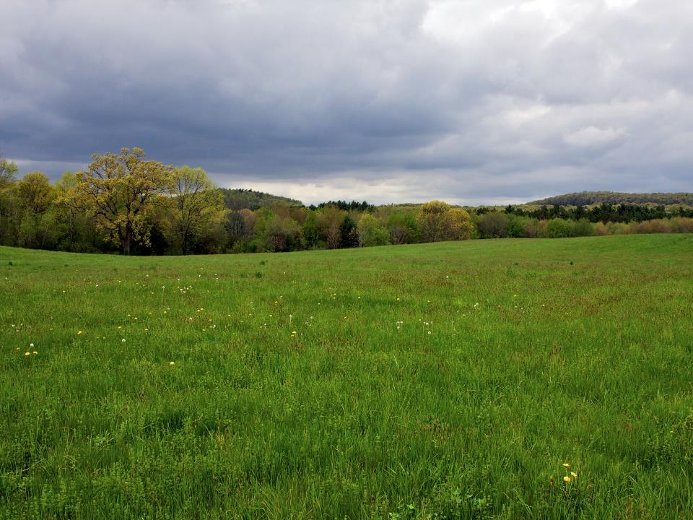

The large rock on which the Levites set the ark of the Lord is a witness to this day in the field of Joshua of Beth Shemesh.

Slide 28
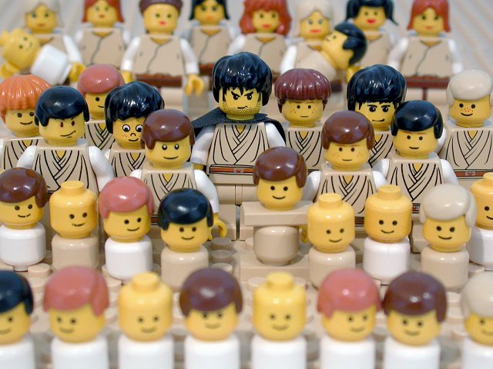
But God struck down some of the inhabitants of Beth Shemesh, putting 70 of them to death because they looked into the ark of the Lord. The people mourned because of the heavy blow the Lord had dealt them.
X

Slide 29
And the people of Beth Shemesh asked,*
Who can stand in the presence of the Lord, this holy God? To whom will the ark go up from here?

Slide 30
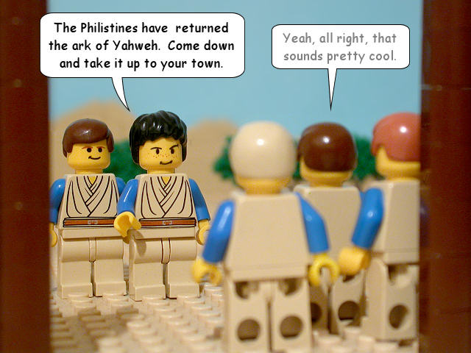
Then they sent messengers to the people of Kiriath Jearim, saying,
The Philistines have returned the ark of the Lord. Come down and take it up to your town.

Slide 31
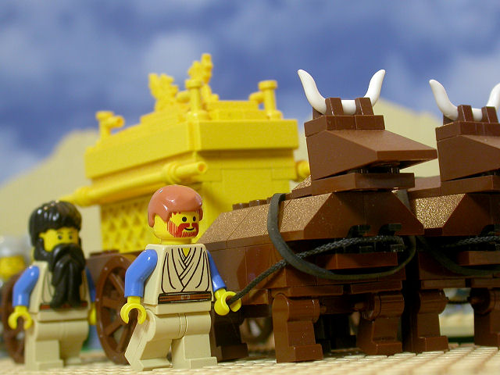
So the men of Kiriath Jearim came and took up the ark of the Lord. They brought it to Abinadab’s house on the hill and consecrated Eleazar his son to guard the ark of the Lord.

