Slide 1
Will the Real God Please Stand Up?
DigSite 3
1 Samuel 4:1b–5:12

Slide 2

Hide it in your
There is no one holy like the Lord;
There is no one besides you;
There is no Rock like our God.
1 Samuel 2:2
DigSite #3

Slide 3
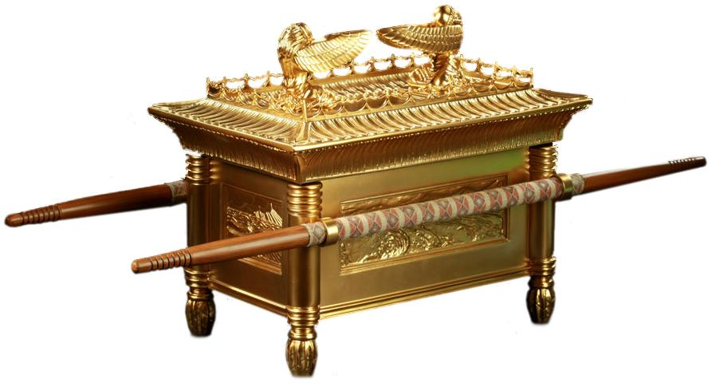
The Philistines Capture the Ark

Slide 4
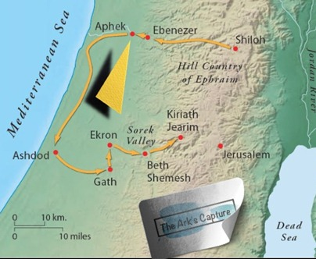
Now the Israelites went out to fight against the Philistines. The Israelites camped at Ebenezer, and the Philistines at Aphek.

Slide 5
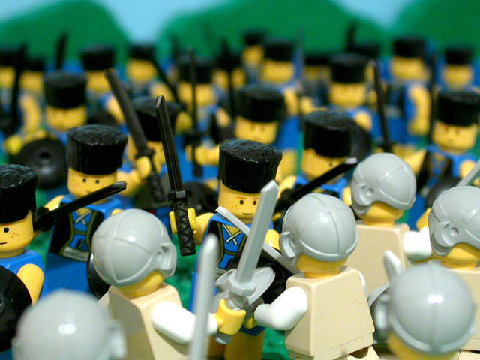
The Philistines deployed their forces to meet Israel, and as the battle spread, Israel was defeated by the Philistines, who killed about four thousand of them on the battlefield.

Slide 6
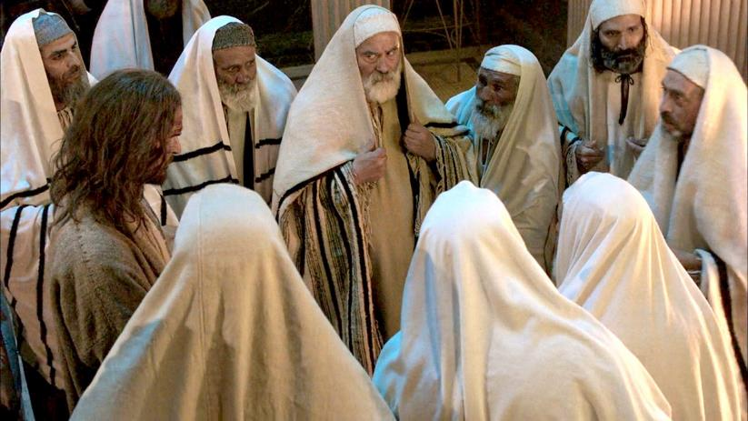
When the soldiers returned to camp, the elders of Israel asked
Why did the Lord bring defeat on us today before the Philistines?

Slide 7
Let us bring the ark of the Lord’s covenant from Shiloh, so that he may go with us and save us from the hand of ur enemies.

Slide 8
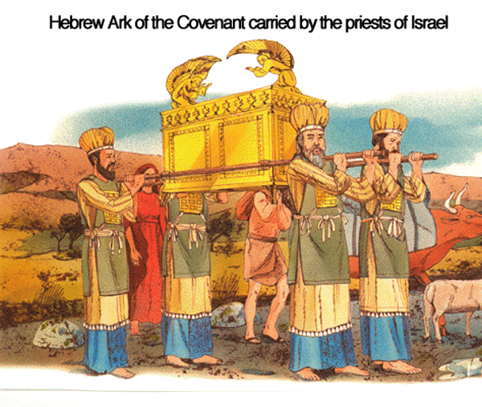
So the people sent men to Shiloh, and they brought back the ark of the covenant of the Lord Almighty, who is enthroned between the cherubim.

Slide 9
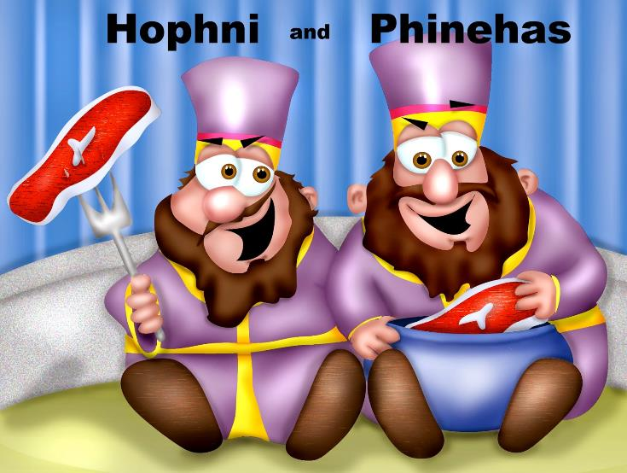
And Eli’s two sons, Hophni and Phinehas, were there with the ark of the covenant of God.

Slide 10
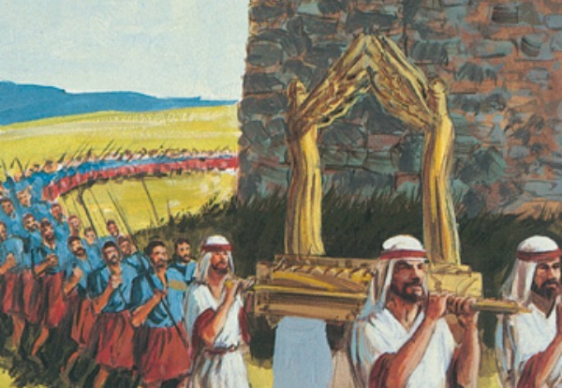
When the ark of the Lord’s covenant came into the camp, all Israel raised such a great shout that the ground shook.

Slide 11
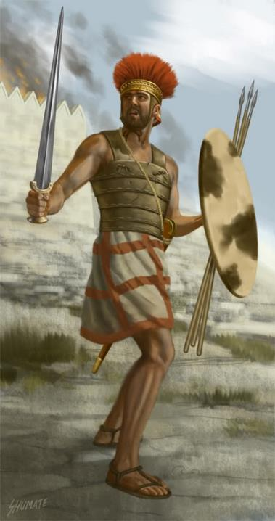
Hearing the uproar, the Philistines asked,
What’s all this shouting in the Hebrew camp?

Slide 12
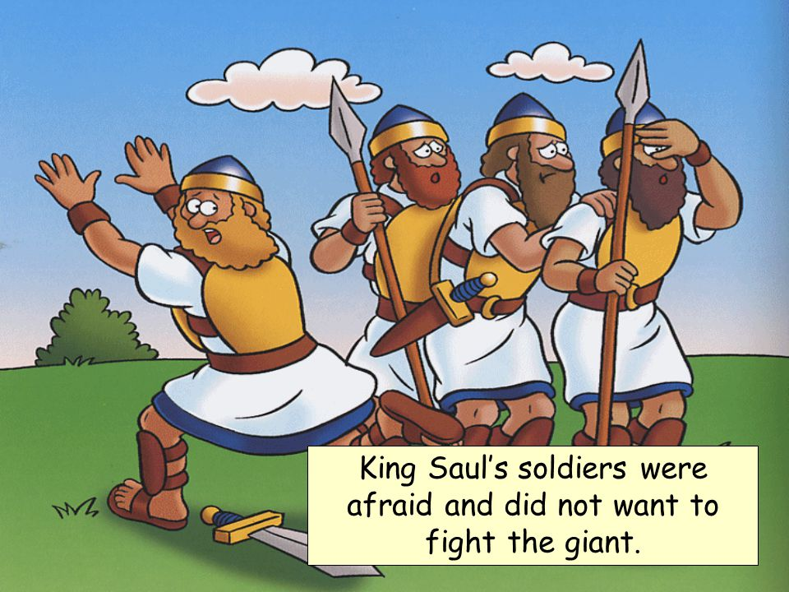
When they learned that the ark of the Lord had come into the camp, the Philistines were afraid.

Slide 13
A god has come into the camp. Oh no! Nothing like this has happened before.

Slide 14
We’re doomed! Who will deliver us from the hand of these mighty gods?

Slide 15
They are the gods who struck the Egyptians with all kinds of plagues in the wilderness.

Slide 16
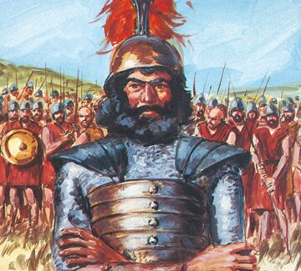
Be strong, Philistines! Be men, or you will be subject to the Hebrews, as they have been to you. Be men, and fight!

Slide 17
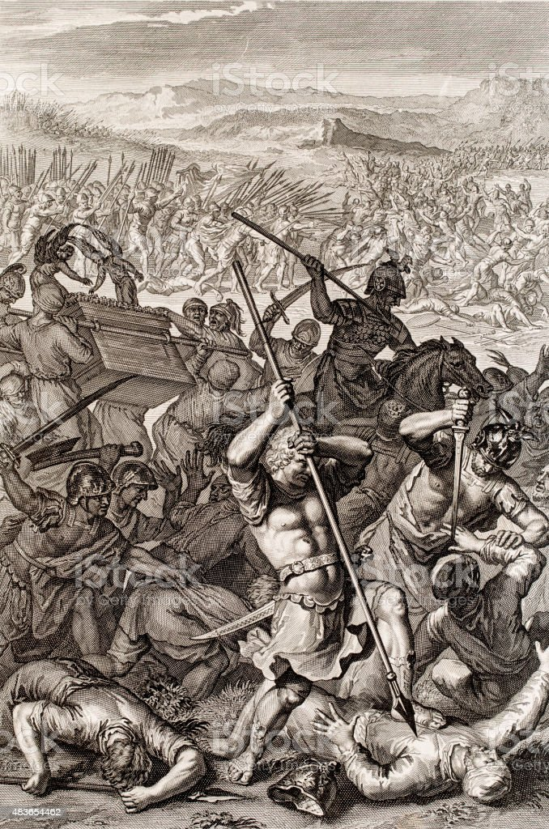
So the Philistines fought, and the Israelites were defeated and every man fled to his tent. The slaughter was very great; Israel lost thirty thousand foot soldiers.

Slide 18
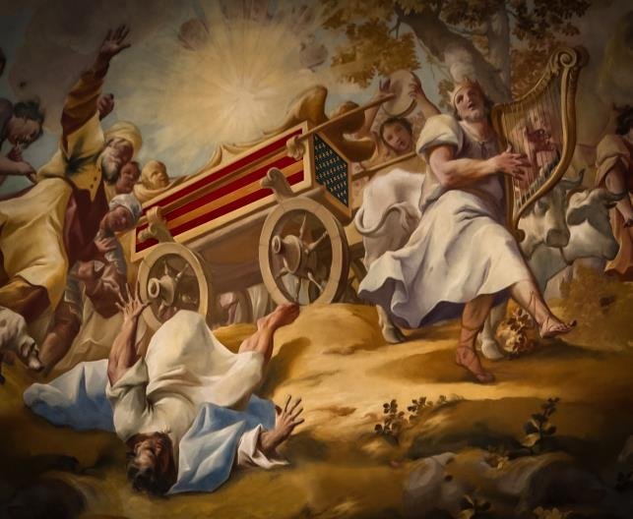
The ark of God was captured, and Eli’s two sons, Hophni and Phinehas, died.

Slide 19

Death of Eli

Slide 20
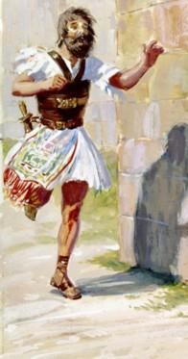
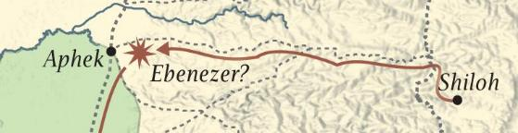
That same day a Benjamite ran from the battle line and went to Shiloh with his clothes torn and dust on his head.

Slide 21
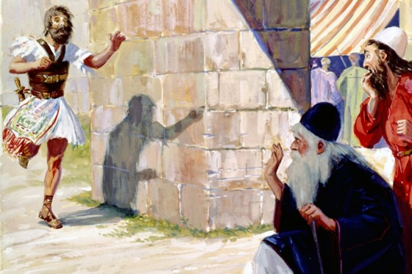
When he arrived, there was Eli sitting on his chair by the side of the road, watching, because his heart feared for the ark of God.

Slide 22
When the man entered the town and told what had happened, the whole town sent up a cry.

Slide 23
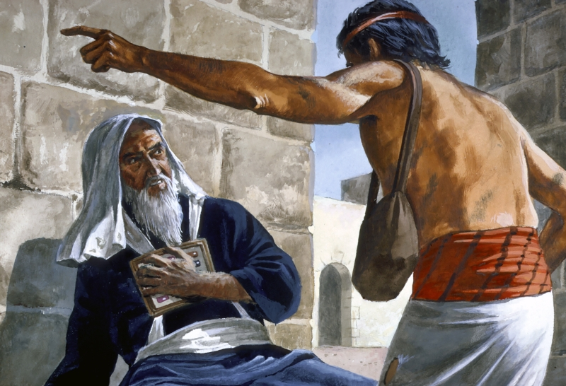
Eli heard the outcry and asked,
What is the meaning of this uproar?

Slide 24
The man hurried over to Eli, who was 98-years old and whose eyes had failed so that he could not see. He told Eli,
I have just come from the battle line; I fled from it this very day.

Slide 25
Eli asked,
What happened, my son?

Slide 26
The man who brought the news replied,
Israel fled before the Philistines, and the army has suffered heavy losses.

Slide 27
The man who brought the news replied,
Also your two sons, Hophni and Phinehas, are dead, and the ark of God has been captured.

Slide 28
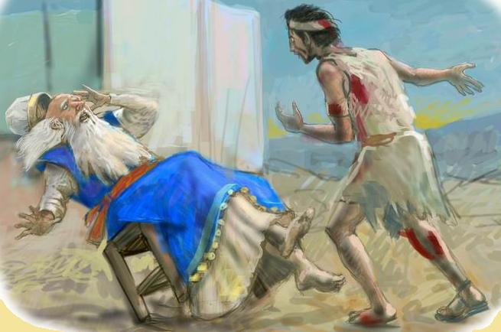
When he mentioned the ark of God, Eli fell backward off his chair by the side of the gate.

Slide 29
His neck was broken and he died,
for he was an old man, and he was heavy.
He had led Israel forty years.

Slide 30
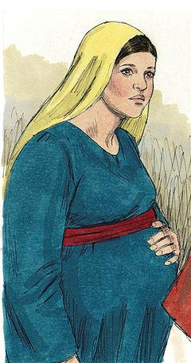
His daughter-in-law, the wife of Phinehas, was pregnant and near the time of delivery.

Slide 31
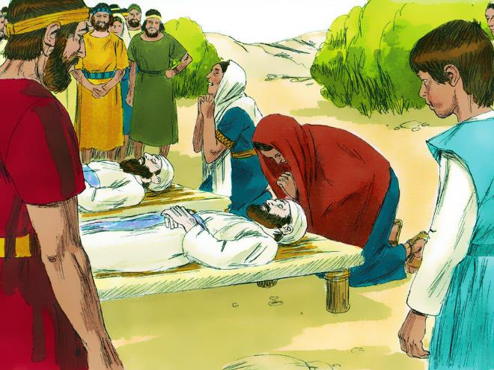
When she heard the news that the ark of God had been captured and that her father-in-law and her husband were dead, she went into labor and gave birth, but was overcome by her labor pains.

Slide 32
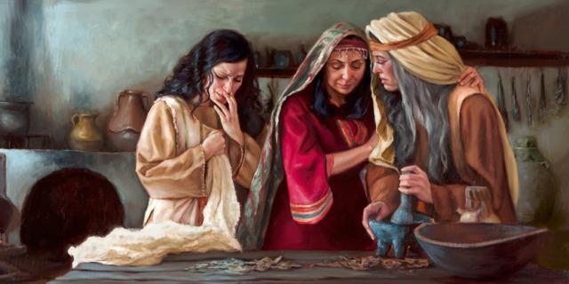
As she was dying, the women attending her said,
Don’t despair; you have given birth to a son.

Slide 33
But she did not respond or pay any attention.

Slide 34
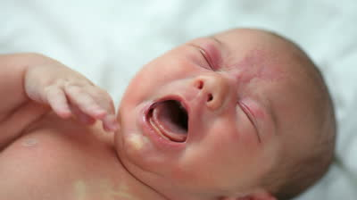
She named the boy Ichabod, saying, “The glory has departed from Israel – because of the capture of the ark of God and the deaths of her father-in-law and her husband.”
Notes:
,

Slide 35
She said, The glory has departed from Israel, for the ark of God has been captured.
Ichabod means no glory.
Notes:
,

Slide 36
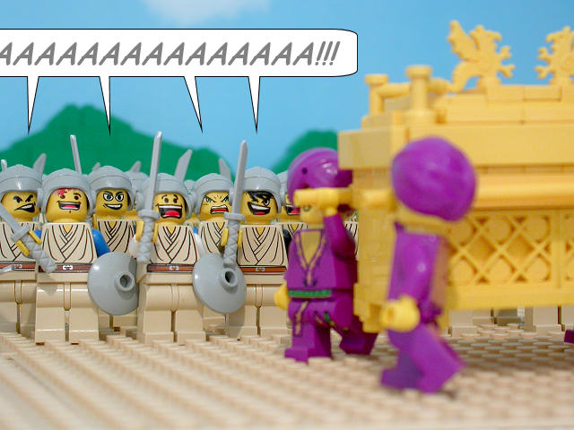
After the Philistines had captured the ark of God, they took it from Ebenezer to Ashdod. Then they carried the ark into Dagon’s temple and set it beside Dagon.

Slide 37
The Ark in Ashdod and Ekron

Slide 38
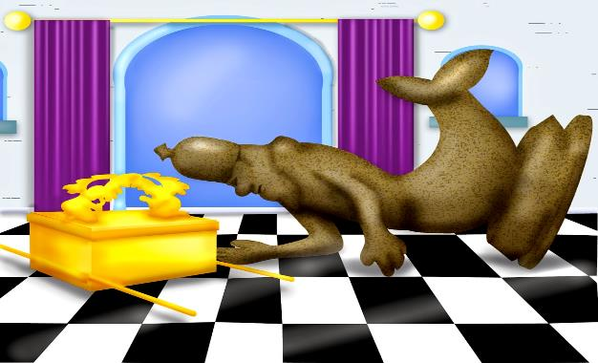
When the people of Ashdod rose early the next day, there was Dagon, fallen on his face on the ground before the ark of the Lord!
They took Dagon and put him back in his place.

Slide 39
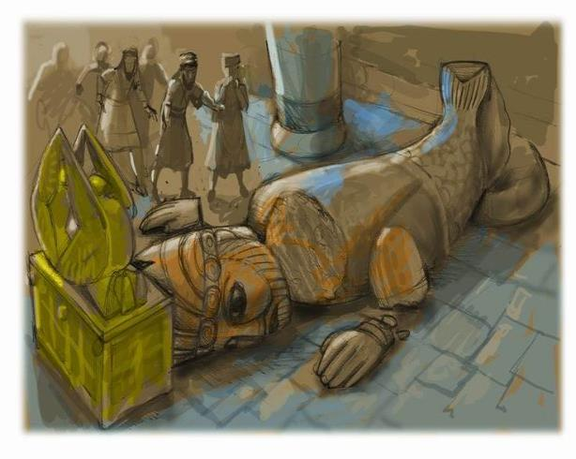
But the following morning when they rose, there was Dagon, fallen on his face on the ground before the ark of the Lord!

Slide 40
His head and hands had been broken off and were lying on the threshold; only his body remained.

Slide 41
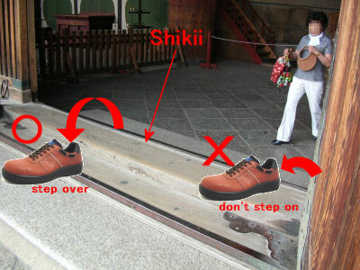
That is why to this day neither the priests of Dagon nor any others who enter Dagon’s temple at Ashdod step on the threshold.
threshold

Slide 42
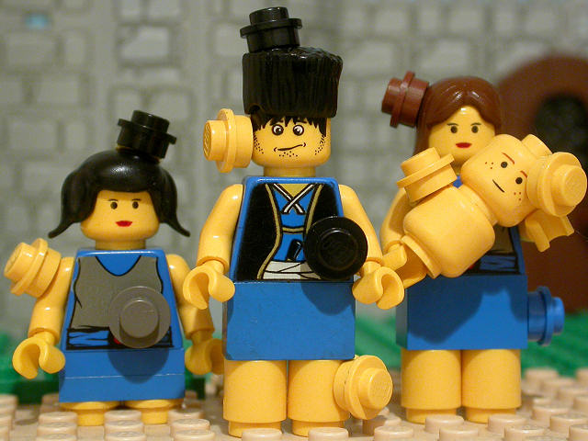
The Lord’s hand was heavy on the people of Ashdod and its vicinity; he brought devastation on them and afflicted them with tumors.

Slide 43
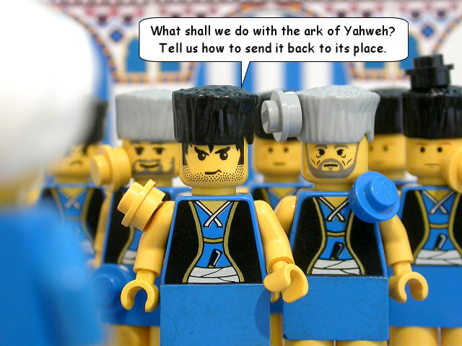
When the people of Ashdod saw what was happening, they said,
The ark of the god of Israel must not stay here with us, because his hand is heavy on us and on Dagon our god.

Slide 44
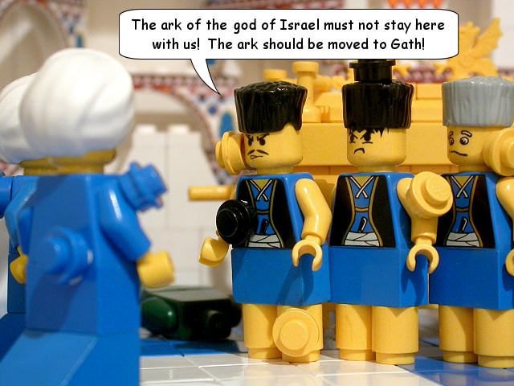
So they called together all the rulers of the Philistines and asked them,
What shall we do with the ark of the god of Israel?

Slide 45
They answered,
Have the ark of the god of Israel moved to Gath.
So they moved the ark of the God of Israel.

Slide 46
The Ark in Ashdod and Ekron

Slide 47
But after they had moved it, the Lord’s hand was against that city, throwing it into a great panic. He afflicted the people of the city, both young and old, with an outbreak of tumors.

Slide 48
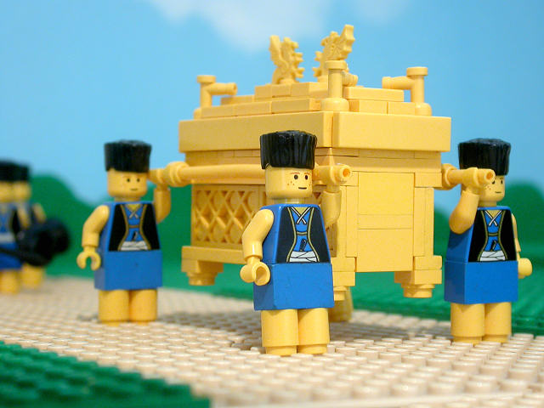
So they sent the ark of God to Ekron.

Slide 49
The Ark in Ashdod and Ekron

Slide 50
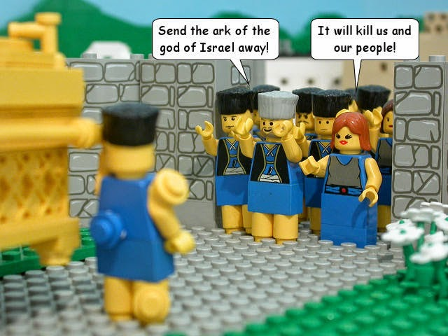
As the ark of God was entering Ekron, the people of Ekron cried out,
They have brought the ark of the god of Israel around to us to kill us and our people.

Slide 51
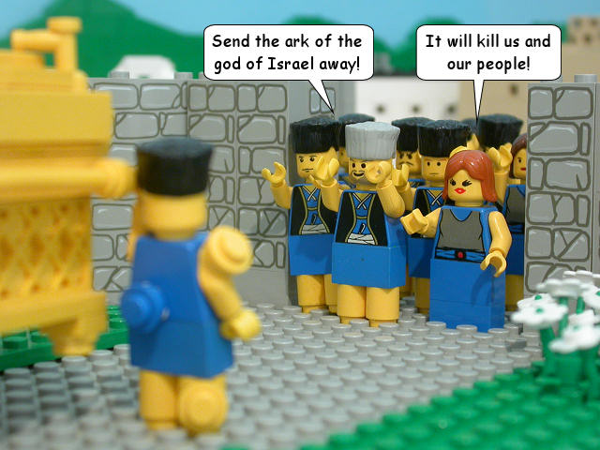
So they called together all the rulers of the Philistines and said,
Send the ark of the god of Israel away; let it go back to its own place, or it will kill us and our people.
For death had filled the city with panic; God’s hand was very heavy on it.

Slide 52
Those who did not die were afflicted with tumors, and the outcry of the city went up to heaven.

